Slide 1


Google

Slide 2
Content
Google in the world
How does Google work
The content of Google

Slide 3
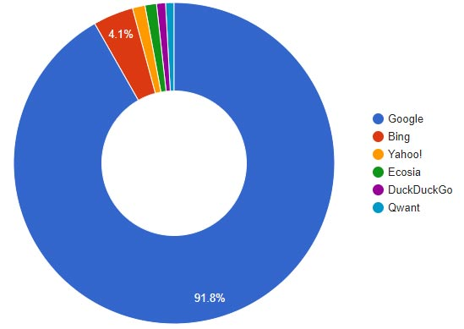
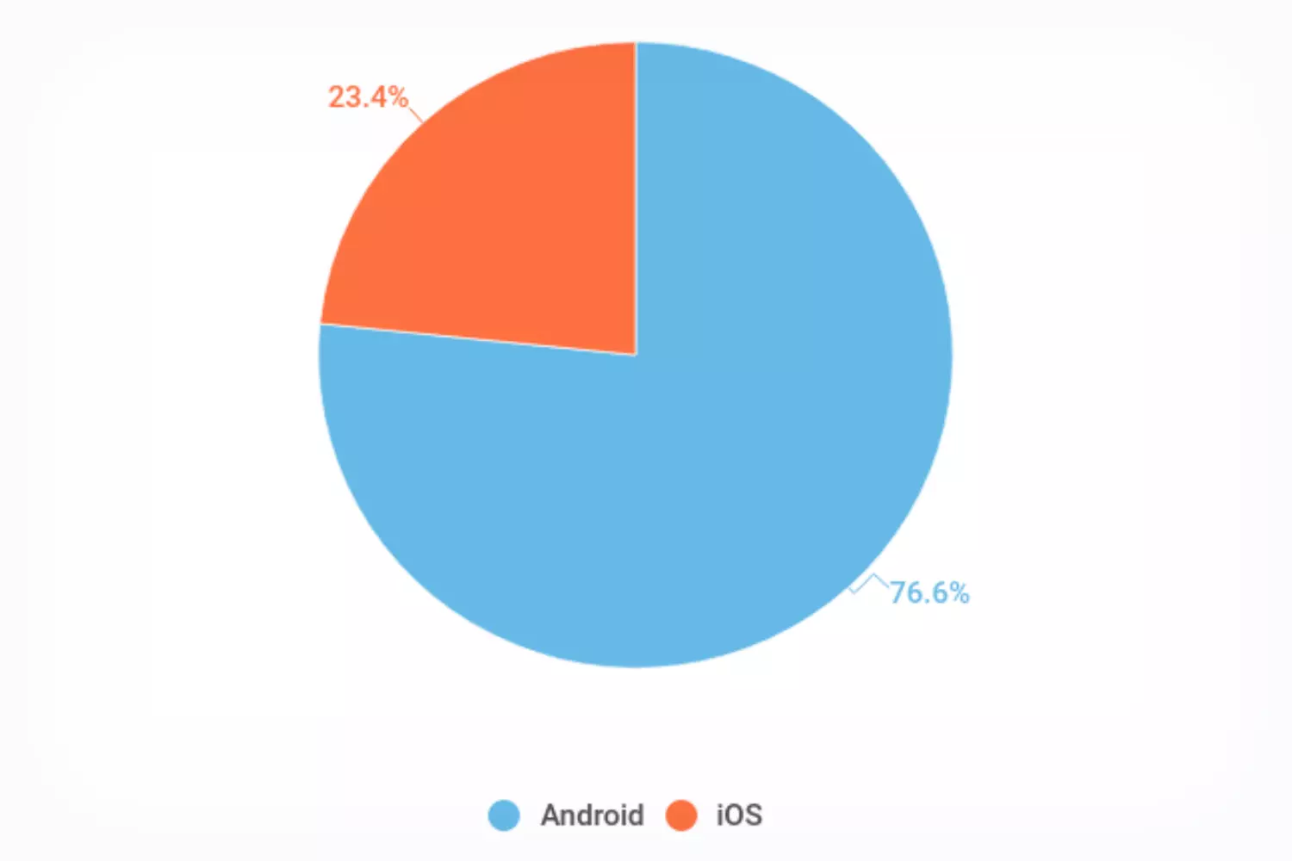
Search engine and android

Slide 4
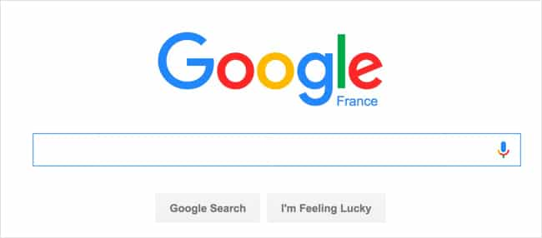
How do search engine work
Complex Algorithm
Database

Slide 5
How Google works with its employees
Lots of training
Promotes a collaborative and innovative corporate culture
a range of exceptional benefits and working conditions
including competitive salaries

Slide 6





Google’s Software
Google Docs
Google Sheets
Google Slides
Google Forms
YouTube
…

Slide 7



Messaging and communication applications
Gmail
Google Meet
Google Chat

Slide 8
Thanks you for listening

