Slide 1

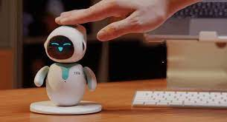
CYBER-SECRETARY
LEMERCIER THIBAULT
BUCCHIOTTY DORIAN
BUT 1A G3.2

Slide 2


Introduction

Slide 3
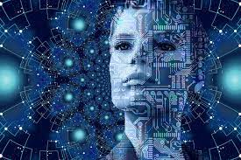
content :
Personal Assistant and Scheduler
Email Management
Object Locator
Intelligent Reminder System
Language Translation
Personal Security
Conclusion

Slide 4

Personal Assistant and Scheduler
Appointments
Reminding you of important events
Meetings
Deadlines

Slide 5
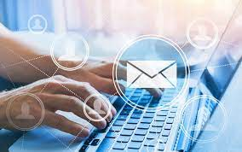
Email Management
Scans incoming emails
Highlights important messages
Deleting unwant or spam emails

Slide 6

Object Locator
It locates lost items
Using RFID and intelligents algorythms

Slide 7
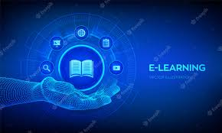
Intelligent Reminder System
It learns your habits and preferences
Reminding you to perform daily tasks

Slide 8

Language Translation
The Cyber Secretary possesses a built-in language translation feature
It can translate speech in real-time

Slide 9
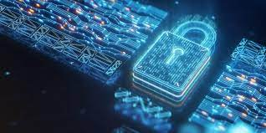
Personal security
It can protect your personal data
It can integrate with your home security system

Slide 10

