Slide 1
Defonfw Specification Module
Overview
Hinken, Glagla, 26.09.2017

Slide 2



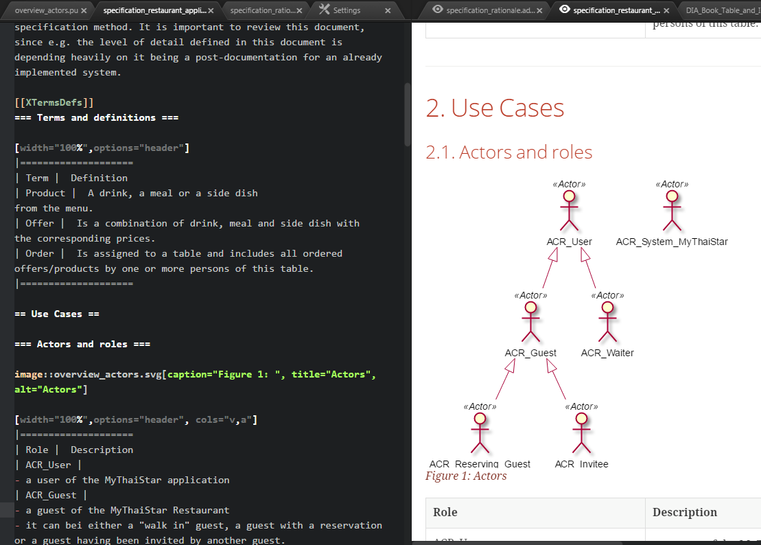
devonfw specification provides excellent support for quick and frequent editing by whole development team
Easy to use, low-level, open-source, developer-friendly tools with good integration in editor
Modular documentation
near to code structure
versioned with code
specification_restaurant_application.adoc
BCO_Order_Management\BCO_Order_Management.adoc
BCO_Order_Management\images\ business_component_order_management.pu
BCO_Order_Management\images\eif_manage_order.pu
BCO_Order_Management\images\mco_user.pu
BCO_Table_Management\
business_component_table_management.pu
BCO_User_Management\BCO_User_Management.adoc
BCO_User_Management\images\ business_component_user_management.pu
BCO_User_Management\images\eif_manage_user.pu
BCO_User_Management\images\mco_user.pu
images\DIA_Book_Table_and_Invite_Friends.pu
images\DIA_Main_Screen_and_User_Management.pu
images\overview_actors.pu

Slide 3
Devonfw Specification method is extremely useful
Comprised of
HowTo for technical aspects
Light description of the method
Design rationales
Example specification
Based on highly proven
specification method of Capgemini Germany
Stripped to the essentials
precise, redundancy free, UML-oriented
Mirroring nomenclature and structure of the code
Excellent basis for
maintenance
further development
Ubiquitous language from business analysis to code
Tailor it:
Use the level of detail you need
Use the parts you need
In tailored form usable as
Basis for stories and implementation
Basis for maintenance / further development

