Slide 1
Defonfw Specification Module
Overview
Hinken, Glagla, 26.09.2017

Slide 2
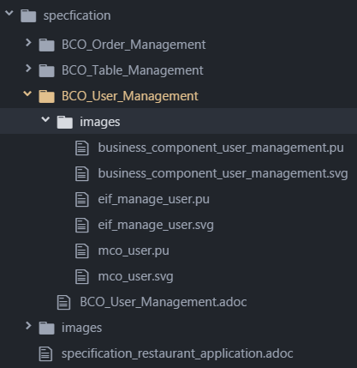
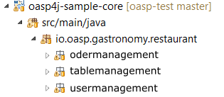
devonfw specification provides excellent support for quick and frequent editing by whole development team
Main benefits
Modular Documentation
using well known import mechanisms
Near to code structure
developers can easy identify relevant business components
Versioned with code
using same mechanisms and structure.
Supported by git
formatted preview in git web-guis (github/ gitlab)

Slide 3
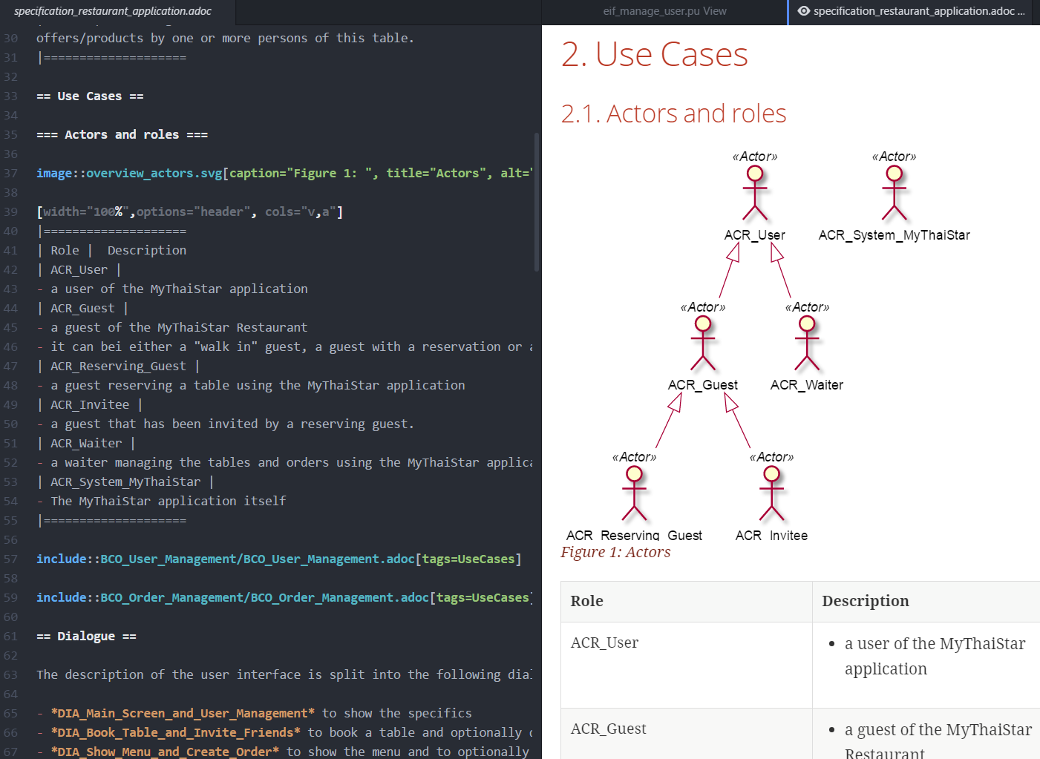






devonfw specification uses a single open source tool
Main benefits
Developer-friendly:
no toolset but a single, open source tool needs to be installed
Low-level:
diagrams, tables and document structure defined by plain ascii-text
easy-to-use
live preview of specification (by component or whole specification)
export and include images from UML-Diagrams from within the text-editor
online live-preview during development/ specification
export-features included

Slide 4
Devonfw Specification method is extremely useful
Comprised of
HowTo for technical aspects
Light description of the method
Design rationales
Example specification
Based on highly proven
specification method of Capgemini Germany
Stripped to the essentials
precise, redundancy free, UML-oriented
Mirroring nomenclature and structure of the code
Excellent basis for
maintenance
further development
Ubiquitous language from business analysis to code
Tailor it:
Use the level of detail you need
Use the parts you need
In tailored form usable as
Basis for stories and implementation
Basis for maintenance / further development

