Slide 1
Accelerated Solution Design
Valencia, February 2018, AD Center

Slide 2
Challenges of Software Design
Unreasonable expectations and schedules
Fast-changing technology
Limited budget and efficient allocation of human resources
Lack of formal Design process
Quality issues
Requirements volatility and continuous customer demands

Slide 3
Objective
Key principles
Ways of working
Sprint 0
Collaboration tools
Capgemini
1
2
3
4
5
6
7
8
9
Proposed solution
Intersection of industry standard practices
Software design and development lifecycle
Sprint 1

Slide 4
Objective
Formalize Software Design in the context of the Capgemini AD Center concept or other forms of agile Delivery within Capgemini to better understand, apply and promulgate well known design principles, processes and professional practices

Slide 5

Proposed solution: Accelerated solution design
A methodology
A practical guideline
A static, fixed document
A “living” document
Based on proprietrary methods
Based on industry standards
Separate agile teams
The intersection of industry standard practices
Only focused on technical/architectural design
Encapsulating business requirements, functional definitions and Architecture design

Slide 6
Key principles
Involve end users in the development lifecycle
Learn and apply continuous improvement
ASD begins as a design, evolves into a system specification and ends as documentation
Visualize
Be iterative
Improve communication and collaboration among the teams (Customer, Design team and Development team)

Slide 7
Intersection of industry standard practices
User story mapping
Talk about the user journey through your product
Accelerated Solution Design
UX Design Sprint
Domain Driven
Design
Rapid visual prototyping and testing
Modelling the real-world system or process

Slide 8
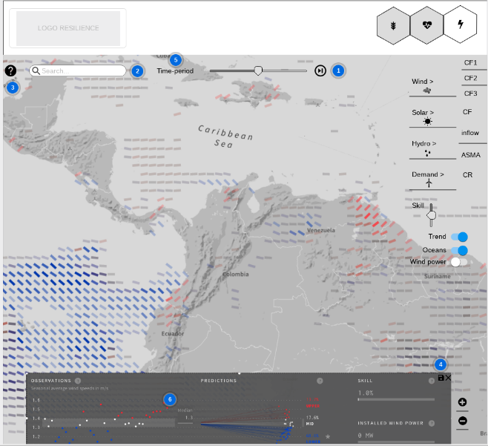
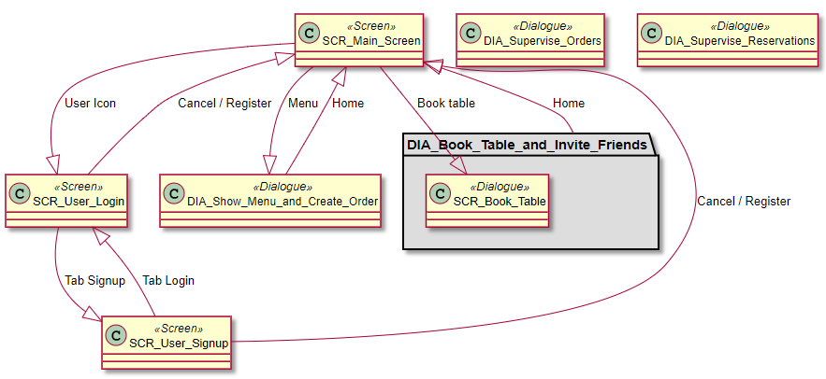
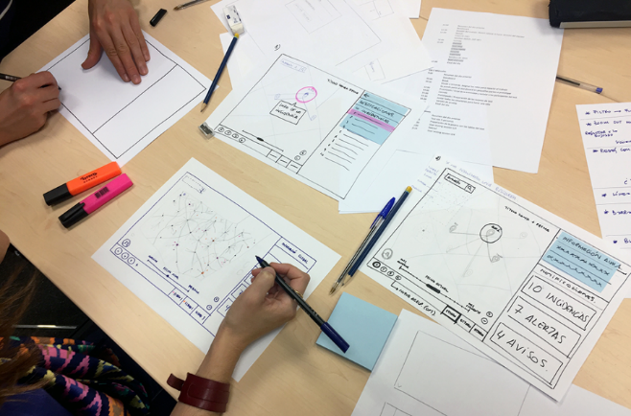
Models
Wireframe
The idea is not to capture the system in one, canonical model but rather to offer many different, overlapping “views” of the “real, hidden” model.
Dialog flow
Sketches

Slide 9
Ways of Working
Process to be followed at the AD Center to deliver the solution

Slide 10

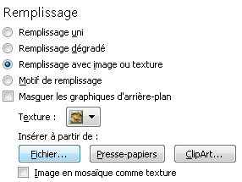
Continuous validation
EXPLORE AND DEFINE
Big idea
Assumptions
User
Solution
This process sinthesizes the essence of the Design Sprint.
The Solution Design Office and Development team will work together to model, test and improve the system design.
Pour modifier l’image d'arrière-plan :
Faites un clic droit et cliquez sur Mise en forme de l’arrière-plan
Dans la fenêtre Remplissage, choisissez Remplissage avec image ou texture puis cliquez sur Insérer à partir de : Fichier
Sélectionnez votre image puis cliquez sur Fermer
Passion & inspiration
Small learning
Riskiest assumptions
Learn
Build
IDEATE AND PROTOTYPE
Measure
Rigth-sized prototype
Focused Test
Interview
Observe & measure
MVP
EMPATHIZE AND TEST

Slide 11
Software design and development lifecycle
Project starts with Design Sprint 0
Desing sprints always ahead of Development sprints
Solution Delivery Office
Sprint 0
Sprint 2
…
Sprint n
Customer
Sprint 1
Sprint 3
Sprint n+1
Yard
Prototype v0.1
Prototype v0.1
Solution

Slide 12
Agile design flow
User story
Use Case,
E-R,..
The Solution Design Office (SDO) will follow this agile design flow to model the solution for the business needs.
The SDO will meet the customer to understand those needs, extract the user journey and ideate the possible uses of the product.
Those elements will be used to articulate and validate with customer a collection of epics, user stories and sketches that shall give meaning and value to the software, APIs and interfaces. In the end, the Solution Design Office shall create all the necessary support material for development.
Epic story
Visual design, Detail Task Flow,..
Sketches, wireframing
..
Bounded context, Domain model, Class diagram...
Business needs
User story
Use Case,
E-R,..
Epic story
Visual design, Detail Task Flow,..
Sketches, wireframing..
Bounded context, Domain model, Class diagram...
Customer input
Business Analysis
UX Design
Architecture

Slide 13
Solution Design sprint
Sprint 0
Sprint where the Solution Design Office get to understand the needs of the customer, why they are necessary and what is the Minimum Viable Product (MVP) that provides the most value to customer.
Core team
Business Analyst
UX Designer
Architect

Slide 14
Explore and define
Sprint 0
Outcomes
Deliverables
The end result is a clear definition of the problem and a framework for the solution.
Purpose
Objectives
Glossary of terms
Initial requirements
Analysis overview

Slide 15
Ideate and prototype
Sprint 0
Outcomes
Deliverables
The end result is a validated concept with brand/visual design vision, content strategy, interaction design guidelines and a proven technical solution to accelerate development.
Epics
User stories
Interactive prototype
Wireframes
First Steps Analysis
Accelerated Solution Design
Style Guide and assets
UATs

Slide 16
Empathize and test
Sprint 0
Outcomes
Deliverables
The ultimate end result is a complete solution accepted by the customer.
UAT results
Test status
Proposed changes
UAT report

Slide 17
Development sprint
Sprint 1
Sprint where developers develop the software solution and produce all the necessary prototypes.
Core team
Developers

Slide 18
Ideate and Prototype
Sprint 1
Outcomes
Deliverables
The end result is a prototype that implements the user stories included in the sprint backlog.
Prototype
Intention to produce an artifact which is visual and tangible

Slide 19
Empathize and test
Sprint 1
Outcomes
Deliverables
The ultimate end result is a complete solution accepted by the customer.
UAT results
Test status
Proposed changes
UAT report

Slide 20




Collaboration tools
1
2
The team shall use collaboration software to share and communicate the design and implementation of the solution.
There will be two supported options:

Slide 21
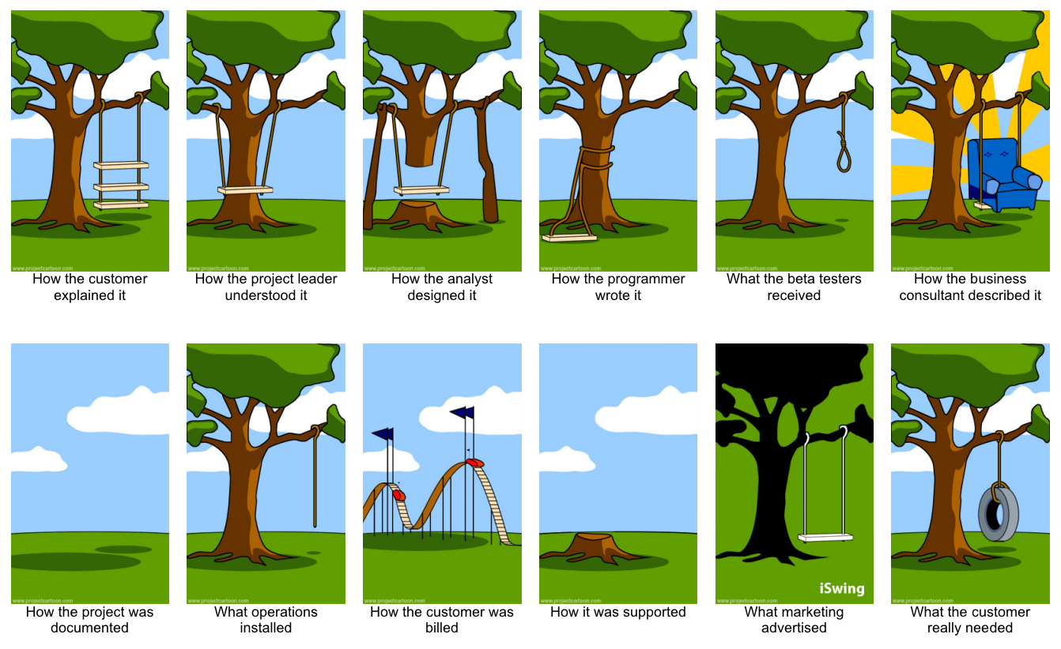
Conclusions

