Slide 1
Defonfw Specification Module
Overview
Hinken, Glagla, 26.09.2017

Slide 2
MyThaiStar-Specification in the agile lifecycle
Initialization
Sprint
Sprint
Sprints
Project End
Backlog Creation
Backlog Prioritization
Story Definition for Sprint 2
Story Definition for Sprint 3
Stories
New Stories
…
Many Stories
Story Definition for Sprint 1
Implementation Sprint 1
Documentation Sprint 1
Implementation Sprint 2
Documentation Sprint 2
Devonfw Specification
Update of Devonfw Specification
Full Devonfw Specification
Devonfw Specification
Method for post-documentation of implemented functionality
Used in parallel to / independent of user stories
Goal is documentation of target system („Specification“)

Slide 3
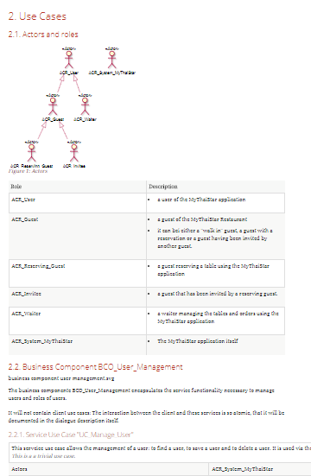
Contents of MyThaiStar-Specification
Business System
Business Logic
Use Cases
Use Case Functions
Data
Data Model
Data Types
User Interface
Dialogues and screens
Printout
External Interfaces
Provides Interfaces
Used Interfaces
Batches
Non-Functional Properties
Cross-sectional concepts
Non-functional requirements

Slide 4
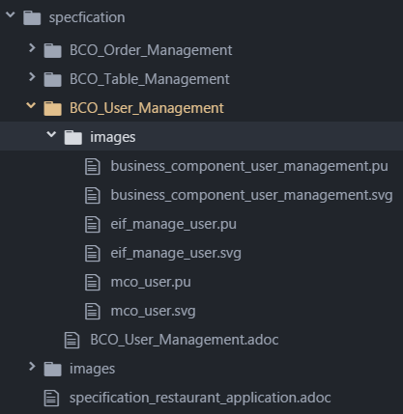
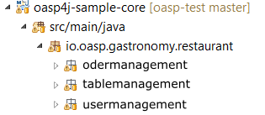
Devonfw-Specification provides excellent support for quick and frequent editing by whole development team
Main benefits
Modular Documentation
using well known import mechanisms
Near to code structure
developers can easy find relevant business components
Versioned in project code repository
using same mechanisms and structure.
Supported by git
formatted preview in git web-guis (github/ gitlab)

Slide 5
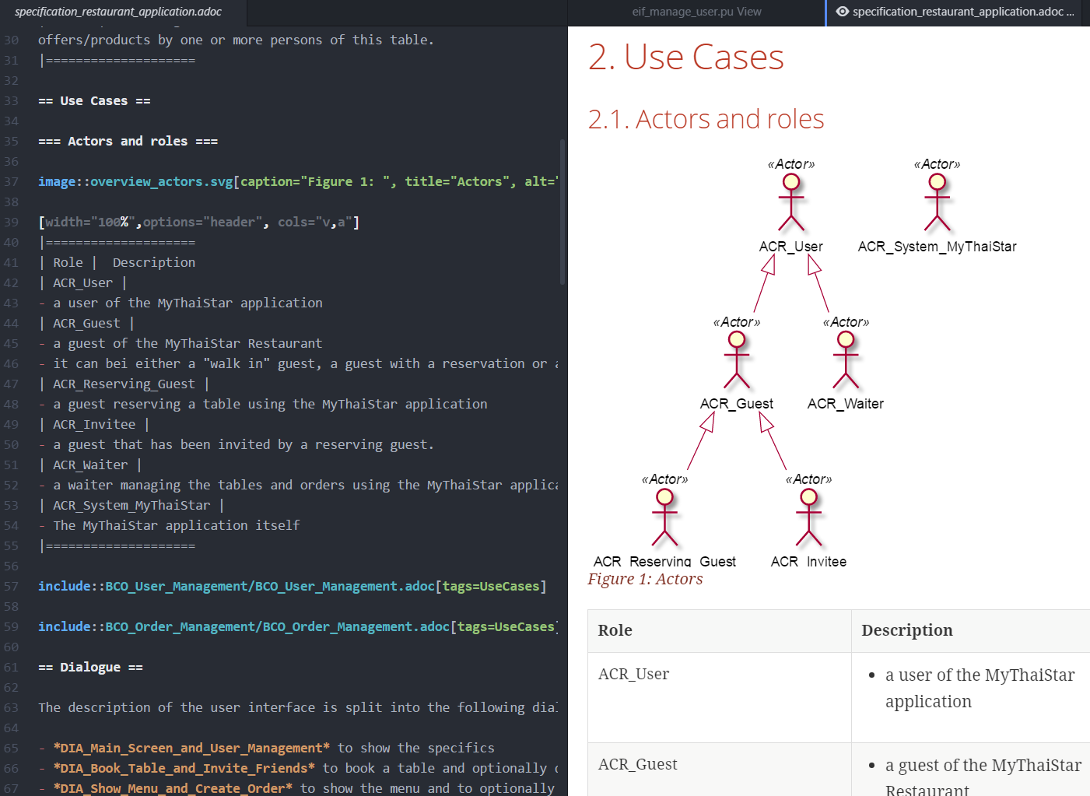






Devonfw-Specification uses a single open source tool
Main benefits
Developer-friendly:
no toolset but a single, open source tool needs to be installed
Low-level:
diagrams, tables and document structure defined by plain ascii-text
easy-to-use
live preview of specification (by component or whole specification)
export and include images from UML-Diagrams from within the text-editor
online live-preview during development/ specification
export-features included

Slide 6
Devonfw Specification method is extremely useful
Comprised of
HowTo for technical aspects
Light description of the method
Design rationales
Example specification
Stripped to the essentials of a specification
precise, redundancy free, UML-oriented
Mirroring nomenclature and structure of the code
Excellent basis for
maintenance
further development
DDD: Ubiquitous language from business analysis to code
Tailor it:
Use the level of detail you need
Use the parts you need
In tailored form usable as
Basis for stories and implementation
Basis for maintenance / further development
Basis for required documentation (e.g. audits)

Slide 7
Links
The Example Specification as asciidoc in github view (imports are not supported and shown als links):
https://github.com/devonfw/devon-methodology/blob/master/functional_specification/MyThaiStar/specfication/specification_restaurant_application.adoc
This presentation:
https://github.com/devonfw/devon-methodology/blob/master/functional_specification/MyThaiStar/concepts/rationale/20170928_Overview_MyThaiStar_Specification.pptx
The rationale for the specification:
https://github.com/devonfw/devon-methodology/blob/master/functional_specification/MyThaiStar/concepts/rationale/specification_rationale.adoc
The lightweight description of the method:
Yet to be done

