Slide 1


oach
AI
COLOSSEUM HACKATHON · 2026
● Voice-first financial learning
Money shouldn't be
a mystery.
1 Ask
2 Learn
Meet Mila — an AI coach that turns money questions into small daily habits, with learning certificates on Solana Devnet.
4 Prove
3 Practice
Voice-first
Habit loop
Solana Devnet certificates
coachfiai.com · Dorian Żaczek, Founder
01 / 09
Notes:
[0:00–0:12 · 12 s] I'm Dorian Żaczek, founder of CoachFI AI. We help people build money habits — with a voice coach called Mila, and learning certificates on Solana.

Slide 2
THE PROBLEM
EU DATA · ORIGINAL POPULATIONS
Financial confidence is not evenly shared.
of EU citizens have a high level of financial literacy.
of people aged 18–65 in the EU lack savings to cover 3 months of living costs.
18%
49%
HIGH LITERACY
NO 3-MONTH
BUFFER
Flash Eurobarometer 525 · European Commission, 2023
EU Financial Literacy Strategy, COM(2025) 681 · Sept 2025
→ Knowing is not the same as doing. People need repeatable habits.
EU statistics only, not global totals. 49% = emergency savings for ≥3 months without borrowing or moving house.
02 / 09
Notes:
[0:12–0:31 · 19 s] The problem is real. In the EU, only eighteen percent of citizens have high financial literacy. And forty-nine percent of people aged eighteen to sixty-five could not live three months on their savings. Knowing is not enough. People need habits.
Sources: Flash Eurobarometer 525 (2023); EC Financial Literacy Strategy COM(2025) 681, 30 Sept 2025.

Slide 3

THE SOLUTION
ACCESSIBLE BY DESIGN
Meet Mila.
Your voice-first money coach.
YOU ASK · BY VOICE
“How do I start saving when there's very little left?”
MILA EXPLAINS · 3-MINUTE LESSON
“Let's find one small step that fits your life.”
Voice in, voice out
Text & captions too
Mila · Explaining
For blind & low-vision users
Short lessons, one next step
Original CoachFI Mila artwork · illustrative dialogue · education, not financial advice
03 / 09
Notes:
[0:31–0:52 · 21 s] Meet Mila — our voice-first AI coach. You ask a real question, out loud. Mila answers with a short lesson and one small next step. Voice helps blind and low-vision learners, and every answer also comes as text and captions.

Slide 4
THE LEARNING LOOP
LIVE DEMO · COACHFIAI.COM ↗
One question becomes a habit.
1
→
2
→
3
→
4
Ask
Learn with Mila
Practice
Earn on-chain
A real money question — by voice or text.
A short lesson in plain words.
Gamified challenge: quiz, points and a streak.
Achievement unlocked → certificate on Solana Devnet.
CHALLENGE
Eligible → on-chain · Devnet ✓
Saving Habit
✓ Quiz ✓ Day 1 ✓ Day 2 ✓ Day 3
Rule from the public Rewards page: “Unlocks after the saving habit quiz and 3-day streak.” Certificate mint verified on Devnet (slide 5).
04 / 09
Notes:
[0:52–1:21 · 29 s] Here is the loop. One: you ask a money question. Two: Mila gives a short lesson. Three: you practice — a quiz and a three-day saving streak, with points to keep it fun. Four: you earn a certificate — on-chain, on Solana Devnet. The goal is a habit, not a game. Let me show you the proof.

Slide 5
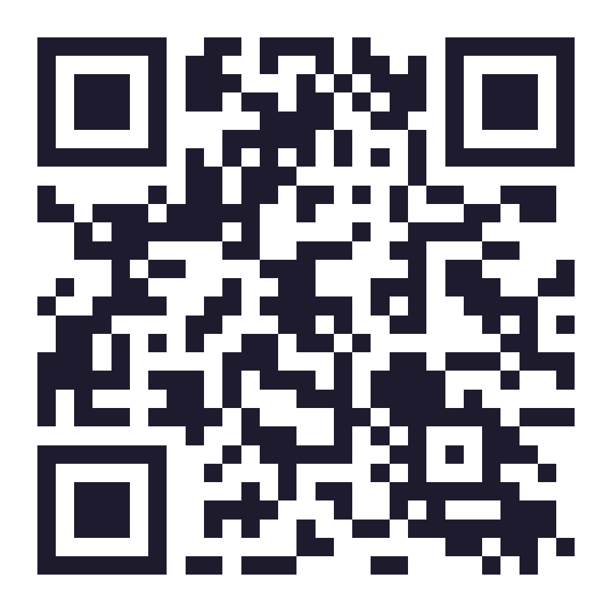
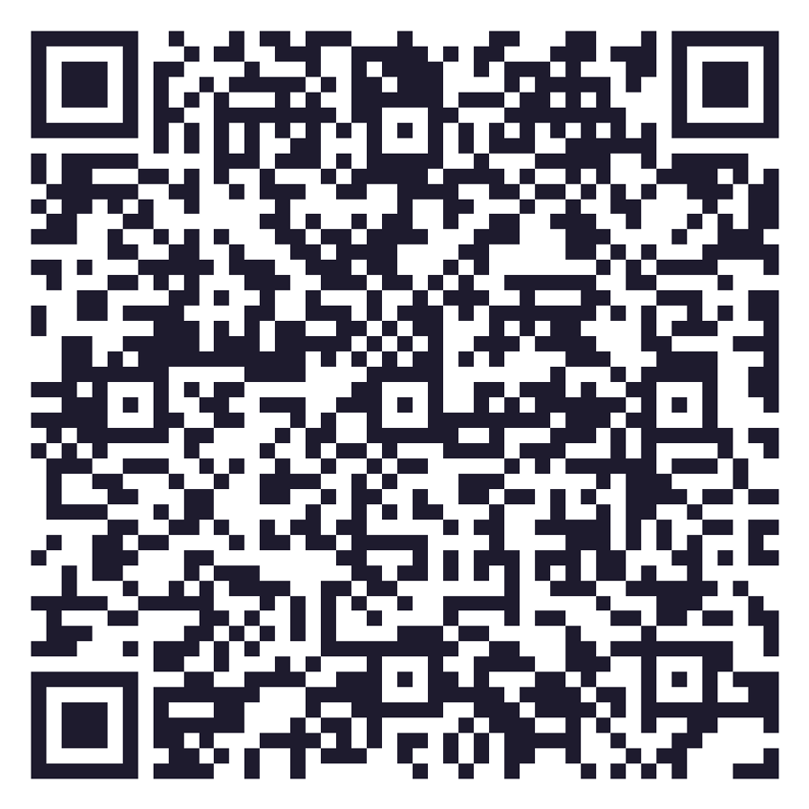
PUBLIC DEMO · TRY IT NOW
● SOLANA DEVNET
Learn here. Prove it on Solana Devnet.
PUBLIC ON THE REWARDS PAGE TODAY
SCAN · LIVE REWARDS PAGE
✓ Coinbase CDP wallet ✓ Blockchain consent ✓ “Mint certificate”
App copy: “Certificates are proof of education, not investment products.”
✓ MINT VERIFIED ON SOLANA DEVNET
First CoachFI certificate · Metaplex Core asset
Tx finalized, no error · checked on Devnet RPC + Explorer, 13 Oct 2026
Tx signature
4o6n9e…jtZLEv
coachfiai.com/rewards
✓
✓
✓
✓
Asset
373B7m…nDsA
Phone camera · no app needed
Rewards UI
public
Wallet +
consent
Mint tx
finalized
Explorer
confirmed
Owner
21dYDb…C2C8p
Program
Metaplex Core · CreateV2
Right QR → the real mint tx in Solana Explorer (cluster=devnet). Owner = learner wallet; the CoachFI issuer key signed and paid.
05 / 09
Notes:
[1:21–1:47 · 26 s] This is live, on Solana Devnet. Scan the left code — it opens coachfiai.com/rewards. You sign in with a Coinbase non-custodial wallet, accept a clear blockchain consent, and press Mint certificate. And this is our first real certificate: a Metaplex Core asset, finalized on Devnet. Scan the right code to see it in Explorer.
Verified 13 Oct 2026: tx 4o6n9e…jtZLEv finalized, err null, Metaplex Core CreateV2; asset 373B7m…nDsA; owner 21dYDb…C2C8p.

Slide 6
WHY SOLANA · HOW THE PROOF WORKS
● SOLANA DEVNET
Private learning. Public, verifiable proof.
OFF-CHAIN · PRIVATE
CONSENT · WALLET
ON-CHAIN · DEVNET
PUBLIC CHECK
Lesson
Quiz
Eligibility
→
Learner wallet
→
Certificate ✓
→
Solana Explorer ✓
Mila
+ streak
backend check
Coinbase CDP · opt-in
Metaplex Core asset
anyone can verify
What a judge can check
What stays where
Transaction · finalized
Asset · Metaplex Core
OFF-CHAIN · PRIVATE
ON-CHAIN · PUBLIC
4o6n9e…jtZLEv
373B7m…nDsA
Identity, money data, quiz answers, voice
Wallet address, asset ID, certificate metadata
Owner · learner wallet
Metadata · name
21dYDb…C2C8p
Coach FI - Saving Habit
NEXT
Permanent Freeze Delegate → non-transferable. Today's asset is still transferable.
The issuer key signs and pays the fee and rent; the learner's wallet only receives. A wallet stays optional for learning.
06 / 09
Notes:
[1:47–2:14 · 27 s] Why Solana? Learning stays private and off-chain. Our backend checks eligibility, then — with consent — mints a Metaplex Core certificate to the learner's own wallet. Anyone can check it in Explorer: signature, asset, owner, metadata. The wallet is optional. Next: make it non-transferable with Permanent Freeze Delegate.

Slide 7
BUSINESS & DISTRIBUTION
PROSPECTIVE · NOT TRACTION
Human trust. AI scale.
01 · B2C
02 · B2B2C
03 · PROSPECTIVE PILOT
Everyday learners
White-label for partners
Metamorfoza Finansowa
Free to start. Premium subscription planned.
Financial planners, educators and institutions offer Mila under their brand — with verifiable certificates.
Grzegorz Kusz · in discussion, not signed
Founder reach: DORIANOS / ZŁAP TREND on YouTube and in community channels.
12k
120
clients*
planners*
* Partner's own figures, founder-reported, pending independent verification. Not CoachFI users or revenue.
No signed partnership, paying customer or user count is claimed.
07 / 09
Notes:
[2:14–2:33 · 19 s] Distribution: I run DORIANOS and Złap Trend — a YouTube channel and community about money and markets. Next: white-label pilots for financial planners. We are talking with Metamorfoza Finansowa and Grzegorz Kusz. This is a prospective pilot — not traction yet.

Slide 8
ROADMAP · THROUGH 2027
MILESTONE 1 DONE · REST ARE GOALS
From Devnet proof to real pilots.
NOW · OCT 2026
OCT 2026
Q4 2026
Q1 2027
Q2–H2 2027
Prove the mint ✓
Credentials + learning
White-label pilot
Scale carefully
First Devnet certificate minted (13 Oct)
Fix metadata URI, repeat on new wallets
Non-transferable badge (Permanent Freeze Delegate)
Robust checks, optional wallet
More Mila lessons · Kids mode
Partner feedback
Engagement proof
Country-aware content
Staged path to 32 languages
Explore regulated marketplace
Possible Jupiter asset discovery
Mainnet only after a security audit and legal review.
Indicative dates. Scope depends on testing, legal review, team capacity and partners.
08 / 09
Notes:
[2:33–2:46 · 13 s] Roadmap. First Devnet certificate: done this month. Q4: non-transferable credentials and Kids mode. Q1 2027: a partner pilot. Mainnet only after audit and legal review.

Slide 9

THE TEAM · THE ASK
oach
AI
Financial confidence should be
a habit, not a privilege.
D
Dorian Żaczek
M
Mieszko Manijak
Founder
Solana Developer
DORIANOS / ZŁAP TREND
YouTube, community and financial education
Wallet flow, Devnet certificates and on-chain proof
ASK 1
ASK 2
ASK 3
Pilot partners
Solana technical support
Funding conversations
coachfiai.com · Talk to us after the session
09 / 09
Notes:
[2:46–3:00 · 14 s] I'm the founder. Mieszko Manijak builds our Solana layer. We ask for three things: pilot partners, Solana technical support, and funding conversations. Financial confidence should be a habit — not a privilege.

Slide 10
JUDGE Q&A 1 · STATUS LEDGER
NOT IN THE 3-MINUTE TIMER
What is live, what needs proof, what is planned.
✓ VERIFIED
? TO FIX / PROVE
→ PLANNED
Rewards page, CDP wallet, consent, Mint action
Mint tx finalized, no error (13 Oct)
Metaplex Core asset, owner = learner
Metadata JSON reachable
URI field holds 8 stacked URLs
“user” attribute = placeholder “Your”
Repeat mint on a fresh wallet
Score is public on-chain — intended?
Permanent Freeze Delegate at creation
One collection for all certificates
Mainnet after audit + legal review
Why Solana?
Built during Colosseum?
Show a live NFT?
Fast, low-cost credentials anyone can verify — while private learning data stays off-chain.
We show commits and the live domain, and separate pre-hackathon modules from hackathon work.
Scan slide 5: tx 4o6n9e… and asset 373B7m… in Explorer (devnet). Details: Q&A 3.
Program ID referenced: Metaplex Core CoREENxT6tW1HoK8ypY1SxRMZTcVPm7R94rH4PZNhX7d
Q&A 1
Notes:
Backup slide (not timed). Verified on Devnet: tx 4o6n9e…, Metaplex Core asset 373B7m…, owner 21dYDb…. Be upfront about the metadata URI and transferability.

Slide 11
JUDGE Q&A 2 · PRIVACY & TRANSFERABILITY
NOT IN THE 3-MINUTE TIMER
Proof is public. Learning data is not.
DATA | WHERE | WHY
Identity, voice, money data | Off-chain · private | Never written to Solana. Protected by app security and consent.
Quiz answers, streaks, points | Off-chain · private | Backend decides eligibility. Only the final score is on the certificate today.
Wallet address | On-chain · pseudonymous | Coinbase CDP non-custodial wallet: the learner controls it. Optional.
Certificate asset + attributes | On-chain · public | Name, URI, issuer, certificate, score, issued-at — verifiable in Explorer.
Transferable?
Can it be sold?
Kids?
Today, yes — the first asset has only an Attributes plugin. Next: Permanent Freeze Delegate, set at creation.
App copy: certificates are proof of education, not investment products.
Education only. No wallets, no financial products.
Sources: Flash Eurobarometer 525 (2023) · EC COM(2025) 681 (30 Sept 2025) · Metaplex Core docs
Q&A 2
Notes:
Backup slide (not timed). The first asset has no freeze plugin: it is transferable. Say so if asked. The score attribute is public on-chain.

Slide 12
JUDGE Q&A 3 · DEVNET EVIDENCE GATE
● SOLANA DEVNET
Show the transaction. Not just the button.
✓ Recorded: Devnet certificate mint verified (13 Oct 2026)
Values copied from the real transaction and checked on the public Devnet RPC and Solana Explorer.
Cluster
devnet
Tx signature
4o6n9eheET…Lk2jtZLEv
Status
finalized · err null
Slot / time
510481868 · 2026-10-13 02:57:13 UTC
Programs
Metaplex Core (CreateV2), System
Open tx in Solana Explorer ↗
Asset
373B7mWUUpDVy9nFXTo9poPcpuETKpX4xYmgMVcUnDsA
Live re-check: Q&A 3 in the animated HTML deck.
Owner (learner)
21dYDb9SxtCMAXitR72V3at1zfVKawYWwx6riJvC2C8p
Issuer / payer
BkQMdMKsG9jYc6yvfhxKcvQR3bAeJJJq5ew2L9ptRzrT
Recorded values come from the real tx. Never add a signature, asset ID or mint count that was not checked.
Q&A 3
Notes:
Backup slide (not timed). Recorded evidence from the real tx, checked 13 Oct 2026 on the public Devnet RPC. Use the animated HTML deck for a live re-check.

