Slide 1


RWA
SHIELD
Oracle price is not cash.
We price recoverable collateral.
Warsaw · 27.09.2026
Notes:
Oracle price is not cash. I'm Dorian, and this is RWA Shield. We price recoverable collateral.

Slide 2

Oracle price ≠ cash in the pool
First user: Solana lending / vault integrating xStocks — not retail.
$200M+
$53M
~63%
Tokenized-equity trading volume on Solana in one day (12.09.2026)
Tokenized-stock lending TVL on Solana, all-time high (late Jul 2026)
Of cumulative trading through Aug 2026, settled outside US market hours
Fixed LTV treats a mark as recoverable USDC. Thin books say otherwise.
Sources: Solana Compass 13.09.2026 (Solana Foundation newsletter); Crypto Briefing 23.07.2026 + Solana Compass 24.07.2026 · not audited
Notes:
Imagine you deposit USDC to tokenized stock pool to get some yield, against a tokenized stock. The oracle says collateral it is worth one hundred. But the market is closed, or the book is thin. Lender get liquidated, and you get much less. That gap is bad debt. Press reports: over two hundred million dollars of tokenized stocks traded on Solana in one day. Our first user is not retail — it is a lending venue on Solana that accepts xStocks.

Slide 3

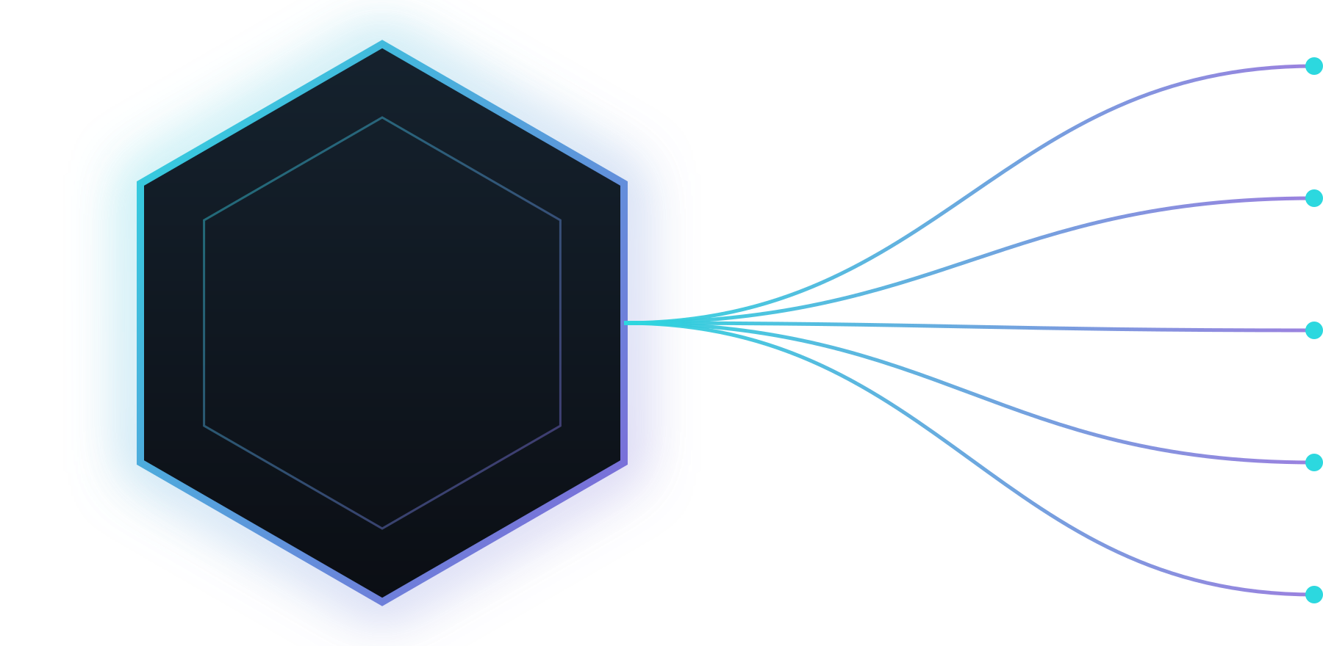

ECV — Executable Collateral Value
One job: tell the venue what is still recoverable USDC under stress.
max_borrow
collateral_cap
ECV
liquidation_route
risk_premium
borrow_disabled
Works today: ECV engine + breaker demo + ECV record published on Solana devnet (Anchor).
Five frozen outputs = the on-chain interface — published on Solana devnet (not mainnet).
Notes:
So we built ECV — Executable Collateral Value. How much USDC can you really recover, right now? Five outputs: max borrow, cap, route, premium, and borrow off.

Slide 4


Watch the breaker
01
02
03
Oracle price
ECV under stress
Breaker: WARNING
TSLAx · $100k · stress sandbox: ECV $84,358 · safe max borrow $58,684 vs Kamino LTV $55,000 · WARNING: USDC reserve utilization at the 90% rate kink
Notes:
Let me show you. Watch the breaker.
This is our Kamino risk dashboard. Recorded Kamino market data, Jupiter quotes measured at four-seventeen, stress sandbox — not a live signal.
Tesla xStock, one hundred thousand dollars, weekend. Oracle price: about three hundred seventy-two dollars.
ECV: about eighty-four thousand of that hundred thousand — a haircut of about sixteen percent, mostly our weekend buffer — a policy choice.
Safe max borrow: about fifty-nine thousand, next to Kamino's LTV limit of fifty-five thousand. Status: WARNING, because USDC utilization is at the ninety-percent rate kink.

Slide 5

Same book. Two models. Synthetic in-sample.
SYNTHETIC IN-SAMPLE — not historical validation · not mainnet
~$3.98M
$0
Fixed 70% LTV · bad debt in synthetic tail stress
ECV · bad debt (synthetic, in-sample) + 369 refusals
In the tail scenario ECV refuses all 369 new loans — that is how bad debt stays at $0.
Trade-off: calm base ≈ 100% of fixed-LTV credit · all six synthetic scenarios ≈ 27%
Notes:
First, the label: synthetic, in-sample. On a synthetic in-sample book, not historical mainnet data. A fixed seventy percent LTV could leave potentially about three point nine eight million dollars of bad debt. ECV: zero bad debt. How? In the tail scenario it refuses all three hundred sixty-nine new loans. In the calm base scenario it lends about the same as fixed LTV.

Slide 6
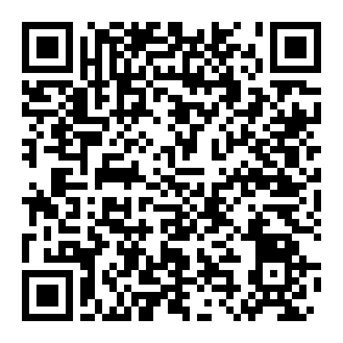
ECV published on Solana devnet
Anchor program ecv_oracle · deployed 26.09
PROGRAM ID · DEVNET
5nsdYo…Euc
Solana Explorer · cluster = devnet · scan the QR →
PUBLISHES THE FIVE ECV OUTPUTS
max_borrow
collateral_cap
liquidation_route
risk_premium
borrow_disabled
NEXT → verifiable inputs · multi-signer posting · vault + borrow gate
Scan → Solana Explorer (devnet)
Rust poster can re-post the ECV record on a schedule (--every-sec) · last devnet post: 26.09.2026, 19:55 (Warsaw)
Today: single-authority signer on devnet. Publishes ECV quotes; integrators enforce. Not mainnet.
Notes:
Since our last pitch, ECV went on-chain: our Anchor program, published on Solana devnet yesterday. Scan the QR.

Slide 7



Built where the collateral already trades
xStocks venues — where the collateral already trades
Jupiter routes = the liquidation path ECV quotes
(demo: Jupiter quote ladder measured 16:17 + Kamino snapshot 13:50, stress sandbox)
Composable ECV risk quotes for those venues
Notes:
Why Solana? Because the collateral already lives here. xStocks are native on Solana, and Jupiter routes are the real liquidation path. And publishing is cheap: the base fee is 5,000 lamports per signature, a fraction of a cent, so the ECV record can be refreshed often.

Slide 8



Monetization — hypothesis, not ARR
Risk API / SDK
Share of risk premium
Optional vault fees
ECV quotes & breakers for lending venues
When ECV sits in the borrow path
If we operate a reference vault
Notes:
How do we make money? First, a risk API and SDK: lending venues pay for ECV quotes and breakers. Second, we may build our own money market.

Slide 9






Team
Hiring: Rust/Anchor · frontend
AK
Dorian Żaczek
Julita Szaruta
Mieszko Manijak
Adam Książkiewicz
CEO, Founder & Product Manager
Legal, Tax & Regulatory · MiCA
CTO & DeFi Architect Engineer
Anchor program + Rust poster
investiatech · Rust · devnet deployment · quant markets
Advisor · Adam Kwak — staff-level COBOL / mainframe, 20 yrs core financial infrastructure (Scandinavia)
Notes:
The team. Mieszko Manijak, our DeFi expert, built the Anchor program and the Rust poster. Julita Szaruta leads legal and regulatory, experience in WEB3. Adam Książkiewicz did the devnet deployment. And as an Advisor we have experienced staff-level COBOL/ mainframe, 20 years core experience.

Slide 10

Recoverable collateral quotes — not a price print.
github.com/Dorianos85/rwa-shield/tree/main/onchain
Notes:
Next fourteen days: we fix the xStocks mint mapping on-chain, then a vault and a borrow gate that reads the ECV record. From you: intros to lending venues that hold xStocks, and Rust and frontend engineers. Oracle price is not cash. Thank you.

