Slide 1
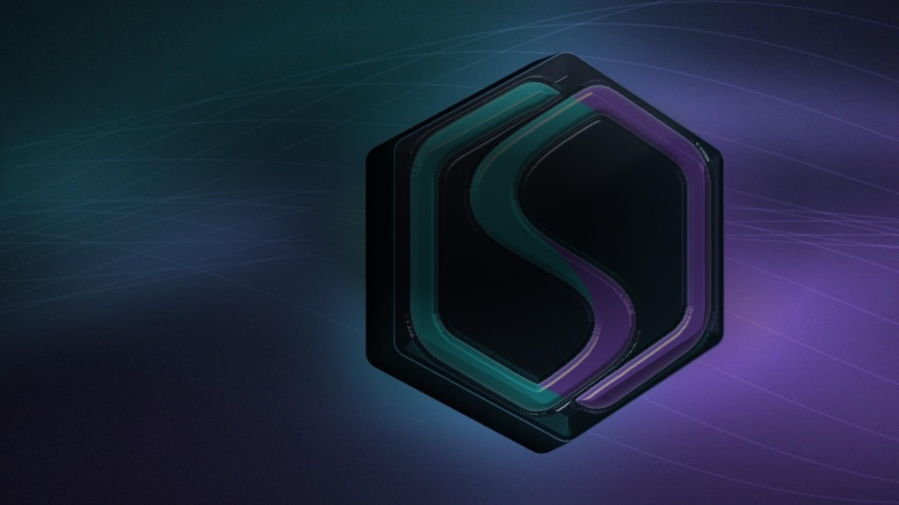

RWA SHIELD
Oracle price is not cash.
We price recoverable collateral.
Solana · xStocks risk data · 10.2026
Notes:
Oracle price is not cash. I'm Dorian, and this is RWA Shield. We price recoverable collateral.

Slide 2
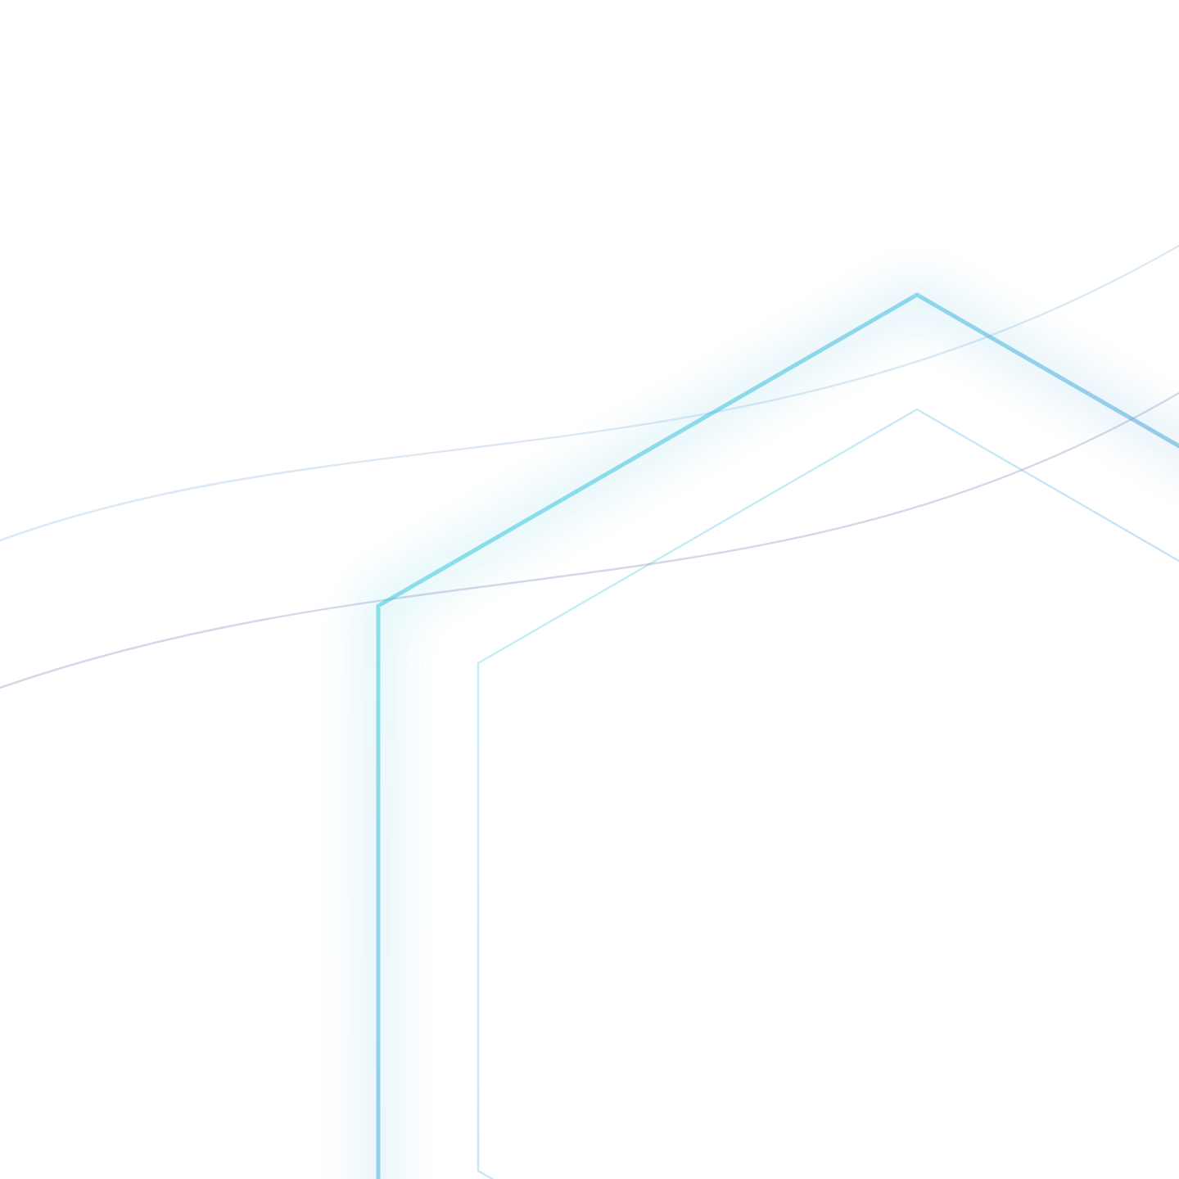
Oracle price ≠ cash in the pool
First user: Solana lending / vault integrating xStocks — not retail.
$200M+
$53M
~63%
Tokenized-equity trading volume on Solana in one day (12.09.2026)
Tokenized-stock lending TVL on Solana, all-time high (late Jul 2026)
Of cumulative trading through Aug 2026, settled outside US market hours
Fixed LTV treats a mark as recoverable USDC. Thin books say otherwise.
Sources: Solana Compass 13.09.2026 (Solana Foundation newsletter); Crypto Briefing 23.07.2026 + Solana Compass 24.07.2026 · not audited
Notes:
Imagine you deposit USDC into a tokenized stock pool to earn some yield, lent against a tokenized stock. The oracle says the collateral is worth one hundred. But the market is closed, or the book is thin. The position gets liquidated, and you get much less. That gap is bad debt. Press reports: over two hundred million dollars of tokenized stocks traded on Solana in one day. Our first user is not retail — it is a lending venue on Solana that accepts xStocks.

Slide 3
This has already cost lenders
WHEN · WHERE
LOSS
WHAT FAILED
RWA SHIELD MEASURES
07.2026 · Edel Finance
~$0.4M
Wrapper price pumped, collateral valued 78× too high. The Chainlink price was correct.
Collateral mark vs real DEX exit
GOOGLx collateral (xStocks)
lost
11.2025 · Stream xUSD
$93M
Collateral hard-coded at $1. The token fell 77% and liquidations never fired.
Curator limits from real liquidity
Morpho & Euler curator vaults
lost · ~$285M debt exposed
11.2022 · Aave
~$1.6M
Position bigger than the market could absorb. Liquidators could not sell in time.
Liquidation capacity vs position size
CRV collateral and debt
bad debt
10.2022 · Mango Markets
>$110M
A thin MNGO market let the attacker pump the collateral and borrow everything.
Marks capped by what the market pays
Solana
drained
06.2022 · Solend
$108M
~$21M of SOL to liquidate, more than Solana DEXes could take. Account seized by emergency vote.
Position and pool limits from exit liquidity
Solana · one whale
loan
Common thread: the protocol trusted a price, the market paid far less. Sources: CoinDesk, CryptoSlate (Edel); Pharos, Tiger Research (Stream); The Defiant, Blockworks (Aave CRV); CoinDesk, Cointelegraph (Mango); Decrypt (Solend).
Notes:
This is not theory. Collateral that cannot be sold at its mark has left lenders with losses many times. July this year, Edel Finance: GOOGLx collateral, the tokenized Google share. Chainlink was right, but the protocol valued the collateral 78 times too high and lost about four hundred thousand dollars. November 2025, Stream: curator vaults on Morpho and Euler took a token hard-coded at one dollar. It fell 77 percent, liquidations never fired, 93 million lost. Aave with CRV, Mango on Solana, and Solend: one whale, 108 million borrowed, more SOL to liquidate than Solana DEXes could take. Common thread: the protocol trusted a price, the market paid far less. If asked whether these were hacks: Mango and Edel were manipulations, and both worked because the collateral mark was never checked against what the market would really pay.

Slide 4
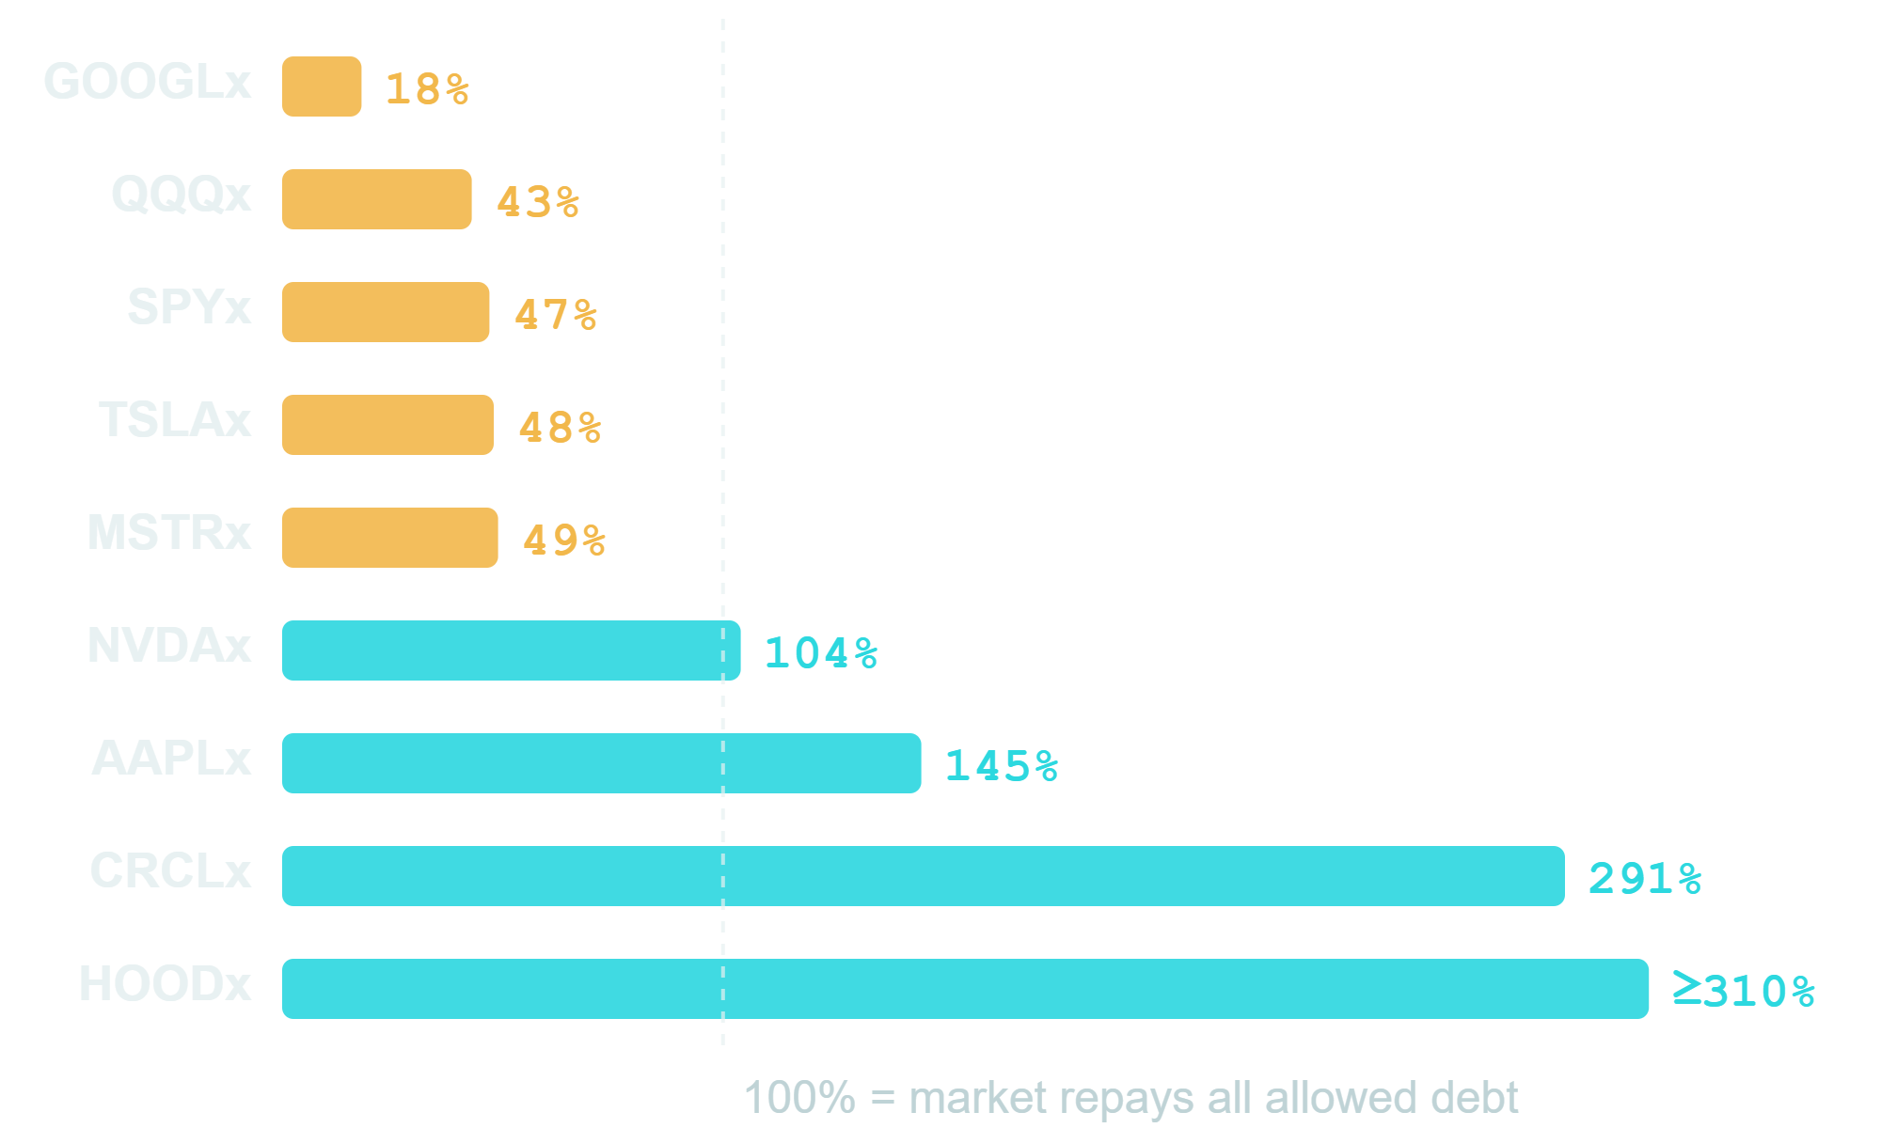
Allowed debt: 4.5× what the chain repays
EXIT BOOK ÷ DEBT ALLOWED ON TODAY'S DEPOSITS
$34.8M
debt Kamino's rules allow against 9 xStocks at full deposit caps
$7.8M
what the on-chain market pays for all of that collateral
Kamino API + Jupiter quotes, 26.09.2026. 5 of 9 assets: the market cannot repay the debt the rules allow. Exit book = total USDC from selling into Jupiter routes at once. HOODx large sizes partly unquoted (lower bound).
Notes:
On real data: Kamino's rules allow thirty-four point eight million dollars of debt against nine tokenized stocks at full deposit caps. Selling all of that collateral on-chain at once returns about seven point eight million. On the right, today's deposits: for GOOGLx the market repays eighteen percent of the debt the rules allow; for five of nine assets, less than half. Measured: Kamino API parameters and Jupiter quotes, 26 September.

Slide 5
Safe today. One asset already is not.
$5.1M
59%
−$197k
borrowed in 1,424 positions. We read all 7,040 accounts of the market.
of that debt needs a drop of more than 30% to be liquidated. Borrowers are careful.
liquidator result if all xStocks fall 30% together. Liquidations stall.
GOOGLx · RISK ALREADY TODAY
$0.91M of debt, but the on-chain book takes ~751 tokens. At −20% liquidators lose money, at −30% bad debt. Same asset as the Edel exploit.
−10%
−20%
−30%
+$2k
−$18k
−$224k
Read on-chain 27.09.2026: getProgramAccounts on KLend, xStocks Market: 7,040 obligations, debt matches the Kamino API at 99.6%. Stress: all xStocks drop together, liquidate to max LTV, 5% bonus, sell into Jupiter quotes of 26.09. xStocks also trade on CEXs; on-chain is the same-block exit, not the only one.
Notes:
How does Kamino look today? We read all seven thousand forty accounts of the xStocks market. Five point one million dollars borrowed in fourteen hundred twenty-four positions. Honestly: today it is safe. Fifty-nine percent of the debt needs a drop of more than thirty percent to be liquidated. But one asset already stands out: GOOGLx. Nine hundred ten thousand of debt, and the on-chain market takes about seven hundred fifty tokens. At minus twenty percent liquidators lose eighteen thousand, at minus thirty two hundred twenty-four thousand. Irony: the same asset Edel lost on in July. That is what we look for: concrete risk in real positions, before it becomes bad debt.

Slide 6
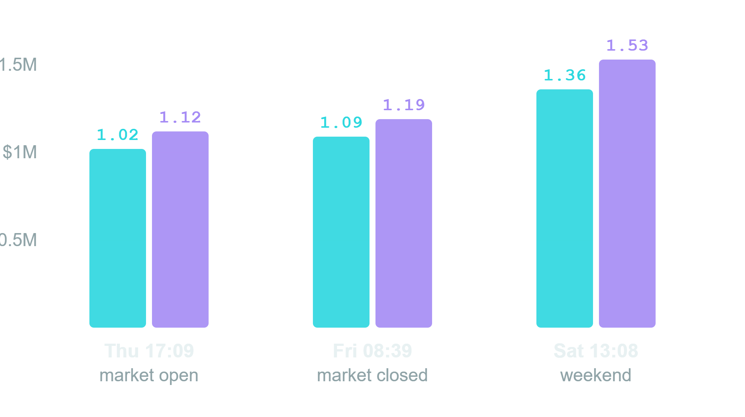
Exit liquidity moves faster than rules
A frozen oracle is not the risk. Missing buyers at liquidation are.
liquidatable at a profit (5% bonus), $M
whole book, $M
+33%
NVDAx exit capacity in 48 h, with no market event
SAME −25% SHOCK · LIQUIDATOR P&L
Thu 17:09
−$22k
Fri 08:39
−$8k
Sat 13:08
+$34k
NVDAx, Jupiter quotes NVDAx→USDC, 19 sizes, 24–26.09.2026; P&L with every position at 55% LTV. Weekend depth was higher, not lower. Kamino parameters did not change once.
Notes:
We measured NVDAx three times: Thursday with the market open, Friday night with it closed, Saturday in the weekend. What a liquidator can sell at a profit went from one point zero two to one point three six million, plus thirty-three percent, with no market event. The same minus twenty-five percent shock: Thursday liquidators lose twenty-two thousand, Saturday they make thirty-four. Kamino's parameters did not move at all. The frozen oracle is not the problem; the missing buyer is. So exit liquidity must be measured continuously, and that is what our oracle does.

Slide 7
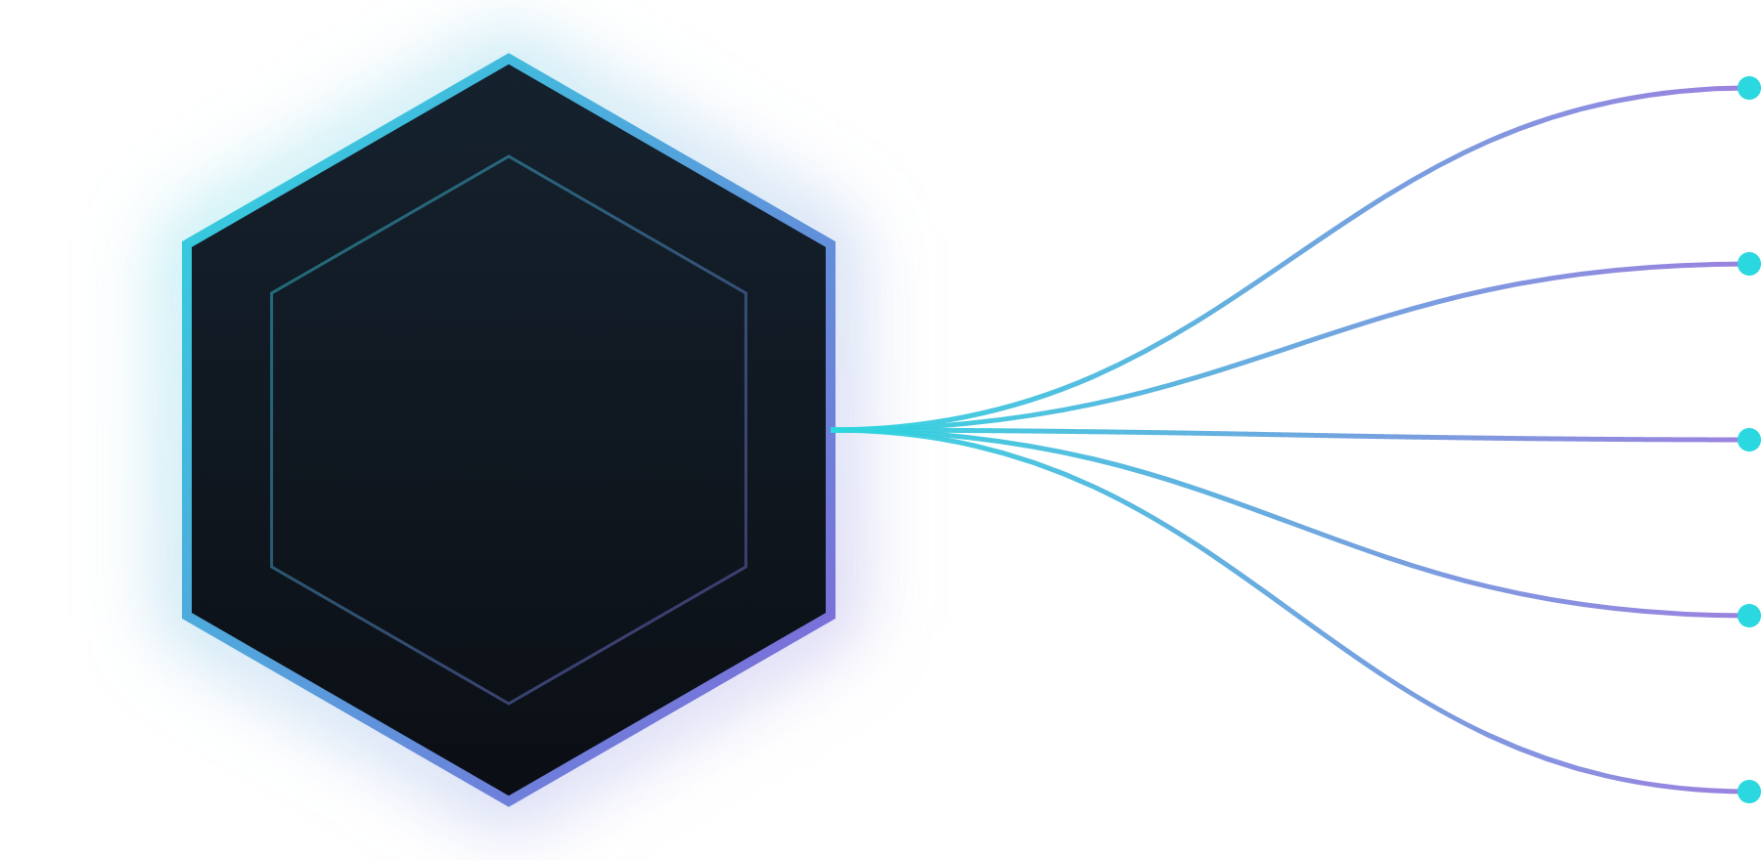

ECV — Executable Collateral Value
One job: tell the venue what is still recoverable USDC under stress.
max_borrow
collateral_cap
ECV
liquidation_route
risk_premium
borrow_disabled
Works today: ECV engine + breaker demo + ECV record published on Solana devnet (Anchor).
Five frozen outputs = the on-chain interface — published on Solana devnet (not mainnet).
Notes:
So we built ECV — Executable Collateral Value. How much USDC can you really recover, right now? Five outputs: max borrow, cap, route, premium, and borrow off.

Slide 8





Watch the breaker
Cut to demo UI (recorded Kamino snapshot, stress sandbox)
01
02
03
Oracle price
ECV under stress
Breaker: WARNING
TSLAx · $100k · stress sandbox: ECV $84,358 · safe max borrow $58,684 vs Kamino LTV $55,000 · WARNING: USDC reserve utilization at the 90% rate kink
Notes:
Let me show you. Watch the breaker. This is our Kamino risk dashboard. Recorded Kamino market data, Jupiter quotes measured at four-seventeen, stress sandbox — not a live signal. Tesla xStock, one hundred thousand dollars, weekend. Oracle price: about three hundred seventy-two dollars. ECV: about eighty-four thousand of that hundred thousand — a haircut of about sixteen percent, mostly our weekend buffer — a policy choice. Safe max borrow: about fifty-nine thousand, next to Kamino's LTV limit of fifty-five thousand. Status: WARNING, because USDC utilization is at the ninety-percent rate kink.

Slide 9
Same book. Two models. Synthetic in-sample.
SYNTHETIC IN-SAMPLE — not historical validation · not mainnet
~$3.98M
$0
Fixed 70% LTV · bad debt in synthetic tail stress
ECV · bad debt (synthetic, in-sample) + 369 refusals
In the tail scenario ECV refuses all 369 new loans — that is how bad debt stays at $0.
Trade-off: calm base ≈ 100% of fixed-LTV credit · all six synthetic scenarios ≈ 27%
Notes:
First, the label: synthetic, in-sample. Based on historical mainnet. A fixed seventy percent LTV could potentially leave about three point nine eight million dollars of bad debt. ECV: zero bad debt. How? In the tail scenario it refuses all sixty-seven new loans. In the calm base scenario it lends about the same as fixed LTV.

Slide 10
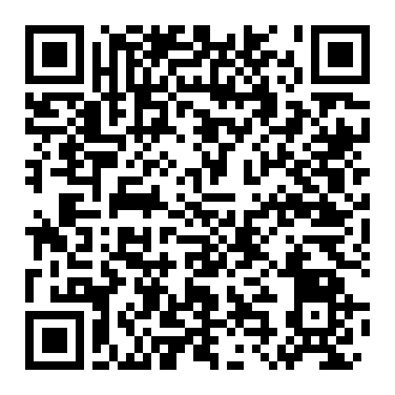
ECV published on Solana devnet
Anchor program ecv_oracle · deployed 26.09
PROGRAM ID · DEVNET
5nsdYo…Euc
Solana Explorer · cluster = devnet · scan the QR →
PUBLISHES THE FIVE ECV OUTPUTS
max_borrow
collateral_cap
liquidation_route
risk_premium
borrow_disabled
NEXT → verifiable inputs · multi-signer posting · vault + borrow gate
Scan → Solana Explorer (devnet)
Rust poster can re-post the ECV record on a schedule (--every-sec) · last devnet post: 26.09.2026, 19:55 (Warsaw)
Today: single-authority signer on devnet. Publishes ECV quotes; integrators enforce. Not mainnet.
Notes:
Since our last pitch, ECV went on-chain: our Anchor program, published on Solana devnet yesterday. Scan the QR.

Slide 11





Built where the collateral already trades
xStocks venues — where the collateral already trades
Jupiter routes = the liquidation path ECV quotes
(demo: Jupiter quote ladder measured 16:17 + Kamino snapshot 13:50, stress sandbox)
Composable ECV risk quotes for those venues
Notes:
Why Solana? Because the collateral already lives here. xStocks are native on Solana, and Jupiter routes are the real liquidation path. And publishing is cheap: the base fee is 5,000 lamports per signature, a fraction of a cent, so the ECV record can be refreshed often.

Slide 12
Protocols pay millions for risk management
Chaos Labs
Gauntlet
RWA Shield
RISK MANAGER · RISK ORACLES
VAULT CURATOR
OUR NICHE
Ran Aave risk for 3 years, TVL $5.2B → $26B.
Risk Oracles adjust LTVs and liquidation thresholds.
Building RWA risk for Aave Horizon, incl. closed markets.
Left Aave 04.2026: offered $5M/yr, wanted ≥ $8M.
$125M Series C from SBI Holdings (07.2026).
Curates ~$1.6B in vaults.
Clients: Coinbase, Circle, Apollo.
On Solana: only ~$7.6M in vaults.
Tokenized stocks on Solana: nobody measures exit liquidity per position.
Liquidity data + position risk map for Kamino curators.
Already: 9 xStocks, 7,040 accounts.
Big players can come. We win on focus and speed.
Per Chaos Labs, the industry standard is 6–10% of protocol revenue spent on risk. Sources: Blockonomi, CoinDesk (Aave, 04.2026); Fortune (Gauntlet, 09.07.2026); DefiLlama (27.09.2026); Chaos Labs.
Notes:
Does anyone pay for this? Yes, a lot. Chaos Labs ran Aave's risk for three years while deposits grew from five to twenty-six billion. Their Risk Oracles move LTVs and thresholds automatically, and they build RWA risk for Aave Horizon. In April they left Aave because five million a year was too little; they wanted at least eight. Gauntlet raised a hundred twenty-five million from SBI in July and curates about one point six billion for Coinbase, Circle and Apollo. On Solana, only about seven and a half million. The gap: tokenized stocks on Solana, where nobody measures exit liquidity position by position. That is where we go in. If asked what happens when they come: they can. Our edge is focus and time, and realistically we can also become a data supplier to them.

Slide 13



Monetization — hypothesis, not ARR
Risk API / SDK
Share of risk premium
Optional vault fees
ECV quotes & breakers for lending venues
If we operate a reference vault
When ECV sits in the borrow path
Skip if short on time.
Notes:
How do we make money? First, a risk API and SDK: lending venues pay for ECV quotes and breakers. Second, we may build our own money market.

Slide 14


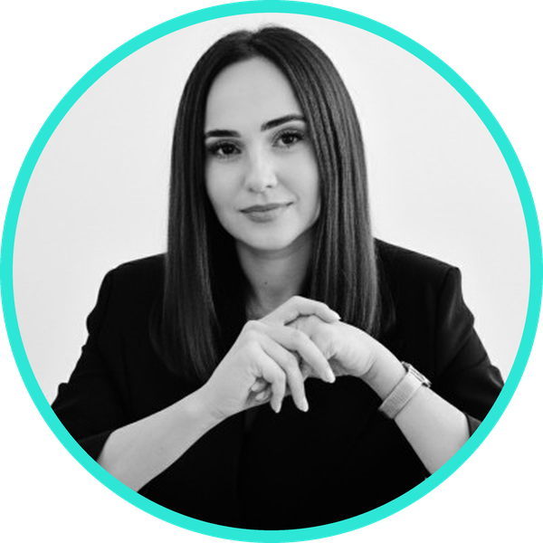


Team
Hiring: Rust/Anchor · frontend
AK
Dorian Żaczek
Julita Szaruta
Mieszko Manijak
Adam Książkiewicz
CEO, Founder & Product Manager
Legal, Tax & Regulatory · MiCA
CTO & DeFi Architect Engineer
Anchor program + Rust poster
investiatech · Rust · devnet deployment · quant markets
Advisor · Adam Kwak — staff-level COBOL / mainframe, 20 yrs core financial infrastructure (Scandinavia)
Notes:
The team. Mieszko Manijak, our DeFi expert, built the Anchor program and the Rust poster. Julita Szaruta leads legal and regulatory, with experience in Web3. Adam Książkiewicz did the devnet deployment. And as an advisor we have Adam Kwak: staff-level COBOL/mainframe, 20 years of core financial infrastructure experience.

Slide 15

Recoverable collateral quotes — not a price print.
github.com/Dorianos85/rwa-shield/tree/main/onchain
Notes:
Next fourteen days: we fix the xStocks mint mapping on-chain, then a vault and a borrow gate that reads the ECV record. From you: intros to lending venues that hold xStocks, and Rust and frontend engineers. Oracle price is not cash. Thank you.

