Slide 1

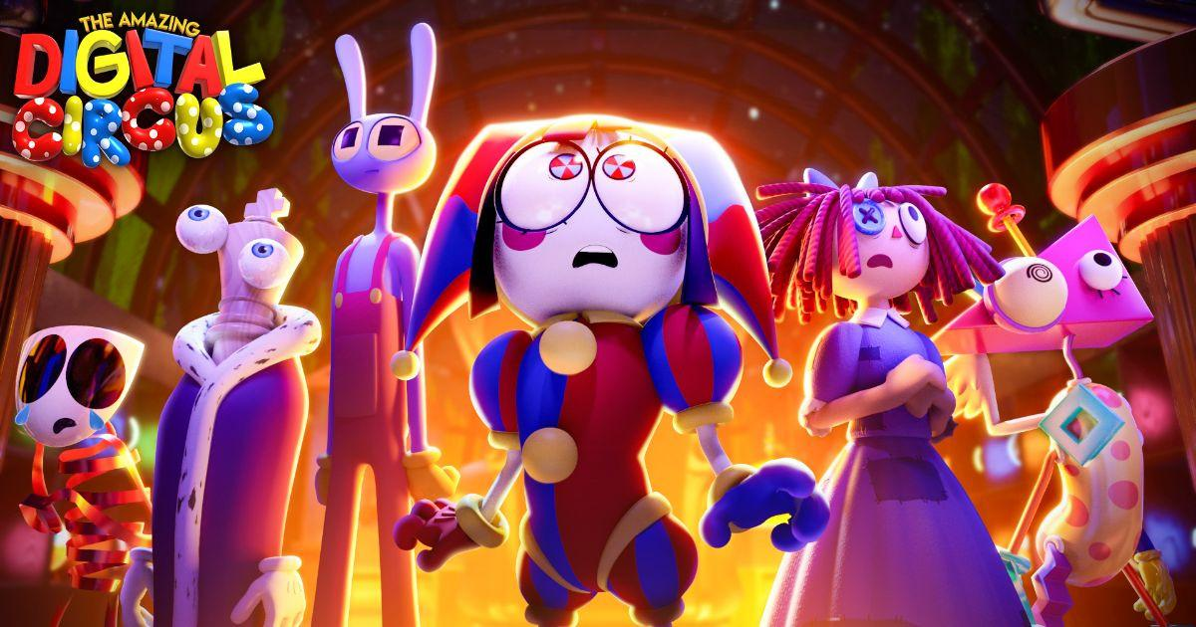

Slide 2


The Amazing Digital Circus
What the show is about
Characters
Ties with the game (Key Points)

Slide 3
The Amazing Digital Circus: what it’s about
Genre: Dark comedy meets psychological drama. Bright, chaotic circus visuals paired with real themes of trauma, identity, and isolation
Premise: Trapped in a virtual circus that never lets you leave
A woman named Pomni wakes up inside a strange virtual circus — and quickly realizes she cannot log out
She joins five other humans, each now trapped in a cartoonish digital body, all stuck in the same place for reasons none of them fully understand.
An AI ringmaster named Caine runs the circus, constantly inventing chaotic games and “adventures” to keep everyone occupied — whether they want to play or not.
Underneath the bright colors, the show is really about how each character copes (or doesn’t) with being stuck somewhere they can't escape.

Slide 4
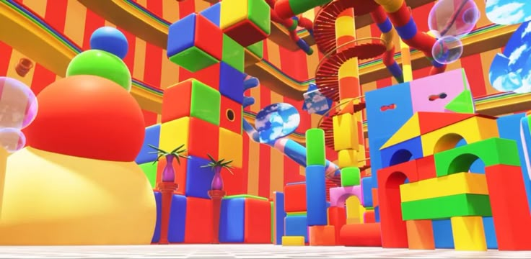
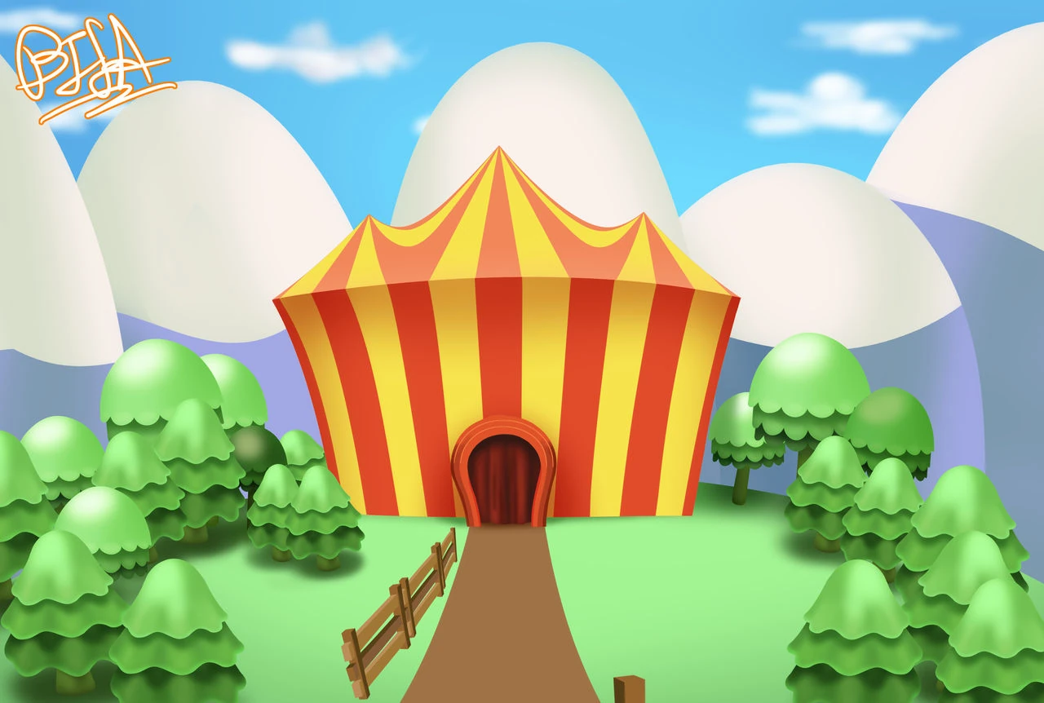
Setting

Slide 5
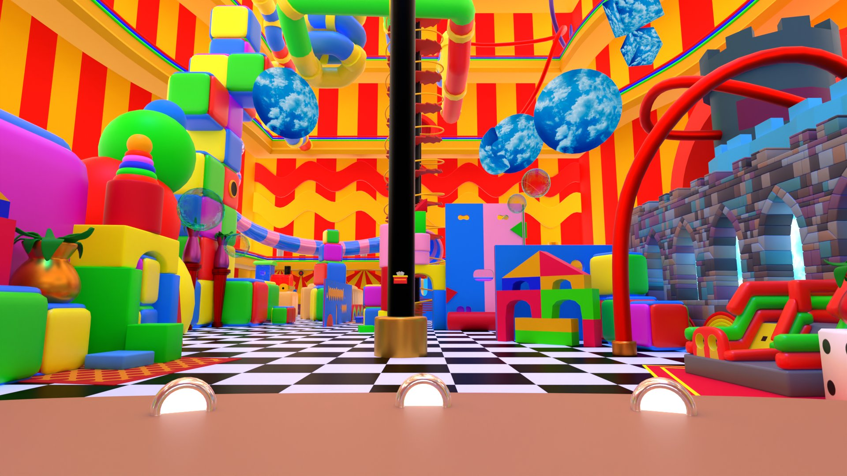
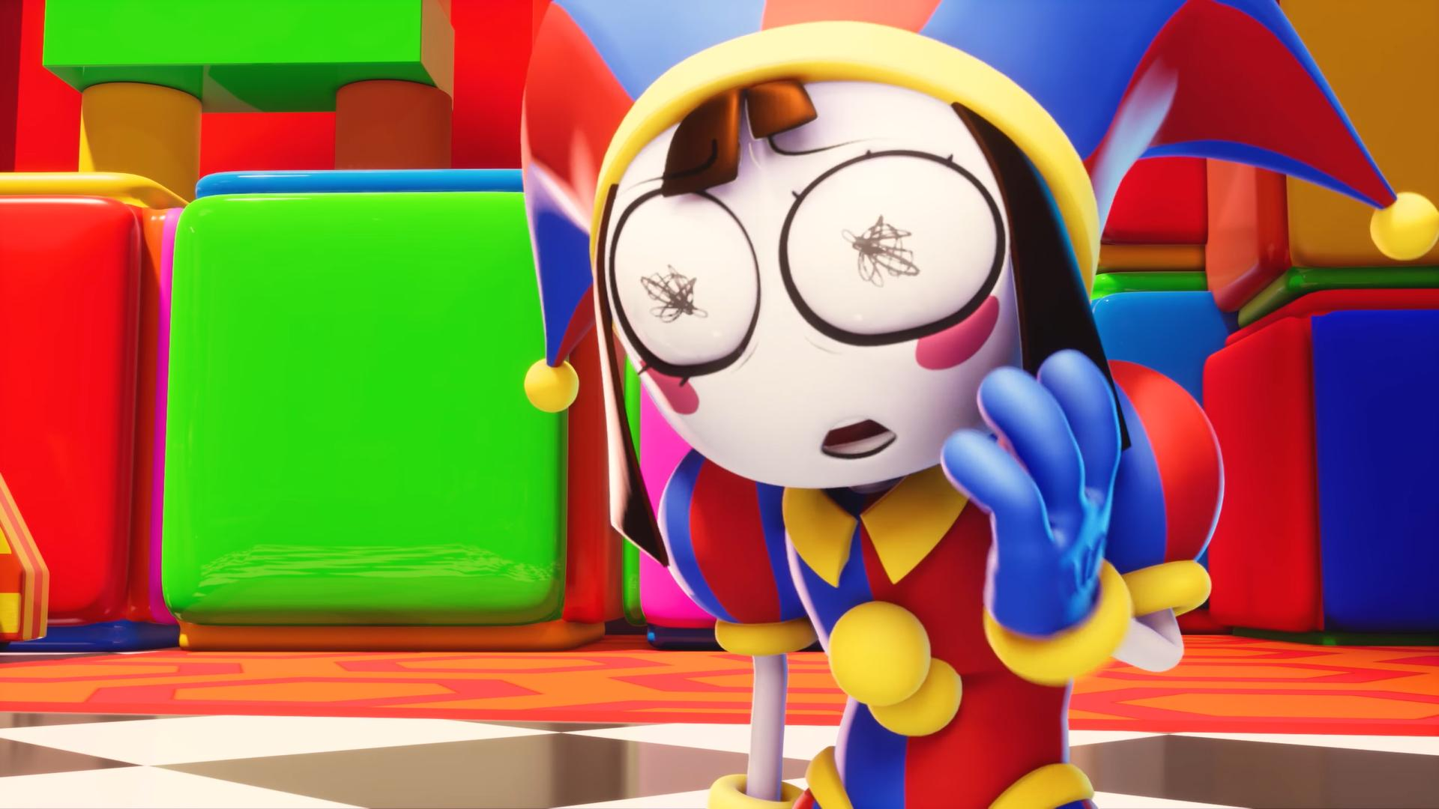

Slide 6
Characters

Slide 7
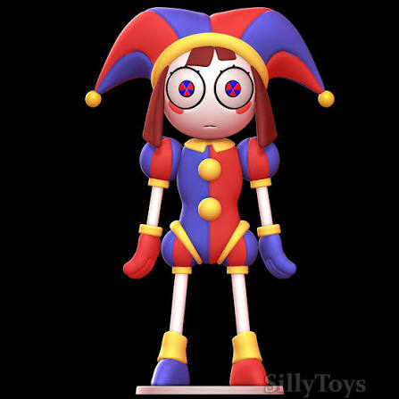
Pomni
The newcomer
The last human to arrive. Anxious and overwhelmed, she becomes our way into the circus's rules and dangers.
She was an ordinary human until a digital copy of her was created by a brain scanner, where her copy takes on the form of a cartoon jester.
Her human counterpart, Abigail Brooks, is a supermarket accountant and a YouTuber who explores urban sites with her newest friends.

Slide 8
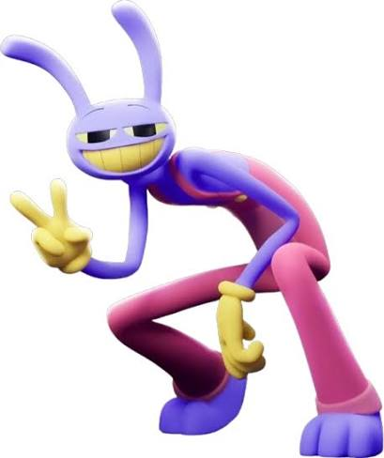
Jax
The (other) main character
The Troublemaker
A rabbit-like character who thrives on chaos and dark humor, and openly enjoys messing with the others.
He’s a lanky periwinkle rabbit with antagonistic tendencies who is a digital copy in the Digital Circus along with five other copies.
n the real world, his human counterpart, Leeroy Mateo or Lee, is a young adult with family issues who ran away from home after pushing his mother. After months of being homeless, he moved in with a close friend and began turning his life around. He now works as a delivery driver.

Slide 9
Caine
Aka: Creative Artificial Intelligence Networking Entity
Caine is the circus's AI ringmaster: cheerful, unpredictable, and completely in control of the world everyone is trapped in.
He invents the games and challenges each episode — candy-kingdom heists, haunted mansions, trust exercises — whether the humans want to play or not.
He's not malicious so much as oblivious: he genuinely thinks he's giving everyone a fun place to be, which makes the situation feel even stranger.

Slide 10
Ribbit
A tall, lanky green frog character, close friends with Jax and Kaufmo before her abstraction.
She was warm, patient, and genuinely tried to reach Jax when he pushed people away, but the group's growing fear that she'd expose Jax's secrets slowly isolated her — and that isolation is what eventually broke her.
The subject of level 1
Objective: help her calm down from the conflict between her and Jax- dialogue options to meet threshold that determines the ending of the game

Slide 11
Kaufmo
A noseless clown who performed in the circus before Pomni's arrival, remembered as the group's jokester (sometimes to an annoying degree — his humor wasn't landing with everyone).
He became fixated on finding a way out of the circus, and that obsession eventually consumed him too, driving him to abstract into a monster that had to be locked away.
The subject of level 2
Objective: Find required objects to keep Kaufmo sane -to meet the threshold for good ending

Slide 12
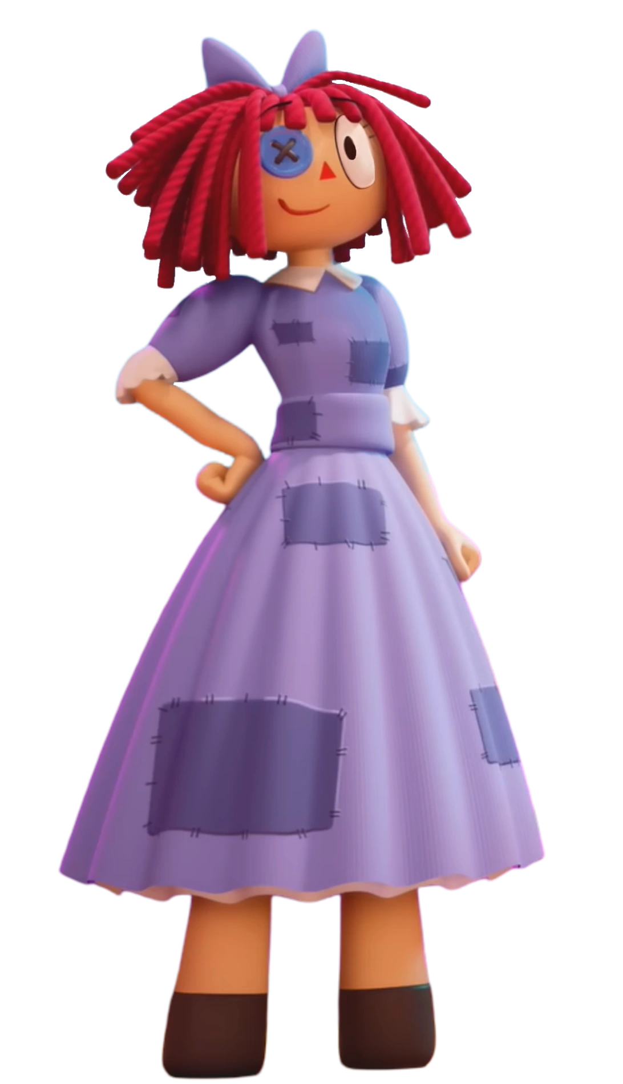
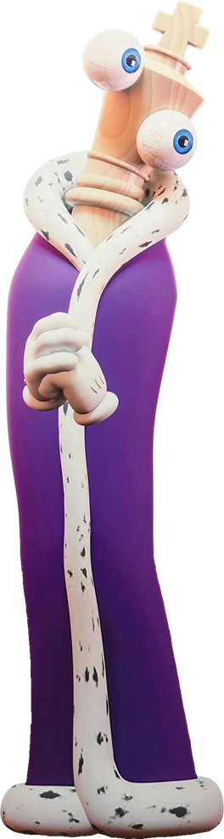
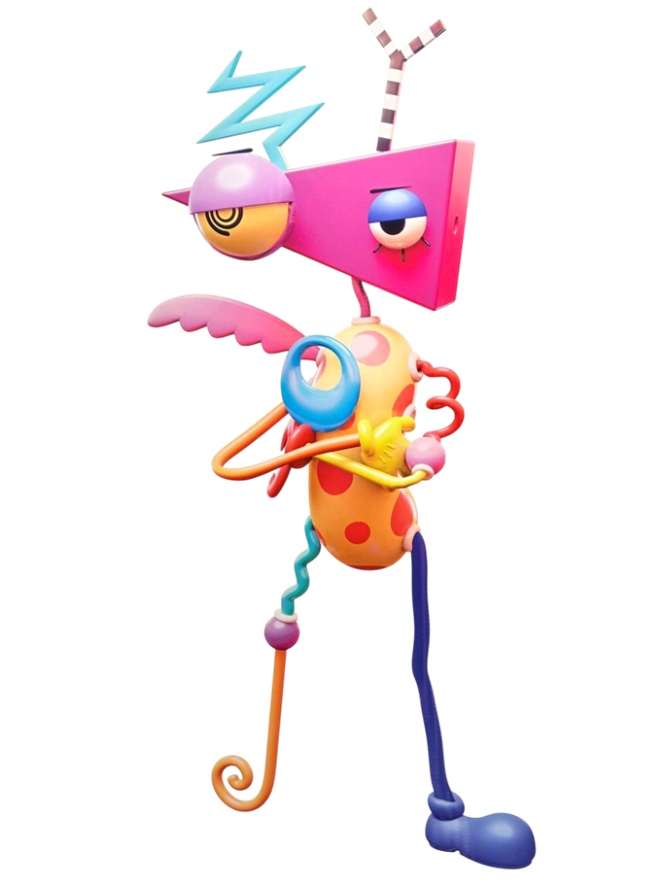
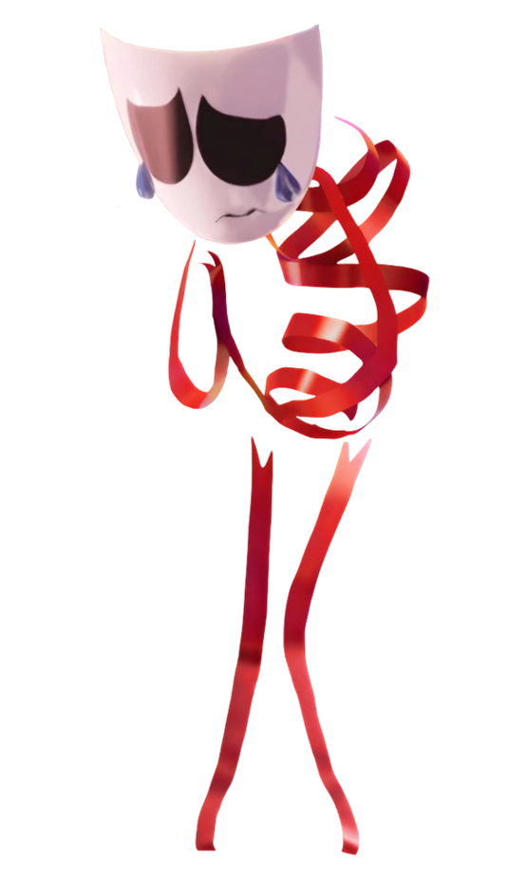
Ragatha
The Caretaker
A patchwork ragdoll who tries to hold the group together and keep morale up — often at her own expense.
Kinger
Co-creator of the circus
A long-term resident whose instability hides important knowledge about the Circus
Kinger is erratic and paranoid, derived from his time in the circus.
Gangle
The Performer
A mask-faced character who swings between an upbeat public persona and real sadness underneath
Zooble
The Mismatched One
Blunt, frustrated and resistant to Caine's forced positivity.

Slide 13
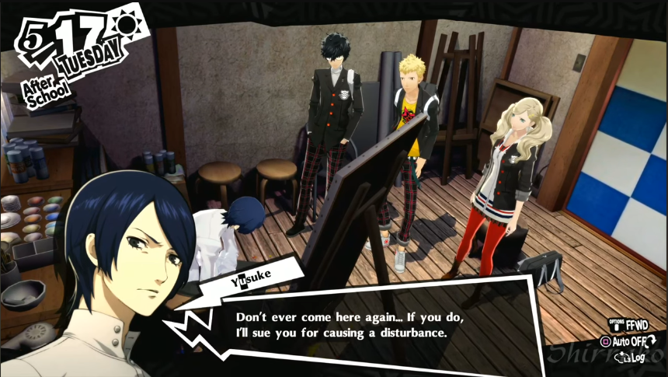
Ties with the game
Inspiration for camera angles and dialogues

Slide 14
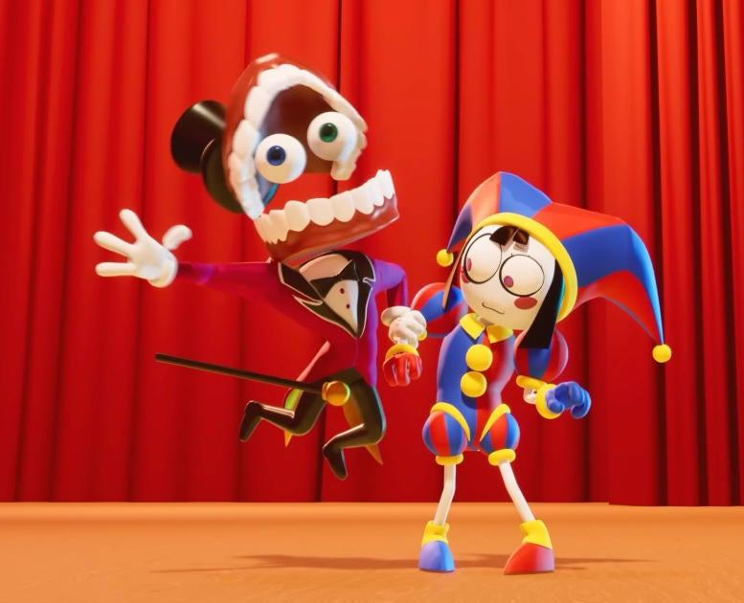
Exposition
Caine approaches Pomni
Explains dilemma and him noticing the thick atmosphere in the circus
Shares his concerns for Jax, since he’s noticed how Jax is isolating, etc (asks you to check up on Ribbit since he saw them having a fight, while he tries to find him)
Mentions the reasoning of helping them out (abstraction)

Slide 15
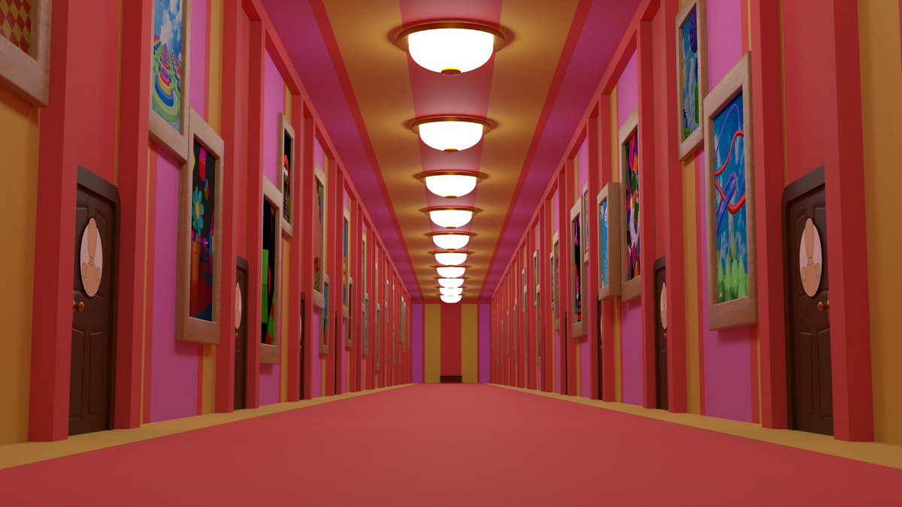
Start of the game

Slide 16
Ribbit’s room
Level 1

Slide 17
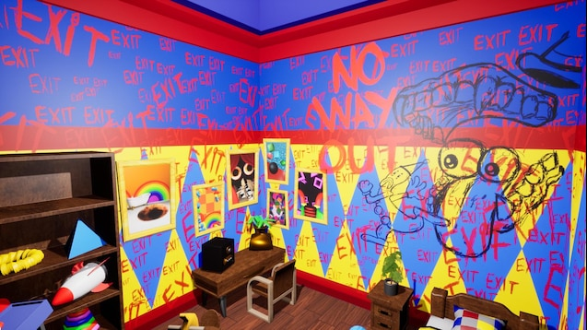
Kaufmo’s room
Level 2

Slide 18
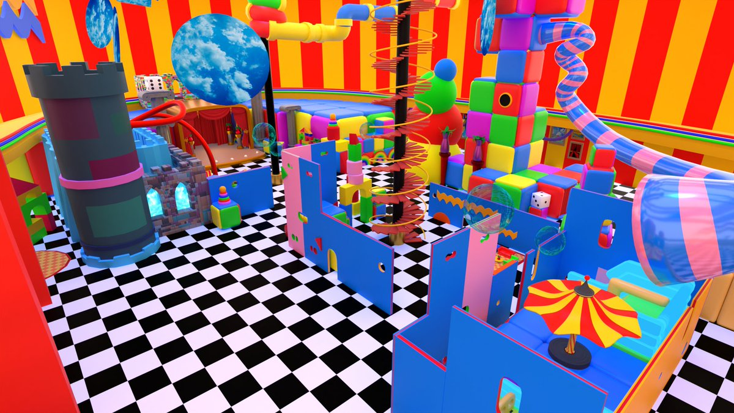
Maze to find Jax then the exit
Level 3

