Slide 1
Checkpoint report
Humicroedit – detecting humor in short headline edits

Slide 2
The dataset
Low quality dataset
High-quality Turkers, but you can't force out humor
Consensus on ratings of 0, sometimes 1
Most annotators probably found the vast majority of headlines unfunny, but felt like they had to rate at least some edits as funny
Very low humor signal?

Slide 3
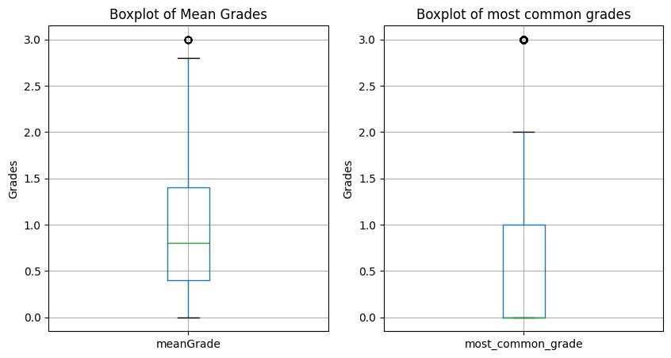

Slide 4
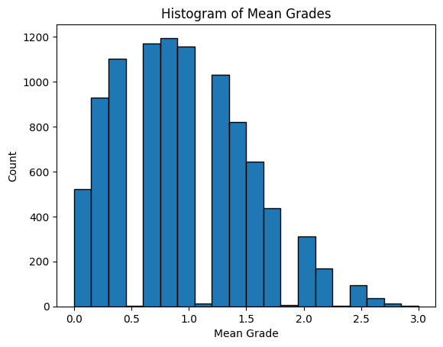

Slide 5
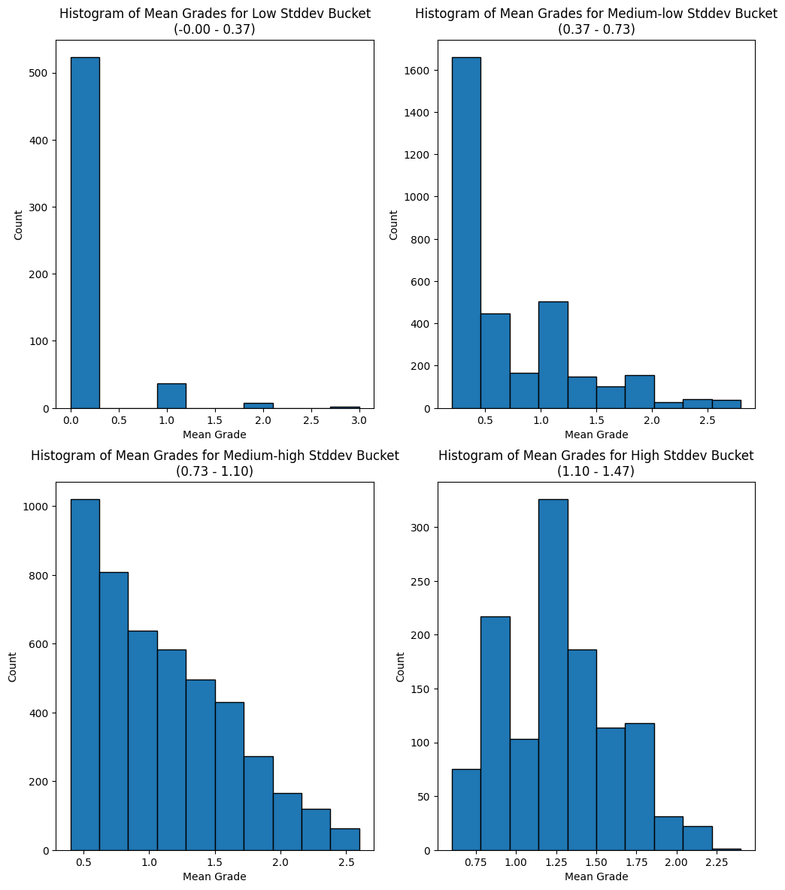

Slide 6
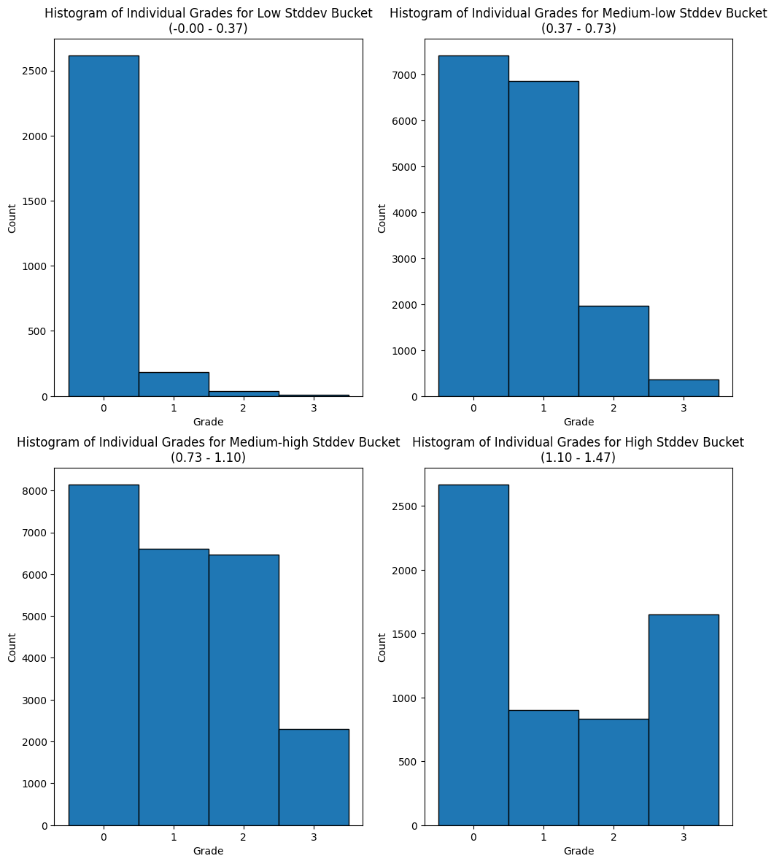

Slide 7
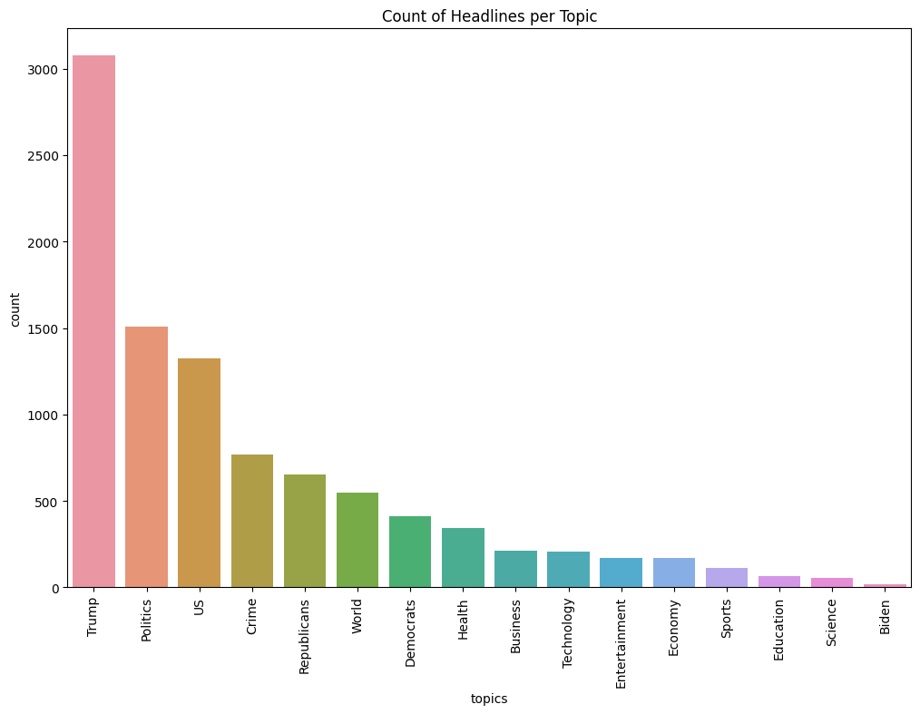

Slide 8
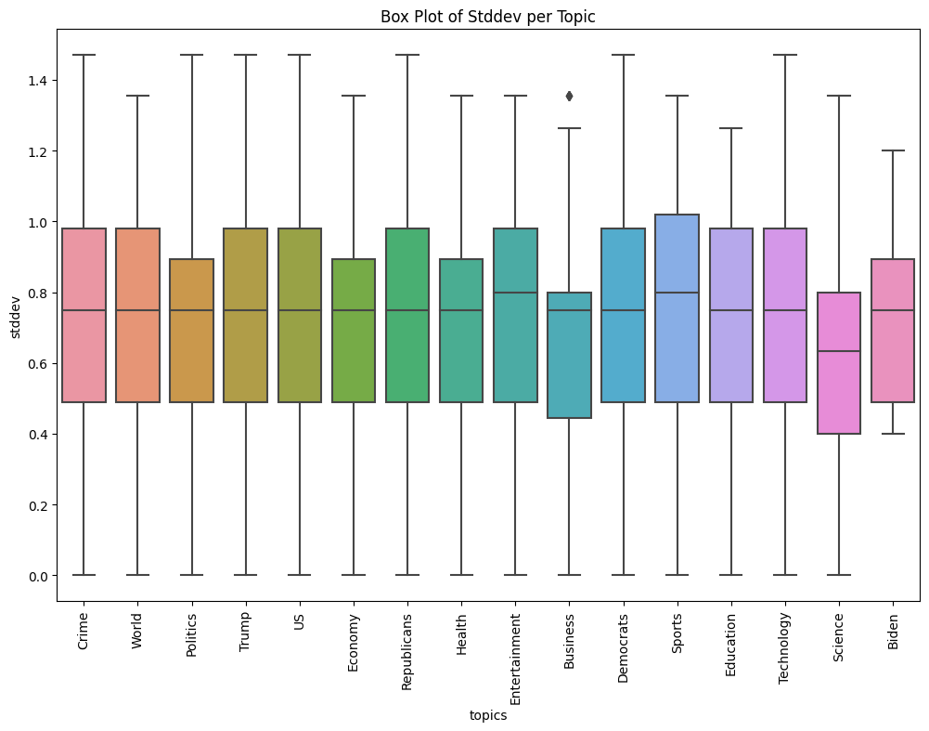

Slide 9
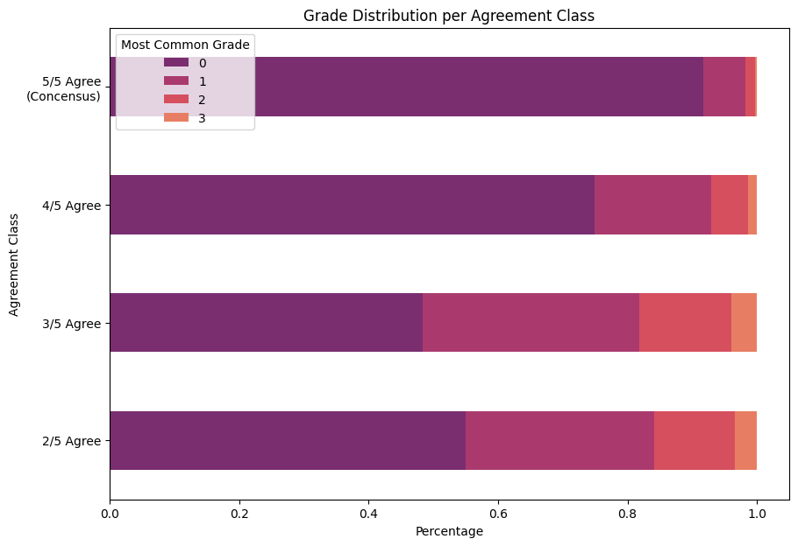

Slide 10
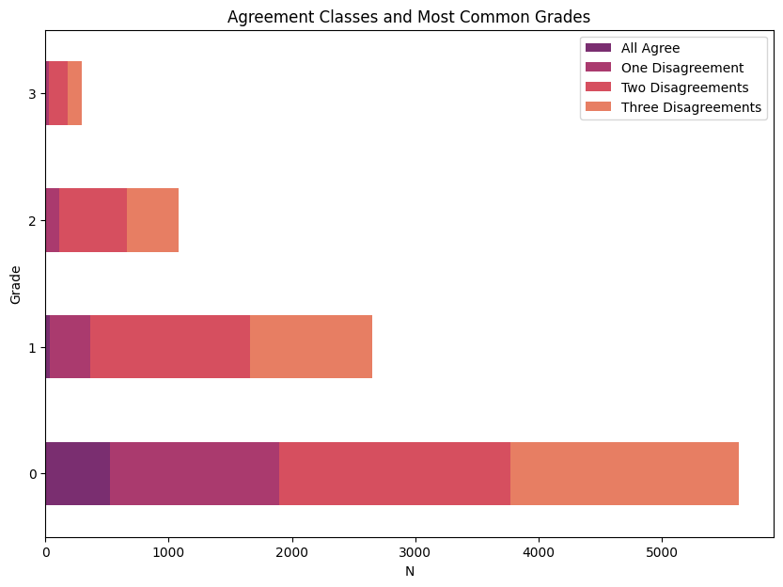

Slide 11
Previous approaches
SemEval 2020
Mostly Transformer models + classification head
Treated as a regression problem
RMSE of 0.5 – seemingly good, but…
Looks like extreme case of "overfitting" to 0-1 grade

Slide 12
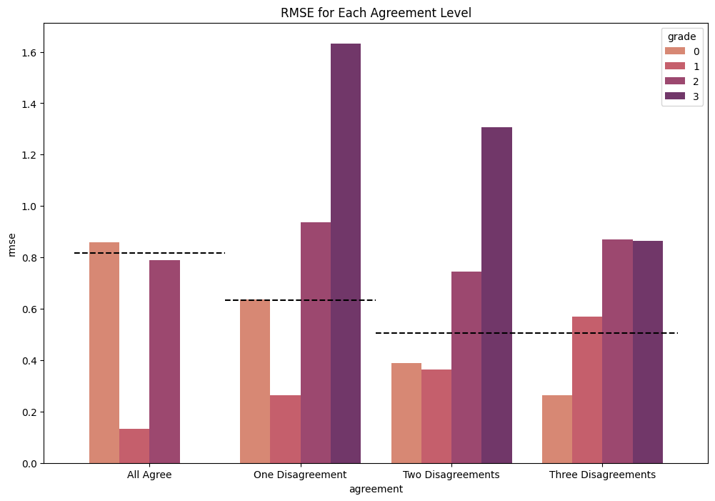

Slide 13
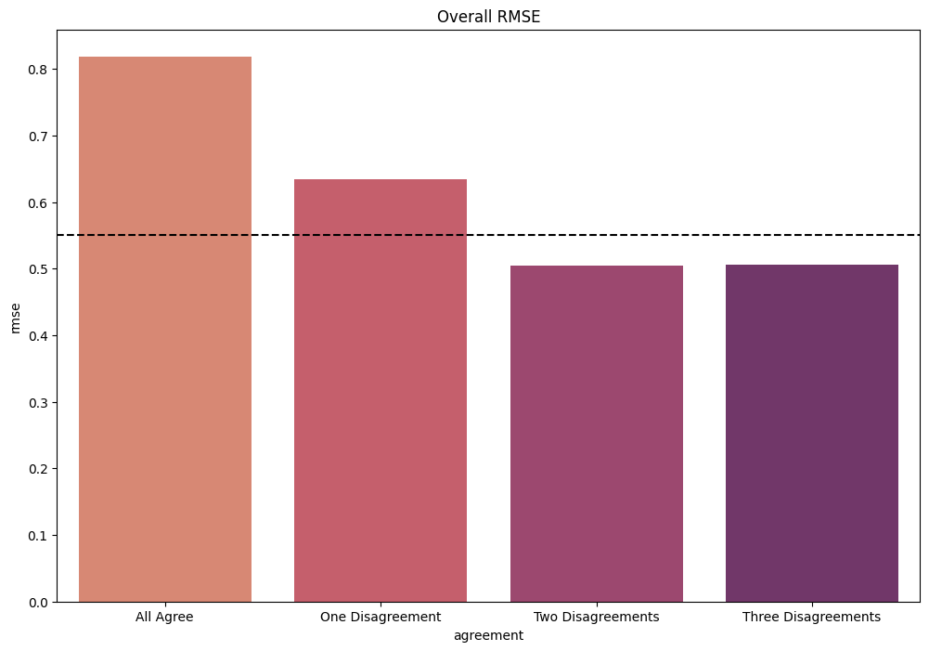

Slide 14
Previous approaches
Attempted to improve over previous art (RMSE), unsuccessfully
Tried:
Different embeddings, classification heads
Beta regression
Masked LM (even tried learning embeddings from scratch)
Cross-Encoders
Modified Generative Pseudo-Labeling (cool idea, no improvement at all)
Modeling annotators in different ways
Doesn't work, there is too little data, and the annotators seemingly answer at random

Slide 15
Ideas
Model the most common grade (mode) instead?
We rarely care for high variance in answers – 00033 situation is rare
It makes sense to at least accurately guess the consensus-zeros
This works OK!
P = 0.8, R = 0.8, F1 = 0.8
Could we train the model just on this "refined" data?

Slide 16
Idea: filtering out low-quality samples
Train a filtering model, that decides whether a sample should be trained on
Train the same regression model as before, only on filtered data
This removes over 70% of training data!
Train the baseline regression model on all data
Compare RMSE on both refined and whole test set

Slide 17
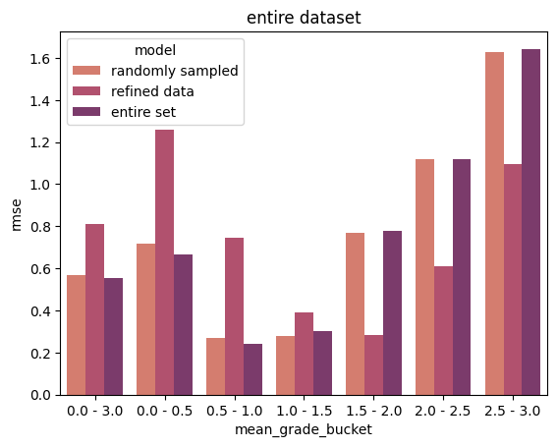

Slide 18
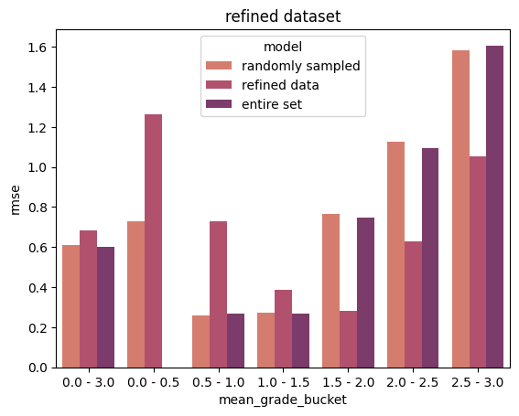

Slide 19
Questions
How to compile all of this into an interesting project?
Do we focus on the bad quality of the dataset?
Show how filtering out worthless samples improves performance
Do we focus on evaluating different metrics & criticizing RMSE?
This seems harder to write
Line of thought would lead to trying to classify just "funny" and "unfunny", which is similar to the filtering classifier from point above
How to present this in an interesting way?

