Slide 1
Health Information System
A Web-Based Application for Managing Health Programs and Client Information
by Dorine Ouma
Date: April 26th, 2025

Slide 2
Table of Content
Problem Statement
Solution Overview
Key Features
System Architecture
Technologies
API Endpoints
Screenshots
Challenges

Slide 3
Problem Statement
Managing health programs manually is time-consuming and error-prone.
Healthcare providers need efficient tools to manage clients and health programs.
Integration with external systems is important for future scalability.

Slide 4
Solution Overview
A web application to manage health programs and clients.
Enables doctors to:
Create and manage programs.
Register and enroll clients.
Search and view client profiles.
Exposes APIs for integration with external systems.

Slide 5
Key Features
Create Health Programs: Add new health programs with a name and description.
Register Clients: Register clients with details such as name, age, gender, and contact information.
Enroll Clients in Programs: Enroll clients in one or more health programs.
Search Clients: Search for clients by name or contact information.
View Client Profiles: View detailed client profiles, including their enrolled programs.
API Integration: Expose client profiles and other functionalities via RESTful APIs.

Slide 6
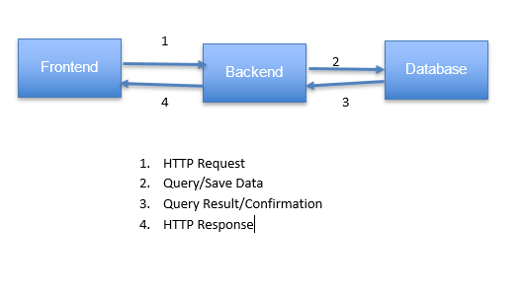
System Architecture

Slide 7
Technologies
Backend: Django, Django REST Framework
Frontend: HTML, CSS, JavaScript, Bootstrap
Database: SQLite
Other Tools:
django-crispy-forms for enhanced forms

Slide 8
API Endpoints
Examples:
Create Health Program: /api/create-program/ (POST)
Register Client: /api/register-client/ (POST)
Enroll Client: /api/enroll-client/ (POST)
Search Clients: /api/search-clients/ (GET)
View Client Profile: /api/client/<client_id>/ (GET)

Slide 9
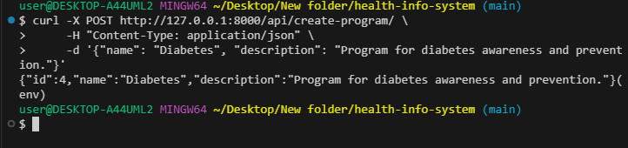
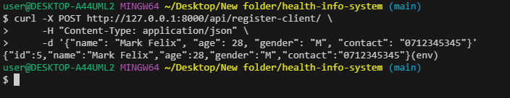
Screenshots

Slide 10
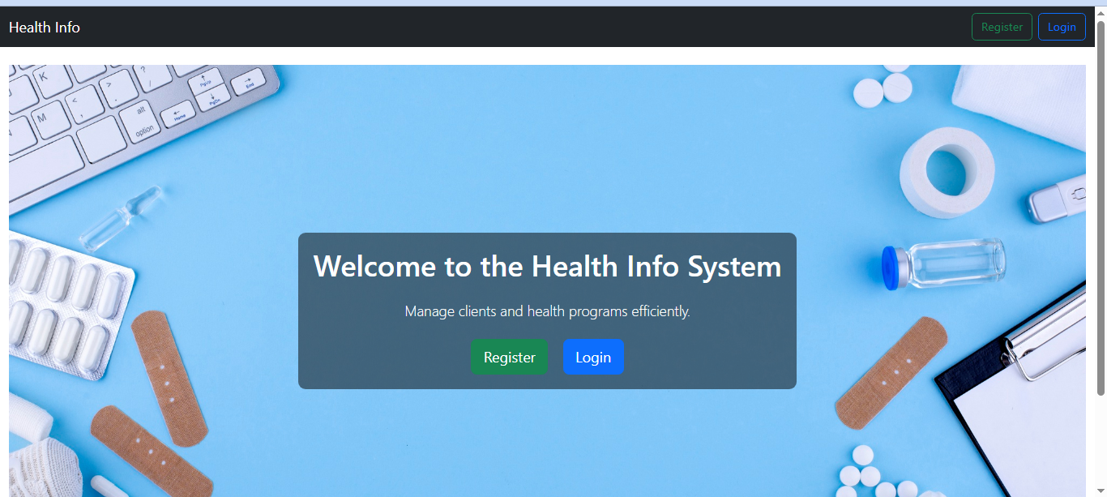
Screenshots

Slide 11
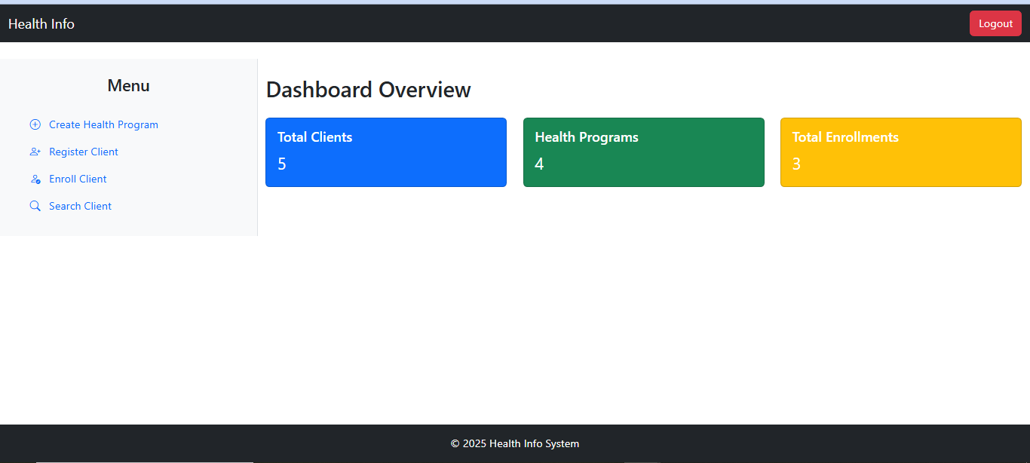
Dashboard

Slide 12
Challenges Faced During Development
Testing API Endpoints Without External Tools
Description: Testing RESTful APIs without using tools like Postman was a challenge, especially for verifying complex functionality like client enrollment and profile retrieval.
Solution: Used Django REST Framework’s APITestCase to write automated test cases for all API endpoints. This ensured that the APIs were thoroughly tested and worked as expected.
Outcome: Successfully validated all API functionality, including edge cases, and ensured the system's reliability.

