Slide 1
DP-CGAN: Differentially Private Synthetic Data and Label Generation
Reihaneh Torkzadehmahani(rtorkzad@ucsc.edu)
Joint work with Peter Kairouz(Google AI) and Benedict Paten(UCSC)

Slide 2

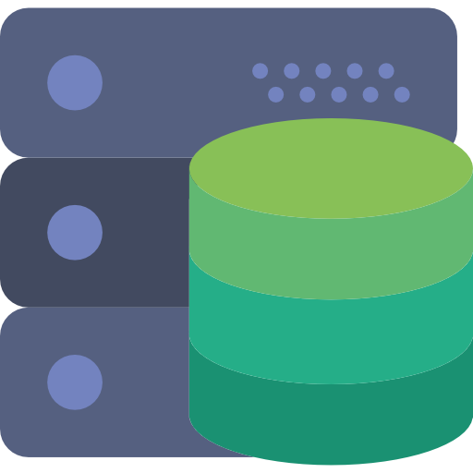


Introduction
Vulnerability of ML models to attacks
Adversary
Training Data
ML Algorithm
ML Model
Great performance of Generative Adversarial Networks(GANs) in various applications

Slide 3



Introduction
Vulnerability of ML models to attacks
Adversary
Training Data
ML Algorithm
ML Model
Great performance of Generative Adversarial Networks(GANs) in various applications
Using GANs to generate synthetic sensitive data
Notes:
Using GANs to generate synthetic sensitive data for the cases we cannot access real sensitive data

Slide 4



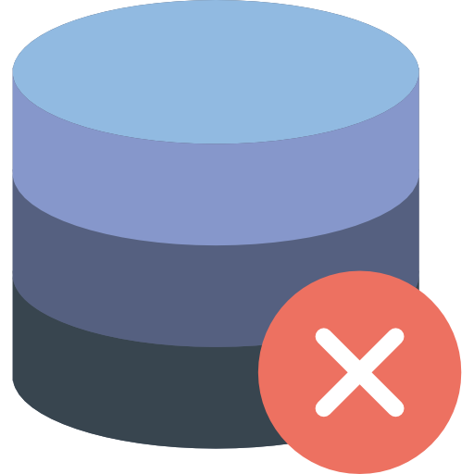
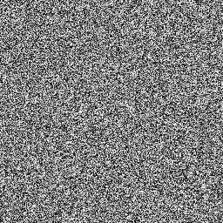
Background
Generative Adversarial Networks(GANs)
Learn the training data distribution and generate synthetic data
Components:
Discriminator
Generator
Real
Real Data
Fake
Discriminator
Random Noise
Generator
Fake Data
Notes:
Discriminator : Tries to distinguish between training(real) data and synthetic(fake) data
Generator: fools the discriminator by generating real-looking data

Slide 5

Background(cnt’d)
Conditional GANs
Real
Real Data
Class Label
Fake
Discriminator
Random Noise
Generator
Fake Data
Objective Function:
M. Mirza and S. Osindero. Conditional generative adversarial nets. arXiv preprint arXiv:1411.1784, 2014
Notes:
Generator and discriminator are conditioned on some side information, “y” (e.g. class label)
“y” can be any kind of extra information like class labels or data from other modalities
In generator, the input random noise and “y” are concatenated
In discriminator, the discriminative function gets “x” and “y” as input.
???there are other way to train GANs/cGANs --> using other distance metrics and regularization tricks???

Slide 6

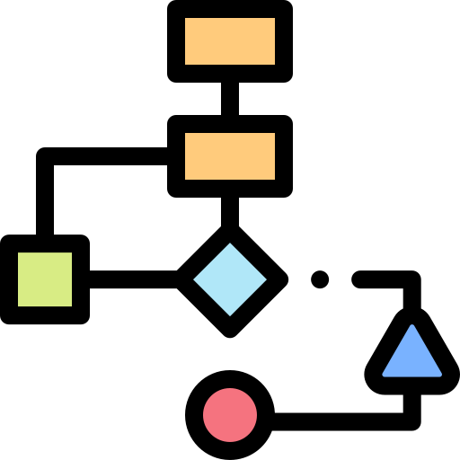


Background(cnt’d)
Differential Privacy
?
Dataset d
Mechanism M
Output
Adversary
?
Dataset d’
Mechanism M
Output
A randomized mechanism M with domain D and range R satisfies (𝜺,𝞭)-differential privacy if for all pairs of adjacent datasets (d , d’) and for any subset S of output:
Notes:
at a high level, differential privacy ensures that the models we are training do not overfit to the data of a particular user.. in particular, the model trained on a dataset with a specific individual should statistically look like the model that is trained on a dataset without that individual.. and the expression i have on this slide tells you how we measure statistical similarity between the two models (with/without a specific user)

Slide 7
Related Work
Privacy-preserving Deep Learning[Shokri et al., 2015]
High privacy loss
PATE[Papernot et al., 2016]
Assumes the model has access to public data which may not be the case in practice
DP-GAN[Xie et al., 2018]
Results do not look promising even on MNIST
No methodology to create labels with synthetic images
PATE-GAN[Yoon et al., 2018]
Assigns just binary labels to synthetic images
Notes:
there is a long and rich literature on differnetially private training of machine learning models... and more recently, there have been some attempts to apply some of these techniques to the training of GANs...

Slide 8
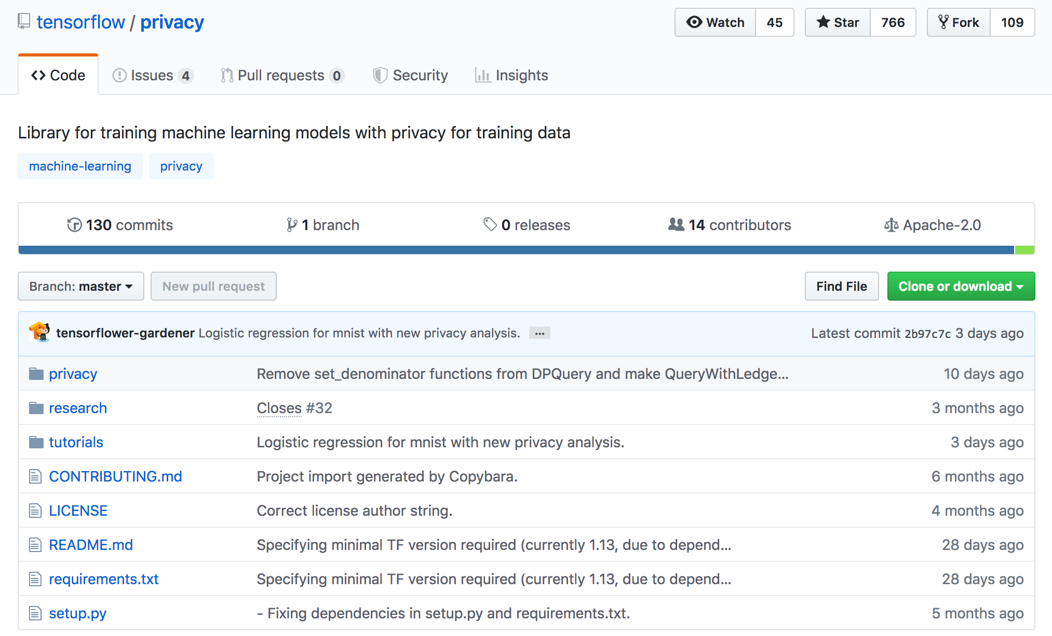
TensorFlow Privacy
https://github.com/tensorflow/privacy/
Notes:
Google has recently open source a TensorFlow library that allows machine learning experts to train ML models with differential privacy
Google TF package enforces DP by tracking what's known as the total privacy budget (i.e., the overall values of epsilon and delta as the training proceeds in rounds) using a technique called Renyi DP accountant

Slide 9
CGAN Architecture
Generator
Discriminator
100
784
z
Fully Connected
Fully Connected
G(x|y)
x
Fully Connected
Fully Connected
D(x|y)
ReLU
ReLU
y
y
10
10
Notes:
for the sake of simplicity, you are only going to focus on small models in this talk -- as a proof of concept.. but everything you say and present applies equally to larger models.

Slide 10
DP-CGAN
Updating the Differentially Private Discriminator Network
Updating the Renyi Differential Privacy(RDP) accountant
DP-CGAN
Update the Generator Network
Notes:
we use the Renyi DP accountant which I talked about a few slides back

Slide 11
DP-CGAN
Updating the Differentially Private Discriminator Network
DP-CGAN
Compute per-example gradients of discriminator loss on real data and clip them
Compute per-example gradients of discriminator loss on fake data and clip them
Compute the overall gradients of discriminator and add Gaussian Noise to them
Take the gradient Descent step for discriminator
Notes:
Split the discriminator loss to the loss on real data and fake data so that we can clip them separately

Slide 12
DP-CGAN
Updating the Renyi Differential Privacy(RDP) accountant
DP-CGAN
Accumulate the spent privacy budget using RDP accountant
Set the termination flag ON if the spent privacy budget exceeds the target privacy budget

Slide 13
DP-CGAN
DP-CGAN
Compute the gradients of Generator loss
Take the gradient Descent step for Generator
Update the Generator Network

Slide 14




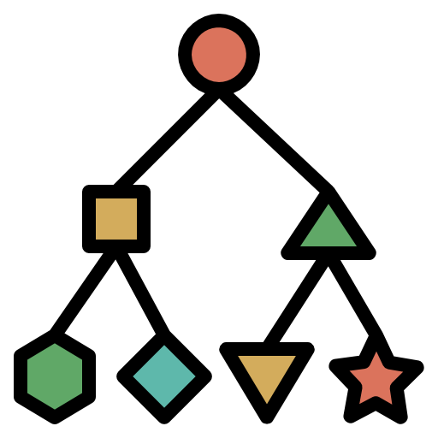

Evaluation Methodology
Evaluation process:
Generate synthetic data
Use the synthetic data to train the classifiers
Test the classifier on real (test) data
Real(Test) Data
Real Data
DP-CGAN
Synthetic(Training) Data
Classifier

Slide 15
Evaluation Methodology
Three methods for generating synthetic training data:
CGAN with no privacy
CGAN with Basic DP
Applies clipping and adds noise to gradients of discriminator loss
DP-CGAN
Splits the gradients of discriminator to gradients on real data and gradients on fake data, then applies clipping and adds noise to them separately
In all the experiments:
Delta is set to 10⁻⁵
MNIST dataset is used (60,000 training samples and 10,000 test samples)

Slide 16



Experimental Results
Evaluation Metric: AuROC
𝜺=9.6 for DP approaches
 | Real | CGAN | DP-CGAN | CGAN with Basic DP
Logistic Regression | 92.17% | 91.10% | 87.57% | 83.42%
Multi-Layer Perceptron | 97.60% | 91.06% | 88.16% | 83.29%
Notes:
!!!!! These are just preliminary results on MNIST -- we are currently trying things out on CIFAR and CelebA datasets -- which are much larger
--- Comparing AuROC for Logistic Regression(LR)
and Multi-Layer Perceptron(MLP), which are trained on real data, data generated by CGAN (non-private), DP-CGAN and CGAN with basic differentially private approach
---According to the table, the AuROC of DP-CGAN is higher than CGAN trained with basic differentially private method, indicating that new clipping and perturbing technique used in DP-CGAN improves the performance. On the other hand, the AuROC of DP-CGAN is about 5% lower than that for real data and this is the price we pay to have privacy.

Slide 17
Future Directions
Improving DP-CGANs accuracy using techniques such as warm-start, random sampling, using a public dataset, etc.
Evaluating the DP-CGANs on larger scale datasets
Considering advanced CGAN architectures

Slide 18
Thank you!
Questions?

