Slide 1
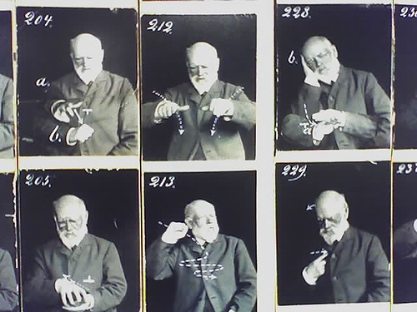
Improving fluency in sign language to text systems
Photo courtesy Gary AK
Sam Black 524689

Slide 2
Presentation outline
Introduction
System outline
Implementation
Current status
Further work

Slide 3
Aims of the Project
Build a system to translate British Sign Language (BSL) to text
Run in real time
Utilise commodity hardware

Slide 4
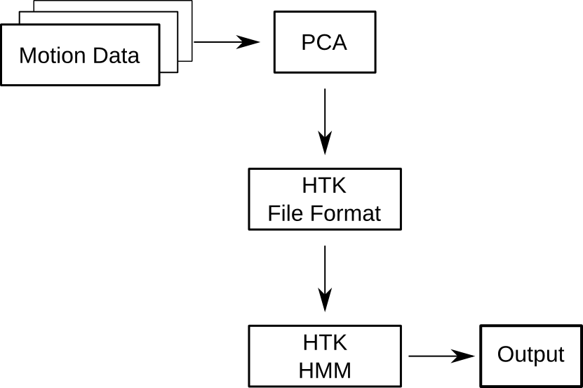
System Outline

Slide 5
Defining the setting
Corpus based on using Information Points
“Where is the Gisbert Kapp building?”
Reduces complexity
Increases overall accuracy

Slide 6
Sign Language Data Capture
Use of motion tracking equipment
Accurate 3D positional data
Controlled environment
Low noise system

Slide 7
Principle Component Analysis
30 3D vectors from motion tracking
900 dimension dataset per second
Reduction using PCA to less than 50
Faster to run PCA

Slide 8
Hidden Markov Models
Statistical model
Probability of state transitions
Probability of outcome from states
Current state is unknown

Slide 9
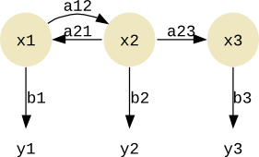
HMM Structure

Slide 10
HMM Training
Word dictionary
Initial state and outcome probabilities
Annotated training data
Training data should include 10 or more examples of each word

Slide 11
HMM Testing
Grammar
“Clean” testing data
Accurracy of system obtained

Slide 12
Implementation
Python wrappers
NumPy and Modular Data Processing for PCA
HMM Tool Kit

Slide 13
System Outline
NumPy/MDP
C module for Python
HTK

Slide 14
Current Status
Currently non-real time
HTK wrappers complete
PCA code implemented
Motion tracker data to be recorded on
Friday

Slide 15
Future work
Thread program for real time processing
Research computer vision based gesture
recognition
Extract features from video
Use webcam or similar as input device

Slide 16
Conclusions
Wide scope for further work
Useful in the real world
Accurracy is important
Running about two weeks late

Slide 17
Any Questions?

