Slide 1
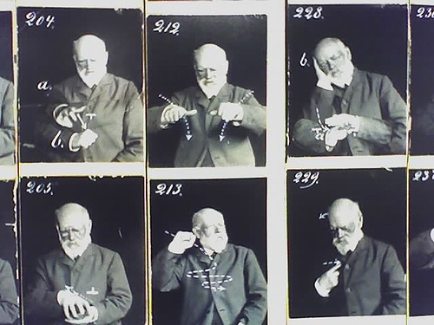
Improving fluency in sign language to text systems
Photo courtesy Gary AK
Sam Black 524689

Slide 2
Presentation outline
Introduction
Previous work
Data capture
Hidden Markov Models
Implementation
Conclusions

Slide 3
Aims of the Project
Build a system to translate British Sign Language (BSL) to text
Run in real time
Utilise commodity hardware

Slide 4
Research and previous work
Most systems use HMMs
Translate single letters only
Few fluent sentence based systems
Image capture instead of motion tracking

Slide 5
Defining the setting
Corpus based on using Information Points
“Where is the Gisbert Kapp building?”
Reduces complexity
Increases overall accuracy

Slide 6
Sign Language Data Capture
Use of motion tracking equipment
Accurate 3D positional data
Controlled environment
Low noise system

Slide 7
Motion tracking system
User signing Motion tracking system

Slide 8
Data collected
Two beginner signers participated
75 sets of data collected
49 words used in 40 sentences
28 body markers used

Slide 9
Hidden Markov Models
Statistical model
Probability of state transitions
Probability of outcome from states
Current state is unknown

Slide 10
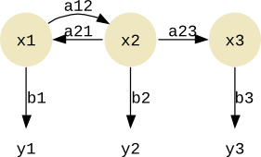
HMM Structure

Slide 11
HMM Training and Testing
Word dictionary
Initial state and outcome probabilities
Annotated training data
Training data includes 8 or more examples of each word
“Clean” testing data
Accuracy of system obtained

Slide 12
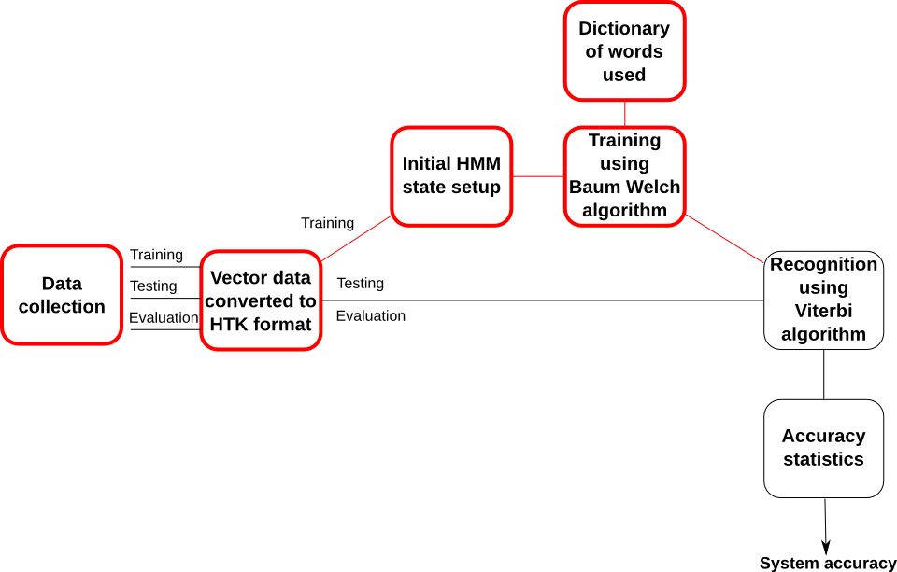
Implementation

Slide 13
Implementation
QTM file format to HTK file format
QTM system not suited to detailed work
HMMs are for whole words
System similar to first voice recognition
attempts

Slide 14
Conclusions
Software to create and use HMMs written
and tested
Converting motion tracking data for use
took more time than planned
On completing motion tracking data,
system would work

Slide 15
Any Questions?

