Slide 1
CS100 Introduction to Programming
Lecture 7. Arrays

Slide 2
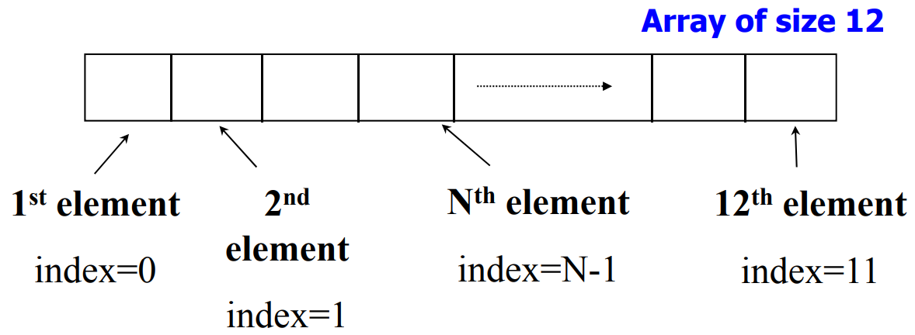
What Is an Array
An array is a list of values with the same data type. Each value is stored at a specific, numbered position in the array.
An array uses an integer called index to reference an element in the array.
The size of an array is fixed once it is created.
Index always starts with 0 (zero).

Slide 3
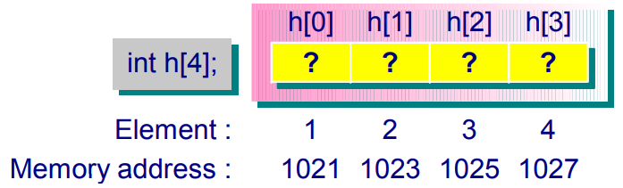
Array Declaration
Declaration of arrays without initialization:
float sales[365]; // array of 365 floats
char name[12]; // array of 12 characters
int states[50]; // array of 50 integers
int *pointers[5]; // array of 5 pointers to integers
When an array is declared, some consecutive memory locations are allocated by the compiler for the whole array (assume 2 bytes for an integer).
The size of an array must be an integer constant or constant expression:
e.g. char name[i]; // i is a variable ==> illegal
int states[i*6]; // i is a variable ==> illegal

Slide 4
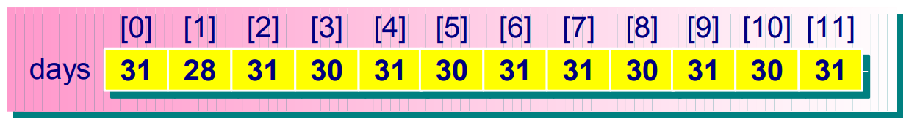
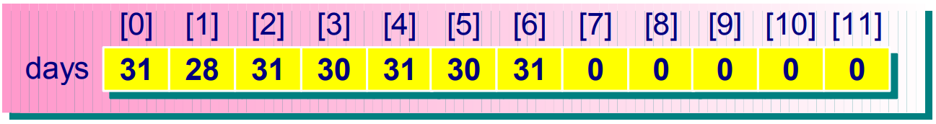
Initialization of Arrays
Initialize array variables at declaration:
#define MTHS 12 /* define a constant */
int days[MTHS]={31,28,31,30,31,30,31,31,30,31,30,31};
Partial array initialization, e.g. to initialize the first 7 elements:
#define MTHS 12
int days[MTHS] = {31, 28, 31, 30, 31, 30, 31};
/* remaining elements are initialized to 0 */

Slide 5
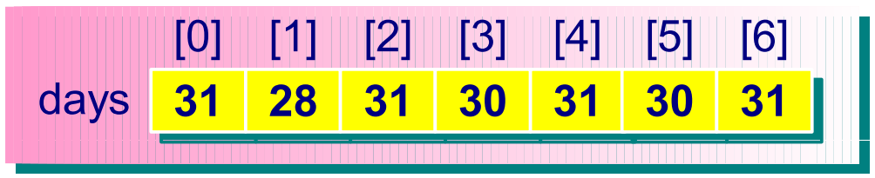
Initialization of Arrays
Omitting the size in array initialization:
int days[] = {31, 28, 31, 30, 31, 30, 31};
/* an array of 7 elements */

Slide 6
Operations on Arrays
Accessing array elements:
sales[0] = 143.50;
if (sales[23] == 50.0) …
Subscripting: The element indices range from 0 to n – 1 where n is the declared size of the array:
char name[12];
name[12] = ‘c’; // error: index out of range
Working on array values:
days[1] = 20; // valid
days[2] = days[2] + 4; // valid
days[3] = days[2] + days[3]; // valid
days[MTHS] = {2, 3, 4, 5, 6}; // invalid

Slide 7
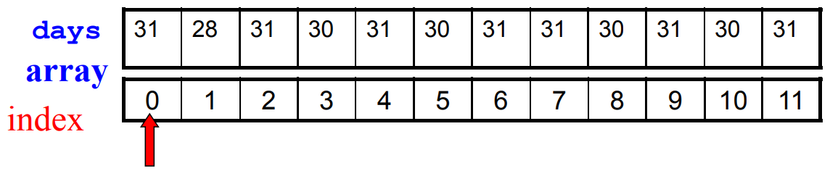
Traversing an Array
One of the most common actions in dealing with arrays is to examine every array element in order to perform an operation.
This action is also known as traversing an array.
Example:
Traverse the days[] array to display every element’s content:

Slide 8
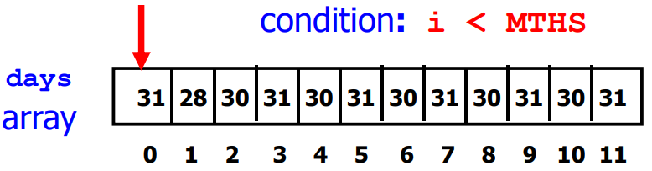
Traversing an Array – print values
#include <stdio.h>
#define MTHS 12 // define a constant
int main(void)
{
int i;
int days[MTHS] = {31,28,31,30,31,30,31,31,30,31,30,31};
// print the number of days in each month
for (i = 0; i < MTHS; i++)
printf(“Month %d has %d days.\n”, i+1, days[i]);
return 0;
}
Output:
Month 1 has 31 days.
Month 2 has 28 days.
…
Month 12 has 31 days.

Slide 9
Traversing an Array – search for a value
#include <stdio.h>
#define SIZE 5 // define a constant
int main(void)
{
char myChar[SIZE] = {‘b’, ‘a’, ‘c’, ‘k’, ‘s’};
// Reading in user’s input to search
printf(“Enter a char to search: ”);
char searchChar;
scanf(“%c”, &searchChar);
/* Traverse myChar array and output the index of searchChar if found */
int i;
for (i = 0; i < SIZE; i++) {
if (myChar[i] == searchChar) {
printf(“Found %c at index %d”, myChar[i], i);
break; // break out of the loop
}
}
return 0;
}
Output:
Enter a char to search: a
Found a at index 1

Slide 10
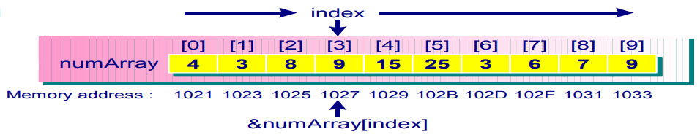
Traversing an Array – find maximum value
/* This example shows how to find the largest value in an array of numbers. */
#include <stdio.h>
int main(void)
{
int i, max, numArray[10];
max = -1;
printf(“Enter 10 numbers: \n”);
for (i = 0; i < 10; i++)
scanf(“%d”, &numArray[index]);
for (i = 0; i < 10; i++) {
if (numArray[i] > max)
max = numArray[i];
}
printf(“The max value is %d.\n”, max);
return 0;
}
Output:
Enter 10 numbers:
4 3 8 9 15 25 3 6 7 9
The max value is 25.

Slide 11
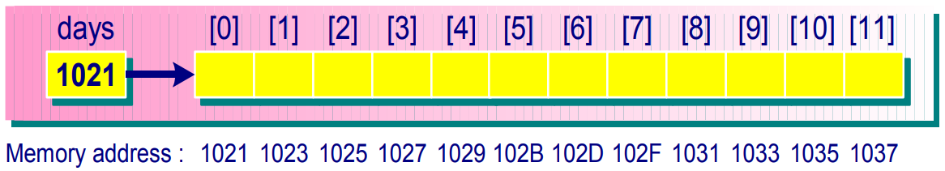
Pointers and Arrays
The array name is really a pointer constant:
e.g. int days[12];
If an integer is represented by 2 bytes and the array days begins at memory location 1021, the above figure shows the layout of the array.
Address of an array element: e.g. int h[5];
&h[0] is the address of the 1st element
&h[i] is the address of the (i+1)-th element

Slide 12
Pointers and Arrays
Thus, days, the array name by itself, is really the address (or pointer) of the 1st element of the array, e.g. when using the array of int days[12], the following expressions are all true:
days == &days[0]
*days == days[0]
days + 1 == &days[1]
*(days + 1) == days[1]
You cannot change the value of the array name, because it is a pointer constant, not a pointer variable:
days += 5; // invalid
days++; // invalid

Slide 13
Pointers and Arrays
A pointer variable can take on different addresses, but an array cannot:
/* pointer arithmetic */
#define MTHS 12
int main(void)
{
int days[MTHS] = {31,28,31,30,31,30,31,31,30,31,30,31};
int *day_ptr;
day_ptr = days; /* points to the first element */
day_ptr = &days[3]; /* points to the fourth element */
day_ptr += 3; /* points to the seventh element */
day_ptr--; /* points to the sixth element */
return 0;
}

Slide 14
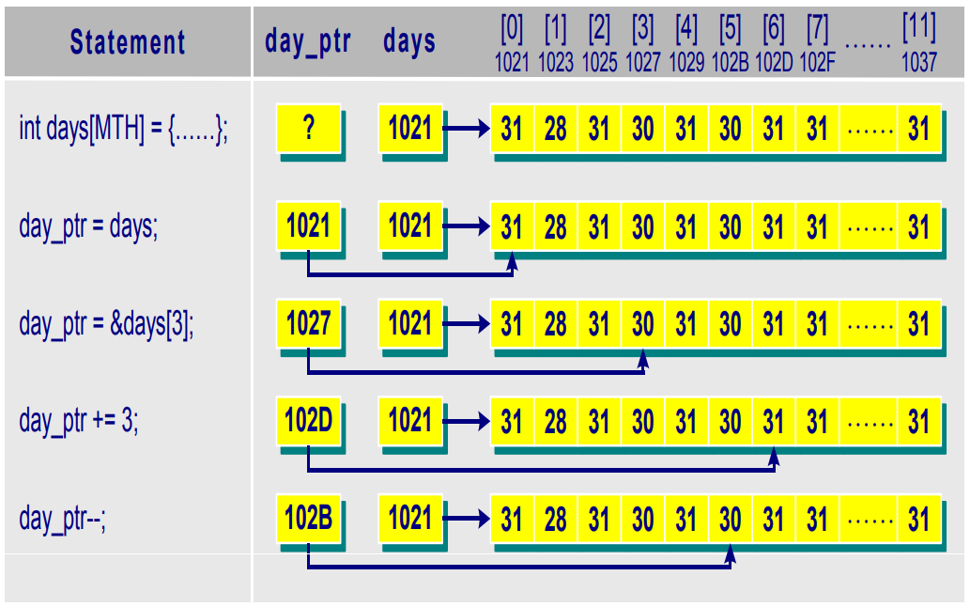
Pointers and Arrays

Slide 15
Pointer – Finding Maximum Number
#include <stdio.h>
int main(void)
{
int i, max, numArray[10];
printf(“Enter 10 numbers: \n”);
for (i = 0; i < 10; i++)
scanf(“%d”, numArray + i);
max = *numArray;
for (i = 1; i < 10; i++) {
if (*(numArray + i) > max)
max = *(numArray + i);
}
printf(“The max value is %d.\n”, max);
return 0;
}
Output:
Enter 10 numbers:
4 3 8 9 15 25 3 6 7 9
The max value is 25.

Slide 16
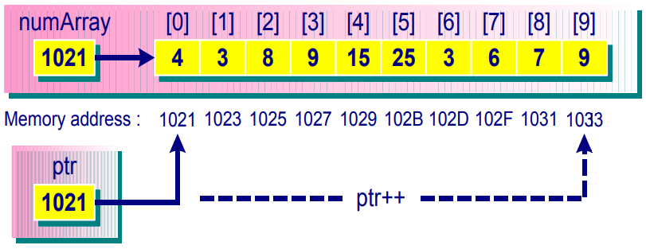
Pointer – Finding Maximum Number
#include <stdio.h>
int main(void) {
int i, max, numArray[10];
int *ptr;
ptr = numArray;
printf(“Enter 10 numbers: \n”);
for (i = 0; i < 10; i++)
scanf(“%d”, ptr++);
ptr = numArray;
max = *ptr;
for (i = 1; i < 10; i++) { // find the max
if (*ptr > max)
max = *ptr;
ptr++;
}
printf(“max is %d.\n”, max);
return 0;
}
Output:
Enter 10 numbers:
4 3 8 9 15 25 3 6 7 9
max is 25.

Slide 17
Arrays as Function Arguments
Any dimensional array can be passed as a function argument, e.g.
fn(table); /* call a function */
where fn() is a function and table is a 1-D array.
An array is passed by reference to a function. This means that the address of the first element of the array is passed to the function.

Slide 18
Arrays as Function Arguments
void fn(int table[], int n)
{
……
}
void fn(int table[TABLESIZE])
{
……
}
void fn(int *table, int n)
{
……
}
The prototype of the function becomes
void fn(int table[], int n); or
void fn(int table[TABLESIZE]); or
void fn(int *table, int n);

Slide 19
Passing an Array as a Function Argument
#include <stdio.h>
int maximum(int table[], int n);
int main(void)
{
int max, i, n;
int numArray[10];
printf(“Enter the number of values:”);
scanf(“%d”, &n);
printf(“Enter %d values: ”, n);
for (i = 0; i < n; i++)
scanf(“%d”, &numArray[i]);
max = maximum(numArray, n);
printf(“The max value is %d.\n”, max);
return 0;
}
Output:
Enter the number of values: 5
Enter 5 values: 1 2 3 4 5
The max value is 5.

Slide 20
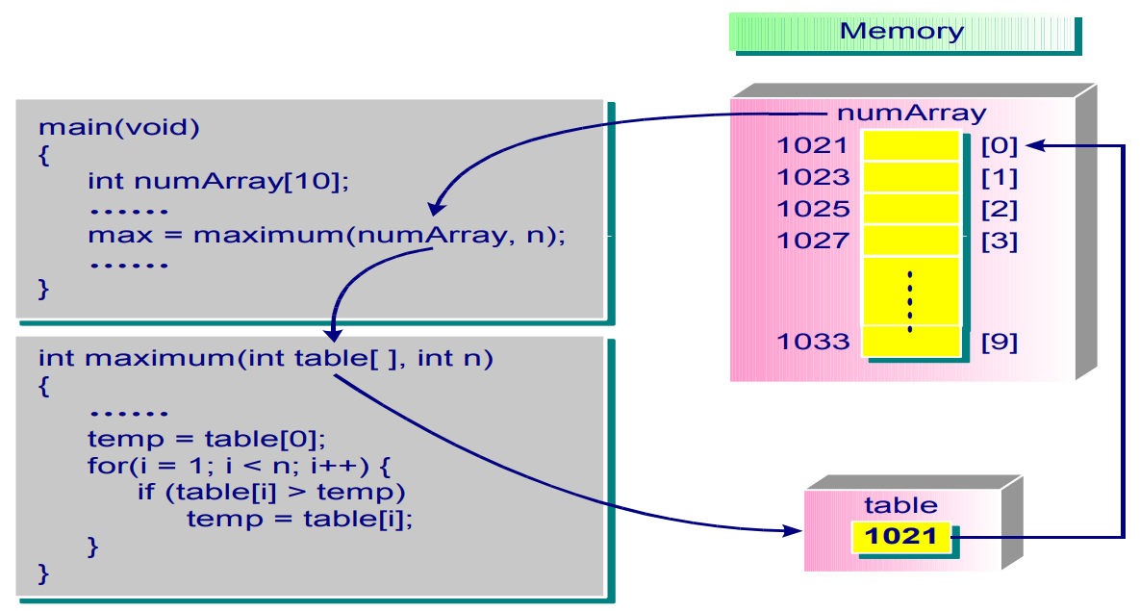
Passing an Array as a Function Argument
int maximum(int table[], int n)
{
int i, temp;
temp = table[0];
for (i = 1; i < n; i++)
if (table[i] > temp) temp = table[i]; return temp;
}

Slide 21
Multidimensional Arrays
Declared as consecutive pairs of brackets.
E.g. A 2-dimensional array, or a 3-element array of 5-element arrays:
int x[3][5];
E.g. A 3-dimensional array, or a 3-element array of 4-element arrays of 5-element arrays:
char x[3][4][5];
ANSI standard requires a minimum of 6 dimensions to be supported.

Slide 22
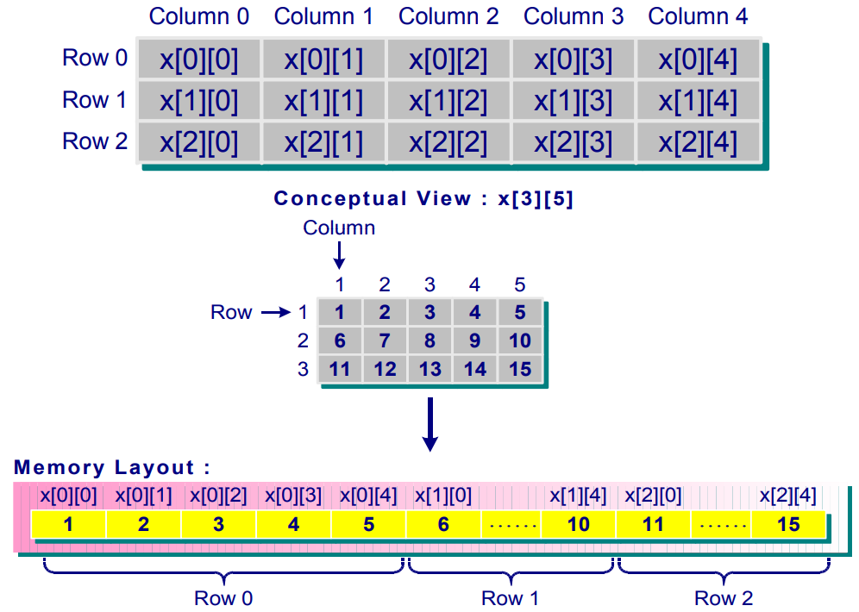
Multidimensional Arrays

Slide 23
Initializing Multidimensional Arrays
Initializing multidimensional arrays: enclose each row in curly braces.
int x[2][2] = {{1, 2}, /* 1st row */
{6, 7}}; /* 2nd row */
or
int x[2][2] = {1, 2, 6, 7};
Partial initialization (other cells are set to 0):
int exam[3][3] = {{1, 2}, {4}, {5, 7}};
int exam[3][3] = { 1, 2, 4, 5, 7 };
or int exam[3][3] = { {1, 2, 4}, {5, 7} };

Slide 24
Initializing Multi-dimensional Arrays
You can omit the outermost dimension because compiler can figure that out, e.g.
int arr[][3][2] = {
{ {1, 1}, {0, 0}, {1, 1} },
{ {0, 0}, {1, 2}, {0, 1} }
};
gives a [2][3][2] dimensioned array.
The following is not correct. Why?
int wrong_arr[][] = {1, 2, 3, 4};

Slide 25
Operations on Multidimensional Arrays
#include <stdio.h>
int main(void)
{
int array[3][3] = {
{5, 10, 15},
{10, 20, 30},
{20, 40, 60}
};
int row, column, sum;
/* sum of rows */
for (row = 0; row < 3; row++) {
sum = 0;
for (column = 0; column < 3; column++)
sum += array[row][column];
printf(“The sum of elements in row %d is %d\n”, row + 1, sum);
}
Code continues in next slide …

Slide 26
Operations on Multidimensional Arrays
/* sum of columns */
for (column = 0; column < 3; column++) {
sum = 0;
for (row = 0; row < 3; row++)
sum += array[row][column];
printf(“The sum of elements in column %d is %d\n”, column + 1, sum);
}
return 0;
}
Output:
The sum of elements in row 1 is 30
The sum of elements in row 2 is 60
The sum of elements in row 3 is 120
The sum of elements in column 1 is 35
The sum of elements in column 2 is 70
The sum of elements in column 3 is 105

Slide 27
Multidimensional Arrays and Pointers
Multidimensional arrays are also stored sequentially in memory, e.g.
int ar[4][2]; /* ar is an array of 4 elements;
each element is an array of 2 ints */
ar is the address of the 1st element of the array. In this case, the 1st element is an array of 2 integers. Thus, ar is the address of a two-int-sized object.
ar == &ar[0] *ar == ar[0]
ar + 1 == &ar[1] *(ar + 1) == ar[1]
ar + 2 == &ar[2] *(ar + 2) == ar[2]
ar + 3 == &ar[3] *(ar + 3) == ar[3]

Slide 28
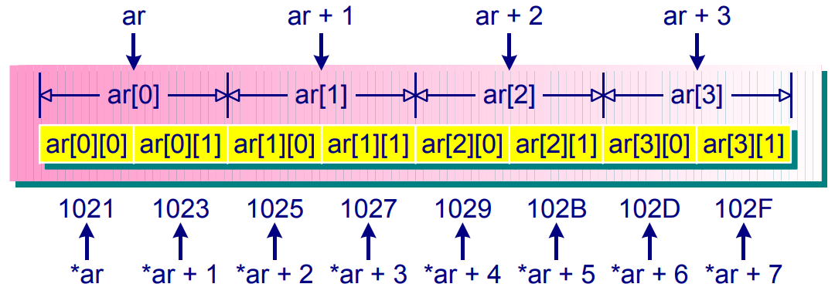
Multidimensional Arrays and Pointers
ar[0] is an array of 2 integers, so ar[0] is the address of an int-sized object.
ar[0] == &ar[0][0] *ar[0] == ar[0][0]
ar[1] == &ar[1][0] *ar[1] == ar[1][0]
ar[2] == &ar[2][0] *ar[2] == ar[2][0]
ar[3] == &ar[3][0] *ar[3] == ar[3][0]

Slide 29
Multidimensional Arrays and Pointers
Adding 1 to a pointer or address yields a value larger by the size of the referred-to object.
E.g. ar has the same address value as ar[0], but
ar+1 (1025) is different from ar[0]+1 (1023)
Dereferencing a pointer or an address (apply * operator) yields the value represented by the referred-to object. For example:
*(ar[0]) == the value stored in ar[0][0].
*ar == the value of its first element, ar[0].
**ar == the value of ar[0][0] (double indirection)
In general,
a[m][n] == *( *(a + m) + n)

Slide 30
Multidimensional Arrays as Function Arguments
The definition of a function with a 2-D array as the argument is:
In the above definition, the first dimension can be excluded because the C compiler needs the information of all but the first dimension.
void fn(int ar2[2][4]) { … } | or | void fn(int ar2[][4]) { … }
/* the first dimension can be excluded */

Slide 31
Multidimensional Arrays as Function Arguments
For example, the assignment operation
ar2[1][3] = 100;
requests the compiler to compute the address of ar2[1][3] and then place 100 to that address. In order to compute the address, the dimension information must be given to the compiler.
Let us redefine ar2 as
int ar2[D1][D2];
The address of ar2[1][3] is computed as
baseAddress + row * D2 + column
==> baseAddress + 1 * 4 + 3
==> baseAddress + 7

Slide 32
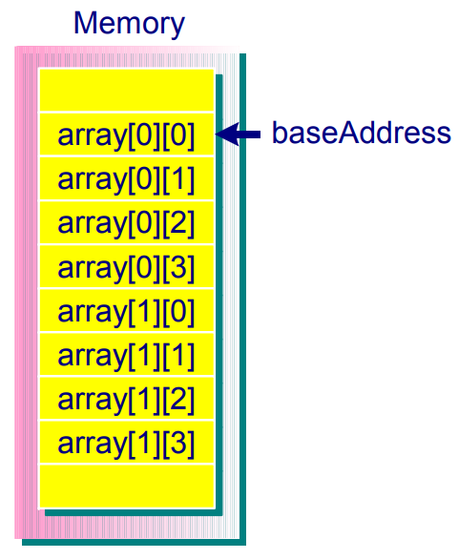
Multidimensional Arrays as Function Arguments
The baseAddress is the address pointing to the beginning of ar2. Because D1 is not needed in computing the address, one can omit the first dimension value in defining a function which takes arrays as its formal arguments.
The prototype of the function becomes
void fn(int ar2[2][4]); or
void fn(int ar2[][4]);

Slide 33
Passing 2-D Array as Function Arguments
#include <stdio.h>
int sum_rows(int ar[][3]);
int sum_columns(int ar[][3]);
int main(void)
{
int array[3][3] = {
{5, 10, 15},
{10, 20, 30},
{20, 40, 60}
};
int total_row, total_column;
total_row = sum_rows(array);
total_column = sum_columns(array);
printf(“The sum of all elements in rows is %d\n”, total_row);
printf(“The sum of all elements in columns is %d\n”, total_column);
return 0;
}
Output:
The sum of all elements in rows is 210
The sum of all elements in columns is 210

Slide 34
Passing 2-D Array as Function Arguments
int sum_rows(int ar[][3]) {
int row, column;
int sum = 0;
for (row = 0; row < 3; row++) {
for (column = 0; column < 3; column++)
sum += ar[row][column];
}
return sum;
}
int sum_columns(int ar[][3]) {
int row, column;
int sum = 0;
for (column = 0; column < 3; column++) {
for (row = 0; row < 3; row++)
sum += ar[row][column];
}
return sum;
}

Slide 35
Processing 2-D Arrays as 1-D Arrays
#include <stdio.h>
void display1(int *ptr, int size);
void display2(int ar[], int size);
void display3(int ar[][4], int size);
int main(void)
{
int array[2][4] = {0,1,2,3,4,5,6,7};
int i;
for (i = 0; i < 2; i++) {
display1(array[i], 4);
display2(array[i], 4);
}
display3(array, 2);
display1(array, 8);
display2(array, 8);
return 0;
}
Output:
Display1 result: 0 1 2 3
Display2 result: 0 5 10 15
Display1 result: 4 5 6 7
Display2 result: 20 25 30 35
Display3 result: 0 10 20 30 40 50 60 70
Display1 result: 0 1 2 3 4 5 6 7
Display2 result: 0 5 10 15 20 25 30 35

Slide 36
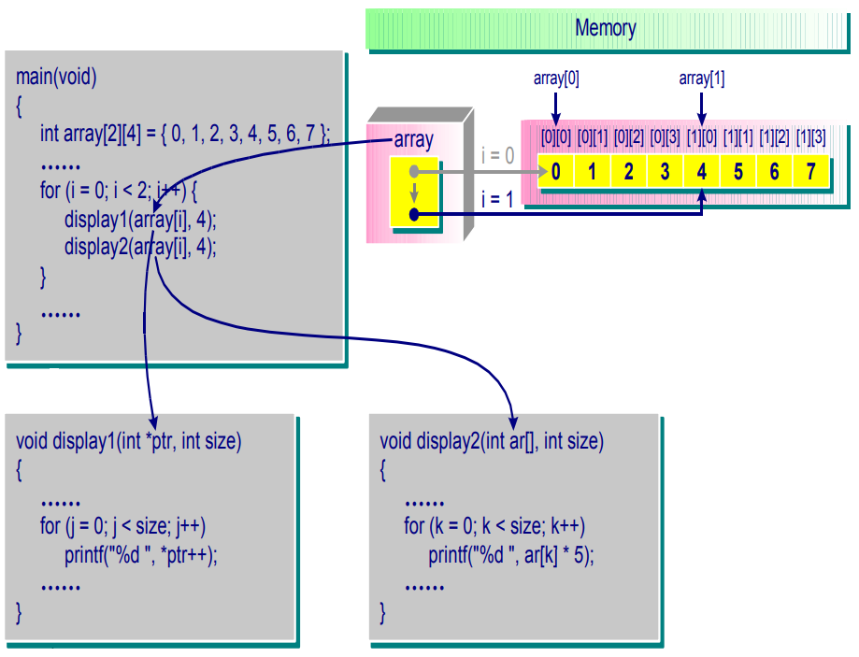
Processing 2-D Arrays as 1-D Arrays
void display1(int *ptr, int size)
{
int j;
printf(“Display1 result: ”);
for (j=0; j < size; j++)
printf(“%d ”, *ptr++);
putchar(‘\n’);
}
void display2(int ar[], int size)
{
int k;
printf(“Display2 result: ”);
for (k=0; k < size; k++)
printf(“%d ”, ar[k]*5);
putchar(‘\n’);
}
void display3(int ar[][4], int size)
{
int i,j;
printf(“Display3 result: ”);
for (i=0; i < size; j++)
for (j=0; j < 4; j++)
printf(“%d ”, ar[i][j]*10);
putchar(‘\n’);
}

Slide 37
Passing Array as Pointer Argument
Passing 1D array as pointer
#include <stdio.h>
void display(int *ptr, int size);
int main(void)
{
int array[8] = {0,1,2,3,4,5,6,7};
display(array, 8);
//display(&array[0], 8);
return 0;
}
void display(int *ptr, int size)
{
int i;
printf(“Display result: ”);
for (i=0; i < size; i++)
printf(“%d ”, *ptr++);
//printf(“%d ”, ptr[i]);
putchar(‘\n’);
}

Slide 38
Passing Array as Pointer Argument
Passing 2D static array as pointer
void display(int *ptr,
int size1, int size2)
{
int i, j;
printf(“Display result: ”);
for (i=0; i < size1; i++)
for (j=0; j < size2; j++)
printf(“%d ”, ptr[size2*i+j]);
putchar(‘\n’);
}
#include <stdio.h>
void display(int *ptr, int size1, int size2);
void display(int **ptr, int size1, int size2);
int main(void)
{
int array[2][4] = {{0,1,2,3},{4,5,6,7}};
display((int *)array, 2, 4);
// display((int **)array, 2, 4);
return 0;
}
void display(int **ptr,
int size1, int size2)
{
int i, j;
printf(“Display result: ”);
for (i=0; i < size1; i++)
for (j=0; j < size2; j++)
printf(“%d ”, *((int *)ptr+size2*i+j));
putchar(‘\n’);
}

Slide 39
The sizeof Operator and Array
#include <stdio.h>
int main(void)
{
int ar2[2][4];
printf(“Array size is %d”,
sizeof(ar2) / sizeof(ar2[0][0]));
return 0;
}
Output:
Array size is 8

Slide 40
The sizeof Operator and Array
sizeof(operand) is an operator which gives the size (how many bytes) of its operand. Its syntax is
sizeof (operand) or
sizeof operand
The operand can be:
int, float, …., complexDataTypeName, variableName, arrayName
#include <stdio.h>
#define SIZE 5
int item[SIZE] = {1, 2, 3, 4, 5};
void main(void)
{
total = sum(item, SIZE);
printf(“Size of item = %d\n”, sizeof(item));
}

Slide 41
The sizeof Operator and Array
int sum(int a[], int n)
{
int i;
int s = 0;
printf(“Size of a = %d\n”, sizeof(a));
for (i=0; i < n; i++)
s += a[i];
return s;
}
Output:
Size of a = 4
Size of item = 20
Applying sizeof to an array name yields the array size
BUT
Applying sizeof to a pointer variable yields the size of the pointer

Slide 42
Size of a Pointer
What is the size of a pointer?
Always fixed size for pointer of any type
OS System dependent
Old system: 32bit (4 bytes); can only access 4G memory
System nowadays: 64bit (8 bytes); can access very large
#include <stdio.h>
void main(void)
{
float a=10.0; float *p_a=&a;
int b=5; int *p_b=&b;
printf(“Size of a = %d\n”, sizeof(p_a));
printf(“Size of b = %d\n”, sizeof(p_b));
}

Slide 43
Dynamically Allocated Array
Static v.s. dynamic array
Whether the size of the array can be dynamically changed during execution
float A[10];
#define SIZE 10
float A[SIZE]
const int SIZE=10;
float A[SIZE];
int SIZE=10;
float A[SIZE];
Examples of declaring static array
How about the dynamic array size?

Slide 44
Dynamically Allocated 1D Array
How to achieve dynamic array?
Using pointers
With dynamic memory allocation function
int main()
{
int size=10;
float *pArray=NULL;
pArray=(float *)malloc(sizeof(float)*size);
memset(pArray,0,sizeof(float)*size);
/*access the array*/
free(pArray);
return 0;
}

Slide 45
Dynamically Allocated 1D Array
Access array elements
The allocated array pointer can be taken as the normal array
int main()
{
…
/*access the array*/
for(int i=0;i<size;i++)
pArray[i]=float(i);
//*(pArray+i)=float(i);
…
return 0;
}

Slide 46
Dynamically Allocated 2D Array
Dynamically allocating 2D array
Using double pointer indexing
int main()
{
int size1=10, size2=8;
float **pArray=NULL;
pArray=(float **)malloc(sizeof(float *)*size1);
for(int i=0;i<size1;i++)
pArray[i]=(float *)malloc(sizeof(float)*size2);
/*access the array*/
for(int i=0;i<size1;i++)
free(pArray[i]);
free(pArray);
return 0;
}

Slide 47
Out-of-Bound Array Access
What is out-of-bound array access?
The array index is out of the allowable range
The range is specified when array is created
int main()
{
int size=10;
float *pArray=NULL;
pArray=(float *)malloc(sizeof(float)*size);
/*access the array*/
for(int i=0;i<20;i++)
pArray[i]=float(i);
free(pArray);
return 0;
}

Slide 48
Memory Leak
What is the potential problem for dynamic memory allocation?
The memory may not be released (freed)
Completely depend on programmer’s design
Memory leak
Memory which is no longer needed is not released
They can exhaust available system memory as an application runs

Slide 49
Memory Leak
Example
int main()
{
int size=10;
float *pArray=NULL;
pArray=(float *)malloc(sizeof(float)*size);
/*access the array*/
for(int i=0;i<size;i++)
pArray[i]=float(i);
return 0;
}

Slide 50
Memory Leak
Example
float* CreateArray(int size)
{
return (float *)malloc(sizeof(float)*size);
}
int main()
{
float* pArray=CreateArray(10);
/*access the array*/
for(int i=0;i<10;i++)
pArray[i]=float(i);
return 0;
}

Slide 51
Dangling Pointer
Pointers that do not point to a valid object of the appropriate type
Usually a pointer which points to a dynamically allocated array which has been freed
float* InitArray(int size)
{
float* pArray=(float *)
malloc(sizeof(float)*size);
for(int i=0;i<size;i++)
pArray[i]=0
free(pArray);
return pArray;
}
int main()
{
float* pArray=InitArray(10);
/*access the array*/
for(int i=0;i<10;i++)
pArray[i]=float(i);
return 0;
}

