Slide 1
SC00039 Course Project Work
Preparing Protein Data Bank (pdb) files for EXAFS modeling
Doris Zoric

Slide 2
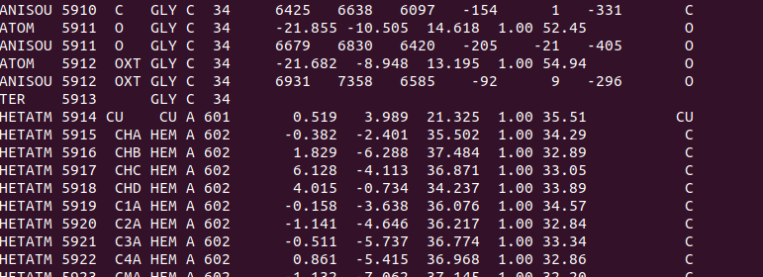
Protein Data Bank (pdb) file
The Protein Data Bank (pdb) file format is a textual file format describing the three-dimensional structures of molecules held in the Protein Data Bank.
The pdb format accordingly provides for description and annotation of protein and nucleic acid structures including atomic coordinates, secondary structure assignments, as well as atomic connectivity. In addition experimental metadata are stored

Slide 3
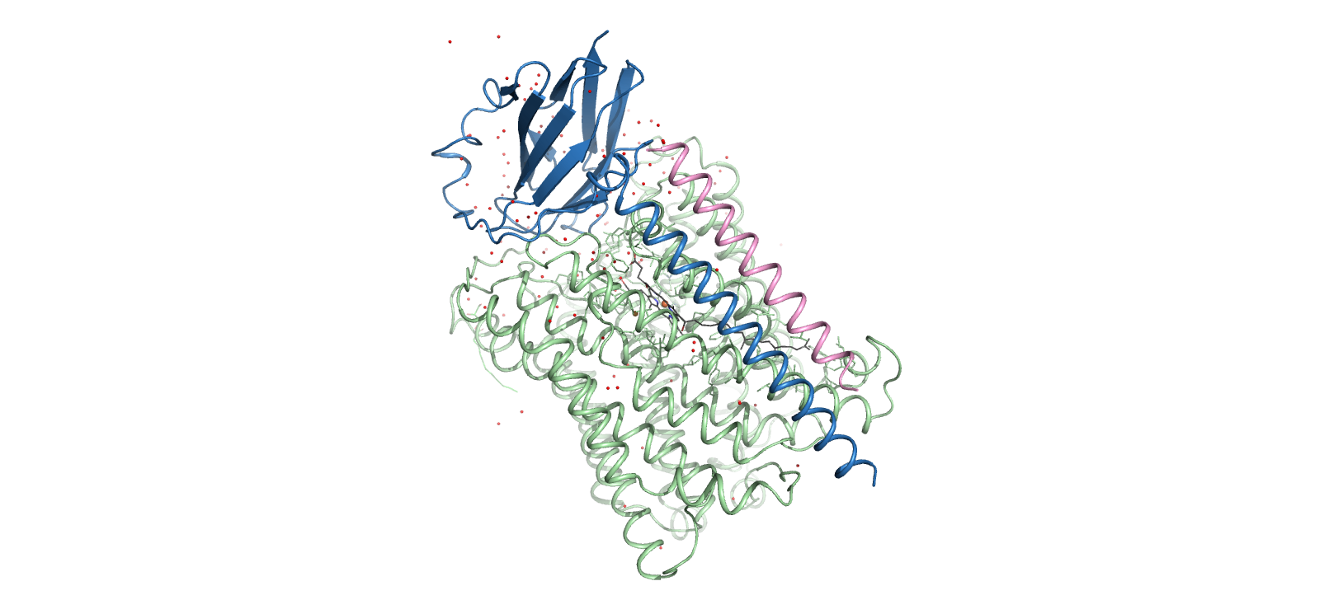
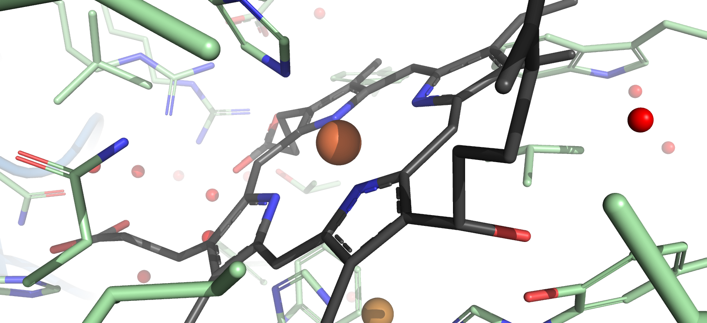
ba3-type cytochrome c oxidase pdb structure (full)
PDB code: 5ndc
Method: serial crystallography
Environment within 5 Å from heme a3 iron

Slide 4
EXAFS
Extended X-ray Absorption Fine Structure (EXAFS) is the major analytical technique to provide local structural information about the absorber atom, with regard to the type of neighbouring ligands, their bonding distances to the absorber, and the coordination numbers. For structural and functional studies of metalloproteins, the technique is a valuable complement to crystallography.

Slide 5
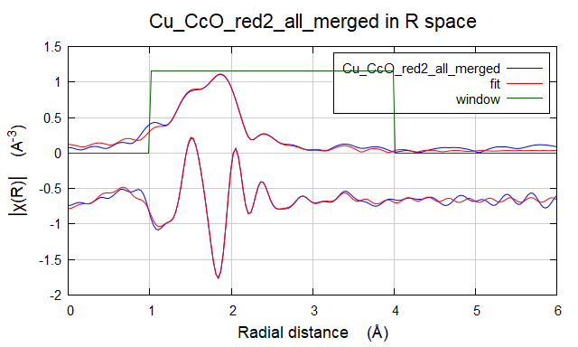
Analysis Pipeline
When analyzing metal co-factors, we are mainly interested in the environment in the vicinity of the metal
For example, in EXAFS modeling, we try to predict and fit various phase functions, which are calculated and ranked based on the existing structural information generated in the pdb file
The resulting fit is plotted as a Fourier transform that indicates distances between the metal co-factor and the atoms. In practice, this fit is most accurate in the radius between 2 and 5 Å.

Slide 6
Problem
However, pdb files don’t place the center (x,y,z) = (0,0,0) in the position of a metal, so we need to extrapolate the co-ordinates as if position (0,0,0) was assigned to our desired metal
Also, proteins are often big molecules, so pdbs can be large files containing the total structural information (protein chain, ligands, solvent molecules etc). Read as text or visualized, they might be hard to manipulate in order to study only desired small radius, or a desired chemical profile.

Slide 7
Program description
This program allows you to fetch the protein structure directly from online database, allows you to choose the co-factor you wish to analyze, and extrapolates the co-ordinates of other atoms in relation to your desired co-factor, generating a new pdb file (or the table for FEFF calculations)
Additionally, you can set the radius of your choice, which trims the structure and generates the pdb containing only features in the selected radius
Optionally, the new pdb file can be visualized in Pymol
Optionally, the program can calculate and plot some other significant parameters, i.e. Bfactor distribution

Slide 8
Code explained in steps
User’s input – type in the 4-character pdb code
Fetch the pdb file from the online database
Load and treat the pdb as DataFrame
Identify and categorize the objects of interest, such as metal atoms, atom co-ordinates etc.
Ask for user’s input on prefered co-factor (metal atom) for modeling
Place the co-factor in the center and transpose other co-ordinates in relation to it (subtraction operation similar to what did in homework task)
Ask for user’s input on the preferred radius of the co-factor environment
Select atoms with co-ordinates within that radius and write out a table of atoms and co-ordinates (needed for some calculations)
Write out a new pdb file (contains more information than the co-ordinate table)
OPTIONALLY: prepare a pymol script with basic settings for visualization of data and make sure the script is updated with the name/path of the new pdb file. If user wants to visualize the generated pdb file, the program will initiate pymol
OPTIONALLY: calculate some interesting parameters, like B factor across the sequence, and plot it if the user selects it

