Slide 1
Databases 3 (CSY3024)
Relational database revisited

Slide 2
Relational Database
Dominant database for more than four decades
Store data in structured format, i.e., tabular format with fixed columns for all rows.

Slide 3
Relational Model
Strong integrity
Minimum redundancy and inconsistency
Transaction support
Good for business critical applications that require good reliability

Slide 4
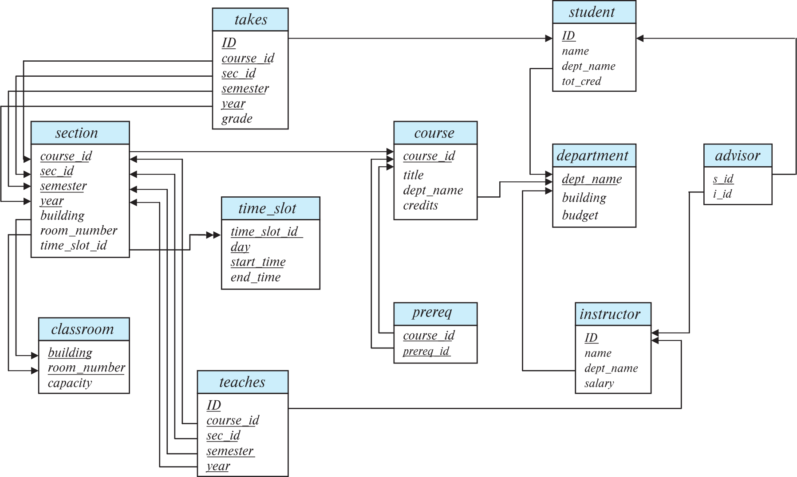
Schema Diagram for University Database

Slide 5
Relational Keys
Candidate key
Primary key
Foreign key
…

Slide 6
Structured Query Language
What does DDL stand for?
A. DDL is Data Definition Language statements. (CREATE, ALTER, etc)
What does DML stand for?
A. DML is Data Manipulation Language statements. (SELECT, UPDATE, DELETE, etc)
What does DCL stand for?
A. DCL is Data Control Language statements. (GRANT, REVOKE, etc)

Slide 7
Domain Types in SQL
char(n). Fixed length character string, with user-specified length n.
varchar(n). Variable length character strings, with user-specified maximum length n.
int. Integer (a finite subset of the integers that is machine-dependent).
smallint. Small integer (a machine-dependent subset of the integer domain type).
numeric(p,d). Fixed point number, with user-specified precision of p digits, with d digits to the right of decimal point. (ex., numeric(3,1), allows 44.5 to be stores exactly, but not 444.5 or 0.32)
real, double precision. Floating point and double-precision floating point numbers, with machine-dependent precision.
float(n). Floating point number, with user-specified precision of at least n digits.

Slide 8
SQL
Which of the following statements are Data Manipulation Language commands?
A. INSERT
B. UPDATE
C. GRANT
D. TRUNCATE
E. CREATE
The INSERT and UPDATE statements are Data Manipulation Language (DML) commands.
GRANT is a Data Control Language (DCL) command.
TRUNCATE and CREATE are Data Definition Language (DDL) commands

Slide 9
Create Table Construct
An SQL relation is defined using the create table command:
create table r
(A₁ D₁, A₂ D₂, ..., A_{n} D_{n}, (integrity-constraint₁), ..., (integrity-constraint_{k}))
r is the name of the relation
each A_{i} is an attribute name in the schema of relation r
D_{i} is the data type of values in the domain of attribute A_{i}
Example:
create table instructor ( ID char(5), name varchar(20), dept_name varchar(20), salary numeric(8,2))

Slide 10
What is NULL value for ?
The NULL is how SQL handles missing/unknown values.

Slide 11
What is entity & referential integrity constraints?
Entity constraint – primary key values CAN’T be NULL.
Referential integrity constraint - the values of a foreign key in the child table must match the values in the parent table or be NULL.
Employee
Department
Emp_no | name | salary | Dep_no
S001 | Alice | 30,000 | D111
S002 | Joe | 50,000 | NULL
Dep_no | Dep_name
D111 | Computing
D222 | Engineering

Slide 12
How do you add a column to a table?
ALTER TABLE Department
ADD location VARCHAR(20);

Slide 13
How do you change value of the field?
UPDATE Employee
SET name = ‘Smith’
WHERE Emp_no = 1000;

Slide 14
How do you delete all records?
DELETE FROM Employee;

Slide 15
How do you add record to a table?
INSERT INTO Employee
VALUES (‘S003’ , ‘Chloe’ , ‘40,000’,‘D111’);

Slide 16
How to display all column in a SELECT statement ?
SELECT *
FROM Employee;

Slide 17
SQL SELECT
The proper order for SQL SELECT clauses is:
SELECT
FROM
WHERE
GROUP BY
HAVING
ORDER BY
Only the SELECT and FROM clause are mandatory.

Slide 18
SQL SELECT
Write SQL SELECT example how you limiting the rows returned with a WHERE clause.
SELECT Emp_no, salary FROM Employee
WHERE salary > 5400 AND salary < 6600;

Slide 19
What is the output of the query?
SELECT name FROM
Employee WHERE name LIKE '_A%’
A. Allen
B. CLARK
C. JACKSON
D. David

Slide 20
What is a join?
Join is a process of retrieve pieces of data from different sets (tables) and returns them to the user or program as one “joined” collection of data.

Slide 21
What kinds of joins are there? Give examples.
We have inner join self join, outer joint (LEFT, RIGHT) , cross-join
Inner join
SELECT Employee.name, Department. Dep_name
FROM Employee, Department
WHERE Employee.Dep_no = Department.Dep_no;
cross-join
SELECT * FROM Employee, Department;
self join
SELECT e1.name, e2.ename FROM Employee e1, Employee e2 WHERE e1. Emp_no = e2.Emp_no;

Slide 22
What kinds of joins are there? Give examples.
Outer join
SELECT Employee.name, Department. Dep_name
FROM Employee LEFT JOIN Department ON
Employee.Dep_no = Department.Dep_no;

Slide 23
Aggregate functions
COUNT
MAX
MIN
AVG
SUM

Slide 24
Which of the following functions can be used only with numeric values?
A. AVG
B. MIN
C. LENGTH
D. SUM
E. ROUND
Only A and D are correct. The MIN function
works with any character, numeric, or date data type.
The LENGTH function is a character function that returns
the number of letters in a character value. The ROUND
function works with both numeric and date values.

Slide 25
Aggregate functions
The COUNT function tells you how many rows were in the result set.
SELECT COUNT(*) FROM Employee;
The AVG function tells you the average value of a numeric column.
SELECT MAX(salary) FROM Employee;
The MAX and MIN functions tell you the maximum and minimum value of a numeric column.
SELECT MIN(salary) FROM Employee;

Slide 26
Aggregate functions …
The AVG function tells you the average value of a numeric column.
SELECT AVG(salary) FROM Employee;
The SUM function tells you the sum value of a numeric column.
SELECT SUM(salary) FROM Employee;

Slide 27
Put together
Write a query to find the employee with highest salary in each department, display the output based on the department name in a reverse order.

Slide 28
The Solution
SELECT Dep_no, MAX(salary) AS highest_salary
FROM Employee e, Department d
WHERE e.Dep_no = d.Dep_no
GROUP BY Dep_no
ORDER BY Dep_name DESC

