Slide 1
iOS PUGLISI Andrea giorgio molino donato vito leonardi leonardo fronte giuseppe

Slide 2
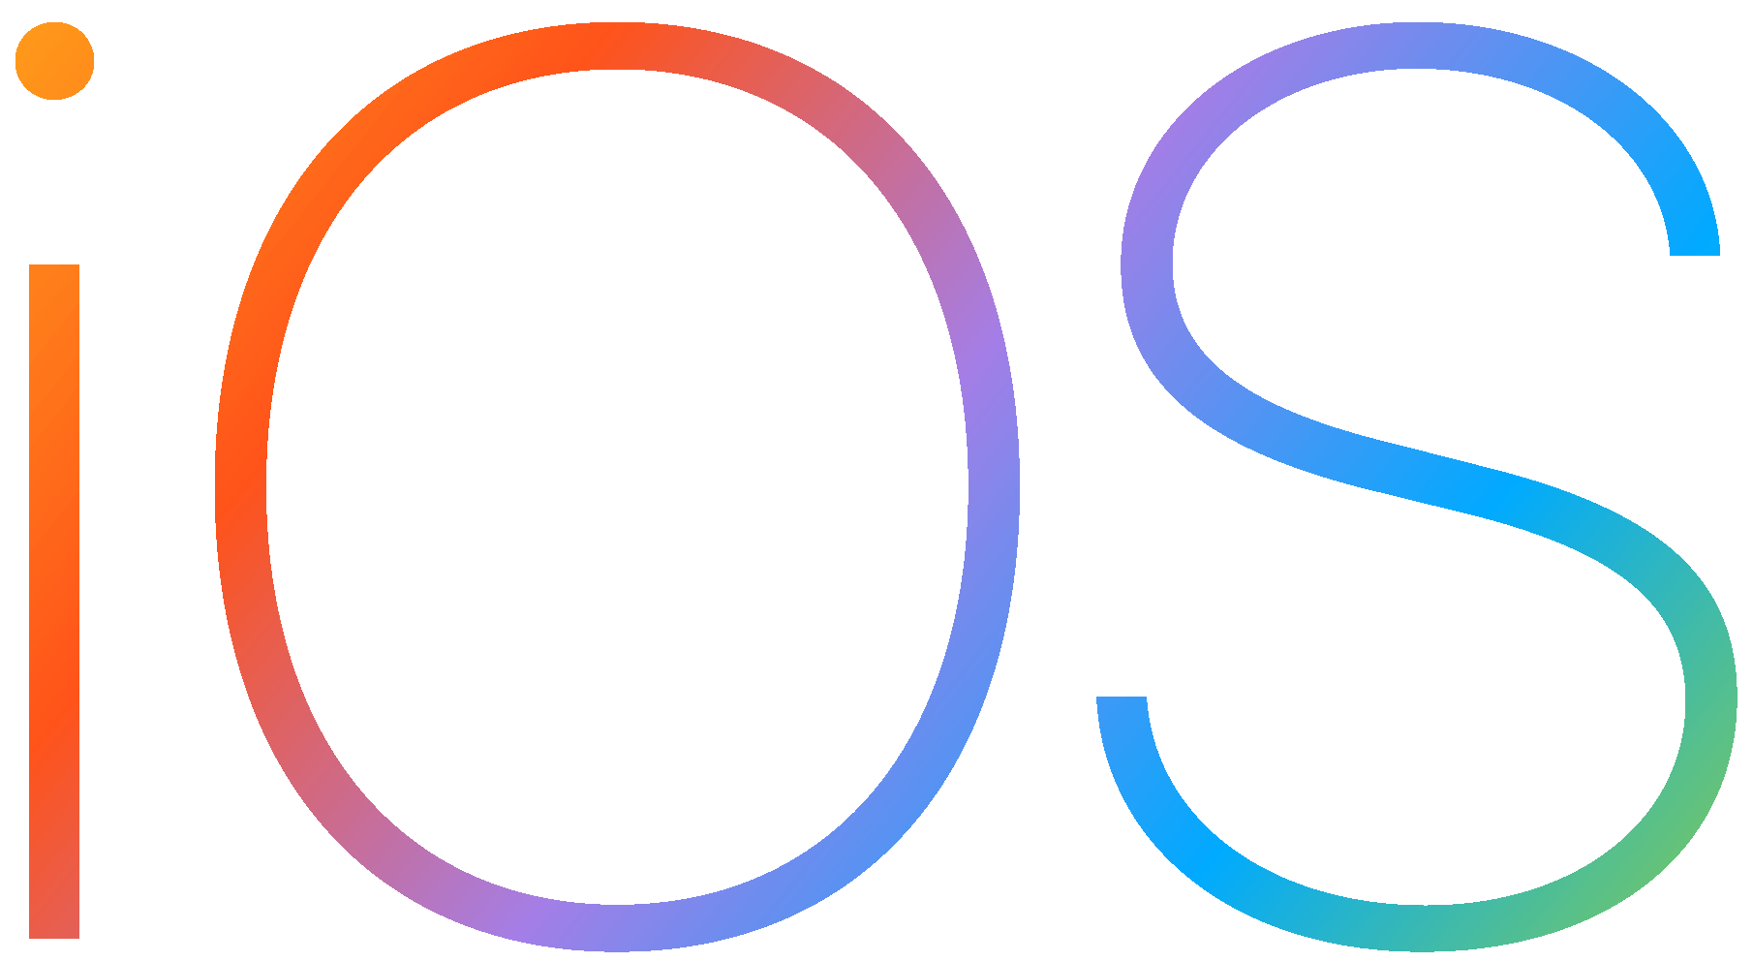
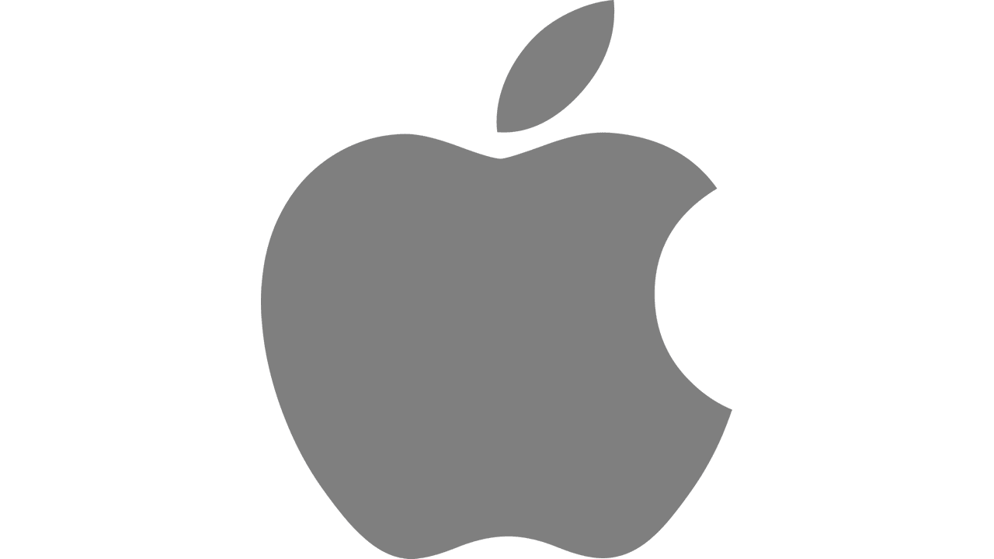
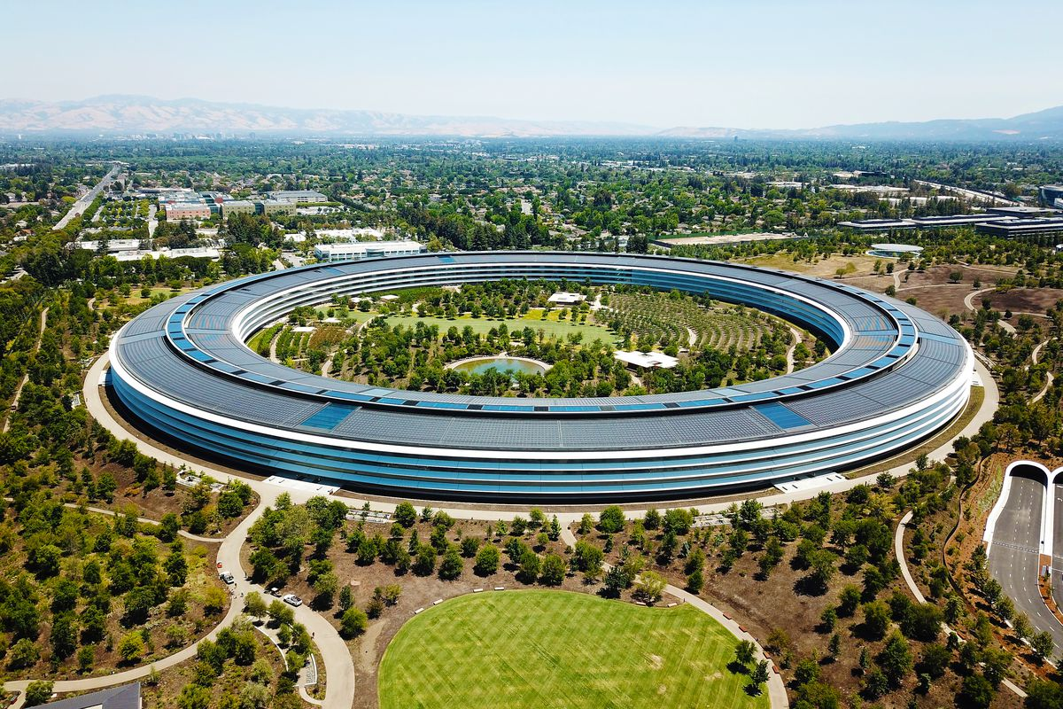
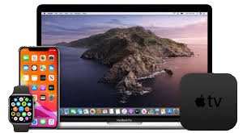

Slide 3


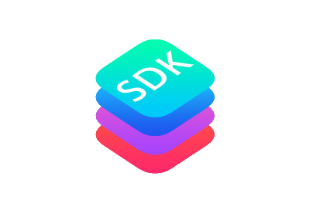
STORY
Thought in 2005
Presented in 9, january, 2007
First App Store on Juli, 10, 2008
1 million apps in 2020

Slide 4
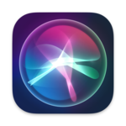


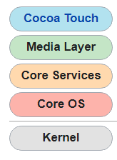
Features
SIRI
iCLOUD
SWIFT

Slide 5
Pros
UPDATE
ECOSYSTEM
SECURITY
SIMPLE
OPTIMIZED

Slide 6
Cons
LOW INTERACTIVe
Expensive developing
LOW CUSTOMIZATION
No unofficial hardware

Slide 7



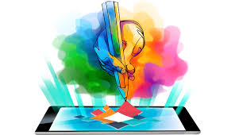
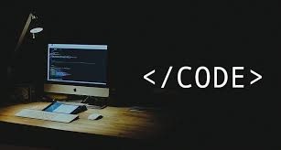
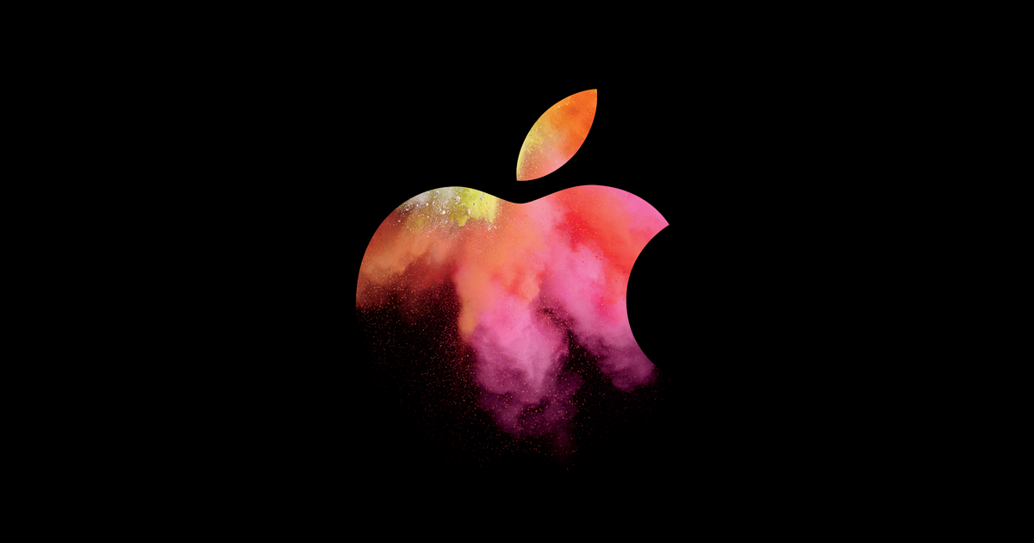

comparison
iOS
✔ | ✔ | ✔ | ✔ | ✔
✘ | ✔ | ✘ | ✘ | ✘
Android

