Slide 1
iOS Fronte Giuseppe leonardi leonardo molino donato vito puglisi andrea

Slide 2


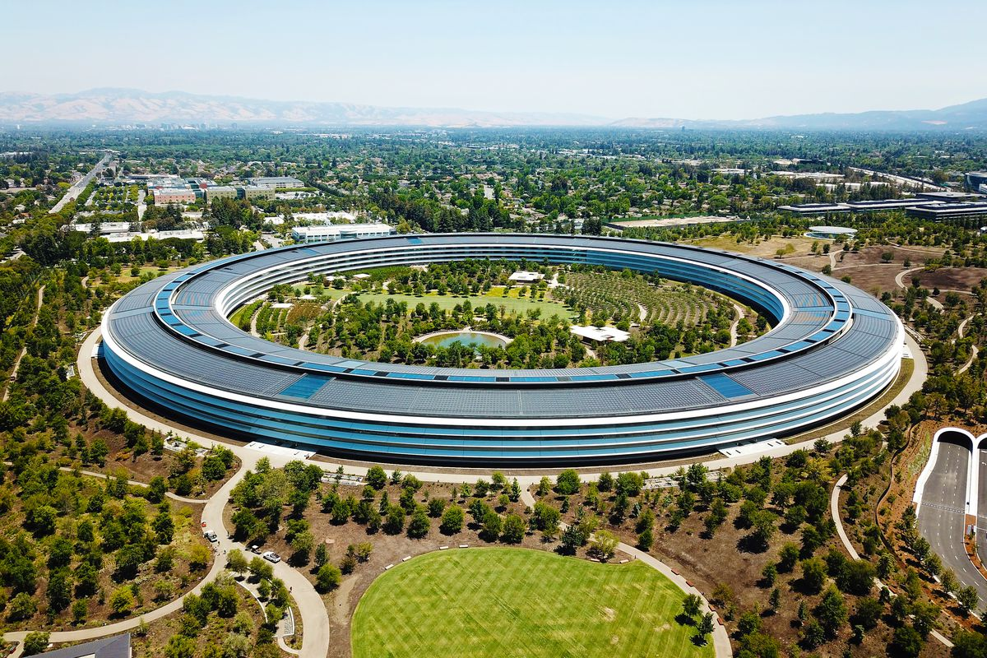
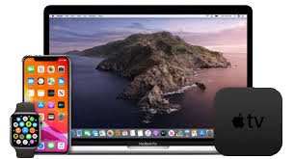

Slide 3


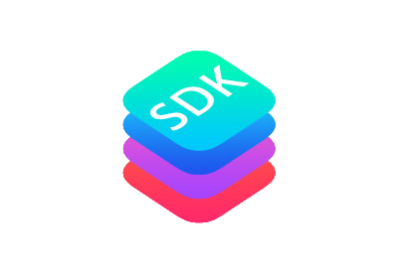
STORY
Thought in 2005
Presented in 9, january, 2007
App Store on Juli, 10, 2008
1 million apps in 2020

Slide 4



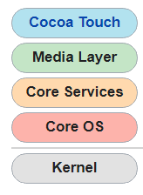
Features
SIRI
iCLOUD
SWIFT

Slide 5
Pros
UPDATE
ECOSYSTEM
SECURITY
SIMPLE
OPTIMIZED

Slide 6
Cons
LOW INTERACTIVe
Expensive developing
LOW CUSTOMIZATION
No unofficial hardware

