Slide 1
HW–SW Co‑Design Project
Roy Dayan
Dor Knafo

Slide 2
Deep Copy Benchmark

Slide 3
Overview
deepcopy python library creates a full, independent copy of complex objects (unlike shallow copy).
Goal: identify bottlenecks and optimize execution efficiency.
Tools: CPython 3.10.12 pyperformance Linux perf flame graphs

Slide 4
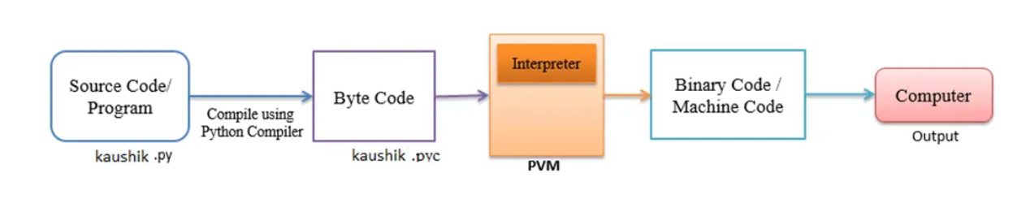
How Python Works
Cpython

Slide 5
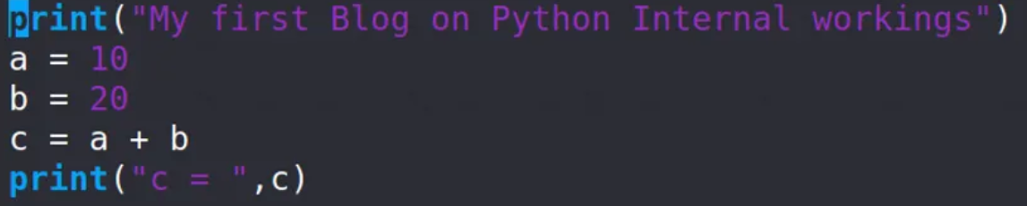

Slide 6
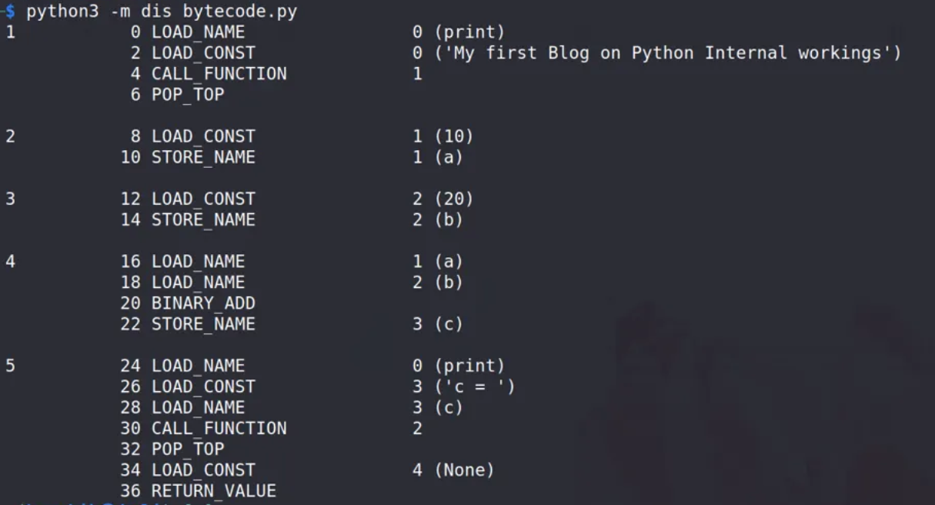

Slide 7
Initial Analysis
Baseline deepcopy profiling performed on CPython 3.10.12 using pyperformance and flame graphs.

Slide 8
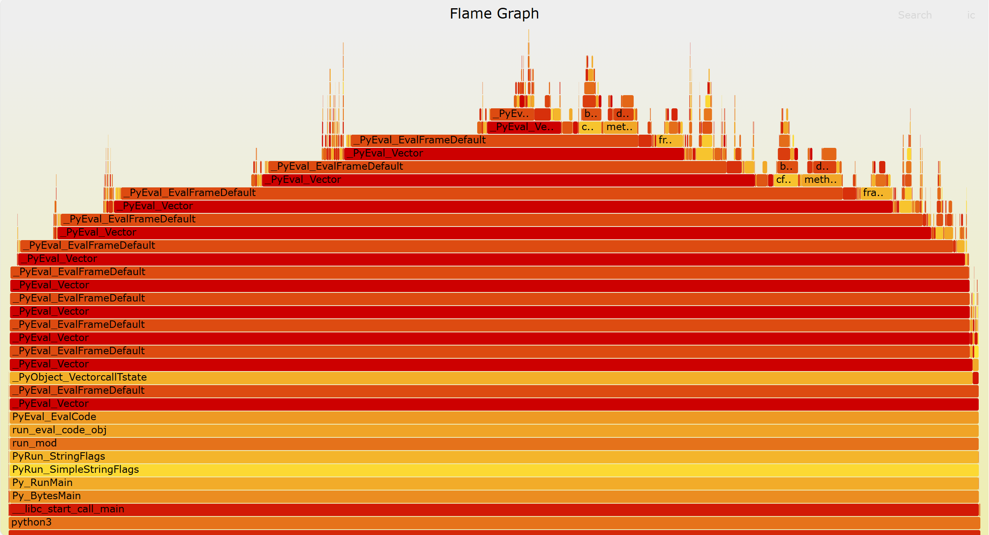

Slide 9
Initial Analysis
Most CPU time spent in the interpreter loop (PyEval_EvalFrameDefault).
Conclusion: execution time may be dominated by interpreter overhead rather than raw data movement - leading us to explore C-level optimization as the next step.

Slide 10
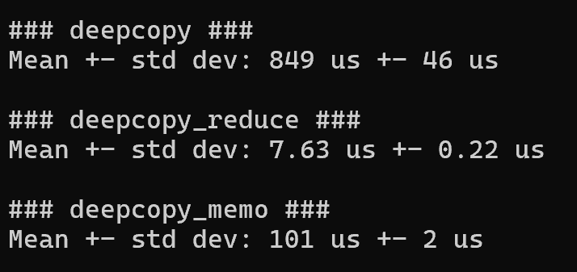
Baseline Benchmark Results

Slide 11
Optimizations
Implemented a native C extension module named fastcopy.c.
Added C implementations for lists, dicts, and tuples deep copy routines.
Modified copy.py to call these C functions directly when available.
This bypassed Python bytecode loops and reduced interpreter overhead.
Result: fewer function calls, better cache locality, and faster execution.

Slide 12
Example: C-based Optimization deepcopy_list_c

Slide 13
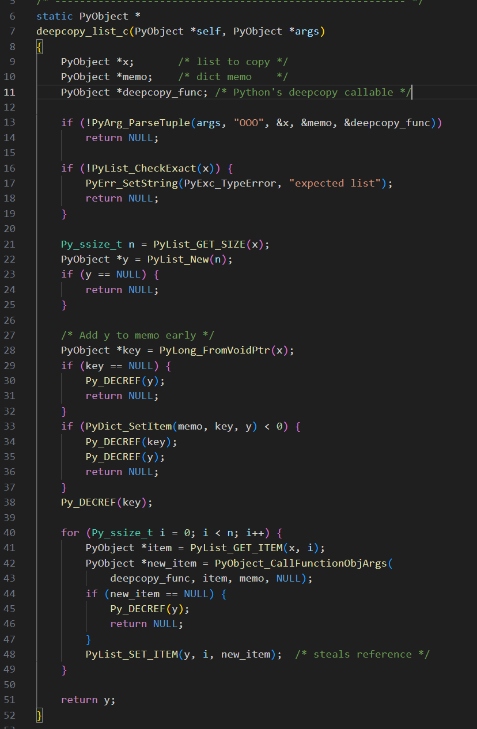
fastcopy.c

Slide 14
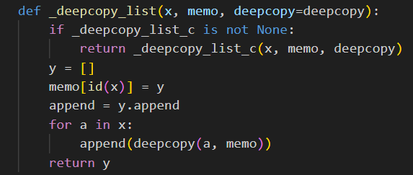
copy.py

Slide 15
Correctness Verification
Verified deepcopy correctness after optimization.
Tested nested, composite, and self-referential structures.
Ensured copies are independent and structurally identical.

Slide 16
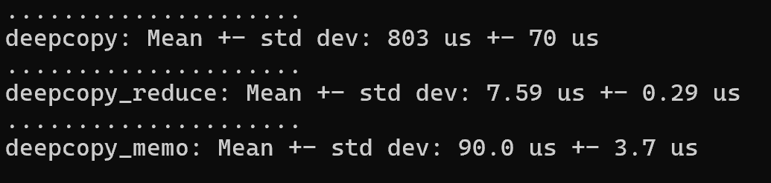
Optimized Benchmark Results

Slide 17
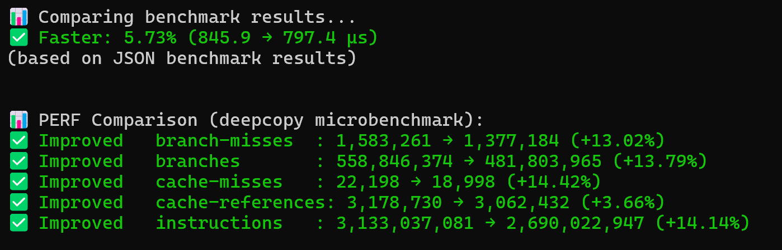

Slide 18
Performance Comparison
Optimized version achieved a better data locality.
5.73% speedup (845.9 → 794.4 µs).
Executed ~14% fewer instructions and ~13% fewer branch misses.
Reduced branching and improved cache locality due to predictable C-level loops.

Slide 19
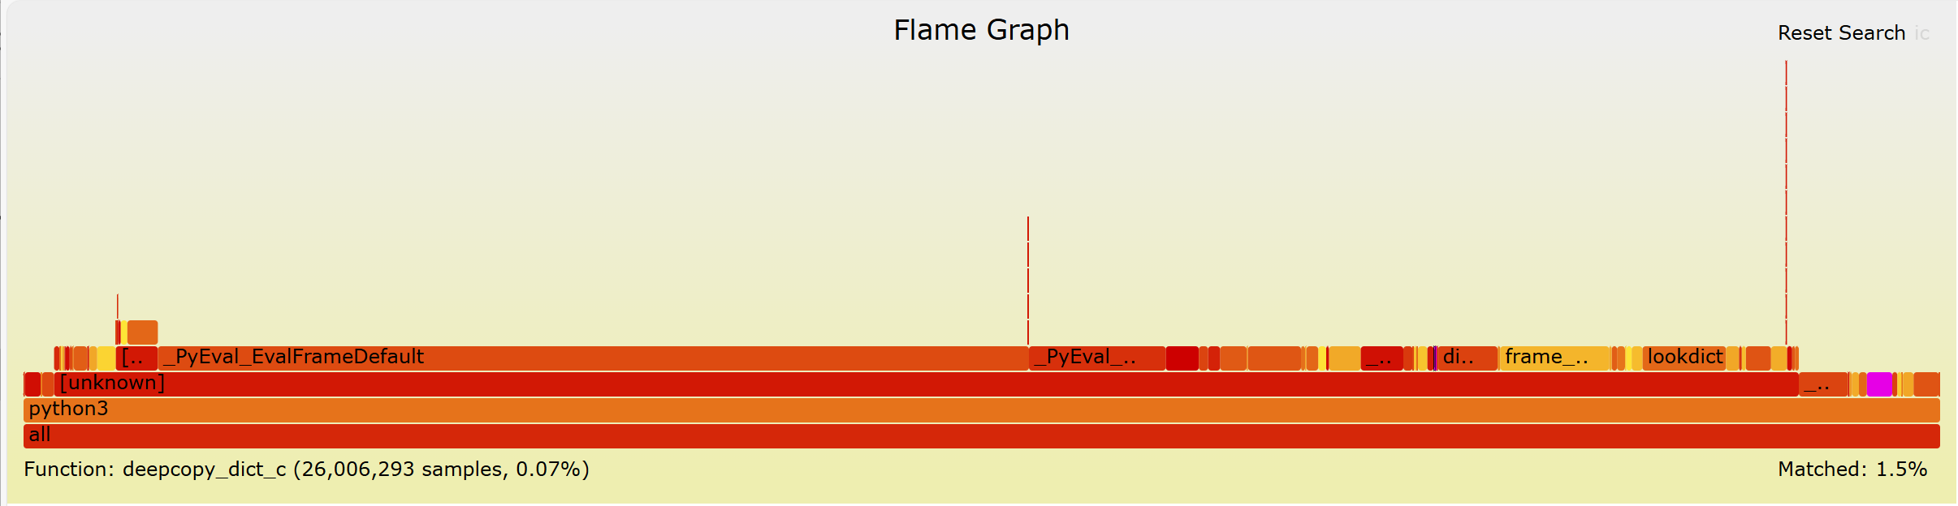

Slide 20
Hardware Acceleration Proposal
FastCopy Hardware Accelerator (FCA)
Offloads recursive deep copy operations from software to hardware.
Uses DMA and descriptor-based traversal for parallel memory copying.
Benefits: lower latency, reduced CPU load, and higher throughput.
Trade-offs: added hardware complexity and power consumption.

Slide 21
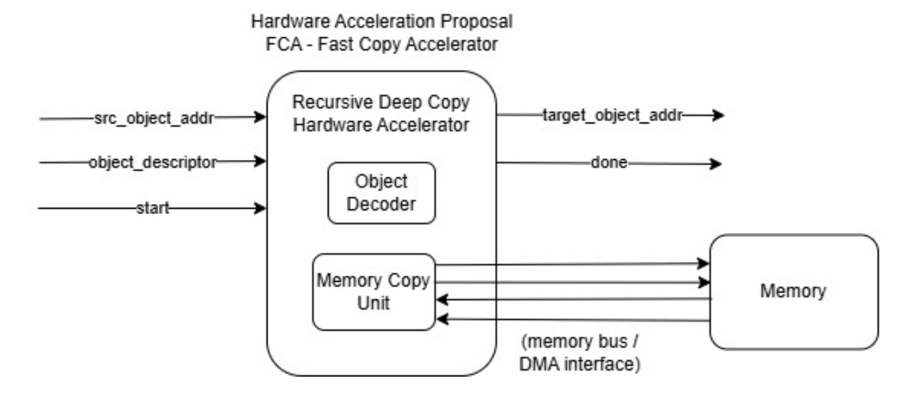
FCA Block Diagram

Slide 22
Conclusion
C-level optimization reduced deepcopy runtime by ~5.8% and cut instruction count by ~14%.
Verified full functional correctness - identical results with improved efficiency.
Proposed hardware accelerator could further enhance performance for large datasets.
Demonstrates how profiling-driven HW–SW co-design effectively removes bottlenecks and boosts execution speed.

