Slide 1
HW–SW Co‑Design Project
Roy Dayan
Dor Knafo

Slide 2
Deep Copy Benchmark

Slide 3
Overview
deepcopy python library creates a full, independent copy of complex objects (unlike shallow copy).
Goal: identify bottlenecks and optimize execution efficiency.
Tools: CPython 3.10.12 pyperformance Linux perf flame graphs

Slide 4
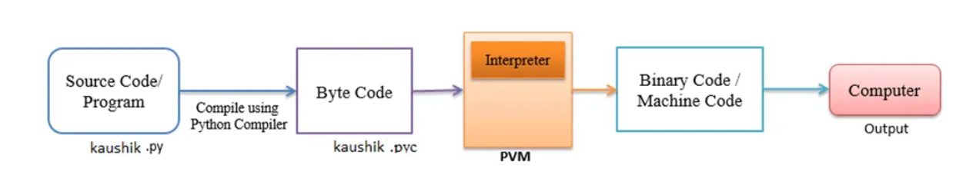
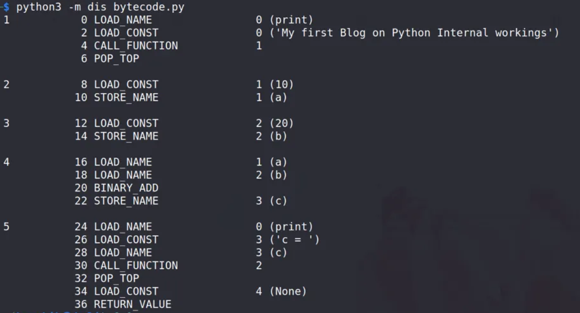
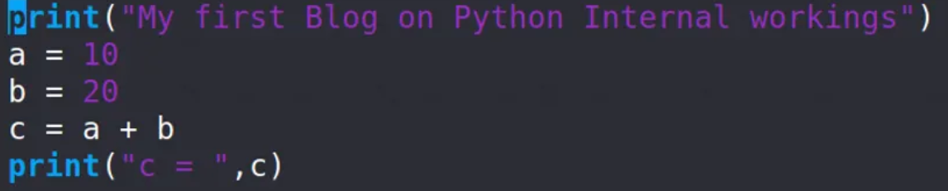
How Python Works
Cpython

Slide 5
Initial Analysis
Baseline deepcopy profiling performed on CPython 3.10.12 using pyperformance and flame graphs.

Slide 6
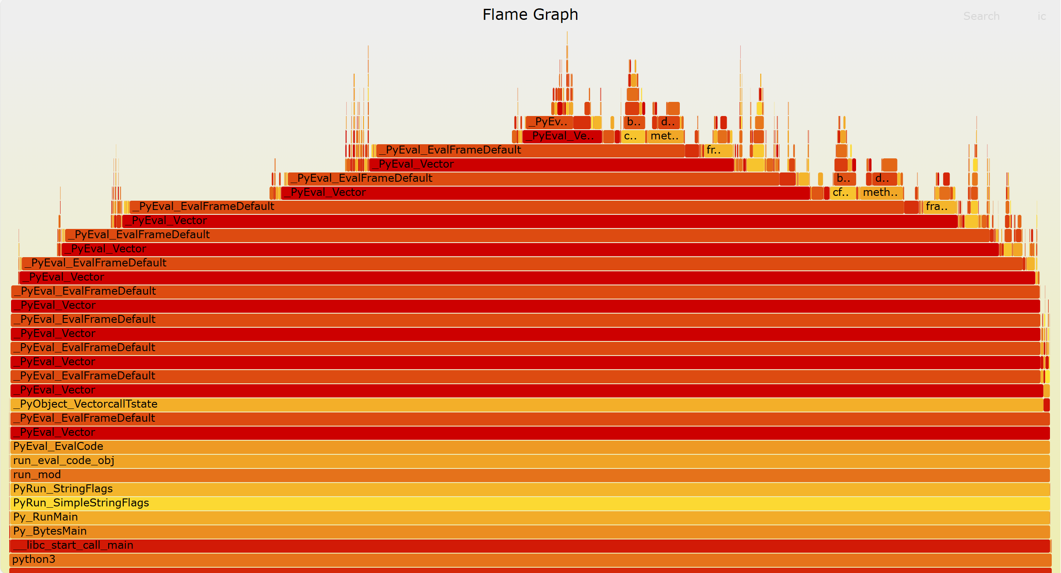

Slide 7
Initial Analysis
Most CPU time spent in the interpreter loop (PyEval_EvalFrameDefault).
Conclusion: execution time may be dominated by interpreter overhead rather than raw data movement - leading us to explore C-level optimization as the next step.

Slide 8
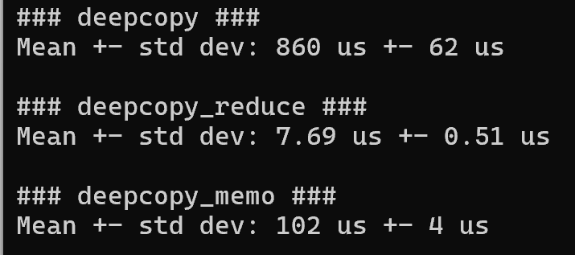
Baseline Benchmark Results

Slide 9
Optimizations
Implemented a native C extension module named fastcopy.c.
Added C implementations for lists, dicts, and tuples deep copy routines.
Modified copy.py to call these C functions directly when available.
This bypassed Python bytecode loops and reduced interpreter overhead.
Result: fewer function calls, better cache locality, and faster execution.

Slide 10
Example: C-based Optimization deepcopy_list_c

Slide 11
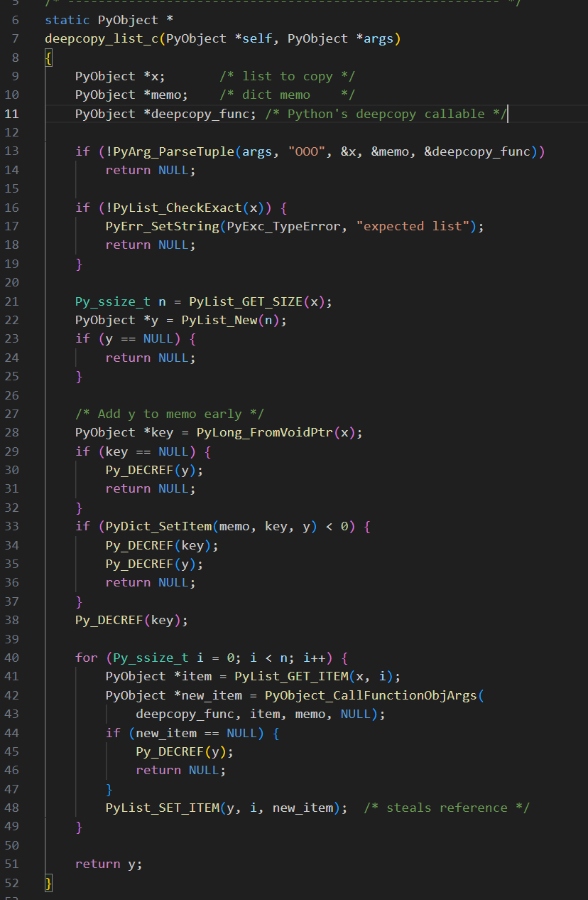
fastcopy.c

Slide 12
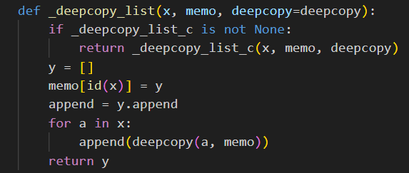
copy.py

Slide 13
Correctness Verification
Verified deepcopy correctness after optimization.
Tested nested, composite, and self-referential structures.
Ensured copies are independent and structurally identical.

Slide 14
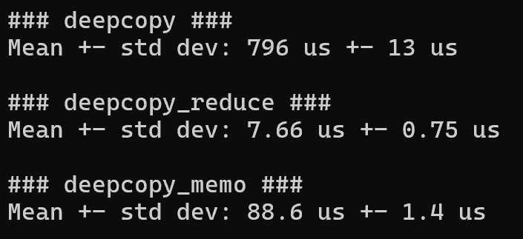
Optimized Benchmark Results

Slide 15
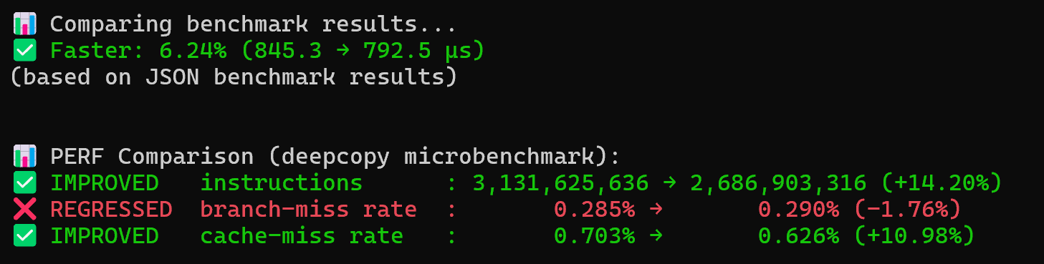
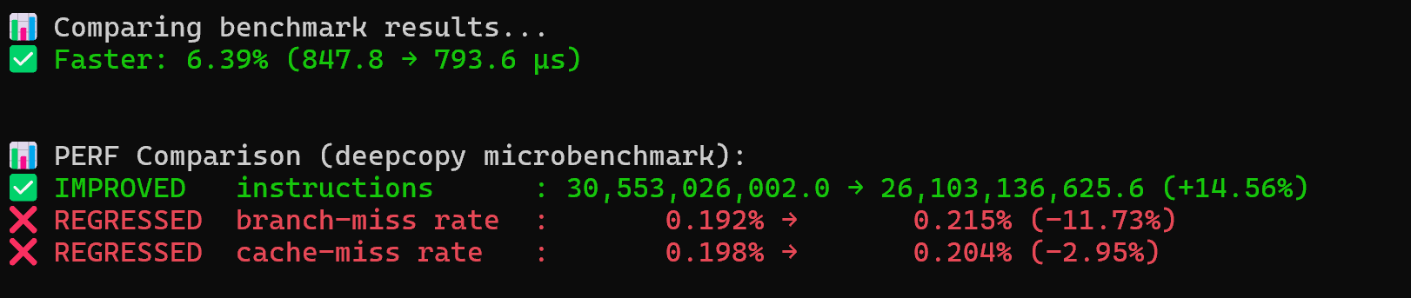
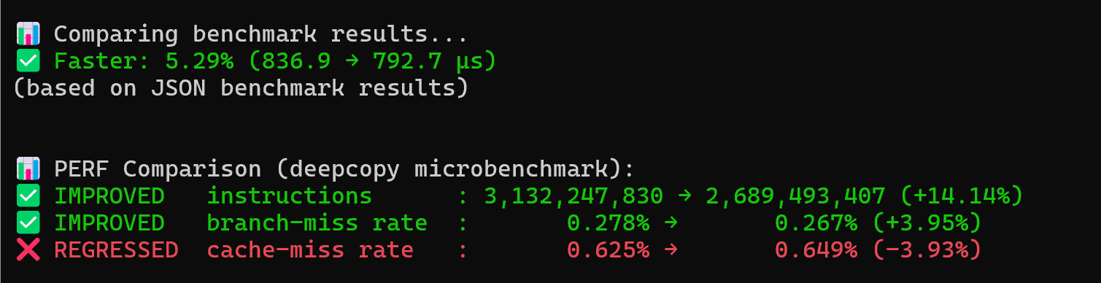

Slide 16
Performance Comparison
6.24% speedup (845.3 → 792.5 µs).
Executed ~14% fewer instructions, indicating lower CPU workload.
The performance gain mainly results from reduced interpreter loops.
Cache-miss and branch-miss rates fluctuated between runs, likely due to fewer memory accesses overall, making the relative ratios more sensitive to small variations and system noise.

Slide 17
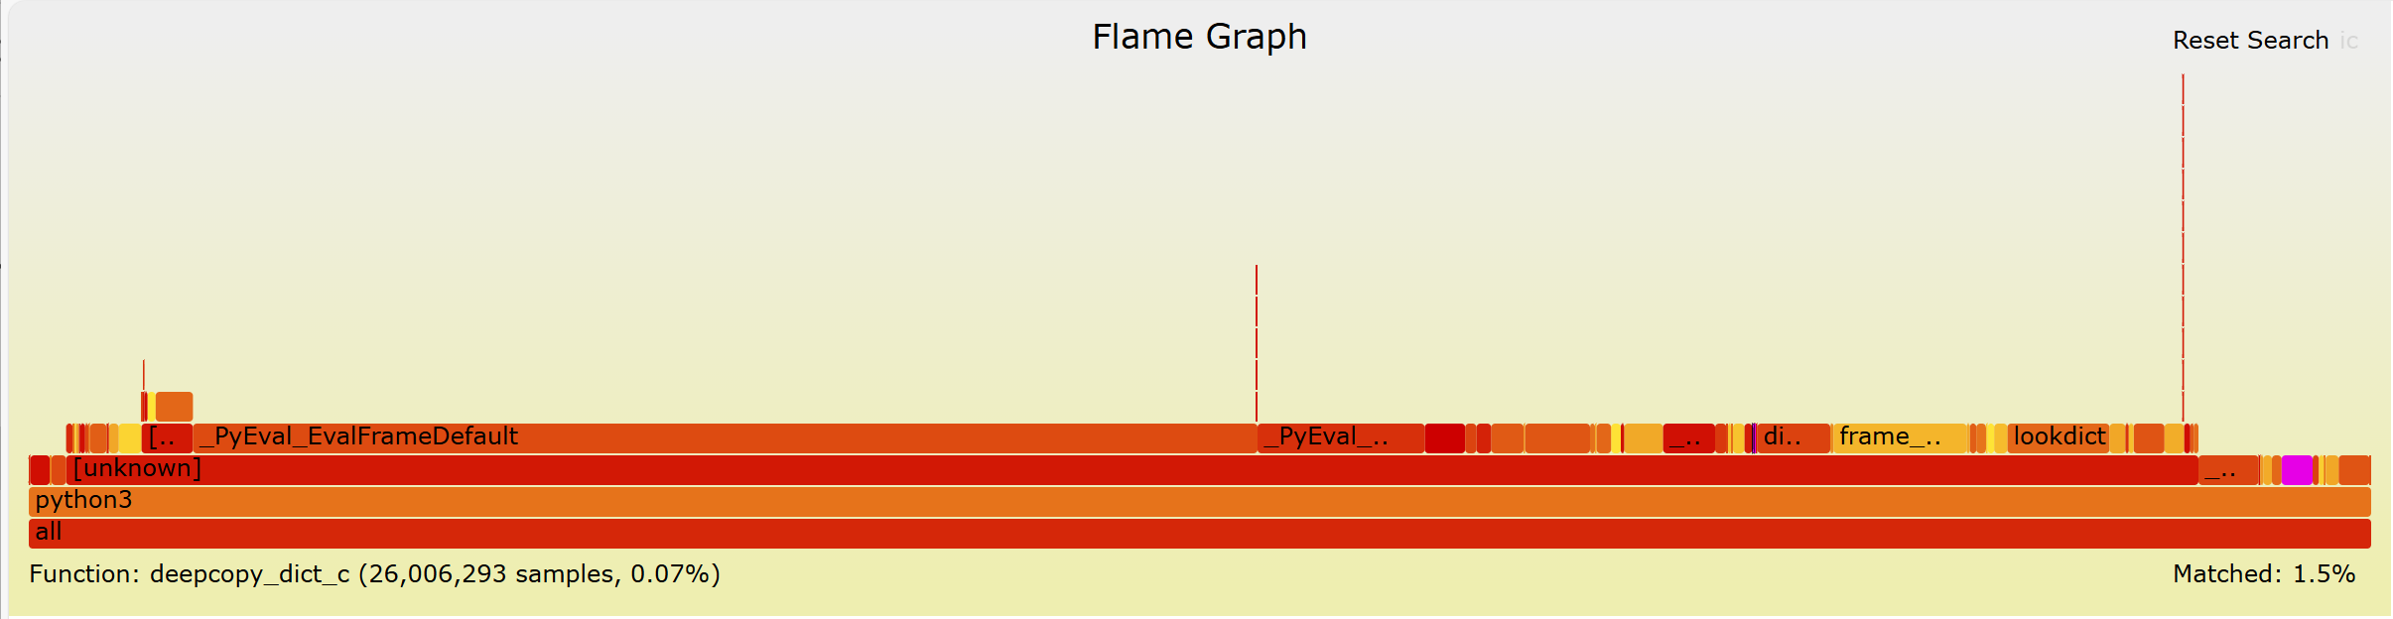

Slide 18
Hardware Acceleration Proposal
FastCopy Hardware Accelerator (FCA)
Offloads recursive deep copy operations from software to hardware.
Uses DMA and descriptor-based traversal for parallel memory copying.
Benefits: lower latency, reduced CPU load, and higher throughput.
Trade-offs: added hardware complexity and power consumption.

Slide 19
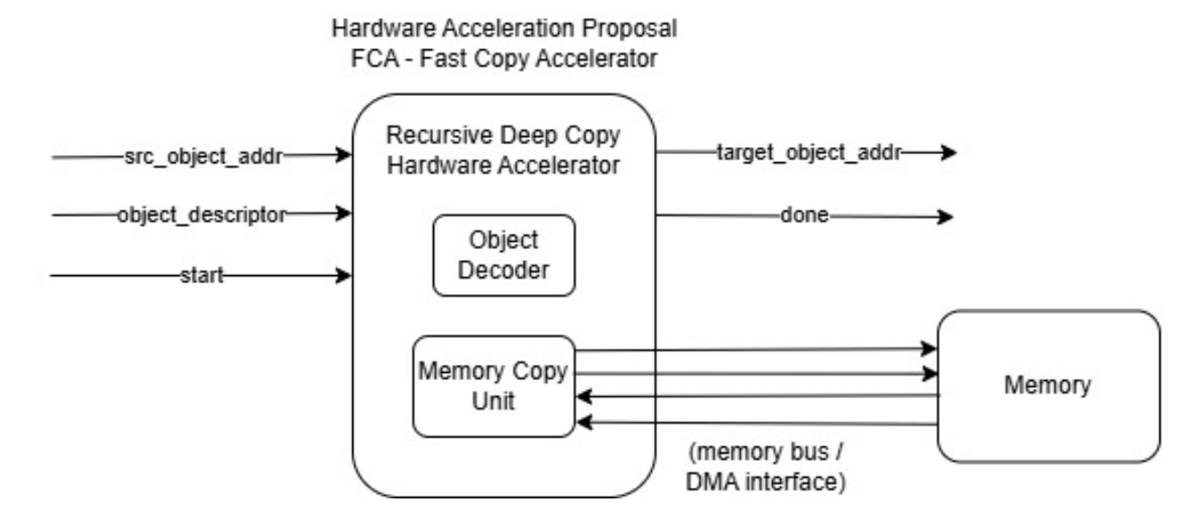
FCA Block Diagram

Slide 20
Conclusion
C-level optimization reduced deepcopy runtime by ~5.8% and cut instruction count by ~14%.
Verified full functional correctness - identical results with improved efficiency.
Proposed hardware accelerator could further enhance performance for large datasets.
Demonstrates how profiling-driven HW–SW co-design effectively removes bottlenecks and boosts execution speed.

