Slide 1
HW–SW Co‑Design Project
Roy Dayan
Dor Knafo

Slide 2
Deep Copy Benchmark

Slide 3
Overview
deepcopy python library creates a full, independent copy of complex objects (unlike shallow copy).
Goal: identify bottlenecks and optimize execution efficiency.
Tools: CPython 3.10.12 pyperformance Linux perf flame graphs

Slide 4
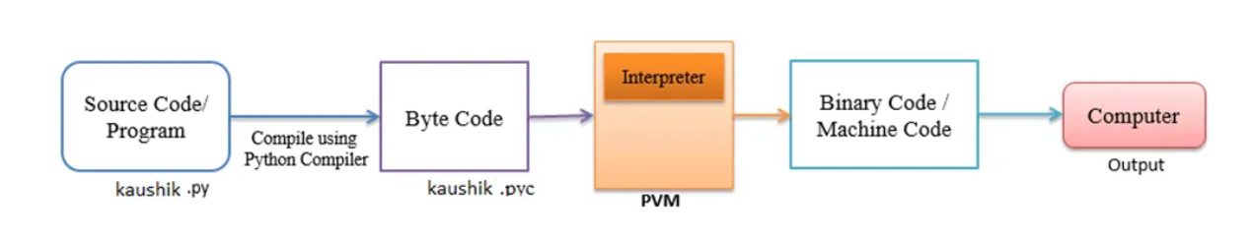
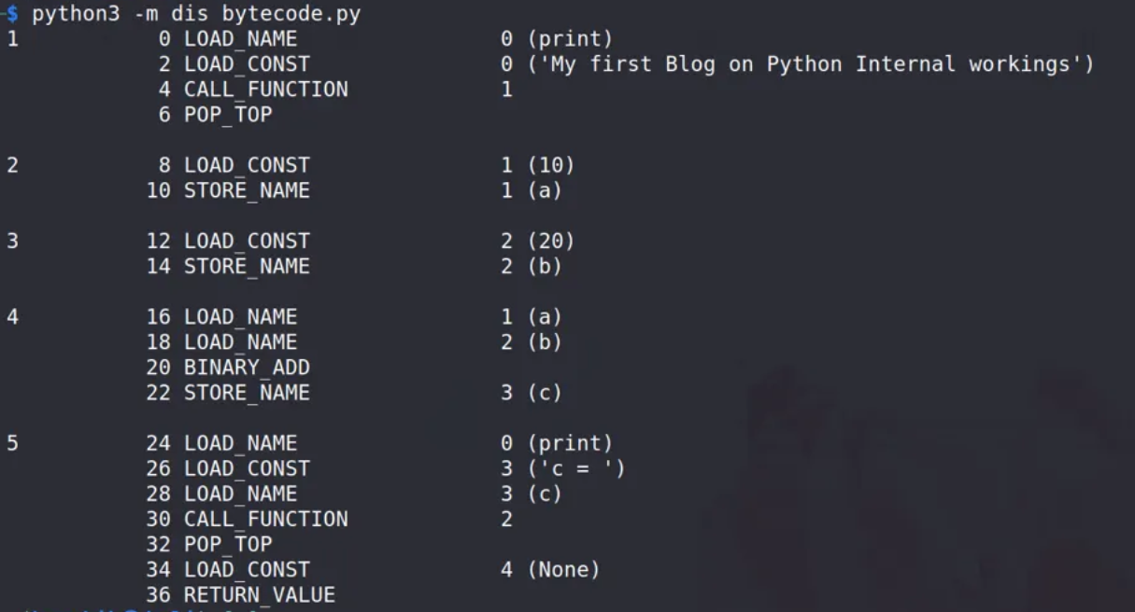
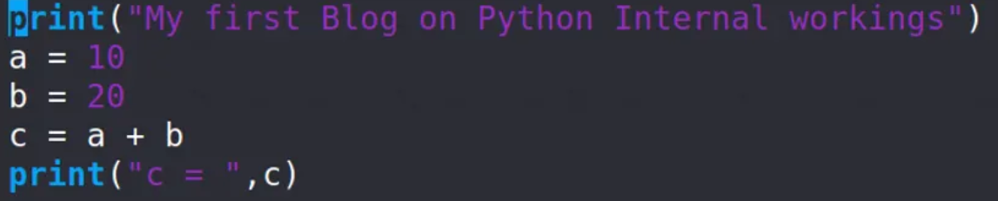
How Python Works
Cpython

Slide 5
Initial Analysis
Baseline deepcopy profiling performed on CPython 3.10.12 using pyperformance and flame graphs.

Slide 6
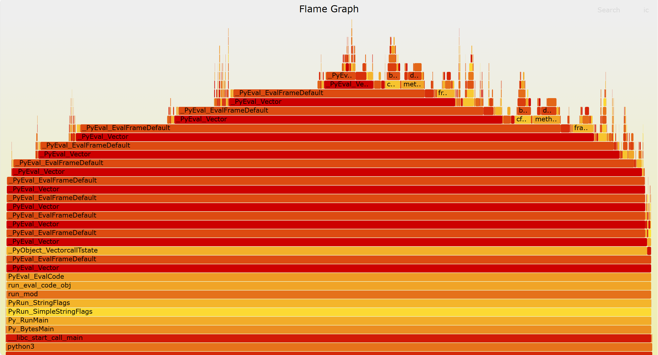

Slide 7
Initial Analysis
Most CPU time spent in the interpreter loop (PyEval_EvalFrameDefault).
Conclusion: execution time may be dominated by interpreter overhead rather than raw data movement - leading us to explore C-level optimization as the next step.

Slide 8
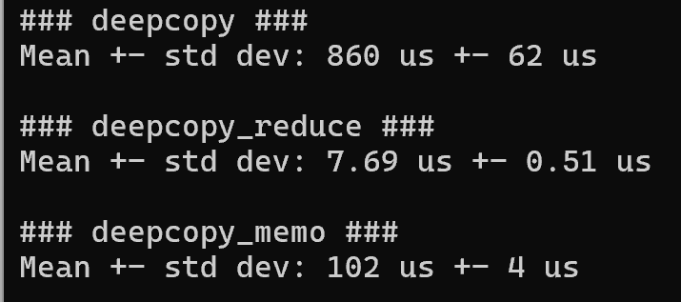
Baseline Benchmark Results

Slide 9
Optimizations
Implemented a native C extension module named fastcopy.c.
Added C implementations for lists, dicts, and tuples deep copy routines.
Modified copy.py to call these C functions directly when available.
This bypassed Python bytecode loops and reduced interpreter overhead.
Result: fewer function calls, better cache locality, and faster execution.

Slide 10
Example: C-based Optimization deepcopy_list_c

Slide 11
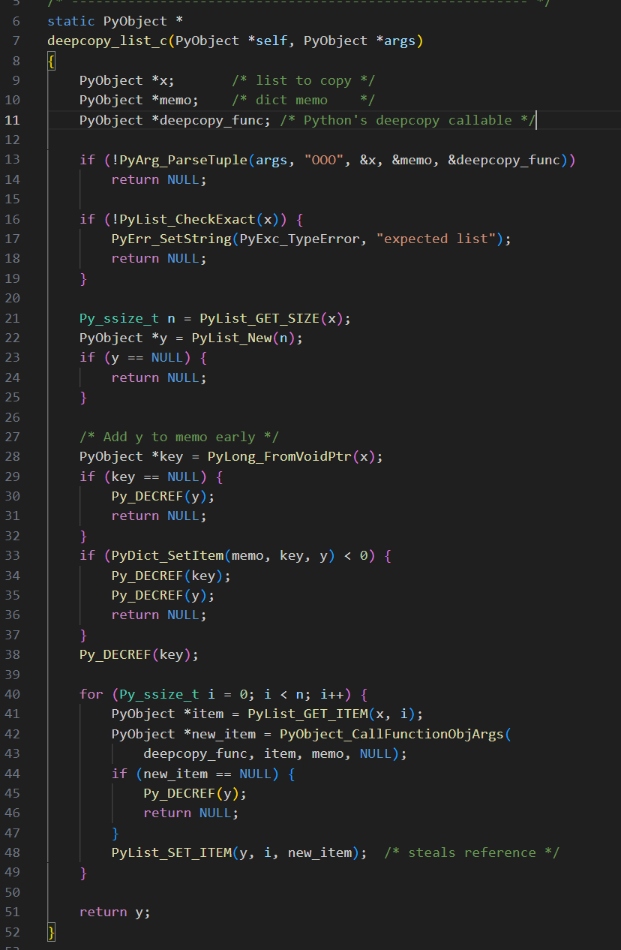
fastcopy.c

Slide 12
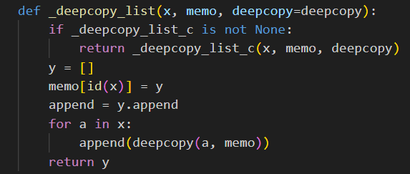
copy.py

Slide 13
Correctness Verification
Verified deepcopy correctness after optimization.
Tested nested, composite, and self-referential structures.
Ensured copies are independent and structurally identical.

Slide 14
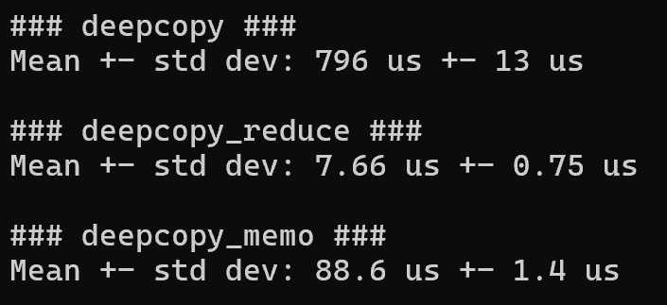
Optimized Benchmark Results

Slide 15
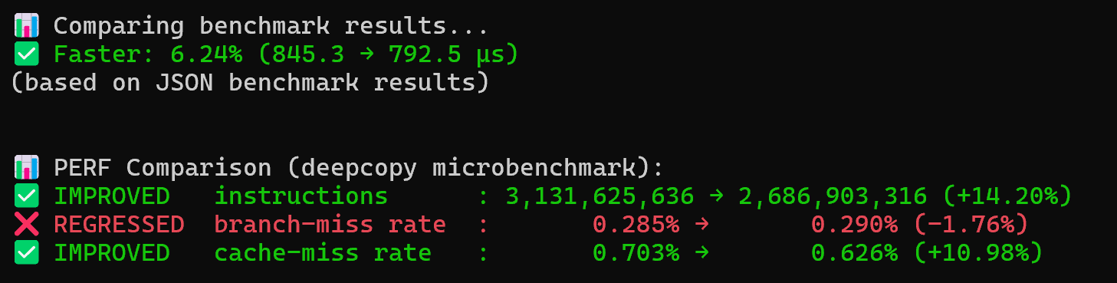
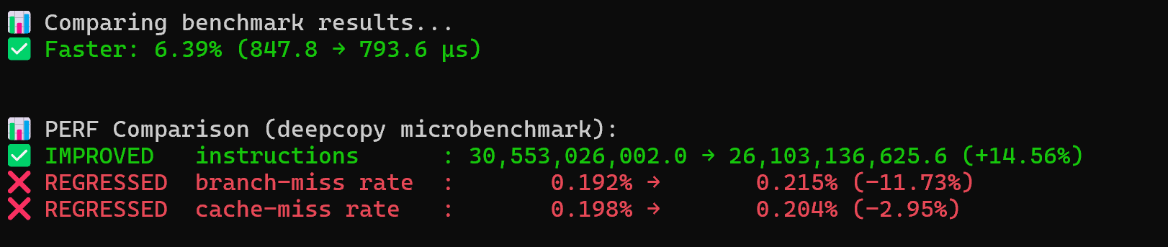
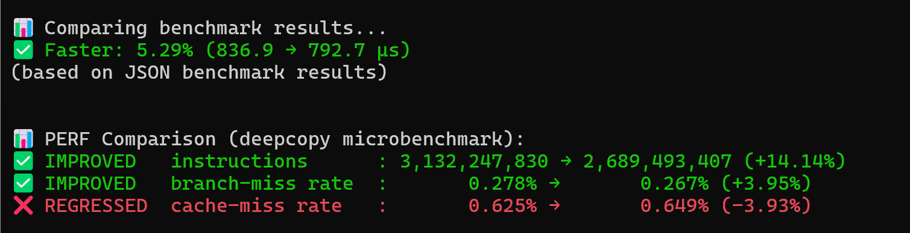

Slide 16
Performance Comparison
6.24% speedup (845.3 → 792.5 µs).
Executed ~14% fewer instructions, indicating lower CPU workload.
The performance gain mainly results from reduced interpreter loops.
Cache-miss and branch-miss rates fluctuated between runs, likely due to fewer memory accesses overall, making the relative ratios more sensitive to small variations and system noise.

Slide 17
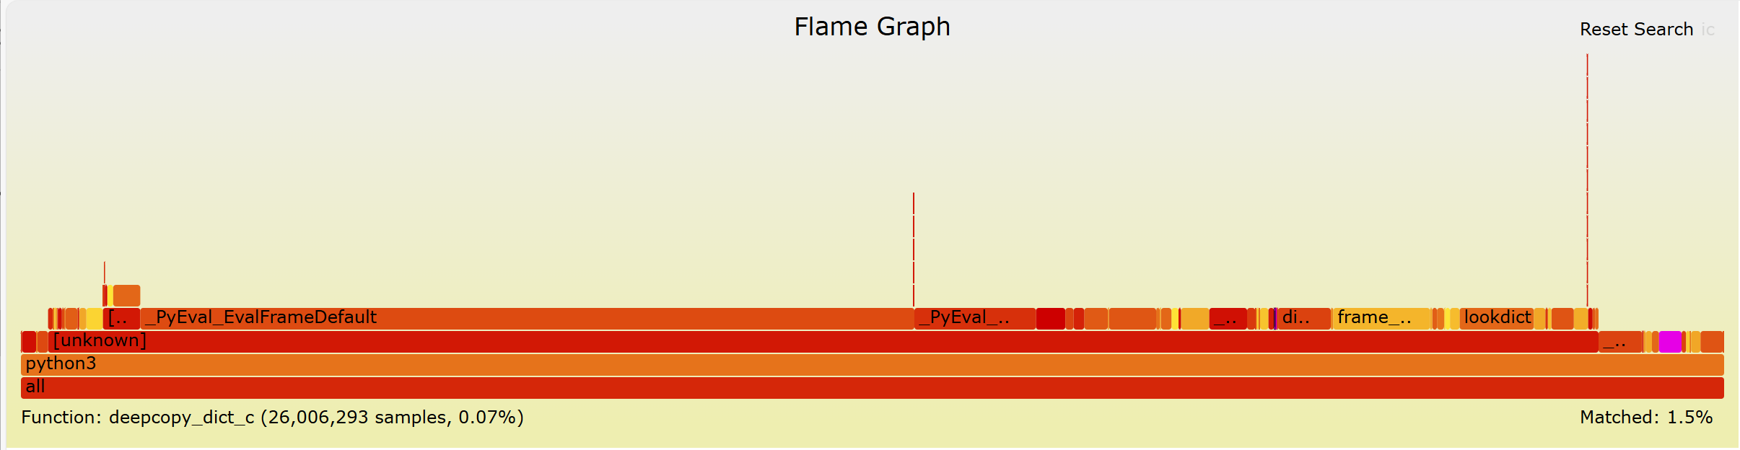

Slide 18
Hardware Acceleration Proposal
FastCopy Hardware Accelerator (FCA)
Offloads recursive deep copy operations from software to hardware.
Uses DMA and descriptor-based traversal for parallel memory copying.
Benefits: lower latency, reduced CPU load, and higher throughput.
Trade-offs: added hardware complexity and power consumption.

Slide 19
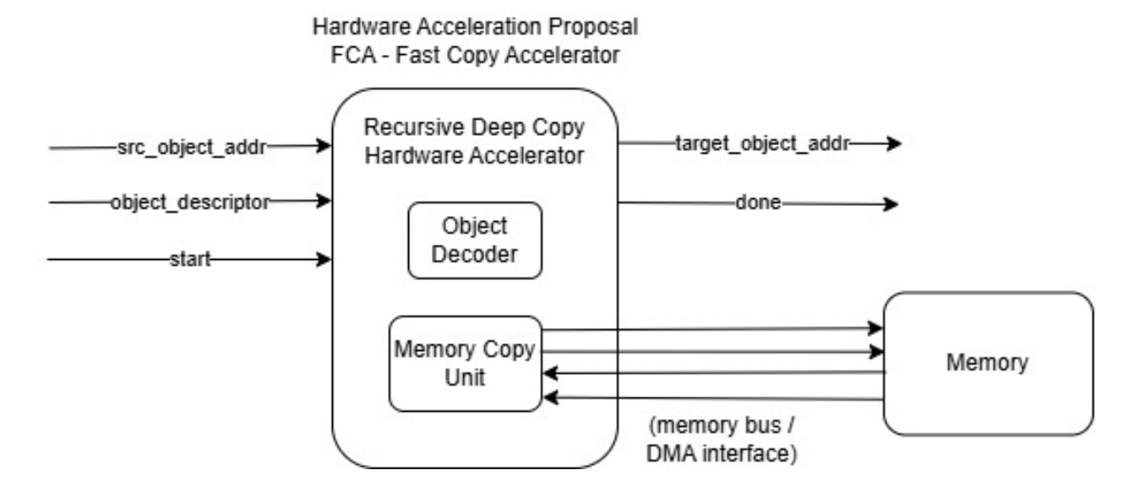
FCA Block Diagram

Slide 20
Conclusion
C-level optimization reduced deepcopy runtime by ~5.8% and cut instruction count by ~14%.
Verified full functional correctness - identical results with improved efficiency.
Proposed hardware accelerator could further enhance performance for large datasets.
Demonstrates how profiling-driven HW–SW co-design effectively removes bottlenecks and boosts execution speed.

Slide 21
Json Dumps Benchmark

Slide 22
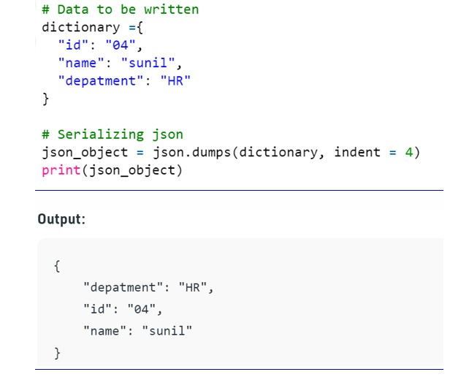
Overview
json.dumps converts Python objects to JSON-formatted strings

Slide 23
Overview
pyperformance json_dumps repeats serialization of nested objects
Workflow:
profile → identify bottlenecks → optimize → re‑measure
Preliminary result: stdlib json = 62.2 ms ± 0.5 ms

Slide 24
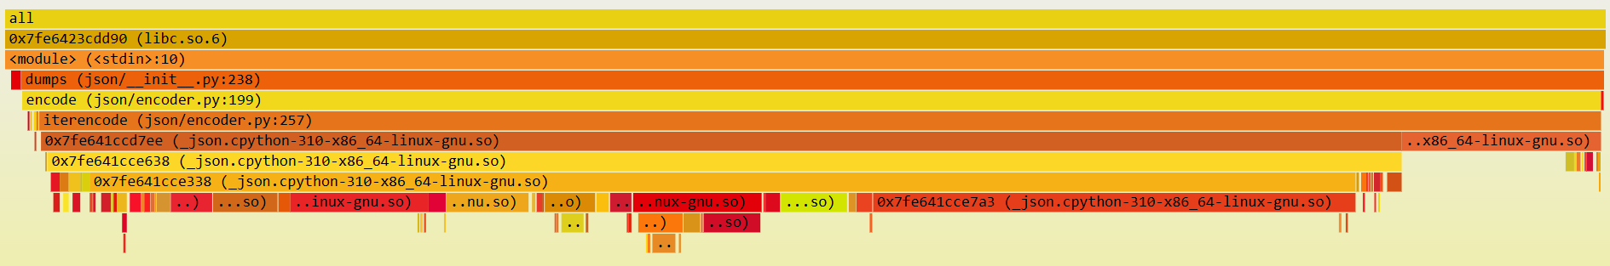
Initial Analysis
Ran microbenchmark with stdlib json
Generated flame graph:
Bottlenecks?

Slide 25
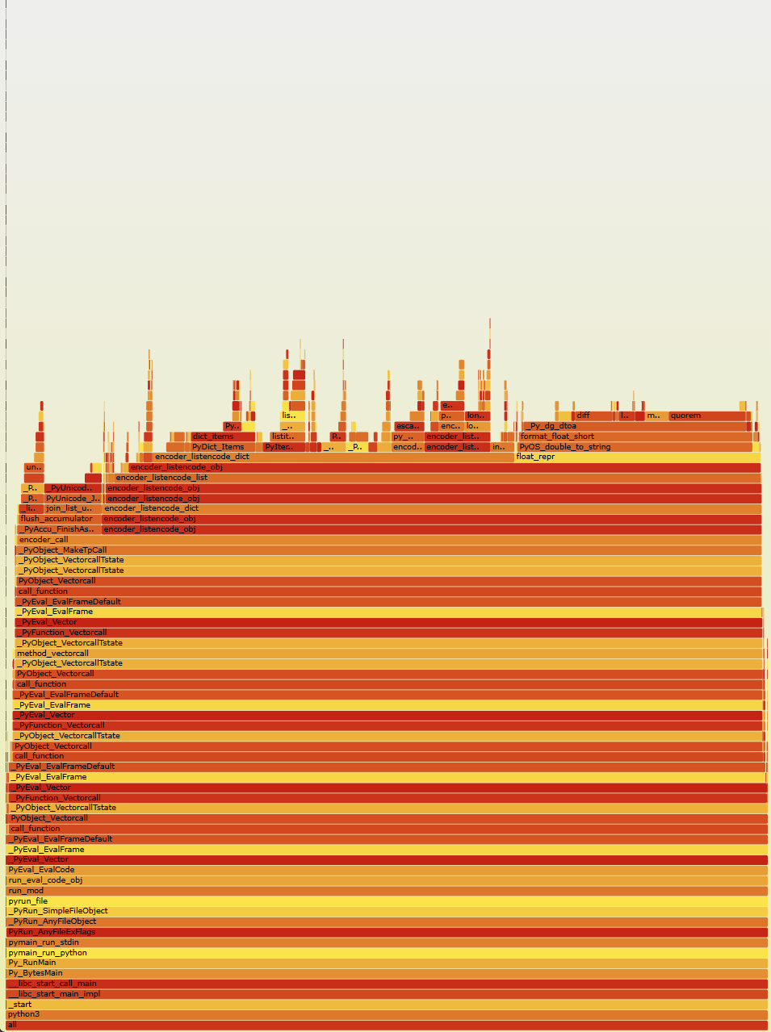
Initial Analysis
Stdlib json already has native C speedups!
Without C speedups:
With C speedups:

Slide 26
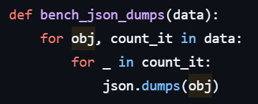
Initial Analysis
Note the python stack is “deep”
pyperformance main loop:
dumps calls JSONEncoder::encode which calls iterencode
Lots of conditionals and eventually calls C functions to encode
Program spends long time in python → seek to minimize

Slide 27


Optimization – Substitute orjson
High-performance JSON library
Native Rust implementation
Avoids slow Python conditionals and interpreter overhead
Utilizes SIMD to process multiple characters in parallel
Result: stdlib json = 62.2 ms ± 0.5 ms; orjson = 11.9 ms ± 0.1 ms

Slide 28
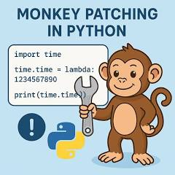

Integration - routing calls to orjson
“Monkey‑patch” json.dumps → orjson.dumps
Create sitecustomize.py and put in PYTHONPATH folder (env variable)
Run benchmark with flag for pyperformance processes to see patch
# Monkey‑patch json.dumps to use orjson.dumps PATCHDIR=$(mktemp -d) cat > "$PATCHDIR/sitecustomize.py" <<'PY' import json try: import orjson json.dumps = lambda obj, *a, **kw: orjson.dumps(obj).decode("utf-8") except Exception as e: import sys print("[sitecustomize] orjson patch failed:", e, file=sys.stderr) PY export PYTHONPATH="$PATCHDIR"
# Run benchmark with flag python3-dbg -m pyperformance run --bench json_dumps --inherit-environ=PYTHONPATH

Slide 29
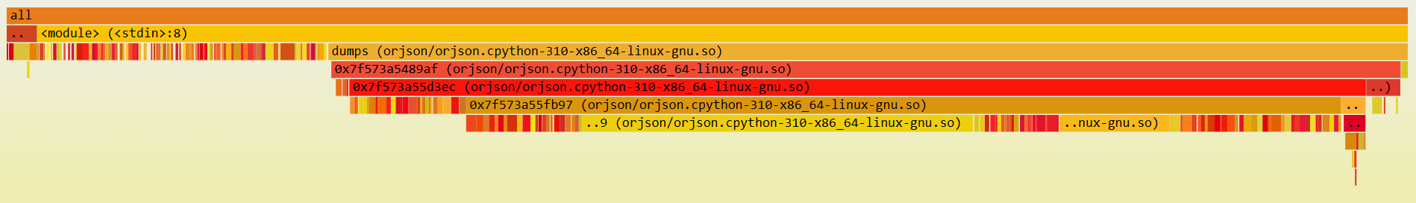
Optimized Analysis — orjson
Flame graph on same microbenchmark:
Shallow native stack
Interpreter frames largely gone

Slide 30
Runtime – pyperformance
Variant | Mean ± stdev (ms) | Δ vs. baseline
stdlib json.dumps | 62.2 ± 0.5 | —
orjson (patched) | 11.9 ± 0.1 | −80.9% (~5.24×)

Slide 31
HW counters – perf stat
Metric | stdlib | orjson | Change
instructions | 167,287,865,175 | 96,822,927,687 | −42.1%
branches | 35,540,658,013 | 20,984,549,290 | −41.0%
branch misses | 335,263,393 | 156,514,197 | −53.3%
cache misses (% of total accesses) | 17,259,734 (2.64%) | 6,968,728 (2.15%) | −59.6%
IPC | 1.83 | 1.93 | +5.5%
Elapsed (s) | 39.91 | 20.30 | −49.1%
Note: stats from full pyperformance program

Slide 32
Hardware Acceleration Proposal
JSON Encode Accelerator (JEA)
Motivation:
Heavy encoding (UTF-8), number→text formatting, special char handling
Aim: offload to HW
Implementation:
SW iterates over Python object with simple prepare_tokens()
Stores ‘token’ stream + string lookup table in memory
Tokens are coded components of the object
Table translates IDs individual strings
HW accesses stream + table to encode JSON string and writes into buffer
Treats tokens as its ISA!

Slide 33
Token Generation
Object: {"a": 1, "ab": [2, "x"]}
Token Stream: OBJ_BEGIN
KEY( id=0 ) # "a"
VAL_INT(1)
KEY( id=1 ) # "ab"
ARR_BEGIN
VAL_INT(2)
VAL_STRING(id=2) # "x"
ARR_END
OBJ_END
Table: 0 – “a”, 1-“ab”, 2-“x”

Slide 34
HW-SW Interface
Inputs: token stream, lookup table, doorbells, options
Outputs: contiguous JSON-formatted string, completion element
Requirement:
Edit orjson library: prepare_tokens(obj) -> (tokens, str_table)
Enable doorbells thru driver
Enable JEA DMA-read tokens+table, write into provided buffer
Completion + SW poll&read → return JSON-formatted string

Slide 35
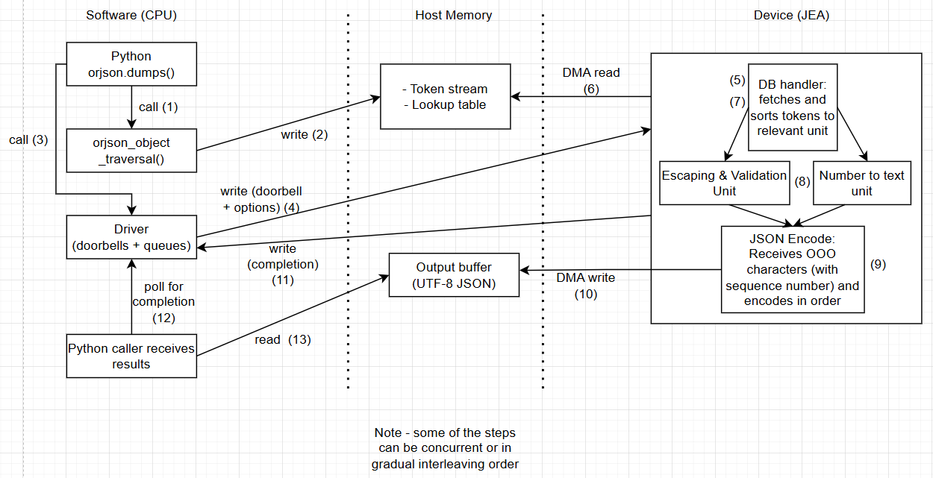
JEA Block Diagram

Slide 36
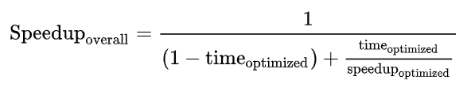
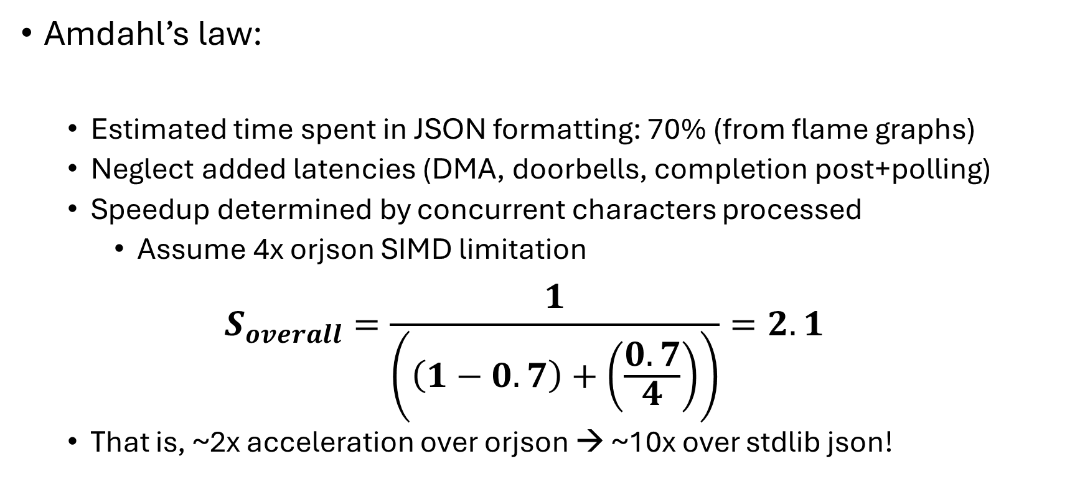
JEA Performance Analysis
Amdahl’s law:
Estimated time spent in JSON formatting: 70% (from flame graphs)
Neglect added latencies (DMA, doorbells, completion post+polling)
Speedup determined by concurrent characters processed
Assume 4x orjson SIMD limitation
$$S_{overall}=\frac{1}{\left(\left(1−0.7\right)+\left(\frac{0.7}{4}\right)\right)}=2.1$$
That is, ~2x acceleration over orjson → ~10x over stdlib json!

Slide 37
JEA Area/Power Trade-offs
Area:
Character formatting logic (small)
DMA unit, caches (scale with performance gains)
More parallelism → better performance, larger inputs and caches
Niche unit (though can be adapted for other vectorized operations)
Power
Efficient per-character encoding
SRAMs for stream, table fetching and reorder buffers

Slide 38
Conclusion
orjson delivers 5× speedup over stdlib
Eliminates python stack and interpreter overhead
Utilizes SIMD capabilities for parallel string processing
Perf counters confirm efficiency
JEA provides additional 2× speedup by offloading heavy encoding
HW-SW co‑design produces substantial gains ☺

