Slide 1

A study of the influence of news reports and other contextual open-source
information on the consumer behavior of bank card users
Student: Grigoryev Mikhail, J4133c
Supervisor: Chunaev Petr Vladimirovich Associate Professor, Department of Digital Transformation Consultant: Kovantsev Anton Nikolaevich

Slide 2
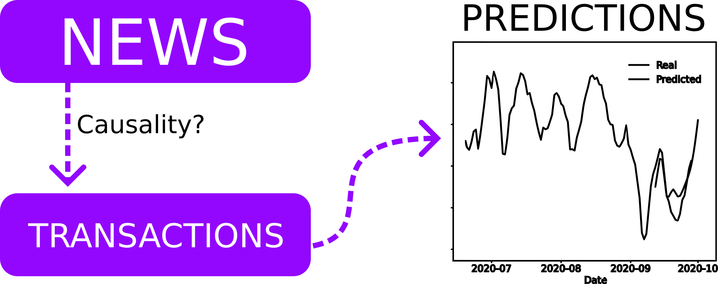
Application

Slide 3
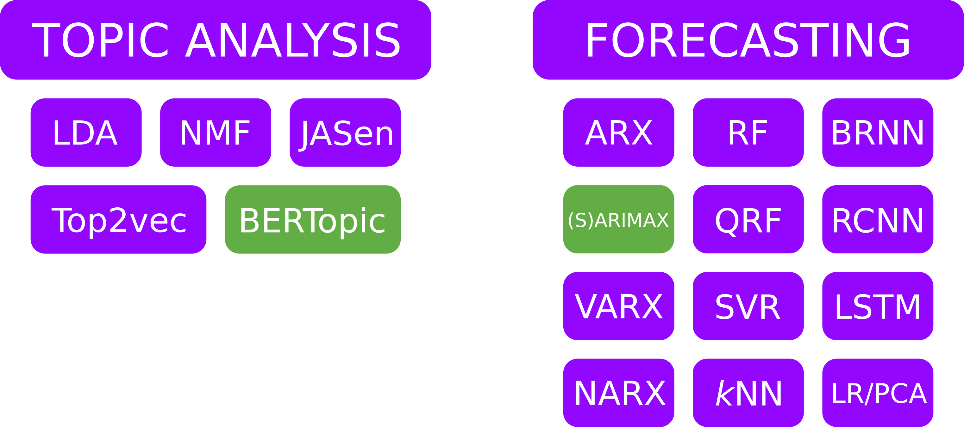
Literature overview

Slide 4
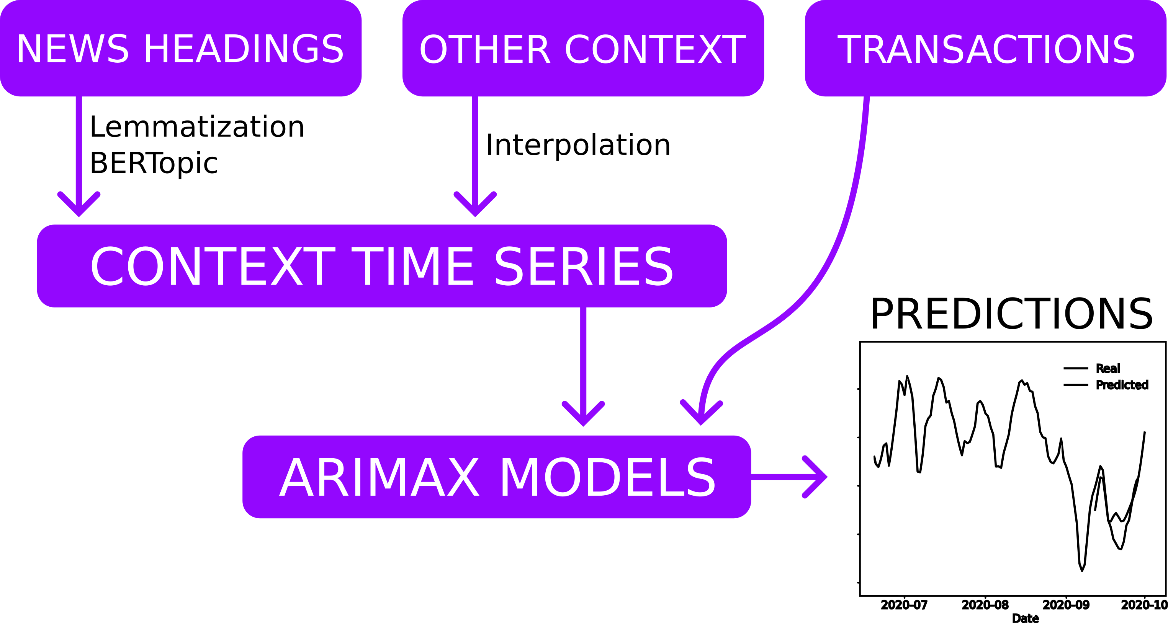
Plan of the experiment

Slide 5
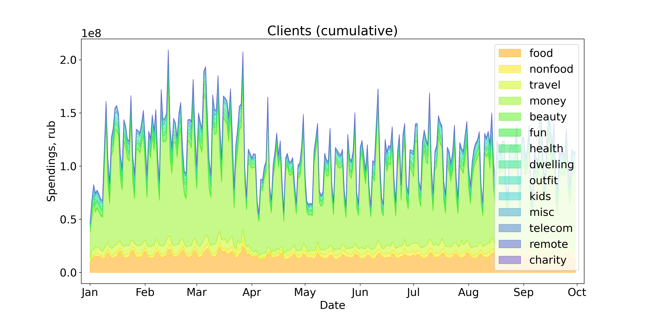
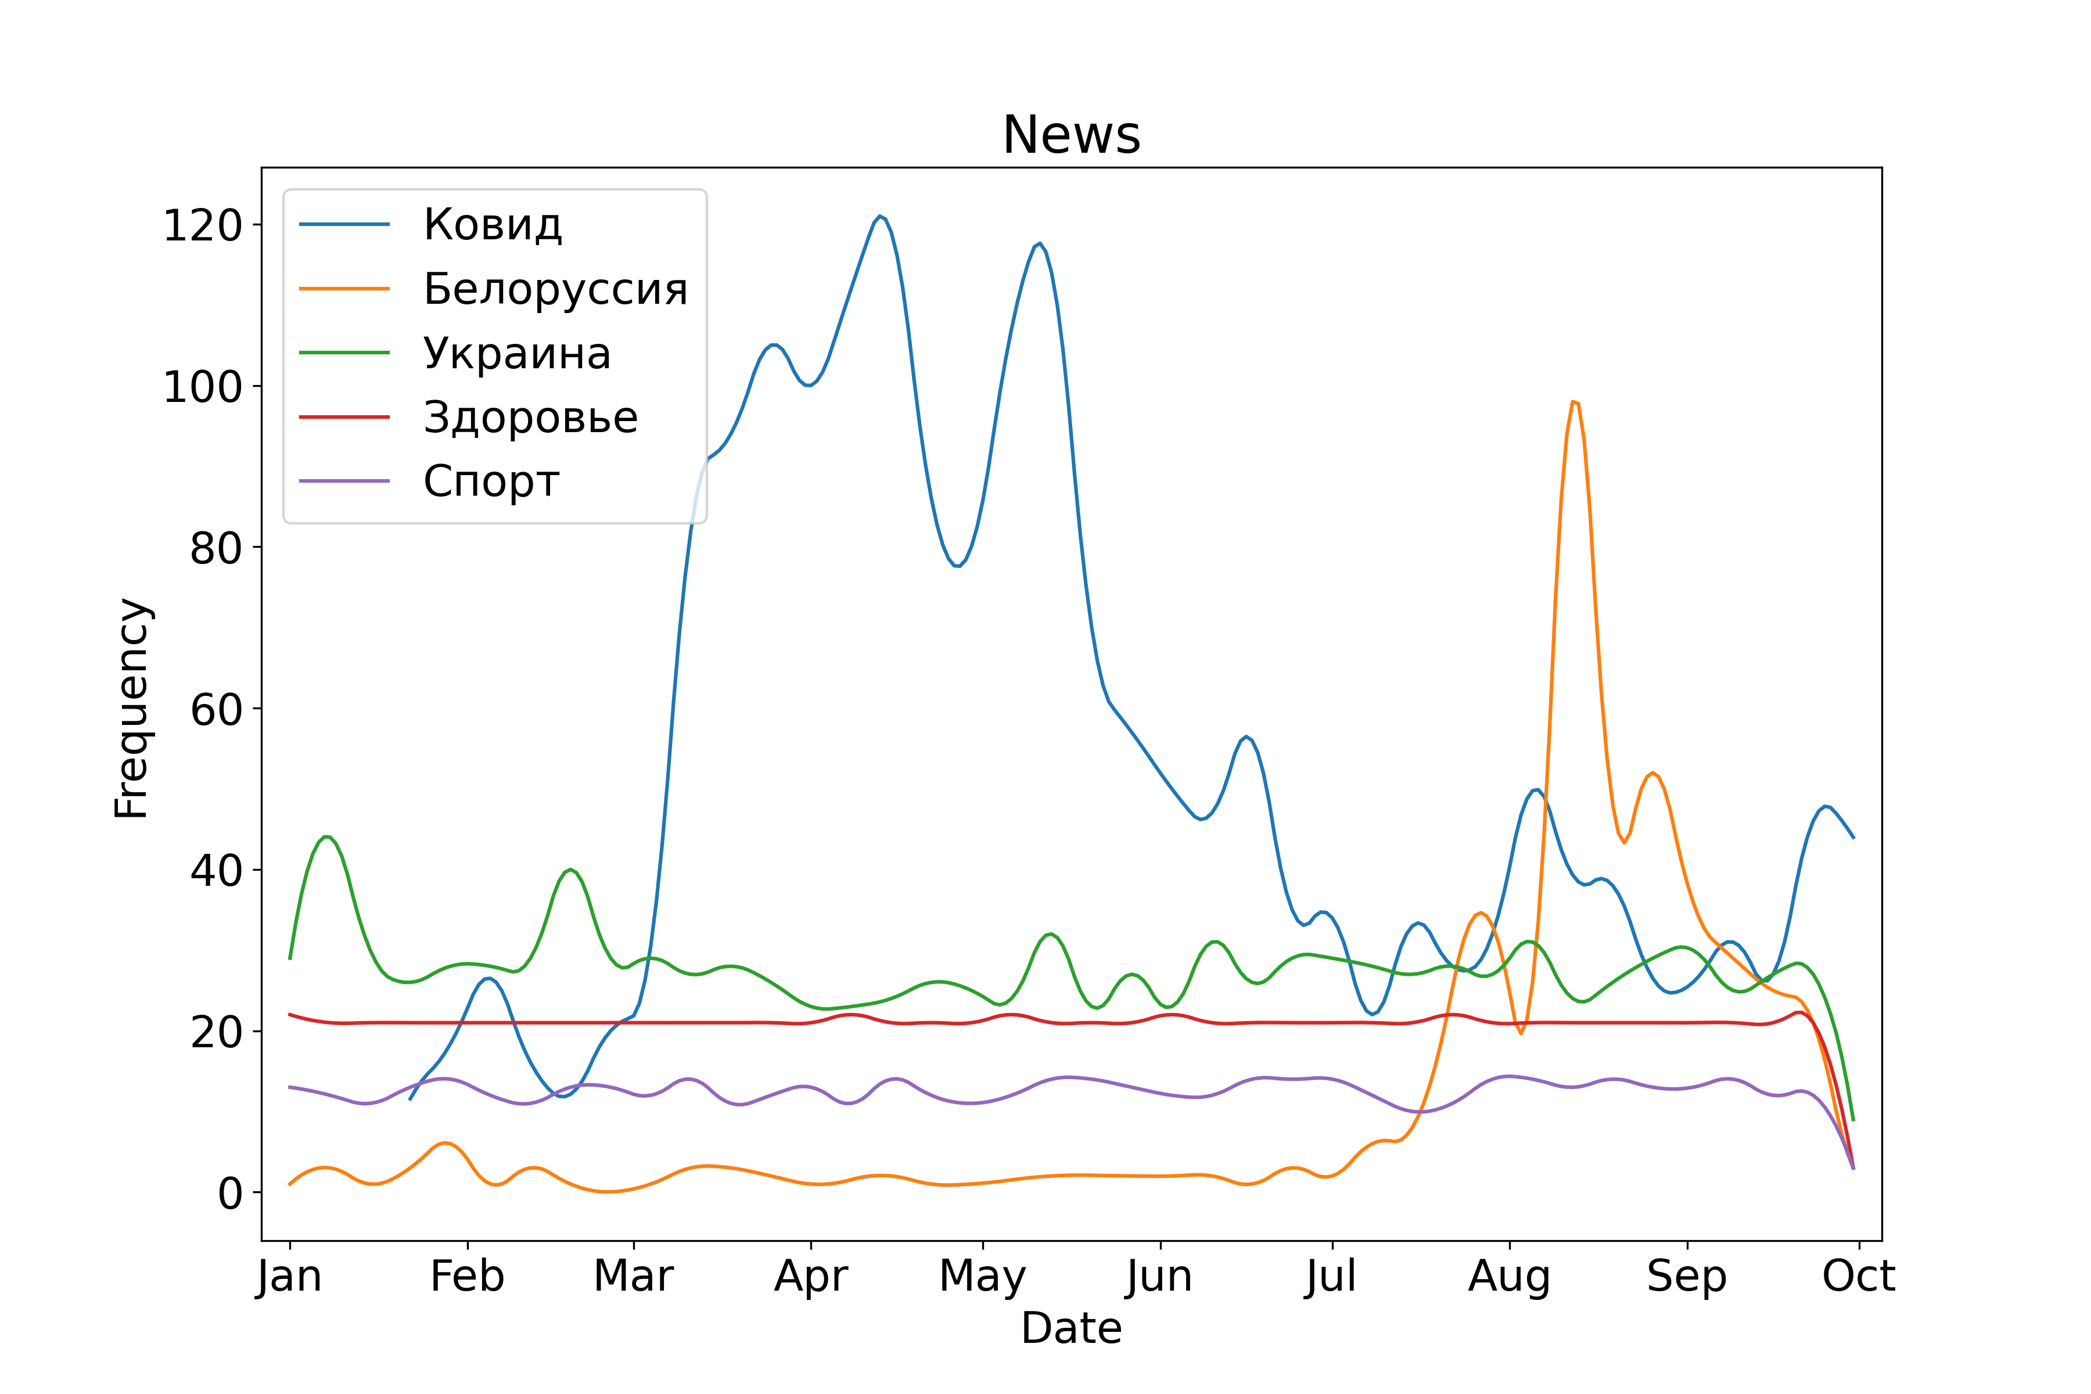
Data overview
Synthetic transactions
News after topic analysis
Additionally, 20 macroeconomical and epidemiological time series were added to the context.

Slide 6
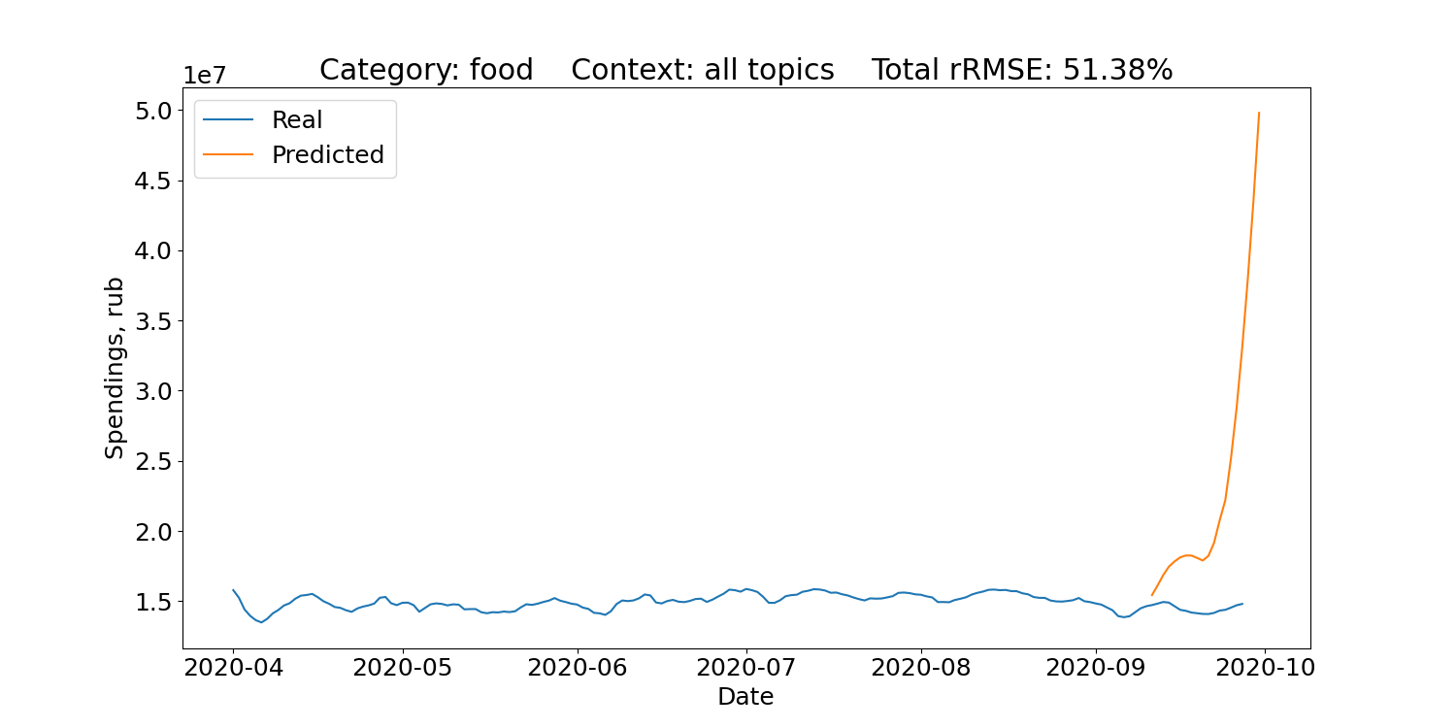
ARIMAX using the whole context
Error metrics are averaged across 10 runs with different prediction dates.
ARIMAX consumption forecast using the whole context is of low quality. Selection of exogenous variables is required.

Slide 7
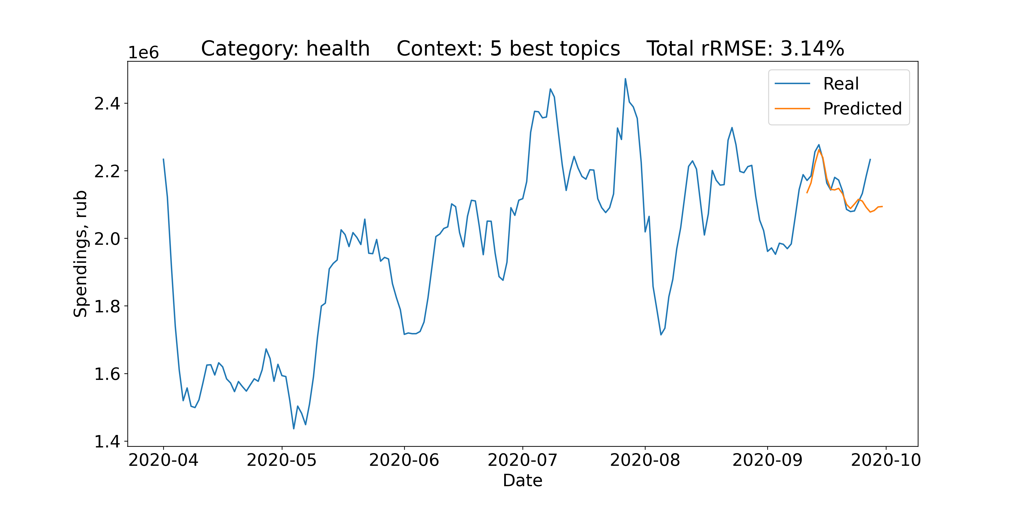
ARIMAX predictions for the best categories
Health – 3.14%
5 best topics, used for the model:
Real estate affordability, Russia
Real estate affordability, SPb
COVID news
GDP
COVID-19 in Russia, new cases

Slide 8
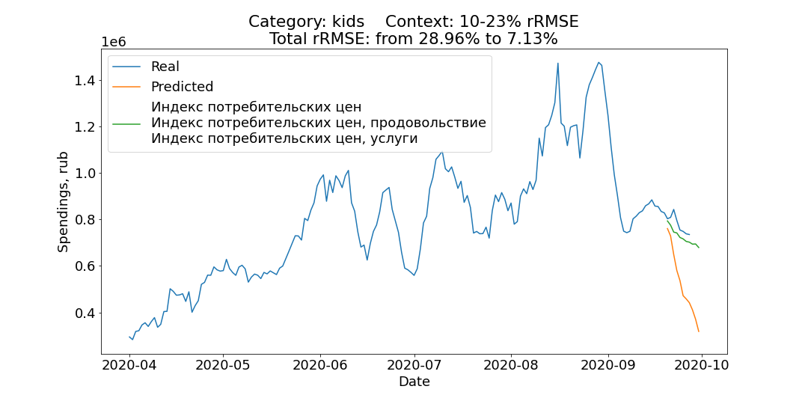
ARIMAX prediction enhancement via adding exogenous variables
Kids – 29.96 → 7.13%
Added variables:
Consumer price index
Consumer price index, food
Consumer price index, services
First two topics are negatively correlated with consumption with zero day lag.

Slide 9
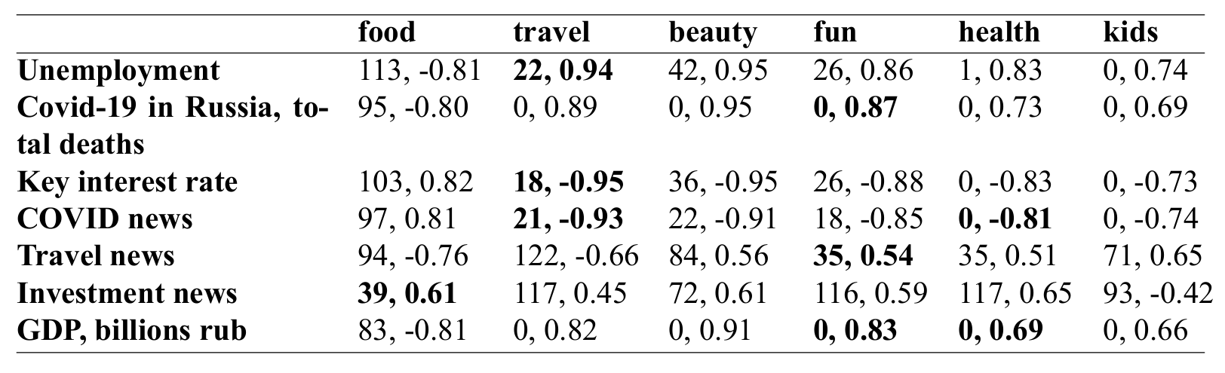
Consumption and context cross-correlation
Lag in days and Pearson cross-correlation

Slide 10
Findings & conclusion
Findings:
Mining and processing methods as well as ARIMAX models were implemented in Python3.
Some consumption categories show dependency on context such as news. The best predictions are achieved when context is carefully selected.
Time-lagged cross-correlation can be used to confirm or refuse causal hypotheses.
Conclusion:
The Individual task was fully completed, although further research is needed.

Slide 11
Thank you for attention!

