Slide 1

A study of the influence of news reports and other contextual open-source
information on the consumer behavior of bank card users
Student: Grigoryev Mikhail, J4133c
Supervisor: Chunaev Petr Vladimirovich Associate Professor, Department of Digital Transformation Consultant: Kovantsev Anton Nikolaevich

Slide 2
Goal, object and subject of research
Goal: to use open-source context information to increase consumption forecasting quality and to identify exogenous impact of this information on consumption
Tasks:
1) review relevant literature
2) scrape and process context info
3) implement forecasting model (preferrably dynamic)
4) evaluate model quality on real data
Object: impact of context information (news) on consumption of bank card users
Subject: correlations between transactions in different categories and context time series (news topic, macroeconomical data, etc.)
2

Slide 3
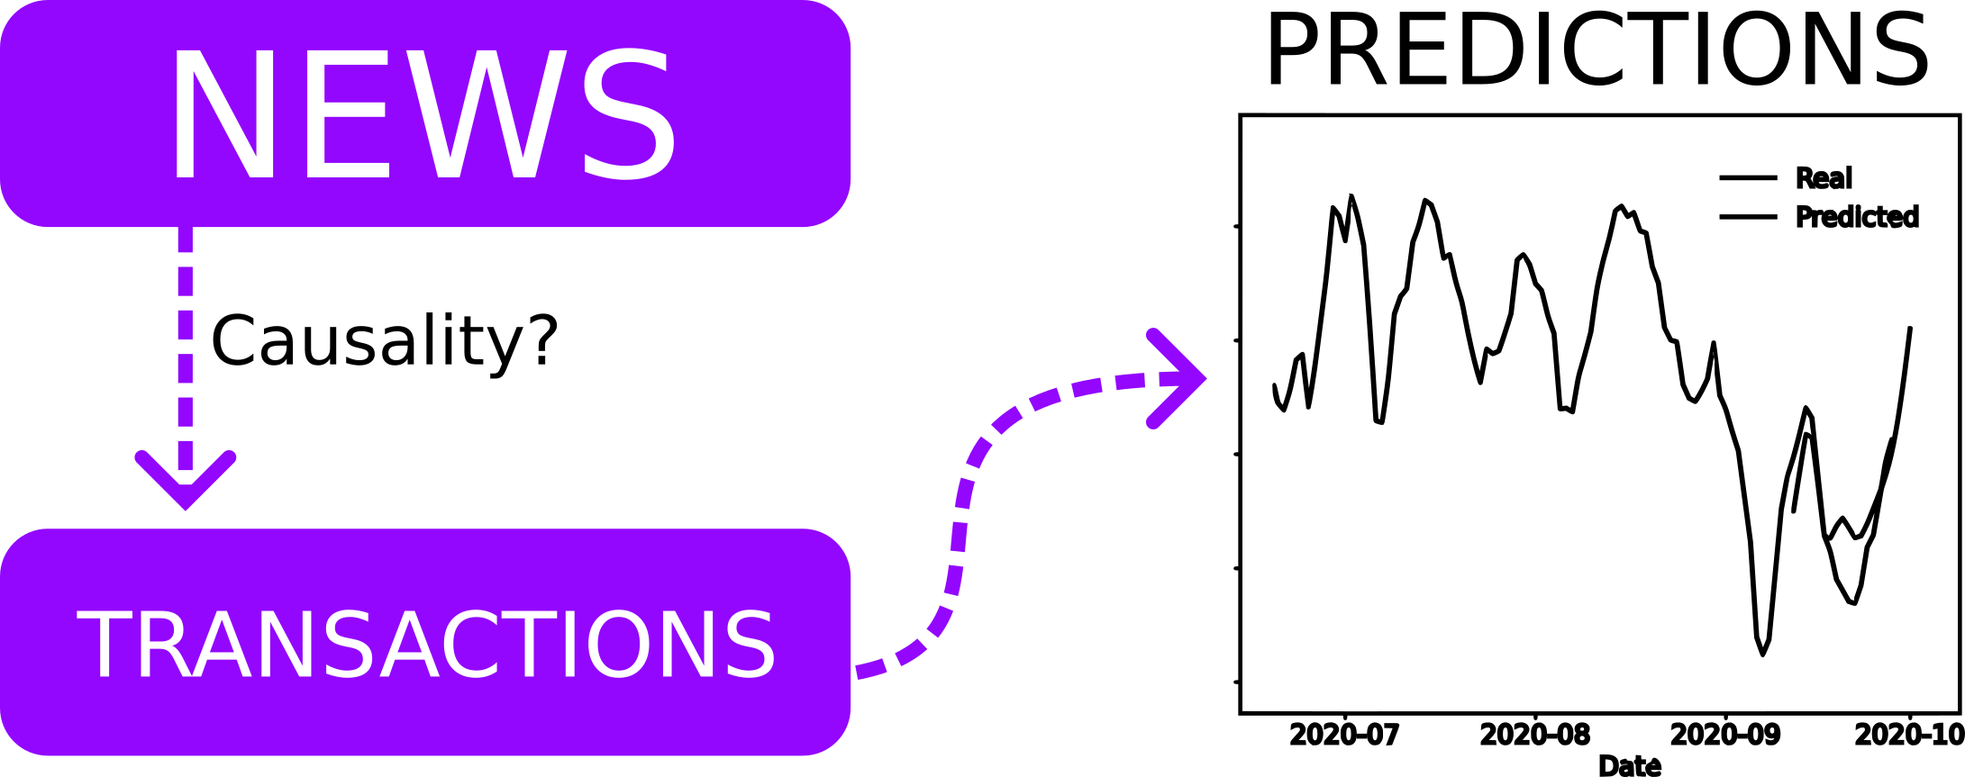
Application
3

Slide 4
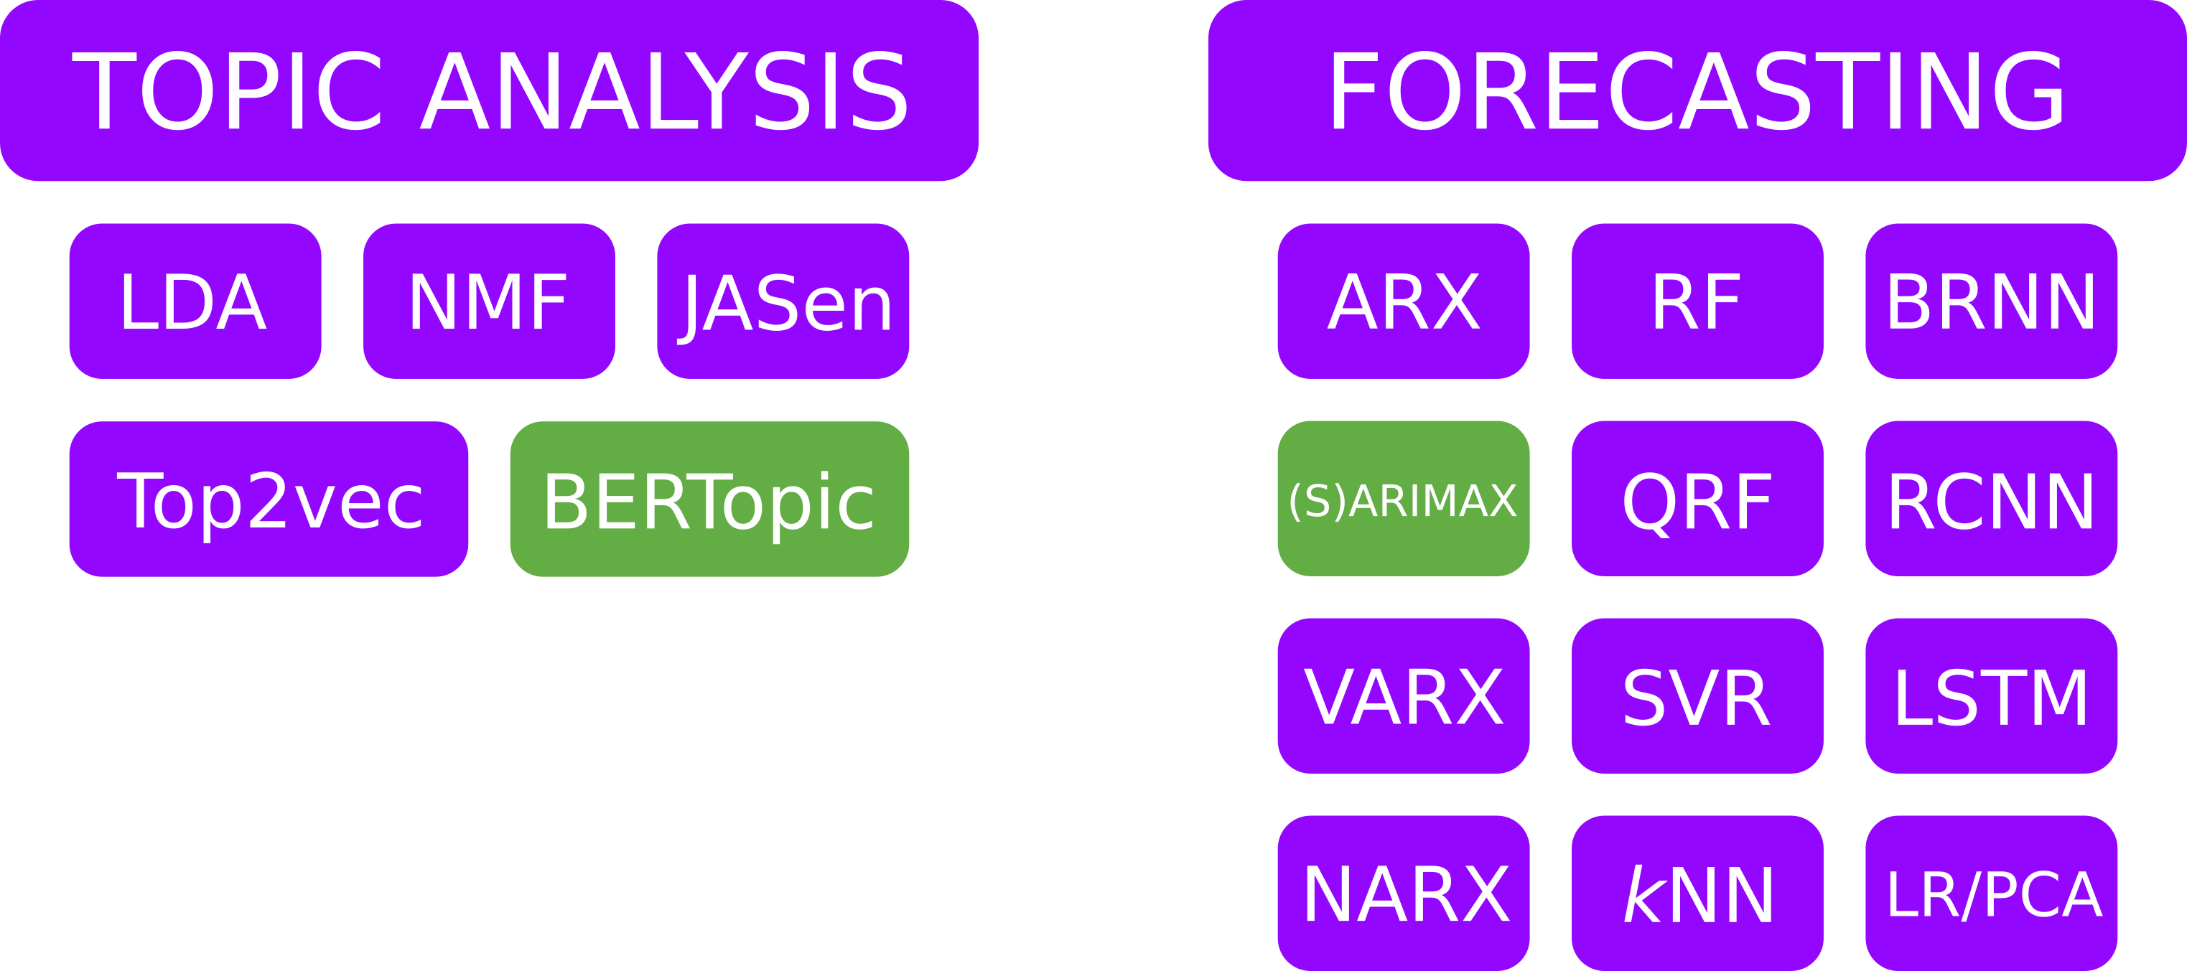
Literature overview
4

Slide 5
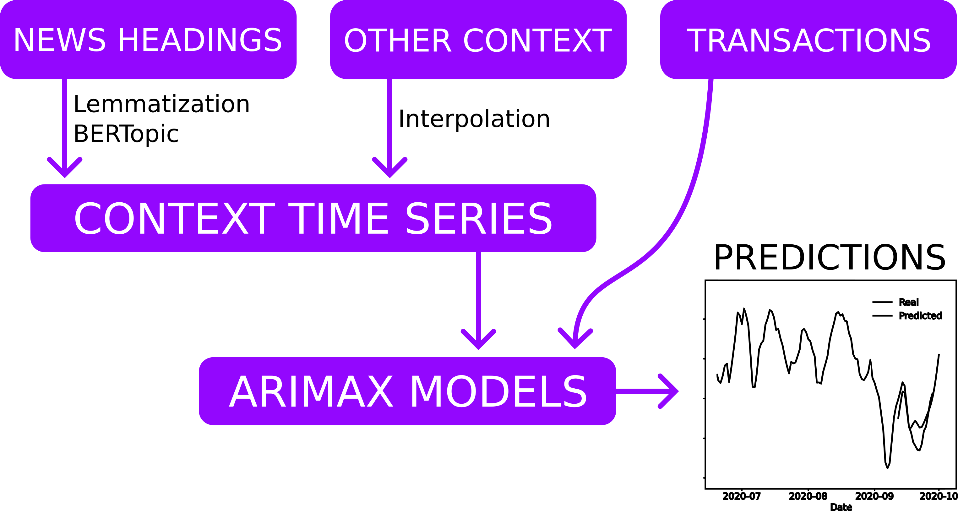
Plan of the experiment
5

Slide 6
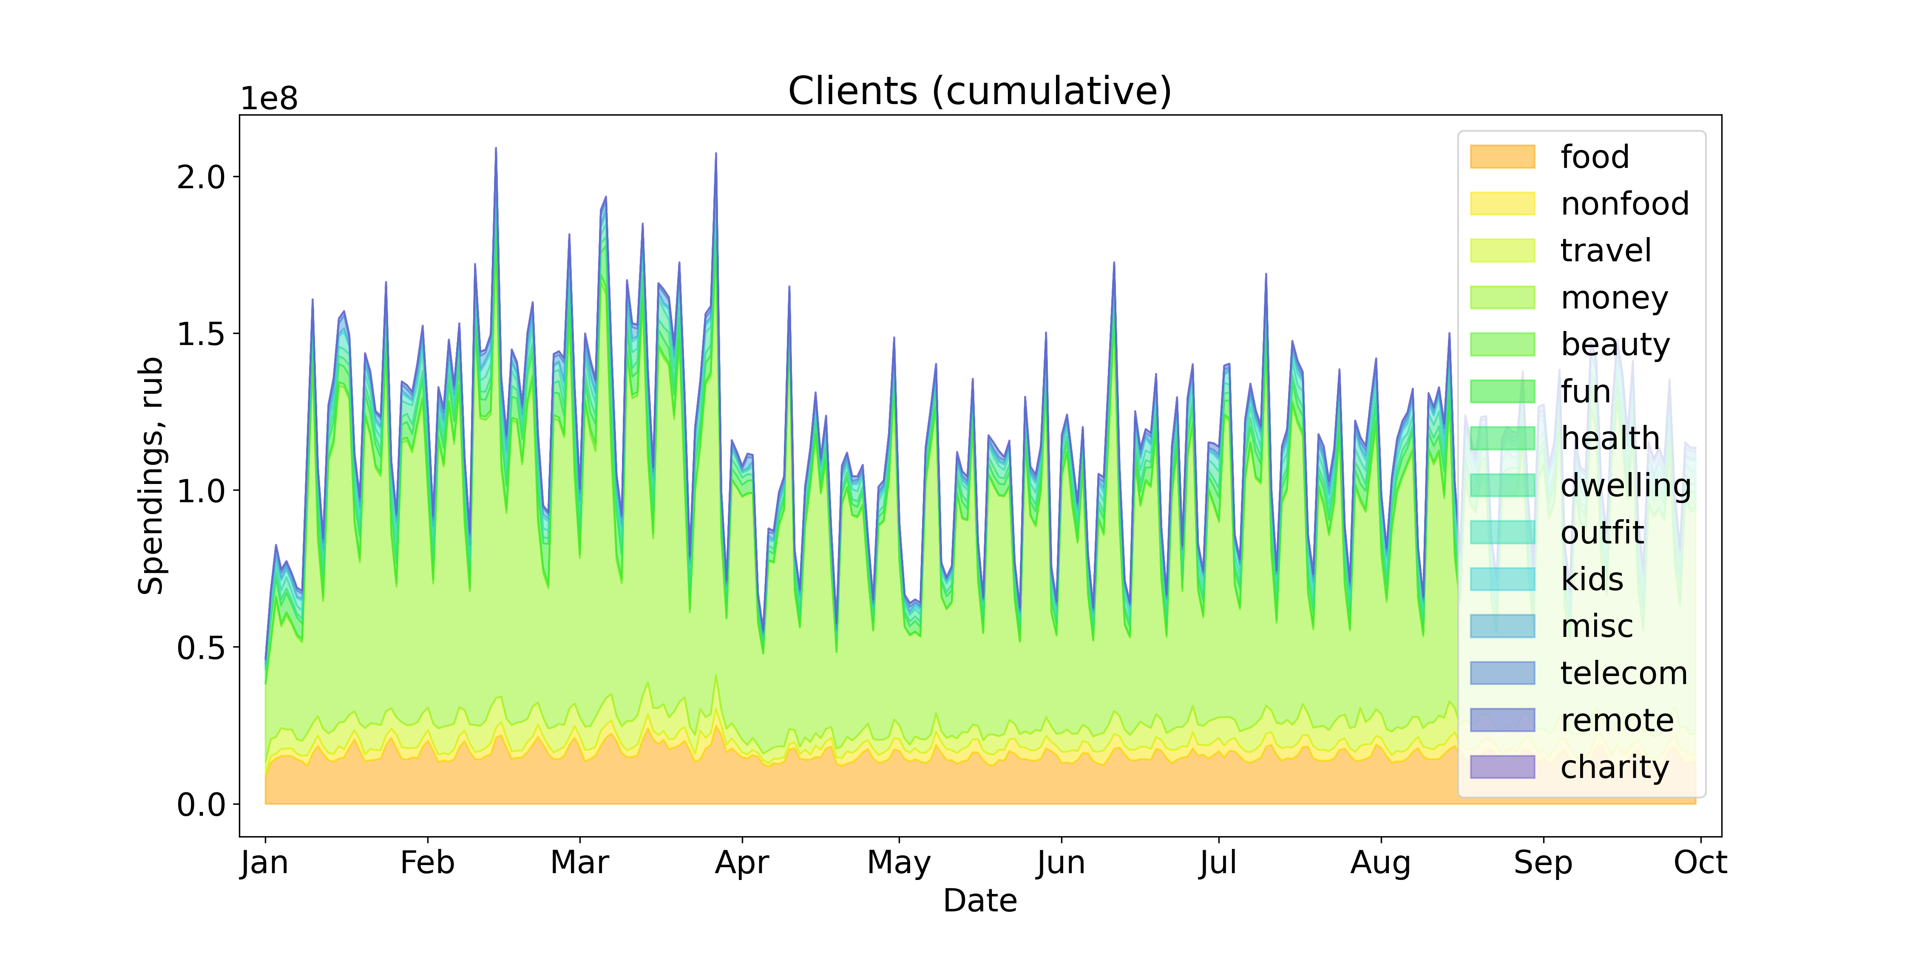
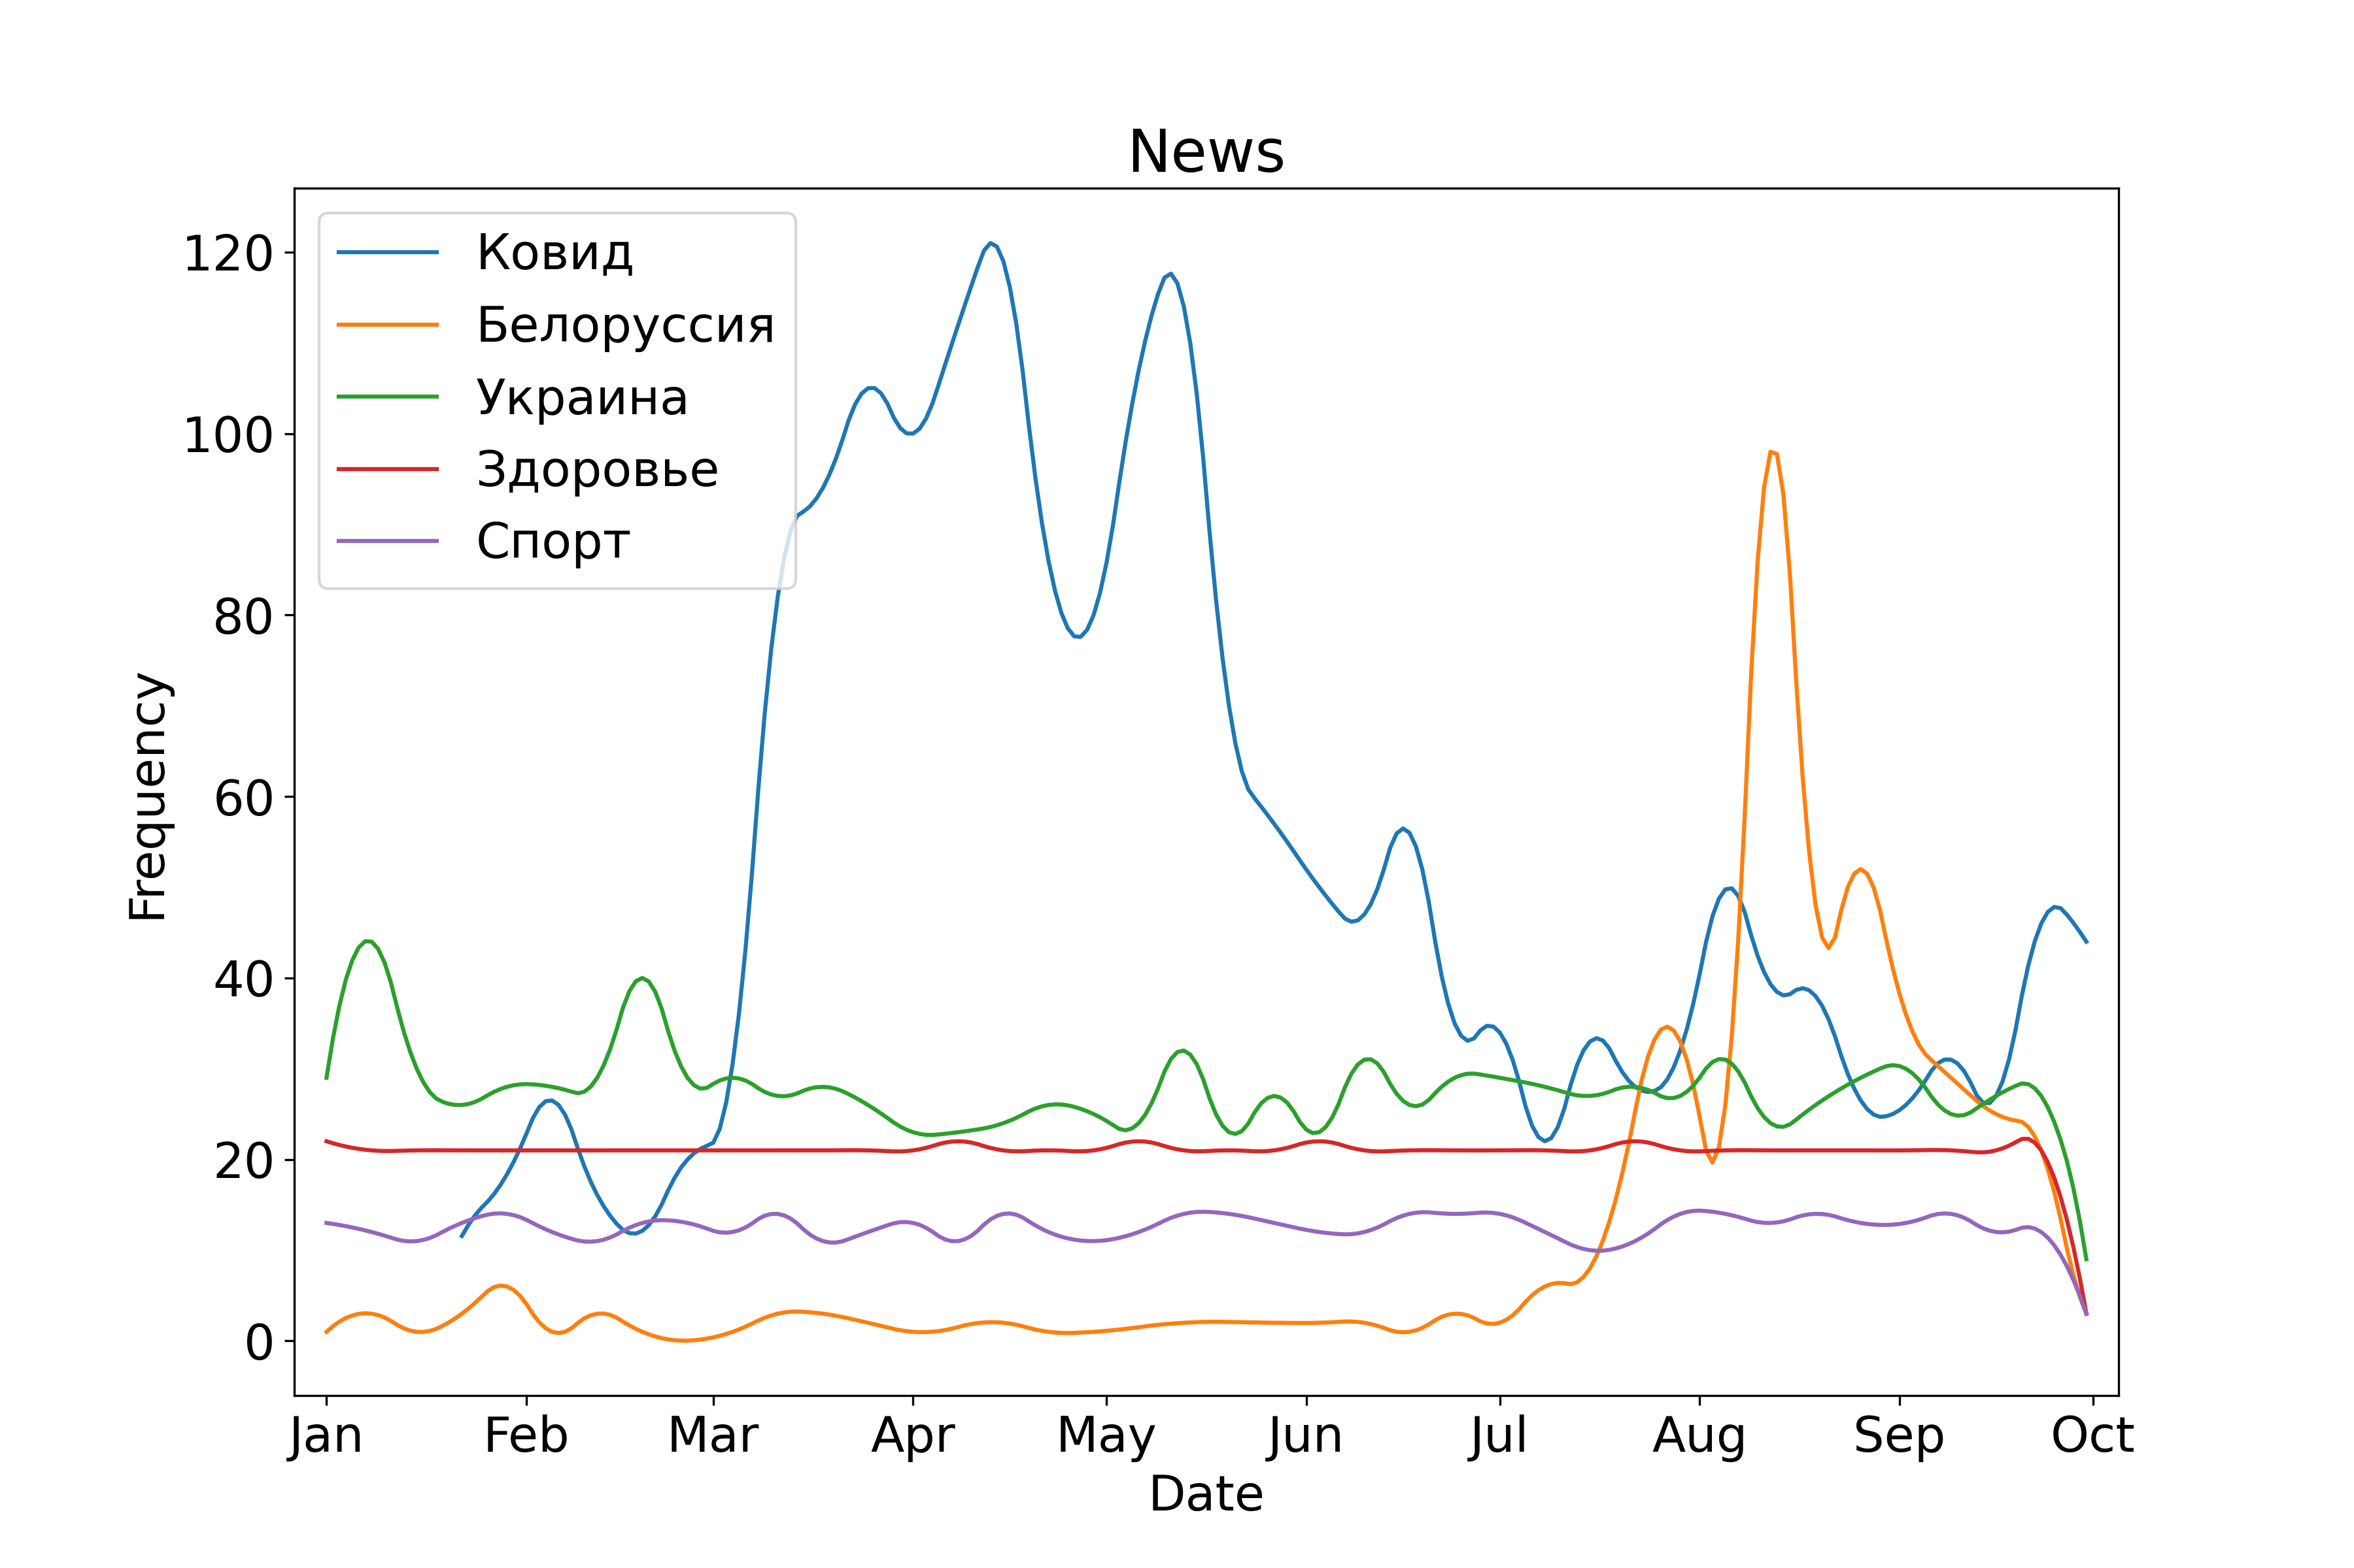
Data overview
Synthetic transactions
News after topic analysis
Additionally, 20 macroeconomical and epidemiological time series were added to the context.
6

Slide 7
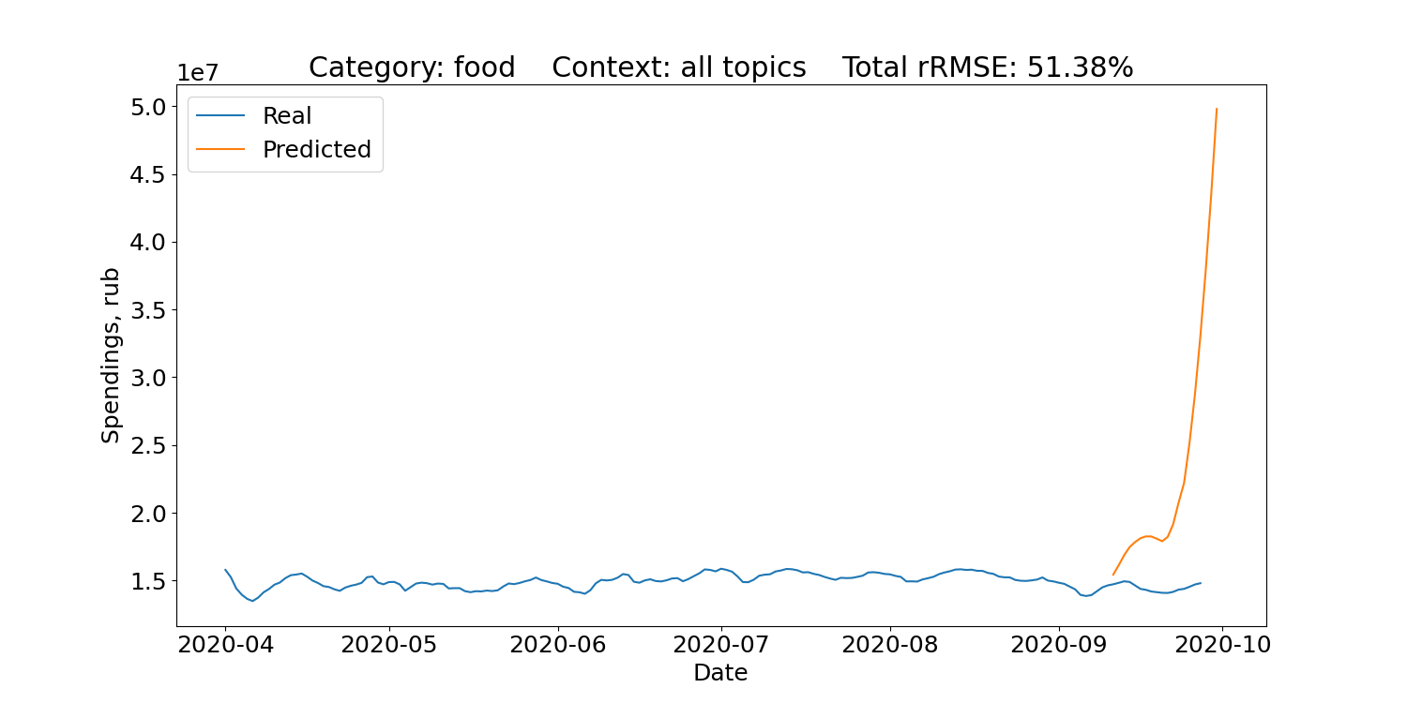
ARIMAX using the whole context
Error metrics are averaged across 10 runs with different prediction dates.
ARIMAX consumption forecast using the whole context is of low quality. Selection of exogenous variables is required.
7

Slide 8
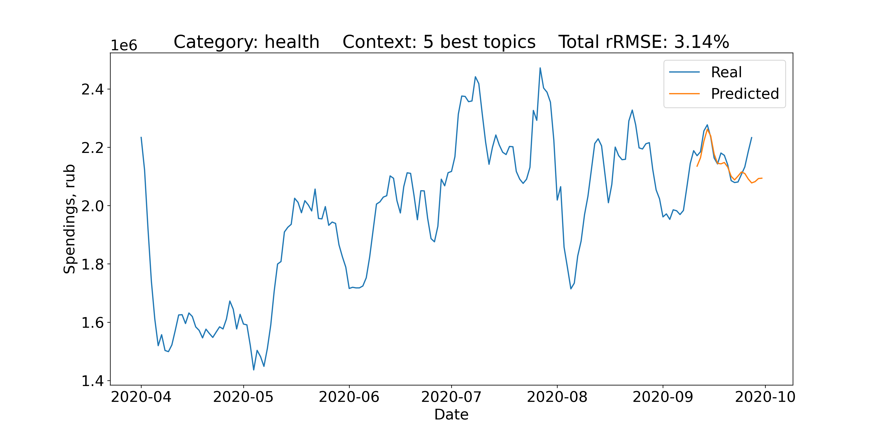
ARIMAX predictions for the best categories
Health – 3.14%
5 best topics, used for the model:
Real estate affordability, Russia
Real estate affordability, SPb
COVID news
GDP
COVID-19 in Russia, new cases
8

Slide 9
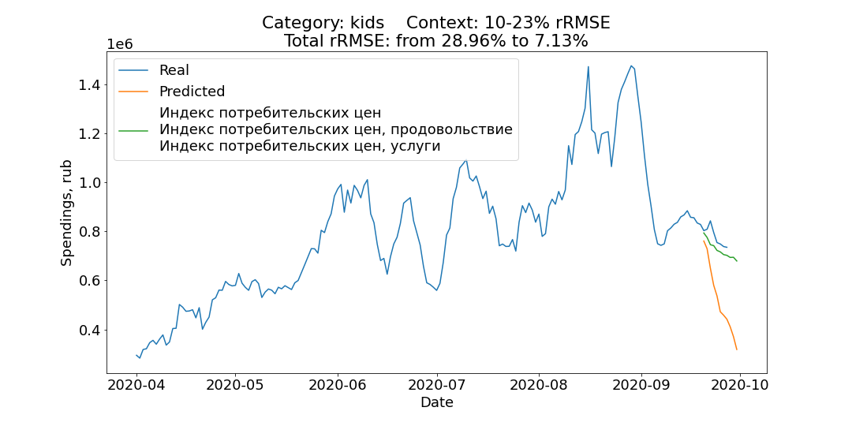
ARIMAX prediction enhancement via adding exogenous variables
Kids – 29.96 → 7.13%
Added variables:
Consumer price index
Consumer price index, food
Consumer price index, services
First two topics are negatively correlated with consumption with zero day lag.
9

Slide 10
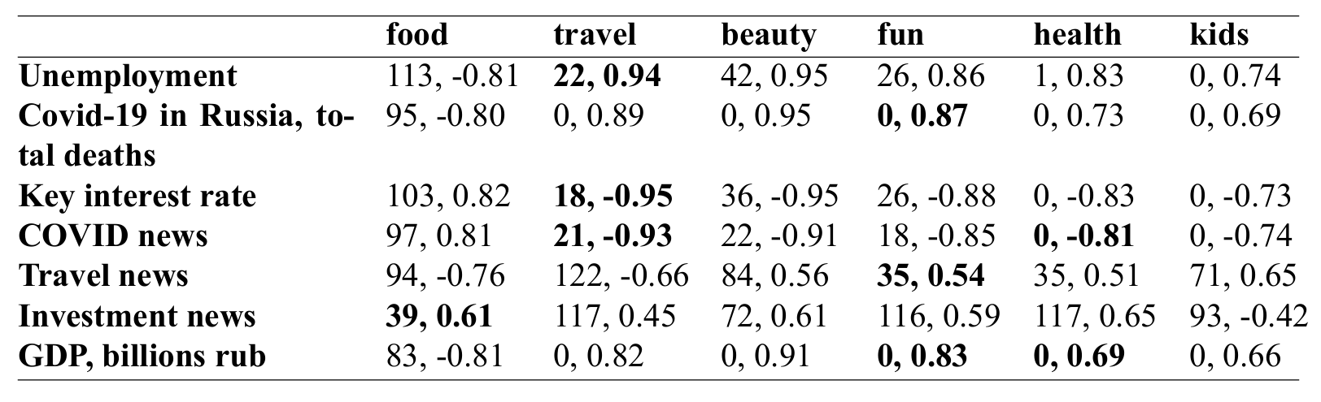
Consumption and context cross-correlation
Lag in days and Pearson cross-correlation
10

Slide 11
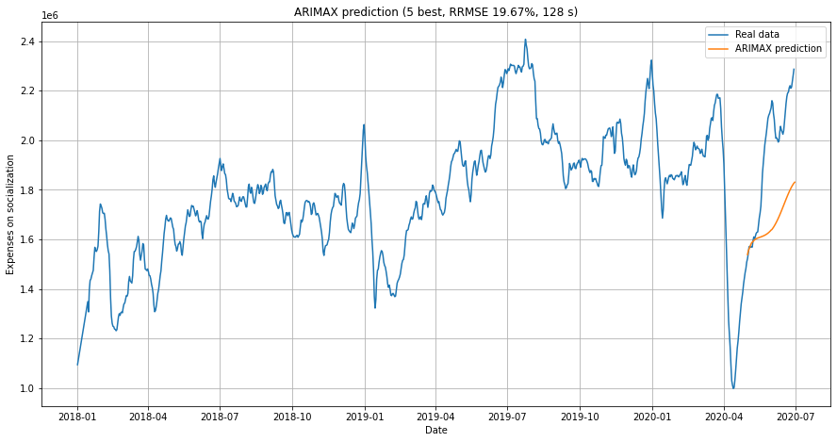
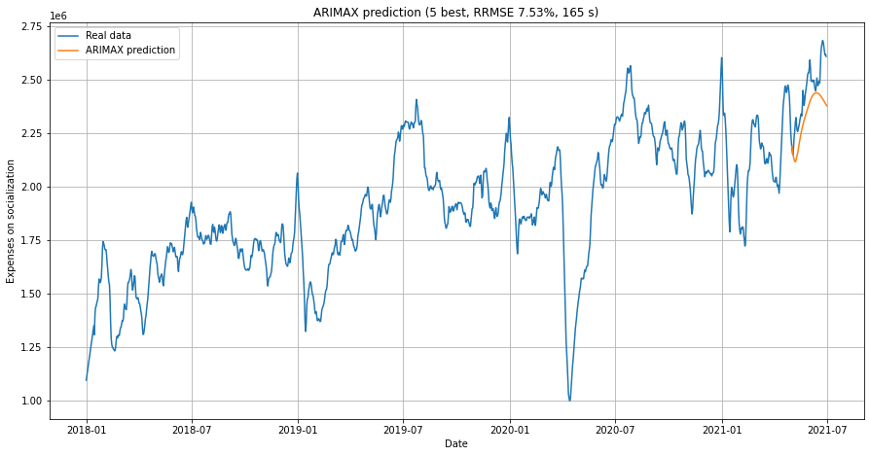
Context choice automation
ARIMAX auto context picking
11

Slide 12
Findings & conclusion
Findings:
Mining and processing methods as well as ARIMAX models were implemented in Python3.
Some consumption categories show dependency on context such as news. The best predictions are achieved when context is carefully selected.
Time-lagged cross-correlation can be used to confirm or refuse causal hypotheses.
Picking context can be automated.
Autoregressive models seem to perform poorly on non-stationary data.
Conclusion:
The Individual task was fully completed, although further research and implementation of non-autoregressive models is needed.
12

Slide 13
Thank you for attention!

