Slide 1






BIG DATA IN REAL-TIME OPTIMIZATION
Moving from Reactive to Proactive decision making
COGNITIVE AGENTS
Mimic human reasoning by perceived information, interpreting it and making autonomous decisions based on defined goals
Technology | Function
NoSQL | Unstructured & semi-structured Netflix user data
MongoDB | Stores data in JSON-like structures Social media, IoT, multimedia data
Hadoop Clusters | Distributed storage & processing Banking & telecom for large scale trend detection
Autonomous data systems | AI managed systems that self-optimize for storage, performance
BELIEF: what they know
DESIRE:
defines their objectives
INTENTION
actions taken to achieve the goal
Capture
Multi-stream sensor data collected in-situ
Analyse
ML models find patterns
Optimize
Algorithms run ‘What-if’ scenarios
Speed: rapid scenario analysis & response to operational disruptions
Agility: continuous improvement through self-learning algos
Integration: integration between physical systems and enterprise-level strategies
Volume : scale of data processed
Velocity: speed at which data is generated & processed
Variety: diversity of data types & formats
Veracity: reliability & accuracy of data
SALES
Hyper-personalized recommendations & predictive lead scoring
SUPPLY CHAIN
Integrate customer insights to ensure production aligns with forecasted demand
FINANCE
Digital advisors analyse investment data, assess risks & offer customized financial guidance
GOVERNMENTS
Logistics, defence, public planning
TELEHEALTH
Track patient history, symptoms & real-time vital signs
ACADEMIA
Virtual mentors to guide students through coursework and research
Cognitive agents rely on:
DISEASE-CENTERED TO PATIENT-CENTERED CARE
Patient-centered - decisions are guided by data and individual needs
Disease-centered - heavy reliance on medical evidence, clinical expertise & diagnostic tests
Predictive models can now predict the early signs of diabetes or heart disease by combining genetic data with patient lifestyle information
Autonomous databases
Autonomous data warehouses
Content management systems
Complex computational clusters
DOMAINS IN BIG DATA
Adaptive diagnostics & prognosis: Uses real‑time and historical data to detect issues early and predict future failures.
Predictive analytics: Analyses large datasets to forecast trends, behaviours, and outcomes.
Process control & monitoring: tracks operations continuously to maintain efficiency, quality and stability
Maintenance & services logistics: Optimizes when & how maintenance happens to reduce downtime and improve resource planning
BIOMEDICAL RESEARCH:
Image processing
Signal processing
Genomics

Slide 2
Intelligent decision support
HEALTHCARE
Smarter compliance audit
Predictive risk management
FINANCIAL SERVICES
Smarter surveillance and safety
PUBLIC SECTOR
DATA ANALYTICS TRANSFORMATION
Raw data to Intelligent action
AUTOMATION TRANSFORMATION
Embedding intelligent automation across the entire organization, allowing tasks to be executed automatically without constant human input.
It supports:
Continuous improvement through analytics feedback loops
Faster response time eliminating manual bottlenecks
Smarter resource allocation as employees focus on analysis and innovation
DESCRIPTIVE ANALYTICS
PREDICTIVE ANALYTICS
PRESCRIPTIVE ANALYTICS
Understand what happened
Forecast what might happen next
Suggest the best actions to take
AUTOMATION TRANSFORMATION
RPA
SPA
AI
ML
ROBOTIC PROCESS AUTOMATION
Software technology that uses bots to perform repetitive, structured tasks ie: data entry, report generation
They follow pre-defined rules and operate on same user interface humans use.
Cognitive Automation : extend capabilities of RPA by incorporating elements of AI such as interpret natural language (emails), learn from past patterns to improve accuracy, provide contextual insights or recommendation
DIGITAL TRANSFORMATION READINESS FRAMEWORK
Leadership creates direction, strategy defines focus, culture enables adoption, fact-based decisions drive value; technology accelerates scale and process integration sustains change
LEADERSHIP SUPPORT
BUSINESS STRATEGY
CULTURAL READINESS
FACT-BASED METHODS
TECHNOLOGY EVOLUTION
PROCESS ALIIGNMENT
Management must
model adaptability,
sponsor new
support employees
through change
A project should be
tied to measurable
business outcomes
Cultural shift
Change
management.
Embrace data-driven thinking and continuous learning
Use data to identify pain points & opportunities
Build strategies around facts rather than assumption
initiatives
Tech as an enabler
Supports scalability, speed & integration across systems
Digitize workflows and integrate analytics into daily operations
SMART PROCESS AUTOMATION
Combines RPA with intelligence and learning
Integrates human tasks with ML and AI to manage end-to-end processes.
It monitors progress, identifies bottlenecks and adapts to new data patterns in real time
SPA empowers organizations to build adaptive, data-driven workflows that connect people, bots, and systems.
USE CASES
Cognitive RPA : customer service bots analyses sentiments in emails & route negative feedback to representative for faster feedback

Slide 3










DATA SOURCES
ASSIGNMENT MODULE 2
DATA STORE
DATA DISTRIBUTION AND ACCESS
Data integration, transformation and cleaning
Dashboards, Analytics tools, use by advanced systems i.e. recommender engines
Where the data is stored i.e.: Cloud, On-prem or hybrid
POS, ERP or CRM systems, Online interactions, Inventory logs
Distribution and consumption by teams, managers
DECENTRALIZED DATA MODEL
CENTRALIZED DATA MODEL
Centralized data store (data warehouse or data lake)
Sales data product
Federated access via catalog or APIs
Marketing data product
Data sources
Finance data product
Analytics and BI reporting tools generated for each domain
Enable self-serve analytics for teams
Analytics and BI reporting tools generated from a single source of truth
Data from domain sources
Domain-owned data products
Data sources
Data from various departments, systems and user interactions
All the data from the different sources are stored in one place
Distributed to various teams
Sales and marketing
Finance
Management

Slide 4
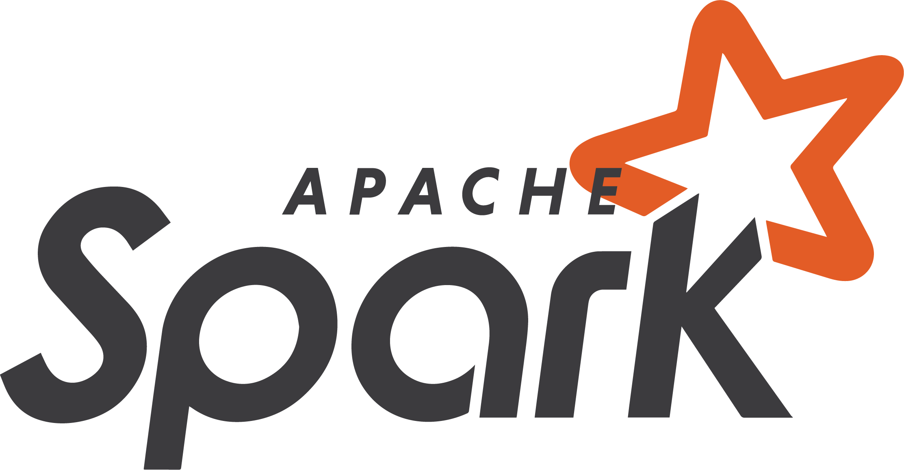


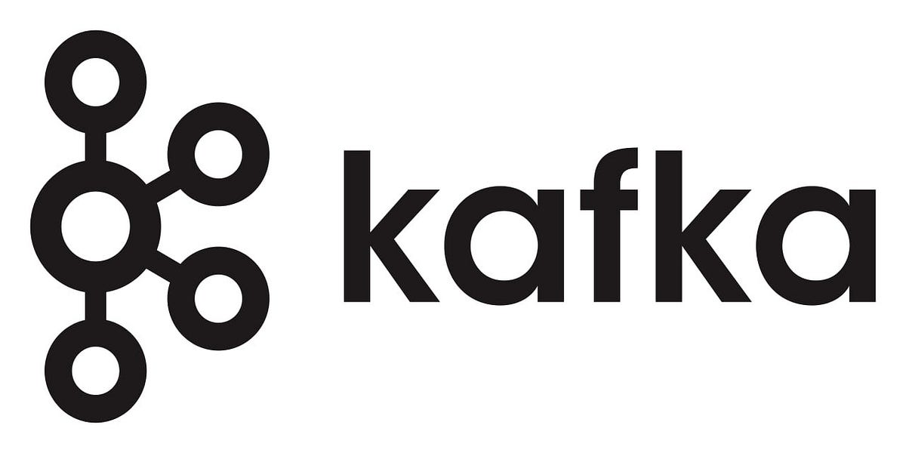




REAL-TIME CUSTOMER INSIGHTS AND PREDICTIONS PLATFORM
DATA INGESTION & STORAGE
PROCESSING & ANALYTICS
SOURCE SYSTEMS
BIG DATA APPS
mobile
online
Real time data streams
RECOMMEDATIONS
DYNAMIC PRICING
In-store
Partner interactions
CHURN PREDICTION
Spark SQL
AZURE DATALAKE
The processed data is accessed through query engines and BI tools for reporting, while ML models generate predictions used to power various applications like recommendation engines.
Spark MLlib ML Models
Distributed storage
Customer interactions from digital and physical channels are captured in real time through Apache Kafka and stored at scale in distributed storage (HDFS + object storage) within Microsoft Azure (Azure Data Lake).
Apache Spark then processes the data in both batch and streaming modes to clean, transform, and aggregate it.

Slide 5
