Slide 1
Geoinformatic project Efficient outliers rejection in positioning of mobile devices
Dorotea Rigamonti 969365

Slide 2
ELOBO: Efficient Leave One Block Out
ELOBO is an outlier rejection algorithm which implements a numerical solution for the
leave one block out procedure.
This implies that:
The problem must be a LS problem
Observation should be able to be split into independent subvectors ( blocks)
A block must not depend on individual parameters otherwise a pre-elimination technique of parameters has to be applied
Advantages
More robust than the classic Least Squares (LS) adjustment, because it is a leave one out algorithm
Faster than a Leave One Block Out (LOBO) because it does not repeat any adjustment procedure

Slide 3
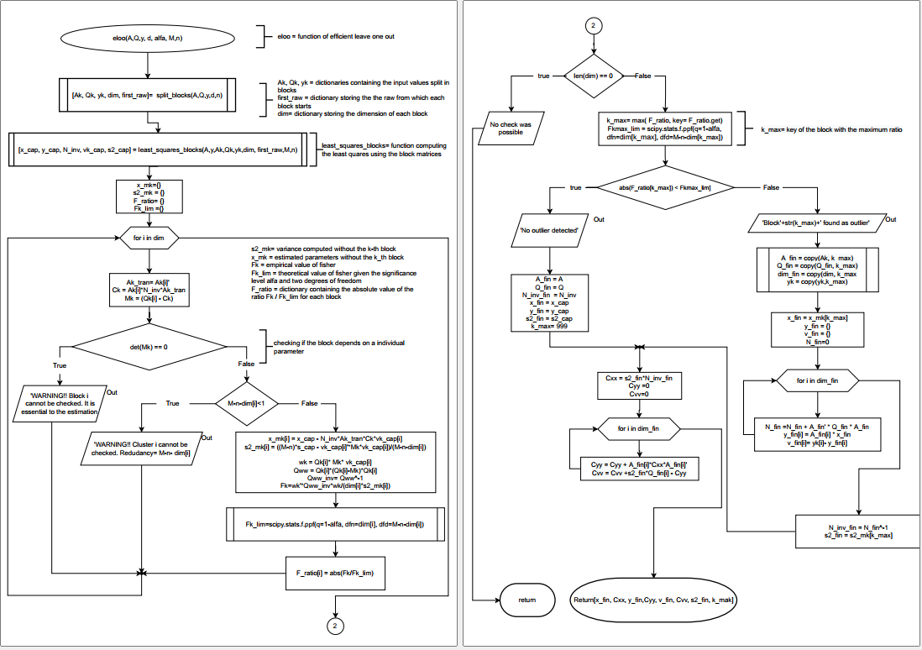
ELOBO: Algorithm
1. Split the input into blocks to be able access at or remove each block
2. Compute the global solution of LS using the blocks
3. For each block:
3.1 Control if it can be checked
3.2 Perform ELOBO numerical procedure
3.3 Compute the theoretical and the empirical values of the test and the ratio between them

Slide 4
ELOBO: Efficient Leave One Block Out
4. Check the presence of outliers
5. Compute the final solution without the outlier, if foud
6. Compute the final matrices

Slide 5
Reliability test
This test compares the reliability of the tree algorithms: LOBO ELOBO and classic LS solution.
100 simulations with independently generated noise have been iterated for different levels of outliers (1.5, 1.75, 2.00, 2.50, 3.00, 3.50 and 4.0 pixels) each time added to a different block
The results are expressed as percentage and they have been clustered in three classes:
{LOBO/ELOBO/LS}_OK: correct identification of the outlier
{LOBO/ELOBO/LS}_NO: no outlier is identified by the test
{LOBO/ELOBO/LS}_WO: one outlier is identified, but in the wrong observation
outlier | lobo_no | lobo_ok | lobo_wo | elobo_no | elobo_ok | elobo_wo | ls_no | ls_ok | ls_wo
1.5 | 0 | 86.2 | 13.8 | 0 | 86.2 | 13.8 | 0 | 85.86 | 14.24
1.75 | 0 | 93.92 | 6.08 | 0 | 93.92 | 6.08 | 0 | 91.76 | 8.24
2 | 0 | 97.08 | 2.92 | 0 | 97.08 | 2.92 | 0 | 95.56 | 4.44
2.5 | 0 | 99.88 | 0.12 | 0 | 99.88 | 0.12 | 0 | 99.24 | 0.76
3 | 0 | 100 | 0 | 0 | 100 | 0 | 0 | 99.72 | 0.28
4 | 0 | 100 | 0 | 0 | 100 | 0 | 0 | 100 | 0
100% of times identified
96% of times correctly
100% of times identified
95% of times correctly
Notes:
Presentation of the problem

Slide 6
Speed test
The speed test is a numerical comparison between ELOBO and repeated LOBO. It tests the efficiency of ELOBO end LOBO with respect to the operational time with different combination of number of parameters and number of blocks.
The results are expressed as ration between the execution time of LOBO and ELOBO
 |  | n° of blocks (n° of observation per block)
 |  | 2000 (1) | 1000 (2) | 500 (4) | 250 (8) | 100 (20) | 50 (40) | 25 (80) | 10 (200) | 5 (400) | 2 (100)
n° of parameters | 1 | 201.87 | 203.88 | 188.89 | 177.1 | 168.53 | 162.17 | 156.43 | 147.53 | 129.5 | 88.07
 | 10 | 107.05 | 119.15 | 119.89 | 118.01 | 116.28 | 114.83 | 113.39 | 110.98 | 105.77 | 91.18
 | 50 | 104.17 | 153.96 | 153.14 | 151.44 | 149.87 | 148.54 | 147.1 | 144.93 | 140.46 | 127.5
 | 100 | 133.47 | 138.06 | 237.93 | 136.91 | 135.81 | 134.81 | 133.8 | 132.39 | 129.48 | 120.81
 | 250 | 157.24 | 161.39 | 160.44 | 158.29 | 156.67 | 155.29 | 154.14 | 152.66 | 149.69 | 141.97
 | 500 | nan | nan | nan | nan | nan | nan | nan | nan | nan | nan
From the speed test ELOBO results faster than LOBO in every case as the ratio is always greater than one and it performs better with an higher number of blocks.

Slide 7
Thank you!

