Slide 1

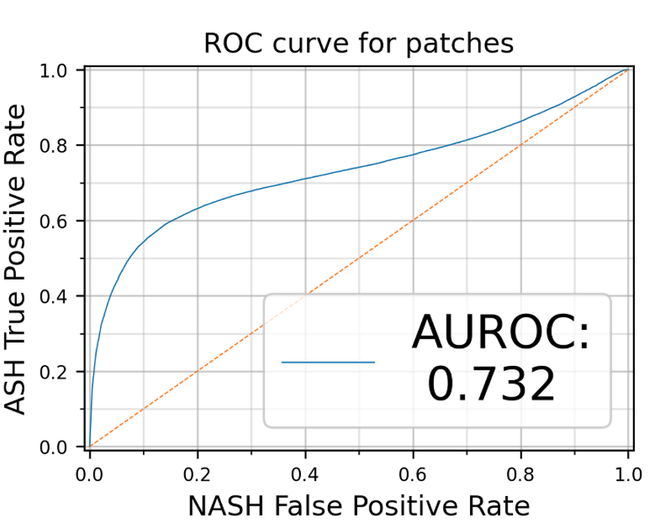
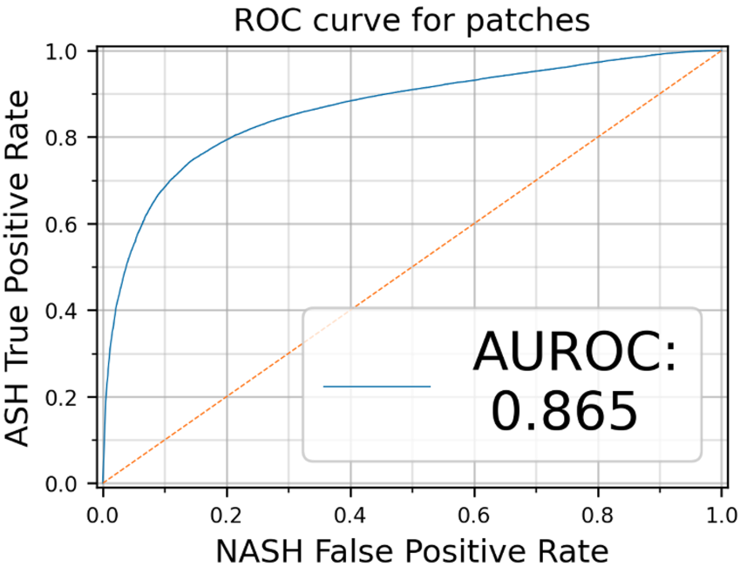
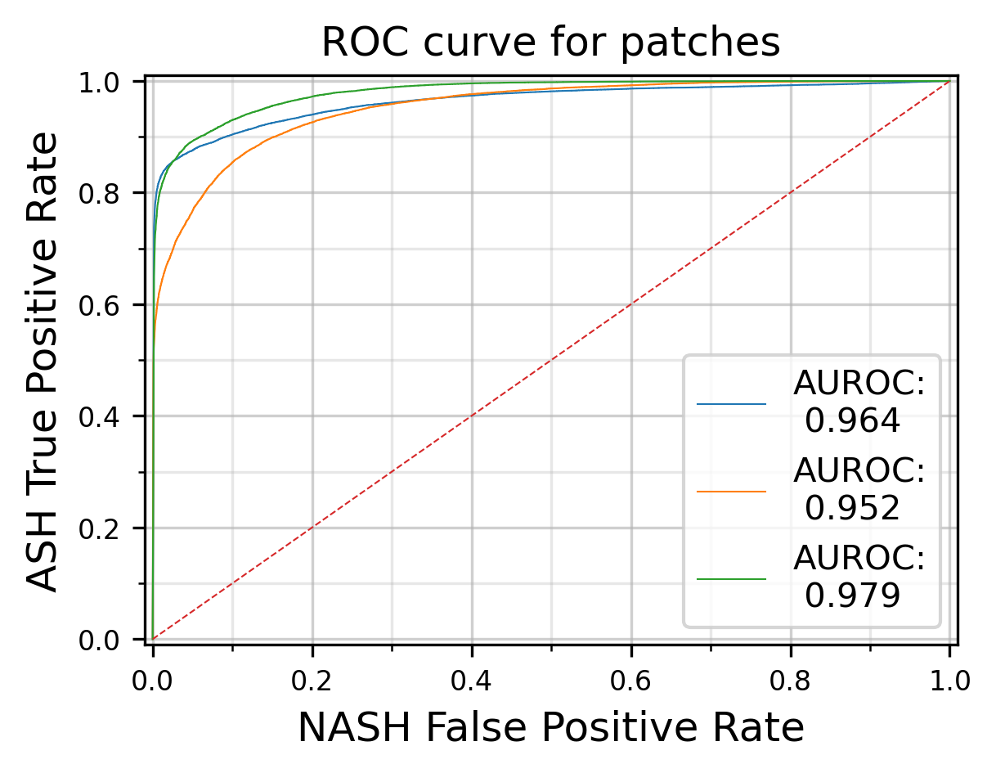
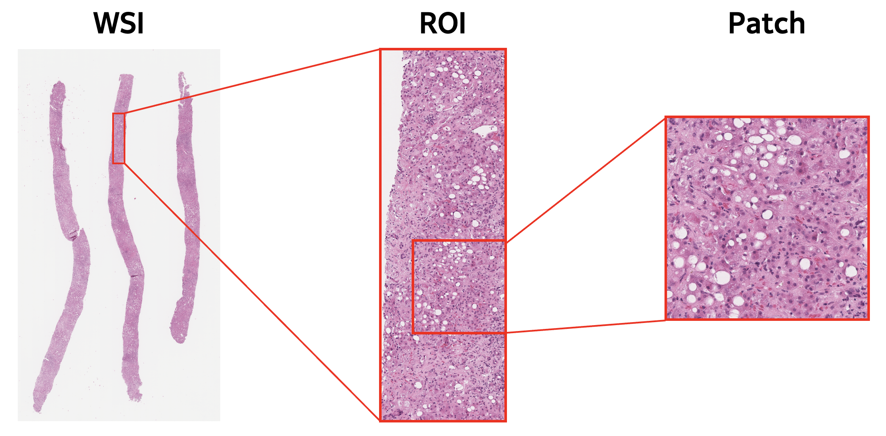
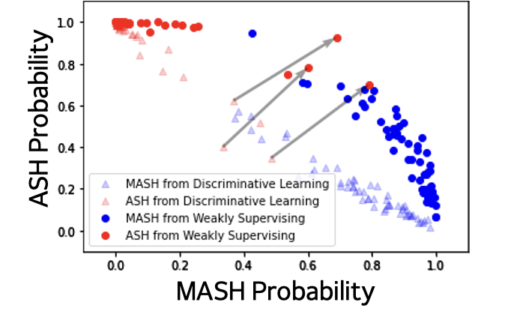
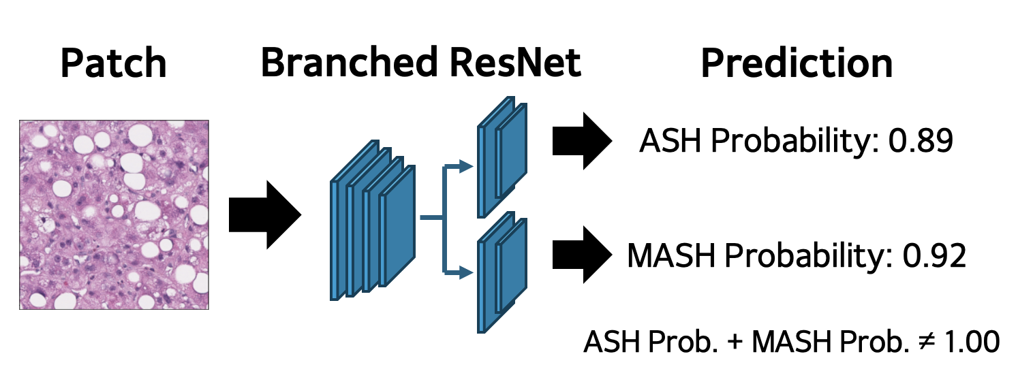
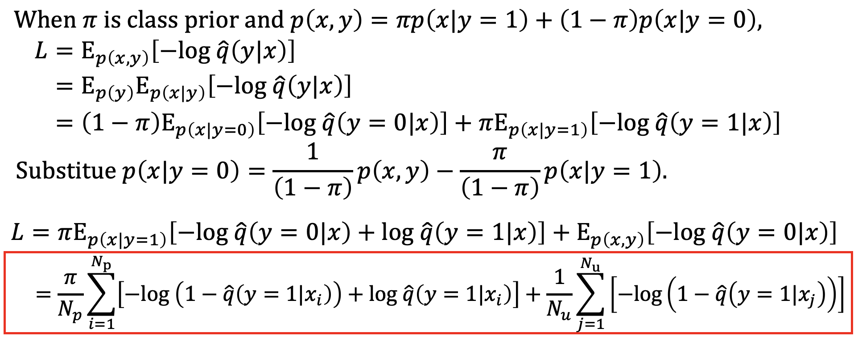
Eigenvalue-Based Preprocessing for Tissue Extraction
From Pathology Image slides
Do-Hyun Lim¹, Yung-Kyun Noh^{1,2}
¹Department of Computer Science, Hanyang University, Seoul, Republic of Korea,
²School of Computational Sciences, Korea Institute for Advanced Study, Seoul, Republic of Korea
Introduction
Results
In various biological fields, tissue samples are frequently collected from subjects and analyzed as image slides. These pathology image slides often contain not only the tissue of interest but also extraneous elements, including background regions and markings, which can compromise analysis accuracy.
To accurately isolate tissue regions, precise preprocessing is essential. By extracting each element’s features using simple algorithms, we can effectively distinguish tissue from unwanted elements.
We found some ASH slides have both ASH and MASH properties.
Objective
Figure 3. AUROC improve by changing 20 ASH labels to MASH
We assessed our model’s performance by 3 fold validation
Extract eigenvalues and eigenvectors from patches
containing each element to analyze their features.
Set an appropriate threshold to extract only tissue.
Method
Obtained liver biopsy slides (ASH 150 + MASH 158)
Slides were digitalized with their diagnosis
Cropped 256x256 patches from region of interesting (ROI)
Figure 4. AUROC curve of 3 fold validation
The CNNs’ average accuracy was 91.5%
Average sensitivity – 84.6%
Average specificity – 98.1%
We trained branched CNN model using PU loss to identify ASH/MASH spectrum
Figure 1. Processing of WSI to patches for train and testing
Figure 5. Distribution difference of discriminative learning and weakly supervising
Train convolution neural network (CNN) model with patches using cross entropy loss and positive unlabeled (PU) loss
Conclusion
Our Algorithm - based experiment demonstrated the coexistence of ASH and MASH in patients labeled with only one, achieving 0.915 prediction accuracy for slide level classification after considering the coexistence.
PU learning with weak supervision and its output spectrum confirmed the coexistence.
Figure 2. Example of model’s prediction process.
Acknowledgements
Derivation of PU loss from cross entropy loss
Dr. Vijay Shah’s Lab (Mayo Clinic, USA)
Dr. Chady Meroueh
Dr. Joseph C. Ahn
Dr. Resham Ramkissoon
Dr. Hamid Tizhoosh’s Lab (Mayo Clinic, USA)
Dr. Peyman Nejat
Dr. Yung-Kyun Noh’s Lab (Hanyang University, Korea)
Yubin Yeon
Contact
Using PU Loss provides flexibility in model’s prediction
Do-Hyun Lim: ldh991014@hanyang.ac.kr
Yung-Kyun Noh: nohyung@hanyang.ac.kr

