Slide 1

Improved Recommendation System
Based on Douban.com
Group17
1155018555 ZHANG He
1155022496 SU Jing
1155025480 BAI Lu
1155026606 LUO Haojing

Slide 2

About
solve
results
comment
What is the problem?
With the explosive growth of the network information, it is hard to search the useful information.
We researched the recommendation algorithm suitable for the Douban.com user and movies information, and implemented the recommendation system.

Slide 3
About
Solve
Result
Comment
significance
Accu-racy
Personalized Decision Support
Efficiency
Information
Service
Extend Interests
Record

Slide 4

About
Solve
Result
Comment
Predicted
Rating
Preference
Timeliness
User’s interest reduces over time
Accumulation tend to be stable
Timeliness
Function

Slide 5
About
Solve
Result
Comment
大数据的简单算法比小数据的复杂算法更有效
纷繁的数据越多越好允许不精确
Difficulties
User-based neighborhood model (main)
Using user-item matrix get user similarity sim(u,v)
M u,i=M v,i×sim(u,v)
User U is target user, user V is U’s neighbor
Some users don’t have a similar user!
Content-based recommendation (auxiliary)
Using item-item matrix get item similarity sim(i,j)
M u,i=M u,j×sim(i,j)
Item i is the item has been rated by user U, and item j is the similarity item with i

Slide 6
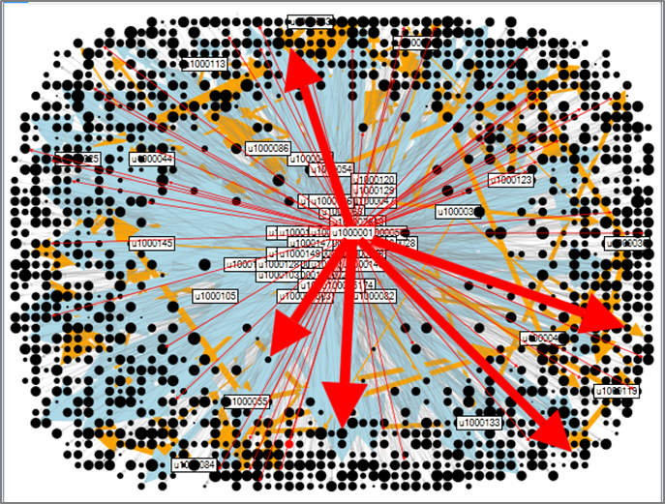
About
Solve
Result
Comment
大数据的简单算法比小数据的复杂算法更有效
纷繁的数据越多越好允许不精确
We use such a figure to show the relation between users and movies. Here the black point represent the movie and the size of it shows the score.
Yellow lines:
Recommendation based on similar users.
Blue lines:
Recommendation based on similar items.

Slide 7
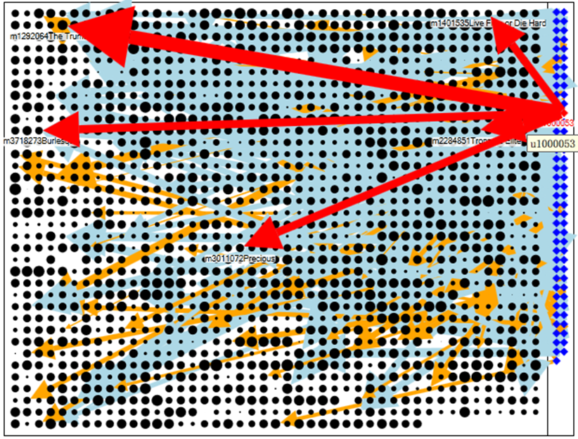
About
Solve
Result
Comment
大数据的简单算法比小数据的复杂算法更有效
纷繁的数据越多越好允许不精确
Recommending Step：Grid Mode
When choosing a user, the chosen one will be linked to movies with red links. The bold ones link it to the recommended movies and the light ones link it to the viewed movies.
The size of the arrow represent the predicted rating that the user will like the movie.

Slide 8
About
Solve
Result
Comment
大数据的简单算法比小数据的复杂算法更有效
纷繁的数据越多越好允许不精确
Usual to see
Limited Open API, Energy and Time
Push Mess-age
Better-ment
Frequ-ency
Hobby

