Slide 1
Fire Hazard Detection in a Smart Home
Smart Homes 1
Applied Data Science Project, University of Bristol
Presenters : Iason Myttas and Samia Mohinta

Slide 2
Table of Contents
Introduction
Background and Significance
Current Progress
Experiment and Data Ingress
Data Preprocessing
Data Visualisation
Data Transformation
Data Annotation, Storage and Integration
Data Exploration with Machine Learning
Summary
References
Q/A

Slide 3
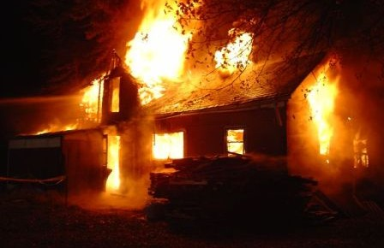
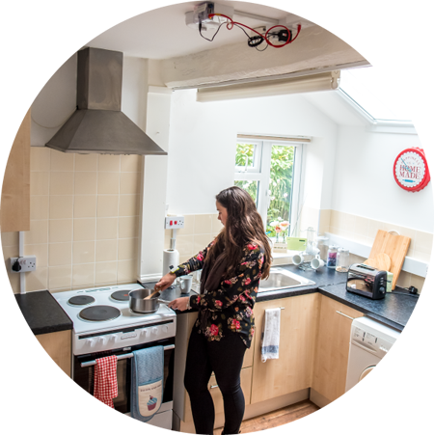
Introduction
Domestic fires are a serious problem all over the world.
Loss of lives and extensive damage to property.
Objective : Smart Technology towards early-fire detection and warning.
Fire risks from unattended cooking appliances.
SPHERE Home
Role of Each Team Member :
Dorothy (Preprocessing)
Samia (Transformation)
Andreas (Storage)
Iason (Data Exploration and Visualisation)

Slide 4
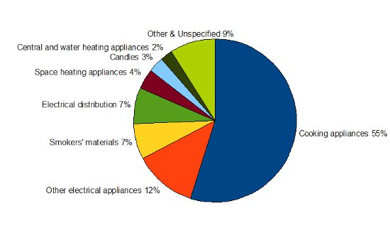
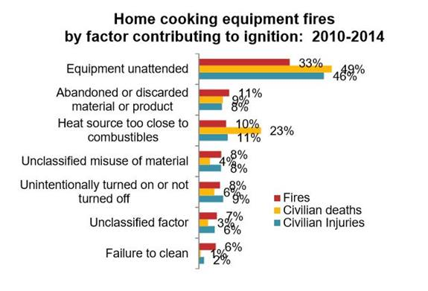
Background and Significance
Background
UK Fire Statistics : Dwelling fires and fire-related fatalities are the most prevalent in the UK [1].
Cooking appliances are most common causes of domestic fire.
Unattended cooking equipment might lead to accidental fires.
Significance :
Within minutes, a fire can cause irreversible devastation and hence, needs early-detection and prevention.
A novel way to quickly detect fire risks using multiple smart sensors and devices.

Slide 5
Current Stage – Data Science Pipeline
Inference
Data Visualisation
Data Modelling – Machine Learning
Data Annotation, Integration & Storage
Data Transformation
Data Preprocessing
We are currently here.
Data Ingress

Slide 6
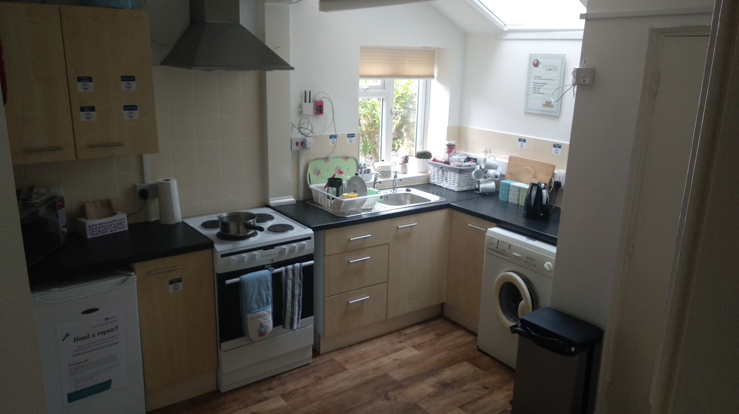
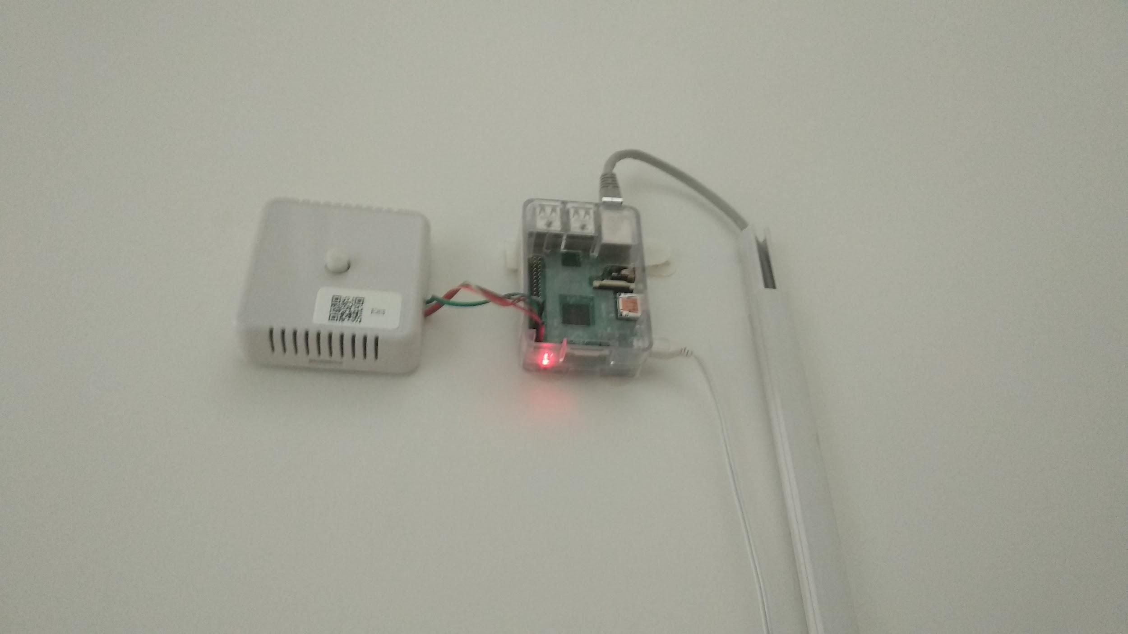
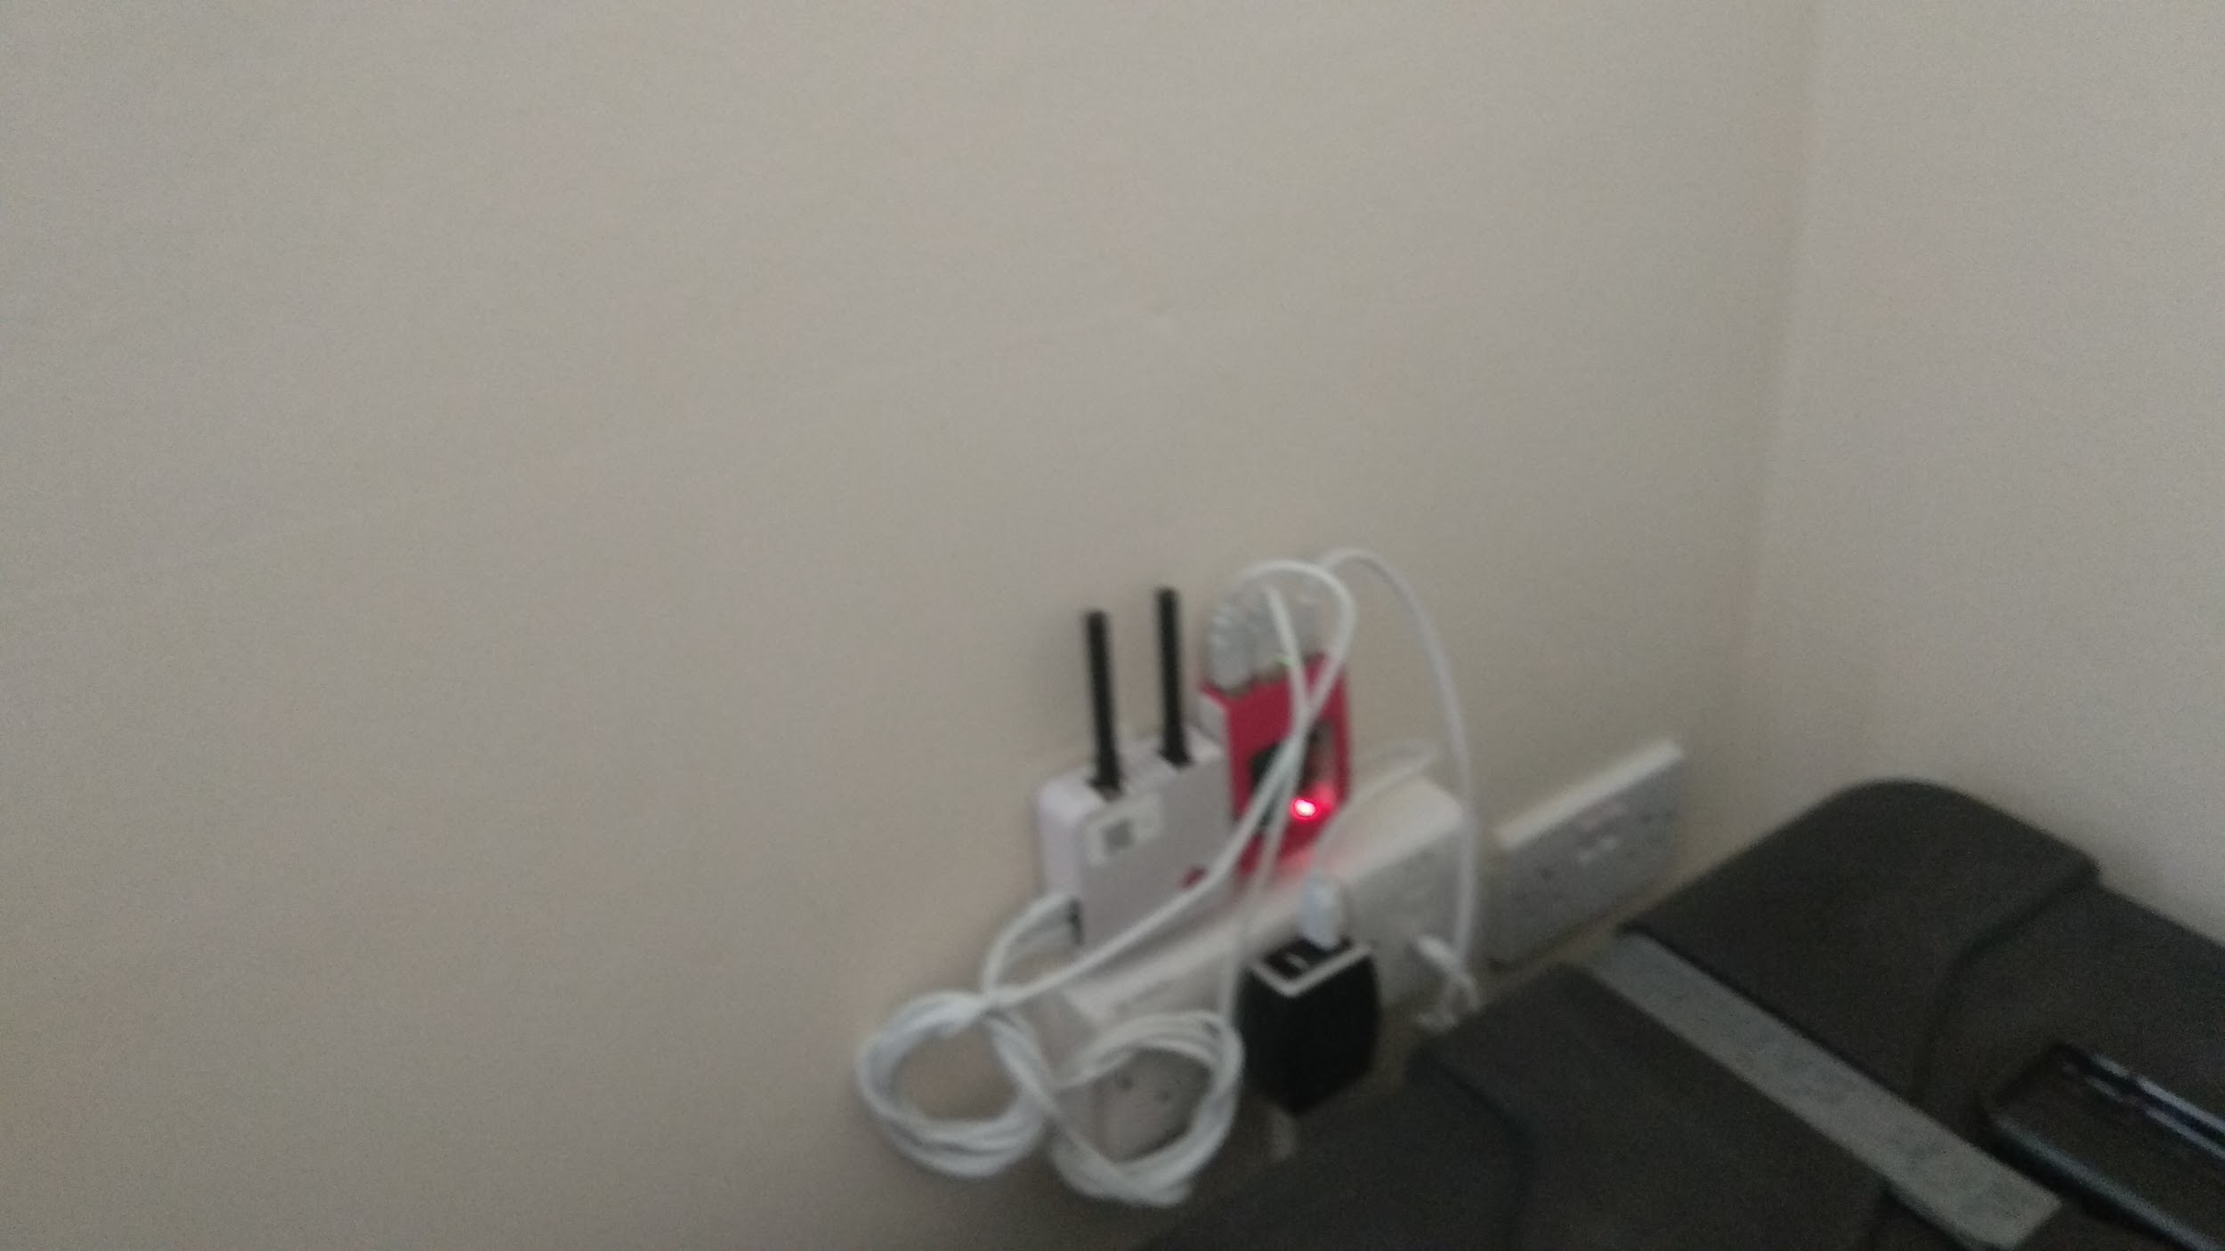
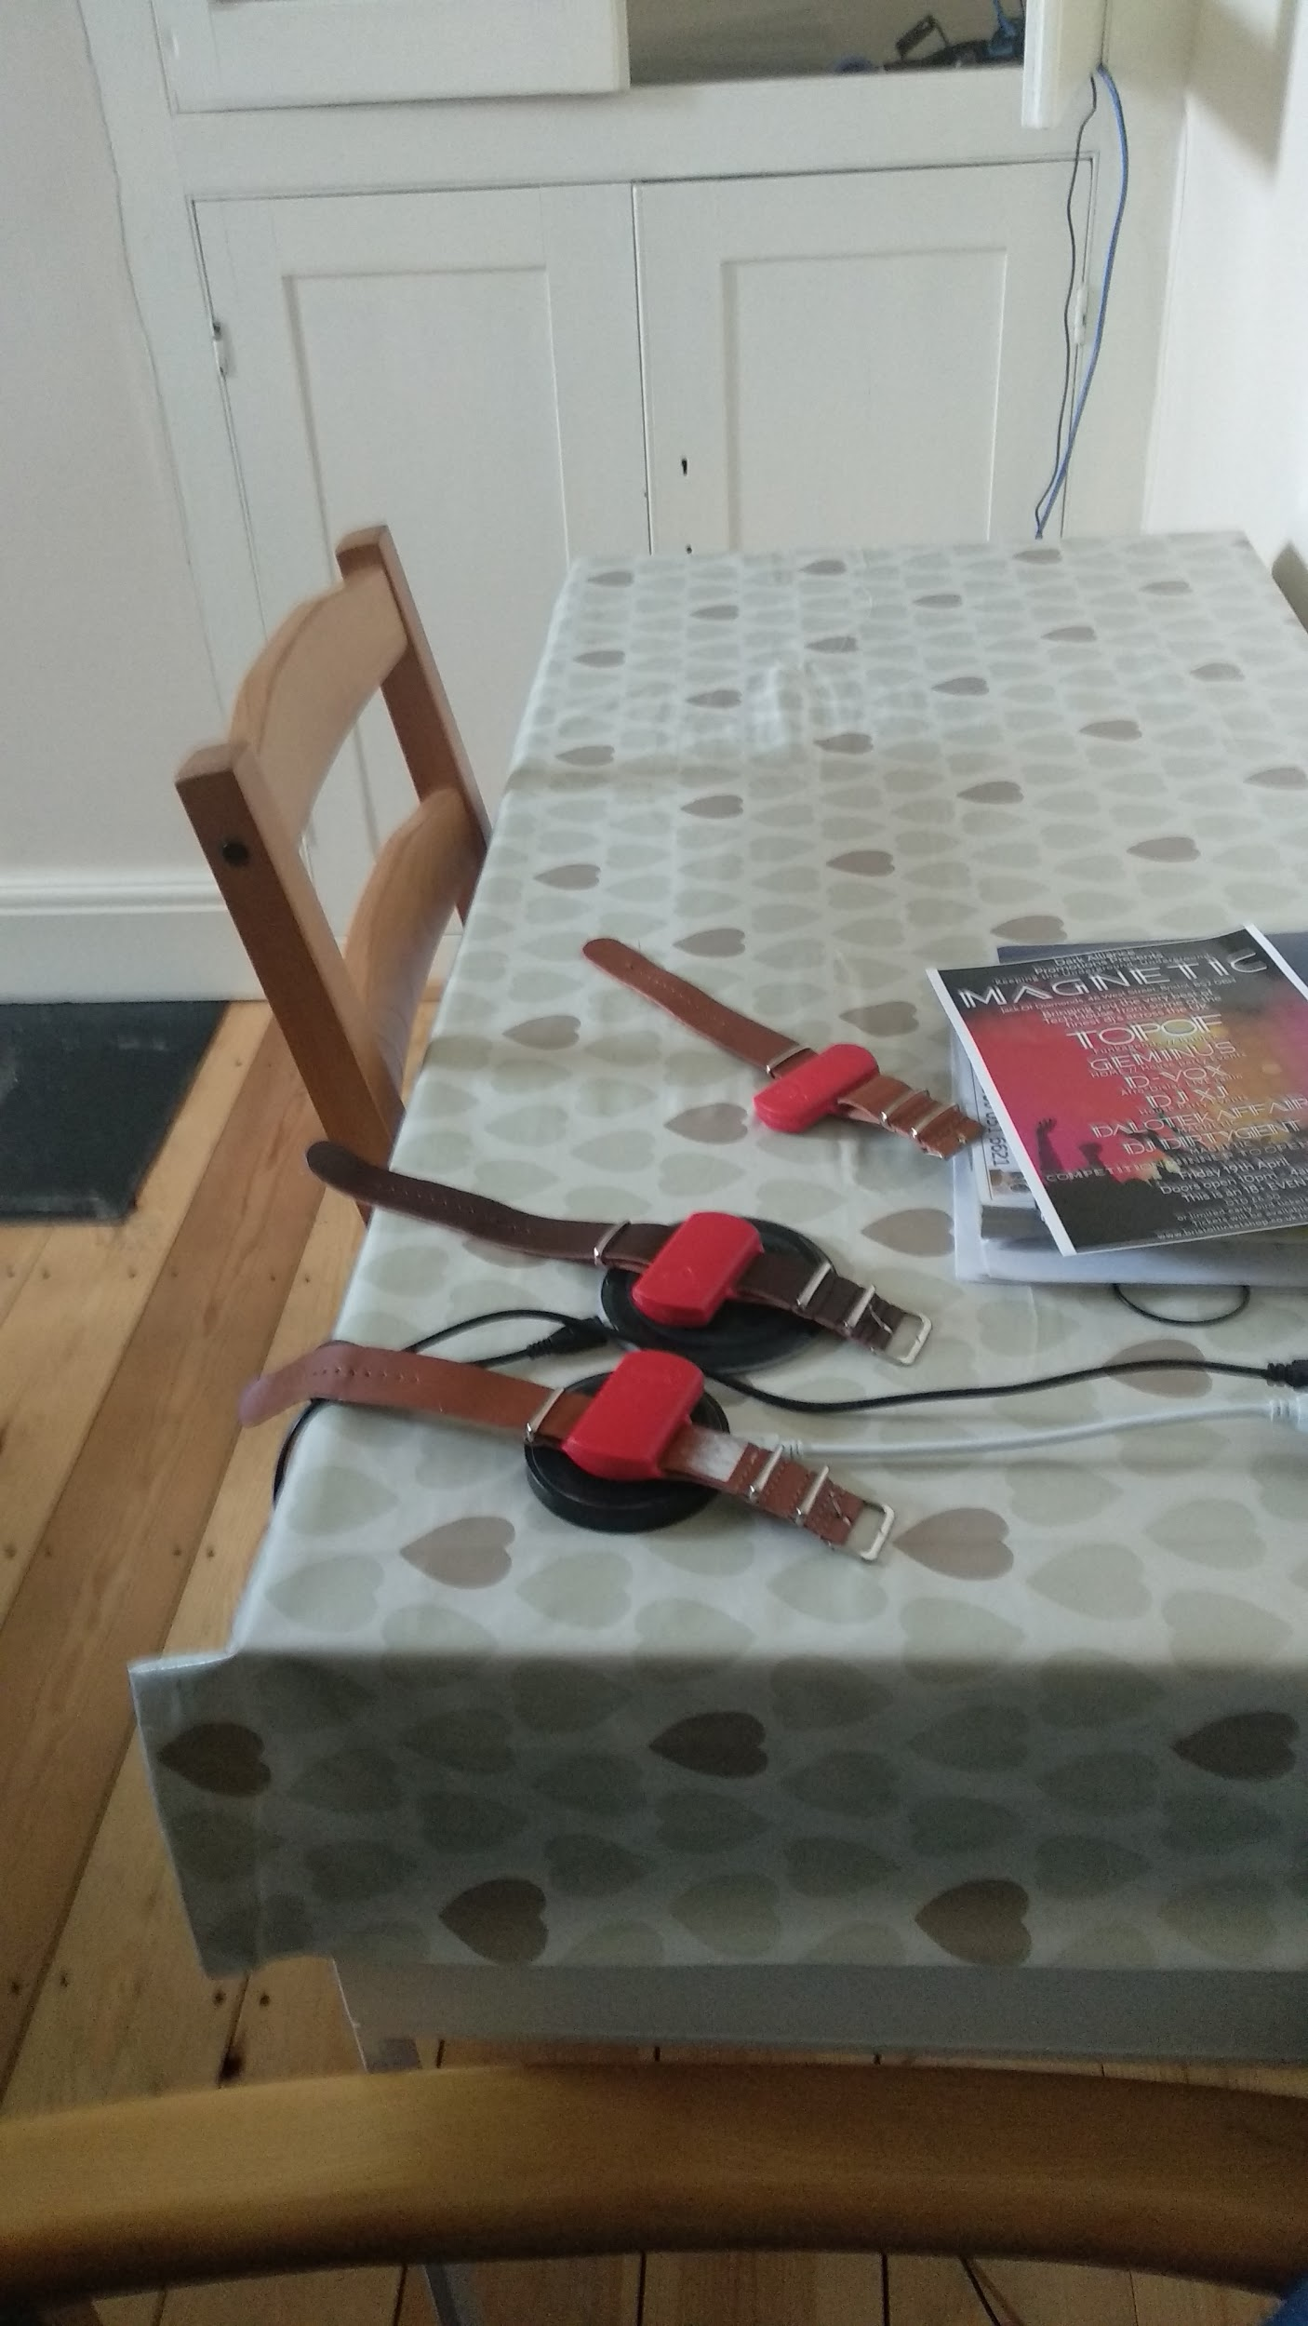
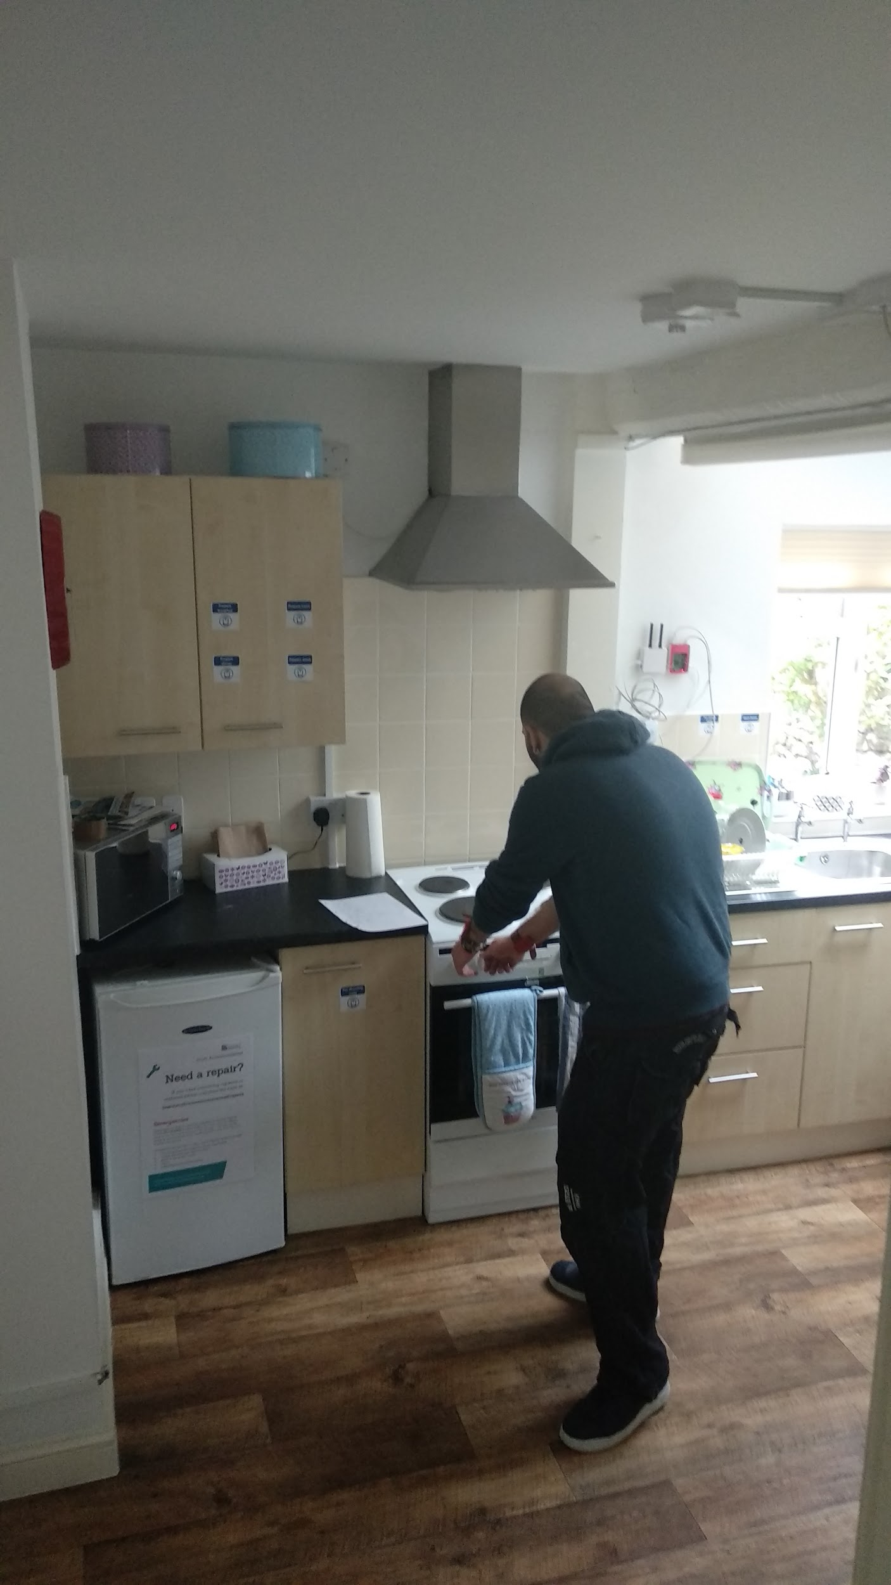
Experiment and Data Ingress
Experiment was conducted in the SPHERE Home test-bed – a two-storey Victorian house maintained by the University of Bristol.
Data collected from all 3 primary sensor modalities :
Environmental Sensors (presence in room, temperature, humidity)
Wearable accelerometers
RGB-Depth Video cameras (not used)
Studied environmental changes resulting from kettle and stove usage.
Human presence in room was determined using PIR sensors and wearable signal strength from SPHERE gateways in each room.
Experiment Duration: Two experiment days lasting 3 hours and 15 minutes: from 5PM to 7PM on 28/03/19 and from 1PM to 2:15PM on 29/04/2019.
24 hour data received from MongoDB dumps as BSON and JSON files.
Notes:
BSON is a language independent data interchange format.
PIR- Passive Infra-Red
RSSI- Received Signal Strength Indicator
Experiment design:
Our experiment design involved imitating everyday activities in a house hold.
We started our experiment - at 5:15 pm and went on till 6:45 pm. As our project revolves around the kitchen, our design was as follows:
Start :- Walks into the kitchen.
Kettle on
Leaving the kitchen[1 trial] [staying in the kitchen- 1 trial] [moving around the house]
Kettle off
Pouring the water in the sink
Opening the kitchen
Coming out of the room/Staying in the room
Wait for 2 mins
Close the window
We had three trials for a kettle and two for a stove.

Slide 7
Data Preprocessing
Prior analysis of data format and expected content of SPHERE datasets.
Selection of attributes to extract from each sensor modality dataset.
Binary JSON files converted to Comma Separated Values using Pandas and Jupyter Notebook.
Separate column fields in .CSV files created to hold values of important data attributes.
Only Base Time fields from data used to maintain consistency of time values.
Outcomes :
More readable and understandable documents.
Enabled primary visualisation of data.
Data Readiness level : B

Slide 8
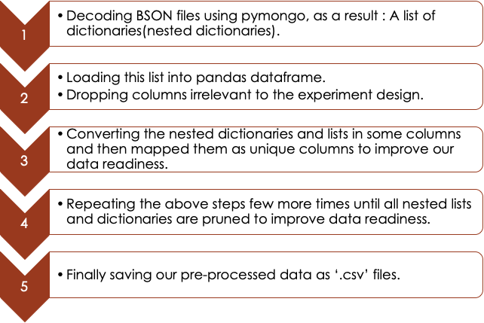
Data Preprocessing - General layout of the steps followed

Slide 9
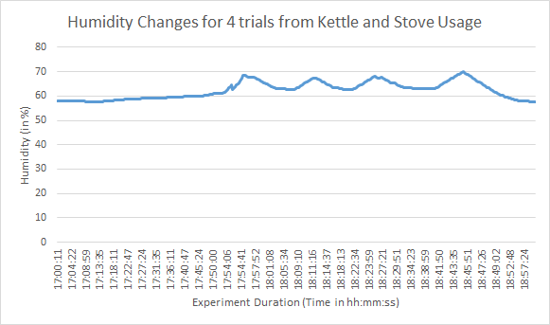
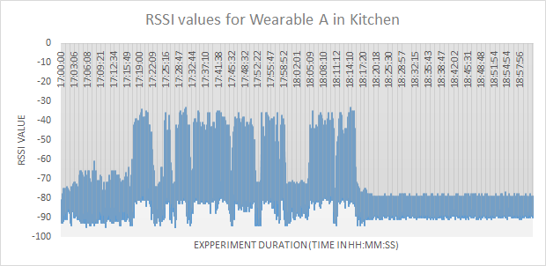

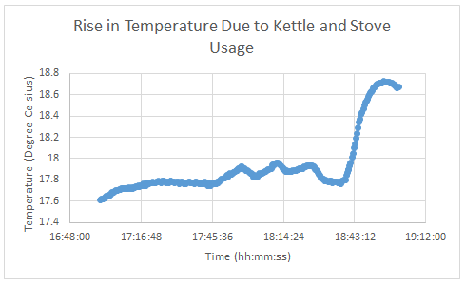
Data Visualisation – Preprocessed Raw Data
Scatter plots and line graphs in Microsoft Excel.
Each parameter such as temperature, humidity and presence in room visualised separately.
Multiple parameters visualised together over time.
Outcome :
Helped pin-point required data transformations.
Primary understanding of the changing values of sensor variables.

Slide 10
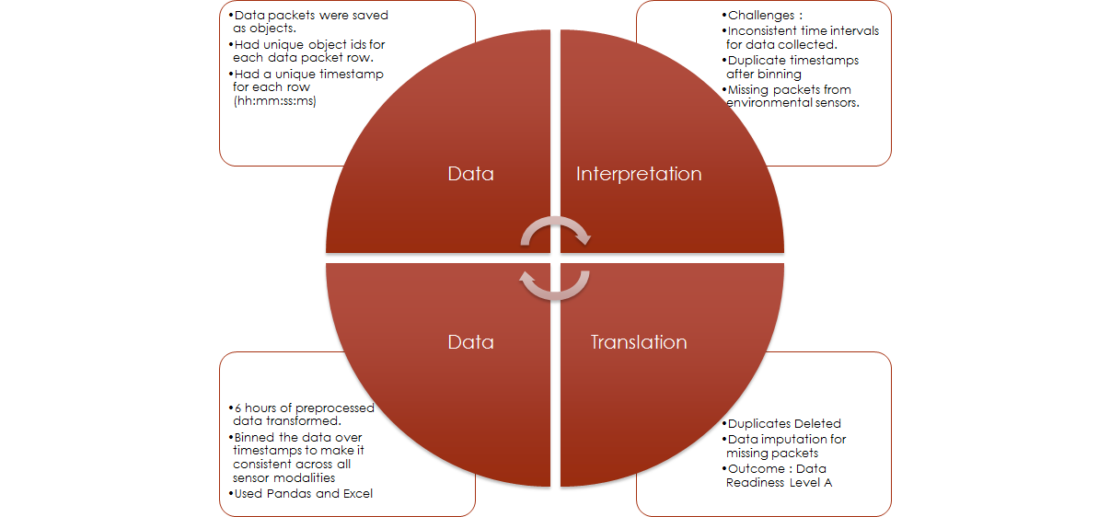
Data Transformation
Notes:
Timestamp was time of packet received and stored in the MongoDB.
Step 1 : Data Interpretation
Data packets from sensors stored as objects with unique object identifiers (o_id) and a timestamp.
Challenges with this data format :
Inconsistent timestamp values and intervals across different sensor files.
Duplicate timestamps due to preprocessing time values till seconds.
Missing packets in terms of timestamps in environmental sensor data.
Step 2 : Data Translation
Duplicate records based on timestamps and individual sensor types dropped.
Binning the data over 40 second windows to allow consistent timestamps across different types of sensor readings.
6 hours of sensor information extracted from the pre-processed data files for wearable and environmental sensors.
Unit data imputation done based on missing timestamps to incorporate consistency.
Facilitated feature extraction down the pipeline.
Data Readiness Level : A

Slide 11

Data Annotation, Storage and Integration
Data Annotation:
Data annotated at a granular level.
Label Fields : Kettle on, Person in Kitchen ; Label values : 0/1; 0- No, 1-Yes
Data Storage
Amazon Web Services(AWS) were used to create a cloud based relational database.
The database used is Amazon RDS for MySQL that is a part of Amazon Web Services (AWS).
Keys for each table were assigned and relational links across disparate sensor reading tables established.
Unified view after joining over keys formed.
Enabled data organization, maintenance, scalability, and availability.
Data Integration
Unified view of the data allowing visualisation of changing patterns of sensor values over time.
Notes:
Data annotation elaboration :
1.Data annotated at a granular level to mark use of a cooking appliance and presence of a person in the room at certain points in time.
2.Time grouped data for each sensor annotated independently with labels 0/1 to specify if an appliance such as the Kettle was on or off and if the participant was in Kitchen or not on that timestamp.
Data integration:
1. Time grouped data for individual sensors was integrated into a singular data file containing readings from disparate sensors installed.

Slide 12
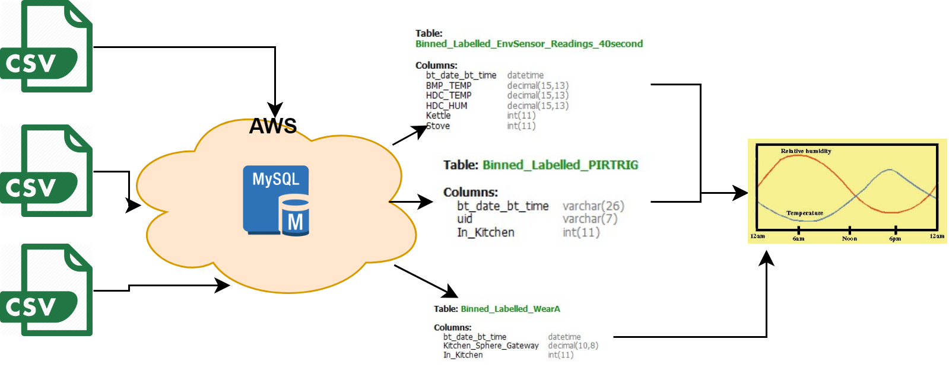
CSV to RDS (MySQL) to Data Integration

Slide 13
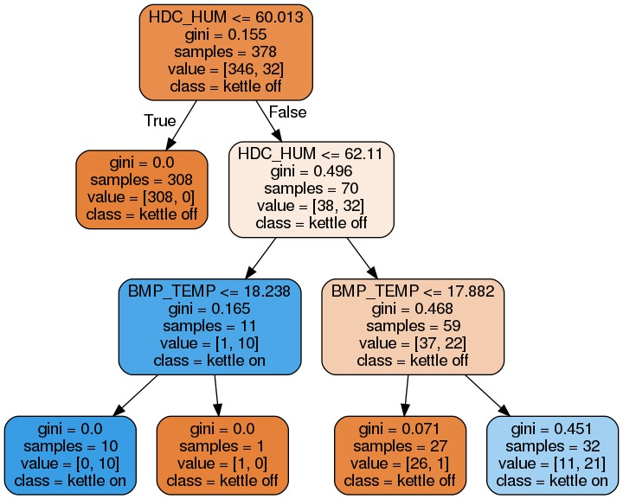
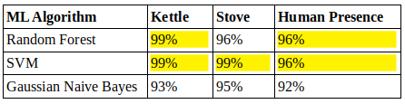
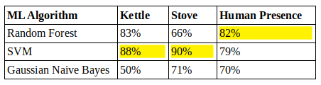
Data Exploration with Machine Learning
Algorithms used:
Support Vector Machines (SVM)
Random Forests
Gaussian Naive Bayes
10-fold cross validation and grid search for parameter tuning
Fire hazard prediction was broken down in two tasks
Kitchen equipment usage prediction (542 rows, 3 features)
Human presence prediction (542 rows, 3 features).
Accuracy
F1 Scores

Slide 14
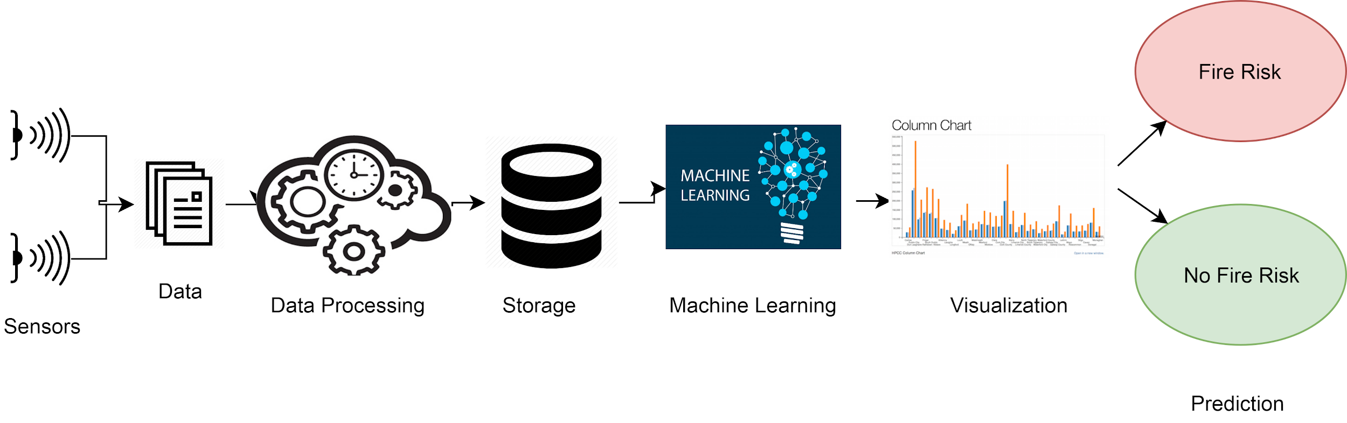
Summary
Random Forests and SVMs are particularly successful at predicting their tasks.
Random Forests better for human presence.
SVMs better for cooking appliance usage.

Slide 15
References
UK Fire Statistics. Retrieved from -https://www.labelbar.co.uk/uk-fire-statistics-i97
The importance of identifying fire hazards. Retrieved from - https://stumpblog.com/fire-hazard-detection-the-importance-of-identifying-fire-hazards/
SPHERE - An EPSRC Interdisciplinary Research Collaboration Retrieved from - https://www.irc-sphere.ac.uk/
Data Readiness Levels: Turning Data from Palid to Vivid. Retrieved from-http://inverseprobability.com/2017/01/12/data-readiness-levels
Pandas. Retrieved from - https://pandas.pydata.org/

Slide 16
Thank you for your attention!

Slide 17
Q/A Session

