Slide 1
Fire Symptom Detection in a Smart Home
Applied Data Science Project
Smart Homes 1
Presenters :

Slide 2
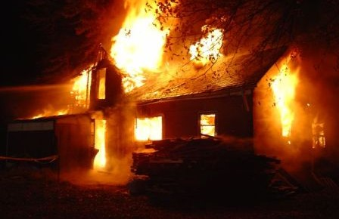
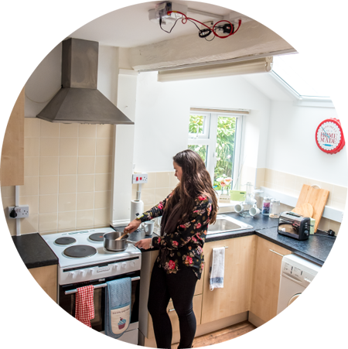
Introduction
Domestic fires are a serious problem all over the world.
Loss of lives and extensive damage to property.
Objective : Smart Technology towards early-fire detection and warning.
SPHERE Home
Fire risks from unattended cooking appliances.
Ethics, Approvals and Anonymity
Role of Each Team Member :
Dorothy
Samia
Andreas
Jason

Slide 3
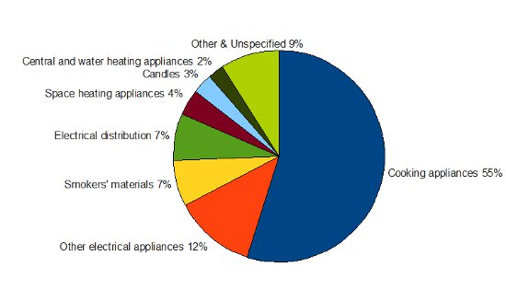
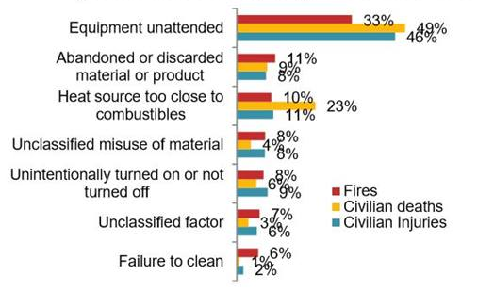
Background and Significance
Background
UK Fire Statistics : Dwelling fires and fire-related fatalities are the most prevalent in the UK [1].
Cooking appliances are most common causes of domestic fire.
Unattended cooking might lead to an accidental fire.
Significance :
Within minutes, a fire can cause irreversible devastation and hence, needs early-detection and prevention.
A novel way to detect fire risks that can be caused from unattended cooking using smart sensors and devices.
An early-warning can prevent an uncalled for incident.

Slide 4
Experiment and Data Ingress
Experiment was conducted in the SPHERE Home test-bed – a two-storey Victorian house maintained by the University of Bristol.
Data collected from all 3 primary sensor modalities :
Environmental Sensors, example Passive Infra-Red sensors
Wearable accelerometers
RGB-Depth Video cameras
Experiment involved kettle and stove to collect data regarding environmental changes caused from cooking appliances.
Person in the room/kitchen data was collected using PIR and wearable RSSI from SPHERE gateways in each room.
Experiment Duration – 2 hours from 5PM to 7PM on 28/03/19.
24 hour data dumped from MongoDB for 28th March,2019 received in Binary JSON and JSON format for all sensor modalities.
Notes:
BSON is a language independent data interchange format.

Slide 5
Data Preprocessing
Prior analysis of data format and expected content of SPHERE datasets.
Selection of attributes to extract from each sensor modality dataset.
Binary JSON files converted to Comma Separated Values using Pandas and Jupyter Notebook.
Separate column fields in .CSV files created to hold values important data attributes.
Only Base Time fields from data used to maintain consistency of time values.
Outcomes :
More readable and understandable documents.
Enabled primary visualization of data.

Slide 6
Data Visualization - Primary
Scatter plots and line graphs in Microsoft Excel.
Each parameter such as temperature, humidity and presence in room visualized separately.
Multiple parameters visualized together over time.
Outcome :
Helped pin-point required data transformations.
Primary understanding of the changing values of sensor variables.

Slide 7
Data Transformation
Step 1 : Data Interpretation
Data packets from sensors stored as objects with unique object identifiers (o_id) and a timestamp.
Challenges with this data format :
Inconsistent timestamp values and intervals across different sensor files.
Duplicate timestamps due to preprocessing time values till seconds.
Missing packets in terms of timestamps in environmental sensor data.
Step 2 : Data Translation
Duplicate records based on timestamps and individual sensor types dropped.
Binning the data over 40 second windows to allow consistent timestamps across different types of sensor readings.
6 hours of sensor information extracted from the pre-processed data files for wearable and environmental sensors.
Unit data imputation done based on missing timestamps to incorporate consistency.
Facilitated feature extraction
Notes:
Timestamp was time of packet received and stored in the MongoDB.
Get the pictures

Slide 8
Data Integration, Annotation and Storage
Data Annotation:
Data annotated at a granular level.
Label Fields : Kettle on, Person in Kitchen ; Label values : 0/1; 0- No, 1-Yes
Data Integration
Data combined into a single CSV file from different sensor modalities.
Outcome : Unified view of the data allowing visualization of changing patterns of sensor values over time.
Data Storage
The binned and labelled CSV files were imported into a cloud-based Relational Database on AWS.
Keys for each table were assigned and relational links across disparate sensor reading tables established.
Unified table after joining over keys formed.
Enabled data organization, maintenance and availability for fruitful collaboration.
Notes:
Data annotation elaboration :
1.Data annotated at a granular level to mark use of a cooking appliance and presence of a person in the room at certain points in time.
2.Time grouped data for each sensor annotated independently with labels 0/1 to specify if an appliance such as the Kettle was on or off and if the participant was in Kitchen or not on that timestamp.
Data integration:
1. Time grouped data for individual sensors was integrated into a singular data file containing readings from disparate sensors installed.

Slide 9
Data Modelling & Visualization- Machine Learning

Slide 10
Results and Discussion

Slide 11
Current Stage – Data Science Pipeline

Slide 12
References
[1] UK Fire Statistics. Retrieved from https://www.labelbar.co.uk/uk-fire-statistics-i97

Slide 13
Thank you for your attention!

Slide 14
Q/A Session

