Slide 1
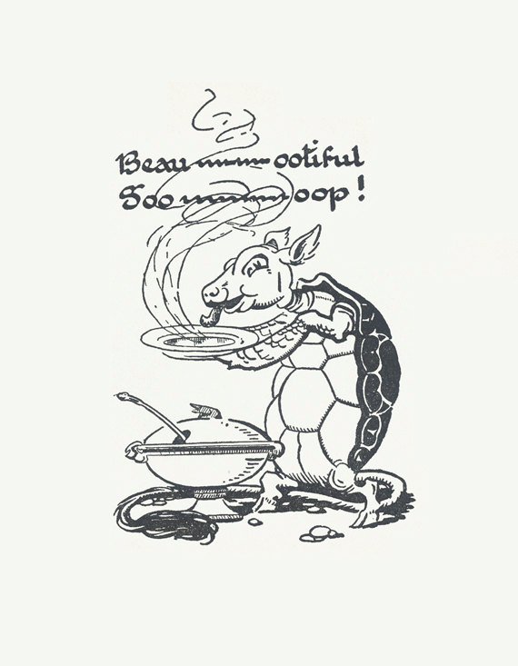
Beautiful Soup

Slide 2
Women Who Code (WWCode) is global non-profit dedicated to inspiring women to excel in technology careers. We work to support this generation in being and becoming leaders and role models in the tech industry. We are the DC Chapter! Volunteer / Donate Visit our Meetup site Python Beginners: 1st Wednesday of the Month; Python Lab Night: 3rd Wednesday of the month

Slide 3
Web Scraping
Extracting information from a website (usually HTML) and parsing it in a readable format (this is called getting soup).
We will be using a package in the Python Library called Beautiful Soup which parses HTML and XML.
Some Best Practices:
Check the Robots.txt to make sure you can web scrape the website. Look for User Agent: *
Scraping too many pages at once quickly can get your IP blocked
Use a browser developer tool to determine the classes of objects (in Chrome you select Inspect)
Use an LXML parser which is faster than HTML parser

Slide 4
Packages Python 3: pip3 install beautifulsoup4
Python 2.7: pip install beautifulsoup4
conda install -c anaconda beautifulsoup4
Dependencies
Install pip
Install lxml
Install requests

Slide 5
https://bit.ly/2JCPPAi

Slide 6
IMDB
Monty Python &
The Holy Grail

Slide 7
Our Web Scraping Exercise
Check the Robots.txt of IMDB
Save your Python File and import the packages that you need (Beautiful Soup & Requests)
Parse the HTML of 1 url of IMDB of a movie: Monty Python Holy Grail’s IMDB.
Let’s web scrape the Title, Content Rating, Description of this movie
Let’s create a function where we pass through an ID of an IMDB movie to add the previous information we web scraped in the form of a dictionary.

Slide 8
Python Training Resources
ONLINE
Coursera
HackerRank
StackOverflow
Slack
CodeCombat
GitHub
Kaggle
EDX by microsoft
How to Think Like a Computer Scientist - PDF
Learn Python the Hard Way
Data Camp
In Person:
WWCDC (1st & 3rd wed)
Hear Me Code (Once a Month on Saturdays)

