Slide 1
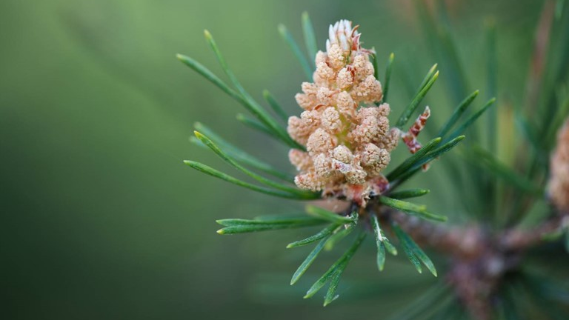
City of Austin Tree Planting
Dorothy Hewitt-Sanchez

Slide 2
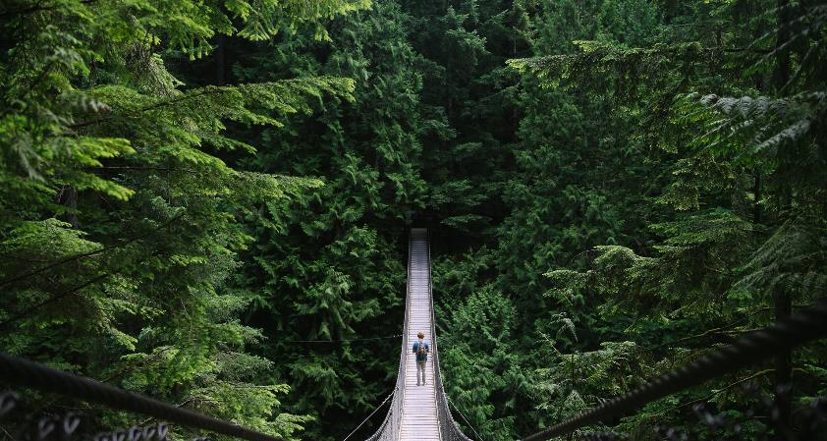

Introduction
The City of Austin has made the data available for the total number of trees that were planted or distributed by the City of Austin from year 2015 through year 2020. Each tree is equivalent to one 5-gallon tree.
The data set can be downloaded from the following web location: https://data.austintexas.gov/dataset/City-of-Austin-Tree-Planting/ingu-qjea

Slide 3
Total number of Trees PLANTED OR DISTRIBUTED
38068

Slide 4
Trees Planted PER Year
Year Summary of Trees Planted
2015 7262
2016 6133
2017 6380
2018 6378
2019 6969
2020 4946

Slide 5
Year 2015
Category | Year |  | Program | Funding_Source | Land_Type | Trees_Planted_or_Distributed
Growing | 2015 |  | Austin Community Trees | UFRF | Residential | 400
Growing | 2015 |  | NeighborWoods | AE Heat Island | Residential | 3604
Growing | 2015 |  | PARD Forestry | PARD | Parks + Open Space | 872
Growing | 2015 |  | Ready Set Plant! | AE Heat Island | Creekside | 940
Growing | 2015 |  | Street trees o/m | PWD | Right-of-Way | 290
Growing | 2015 |  | Utility forestry o/m | AE | Right-of-Way | 1156

Slide 6
Year 2016
Category | Year |  | Program | Funding_Source | Land_Type | Trees_Planted_or_Distributed
Growing | 2016 |  | Austin Community Trees | UFRF | Residential | 260
Growing | 2016 |  | NeighborWoods | AE Heat Island | Residential | 4219
Growing | 2016 |  | PARD Forestry | PARD | Parks + Open Space | 693
Growing | 2016 |  | Ready Set Plant! | AE Heat Island | Creekside | 447
Growing | 2016 |  | Street trees o/m | PWD | Right-of-Way | 56
Growing | 2016 |  | Utility forestry o/m | AE | Right-of-Way | 458

Slide 7
Year 2017
Category | Year |  | Program | Funding_Source | Land_Type | Trees_Planted_or_Distributed
Growing | 2017 |  | Austin Community Trees | UFRF | Residential | 240
Growing | 2017 |  | NeighborWoods | AE Heat Island | Residential | 4121
Growing | 2017 |  | PARD Forestry | PARD | Parks + Open Space | 301
Growing | 2017 |  | Ready Set Plant! | AE Heat Island | Creekside | 1150
Growing | 2017 |  | Street trees o/m | PWD | Right-of-Way | 36
Growing | 2017 |  | Utility forestry o/m | AE | Right-of-Way | 532

Slide 8
YEAR 2018
Category | Year |  | Program | Funding_Source | Land_Type | Trees_Planted_or_Distributed
Growing | 2018 |  | Austin Community Trees | UFRF | Residential | 240
Growing | 2018 |  | NeighborWoods | AE Heat Island | Residential | 4623
Growing | 2018 |  | PARD Forestry | General | Parks + Open Space | 99
Growing | 2018 |  | Ready Set Plant! | AE Heat Island | Creekside | 1007
Growing | 2018 |  | Street trees o/m | General | Right-of-Way | 0
Growing | 2018 |  | Utility forestry o/m | General | Right-of-Way | 409

Slide 9
Year 2019
Category | Year |  | Program | Funding_Source | Land_Type | Trees_Planted_or_Distributed
Growing | 2019 |  | NeighborWoods | AE Heat Island | Residential | 4594
Growing | 2019 |  | PARD Forestry | General | Parks + Open Space | 544
Growing | 2019 |  | Ready Set Plant! | AE Heat Island | Creekside | 1205
Growing | 2019 |  | Street trees o/m | PWD | Right-of-Way | 520
Growing | 2019 |  | Utility forestry o/m | AE | Right-of-Way | 106

Slide 10
Year 2020
Category | Year |  | Program | Funding_Source | Land_Type | Trees_Planted_or_Distributed
Growing | 2020 |  | NeighborWoods | AE Heat Island | Residential | 3406
Growing | 2020 |  | PARD Forestry | PARD | Parks + Open Space | 412
Growing | 2020 |  | Ready Set Plant! | AE Heat Island | Creekside | 993
Growing | 2020 |  | Street trees o/m | PWD | Right-of-Way | 0
Growing | 2020 |  | Utility forestry o/m | AE | Right-of-Way | 135

Slide 11
Funding Sources
The following will show how many trees were planted or distributed per funding source by Program. The first slide will show funding sources and the number of times they contributed over the years. It also shows a ranking starting with the most trees planted or distributed.

Slide 12
Funding contributions

Slide 13
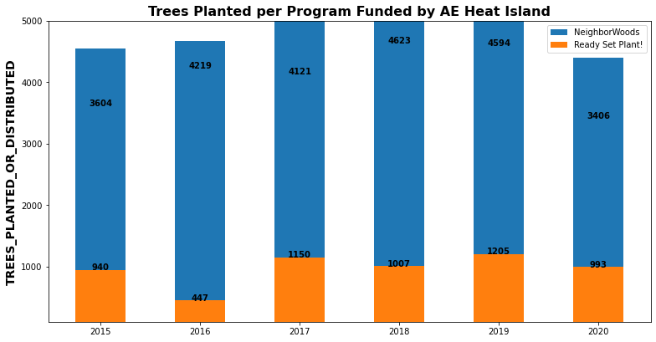
AE Heat island

Slide 14
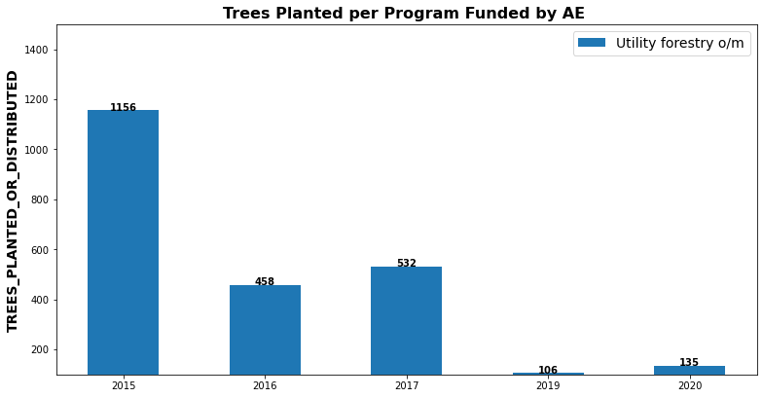
AE

Slide 15
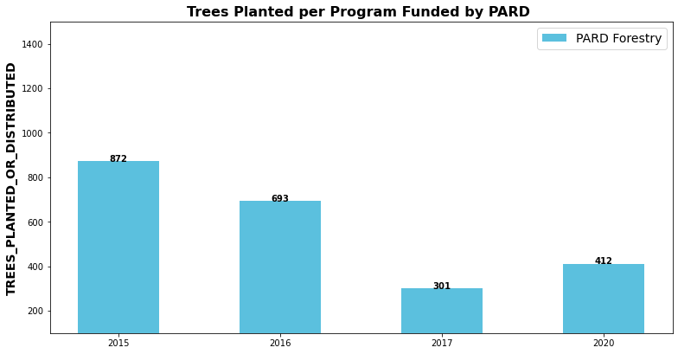
PARD

Slide 16
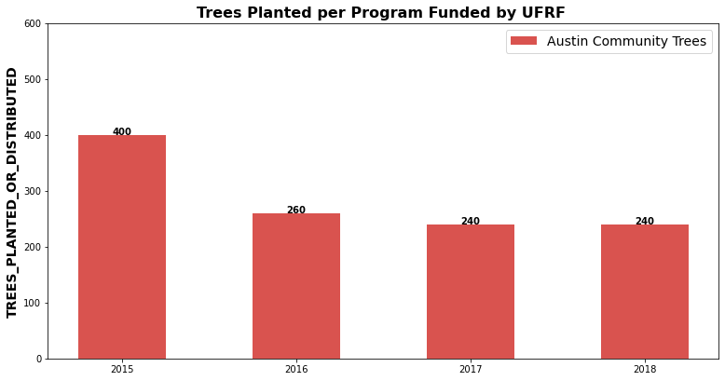
ufrf

Slide 17
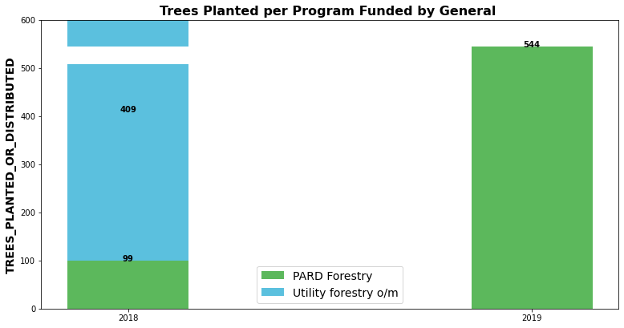
GENERAL

Slide 18
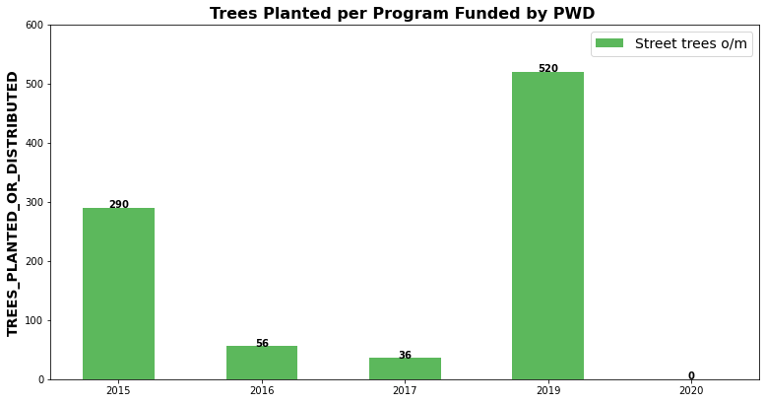
pwd

Slide 19


Thank you
Dorothy Hewitt-Sanchez | Hewitt.Dorothy@gmail.com

