Slide 1
Haladó Big Data
4. Előadás
Apache Spark II.rész

Slide 2
A mai előadáson
Túl nagy és bonyolult a probléma
Polinomiális idő már gyakrolatban túl lassú
Közelítő megoldás
Valószínűségi algoritmusok
Spark/map-reduce számítások
Iteratív algoritmusok Spark-ban
Spark DataFrames, „globális változók”, stb.

Slide 3
Jelölések és kis emlékeztető
https://runawayhorse001.github.io/LearningApacheSpark/stats.html

Slide 4
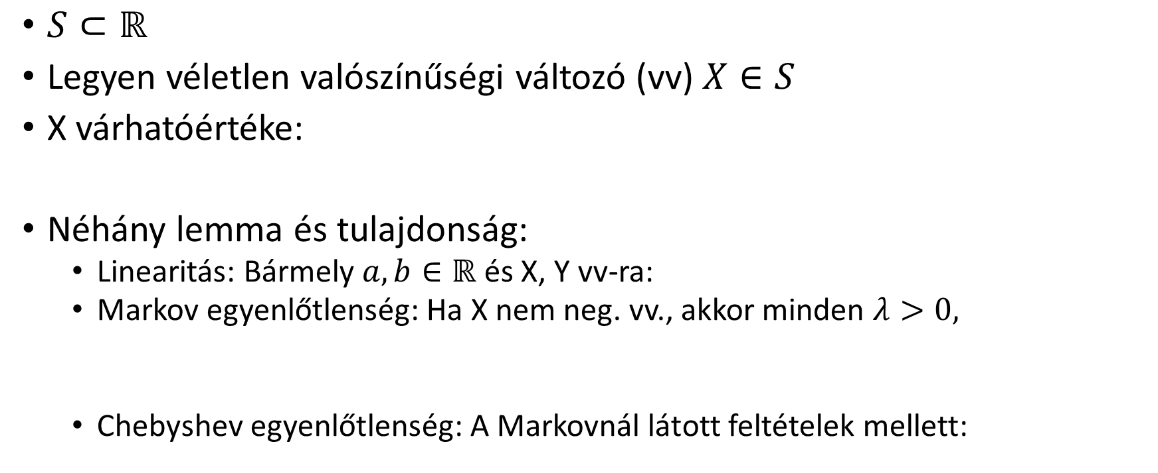
Egy kis valszám emlékeztető
$S⊂ℝ$
Legyen véletlen valószínűségi változó (vv) $X∈S$
X várhatóértéke:
Néhány lemma és tulajdonság:
Linearitás: Bármely $a,b∈ℝ$ és X, Y vv-ra:
Markov egyenlőtlenség: Ha X nem neg. vv., akkor minden $λ>0,$
Chebyshev egyenlőtlenség: A Markovnál látott feltételek mellett:

Slide 5
Egy kis valszám emlékeztető
Chernoff korlát
Tegyük fel, hogy független vv-ók és
Legyen
Ha , akkor

Slide 6
Streaming feladat
Feladat
Adott a Google szervereiből jövő valós idejű log folyam
Adjuk meg az egyedi lekérdezések számát?
Problémák
Az adathalmaz túl nagy – egy gépen nem tárolható
A polinomiális futási idő túl sok
Mit csináljunk?

Slide 7
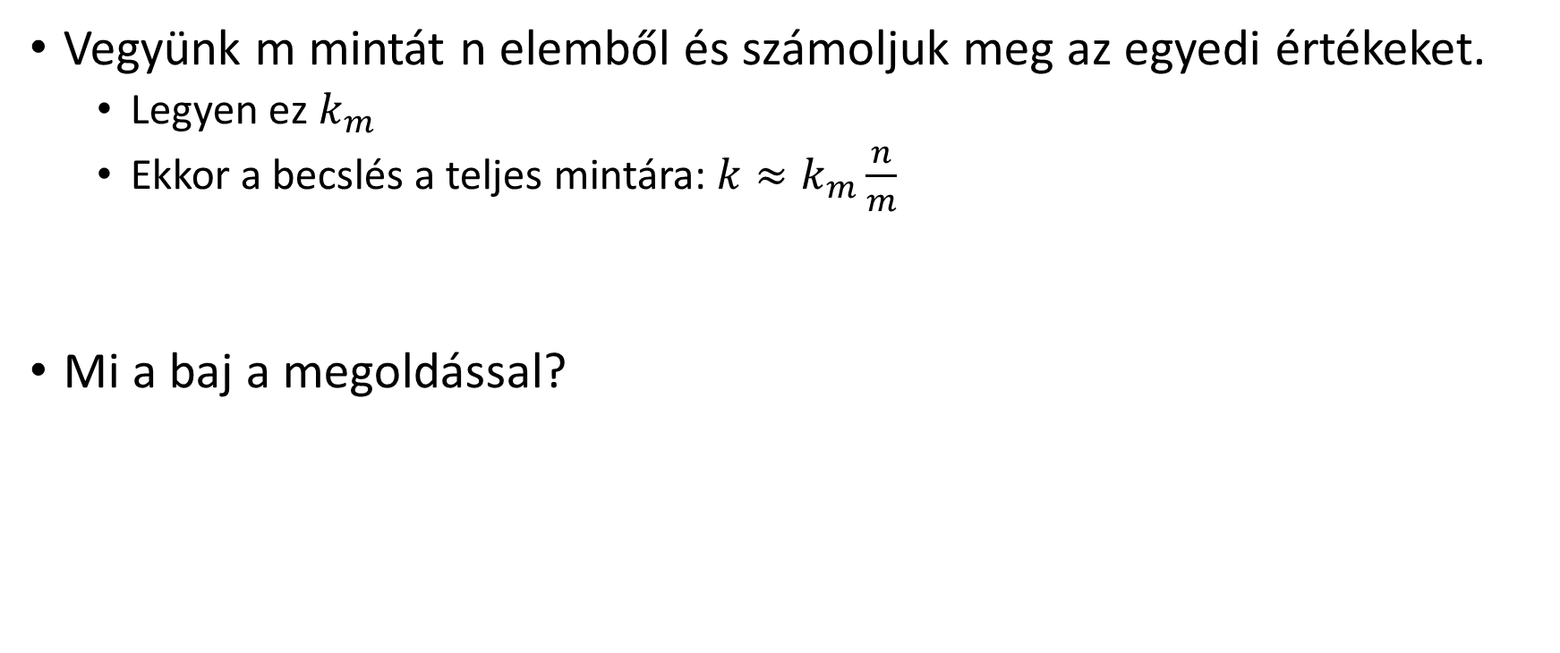
Megoldási javaslat #1
Vegyünk m mintát n elemből és számoljuk meg az egyedi értékeket.
Legyen ez $k_{m}$
Ekkor a becslés a teljes mintára: $k≈k_{m}\frac{n}{m}$
Mi a baj a megoldással?

Slide 8
Egy valószínűségi algoritmus
Ötlet: haszáljunk egy hash függvényt
Hasheljük az összes adatot és tartsuk nyilván a legkisebb hash értéket a memóriában.
A kimenet: k ~ 1/(a legkisebb hash) - 1

Slide 9
Miért jó ez? Vagy miért nem?
Ha k különböző értékünk van
akkor
Y = min h(x_i) becslő

Slide 10
További lépések
Mennyire jól becsül az Y?
Y szórásnégyzete
Hogyan javítható?
Z = Y becslők átlaga
Hogyan gyorsítható?
Átlagok mediánja

Slide 11
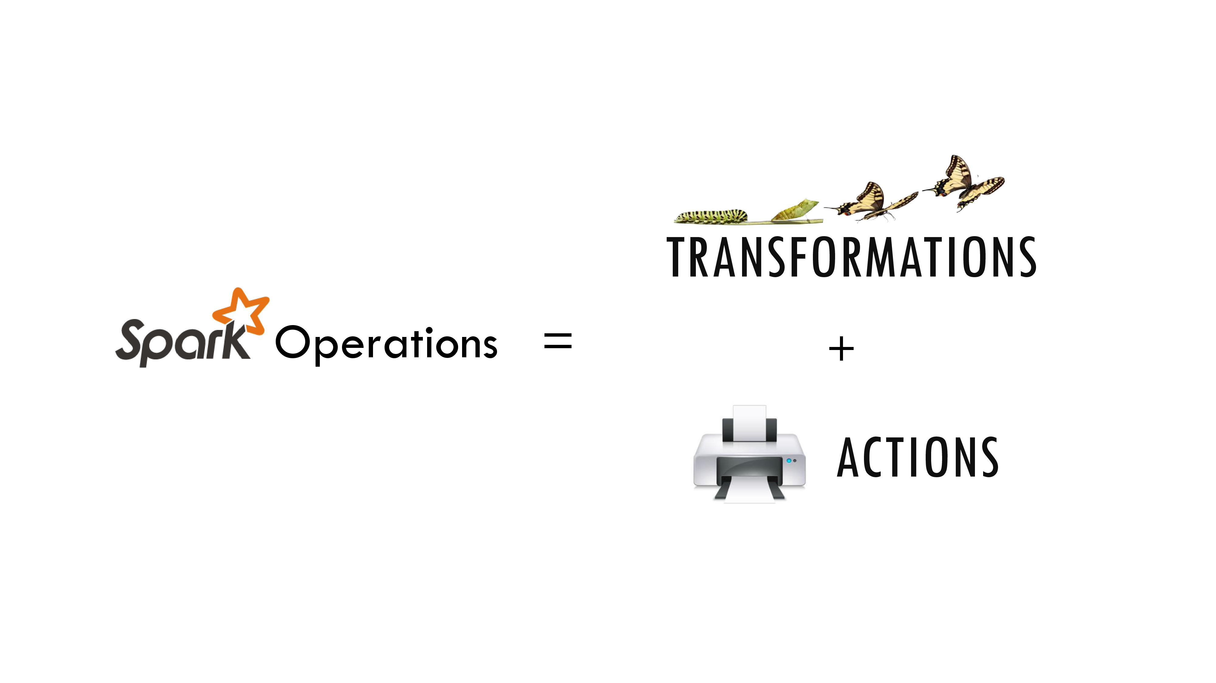
Forrás: W. Feng: Learning Apache Spark with Python

Slide 12
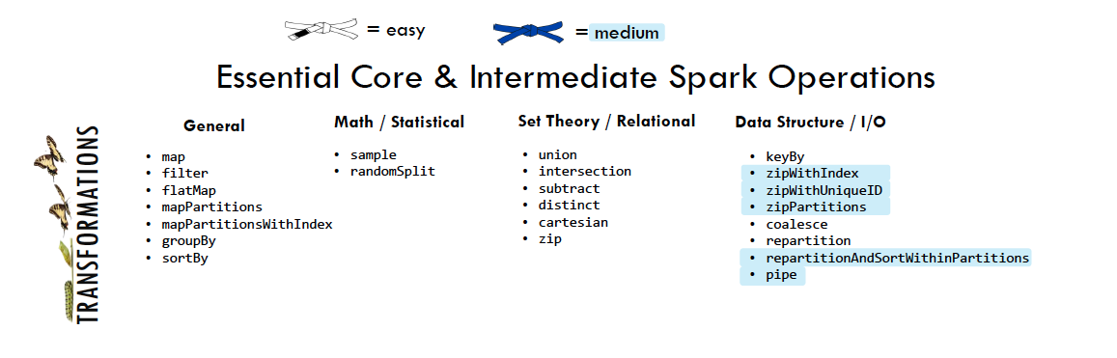
Transformations Új RDD-t készít egy korábbiból
Forrás: W. Feng: Learning Apache Spark with Python

Slide 13
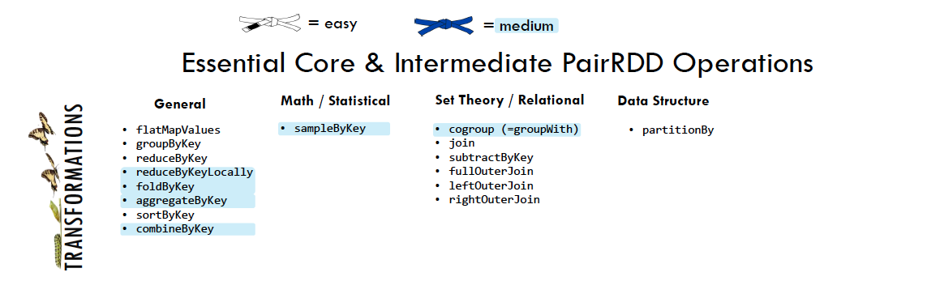
Transformations Új RDD-t készít egy korábbiból
Forrás: W. Feng: Learning Apache Spark with Python

Slide 14
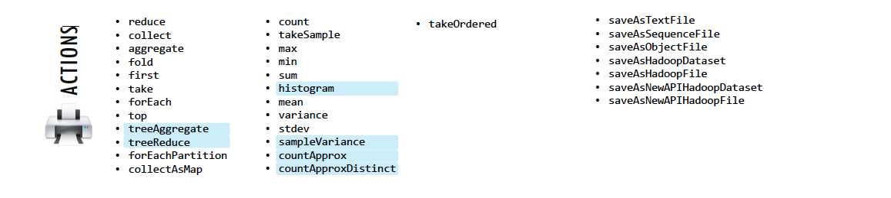
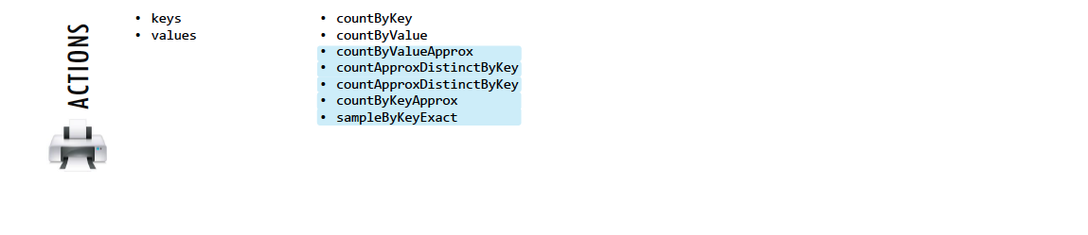
Actions Valamilyen eredményt számít ki egy RDD-ből
Forrás: W. Feng: Learning Apache Spark with Python

Slide 15

Job example
Driver
val log = sc.textFile(“hdfs://...”)
val errors = file.filter(_.contains(“ERROR”))
errors.cache()
errors.filter(_.contains(“I/O”)).count()
errors.filter(_.contains(“timeout”)).count()
Action!
Worker
Worker
Worker
Cache1
Cache2
Cache2
Block1
Block2
Block3
source: https://cwiki.apache.org/confluence/display/SPARK/Spark+Internals

Slide 16
RDD partition-level view
Dataset-level view:
Partition-level view:
log:
HadoopRDD path = hdfs://...
errors:
FilteredRDD func = _.contains(…) shouldCache = true
Task 1
Task 2
...
source: https://cwiki.apache.org/confluence/display/SPARK/Spark+Internals

Slide 17
Job scheduling
RDD Objects
DAGScheduler
TaskScheduler
Worker
Cluster manager
Threads
DAG
TaskSet
Task
Block manager
rdd1.join(rdd2) .groupBy(…)
.filter(…)
split graph into stages of tasks
launch tasks via cluster manager
execute tasks
submit each stage as ready
retry failed or straggling tasks
store and serve blocks
build operator DAG
source: https://cwiki.apache.org/confluence/display/SPARK/Spark+Internals

Slide 18
Available APIs
You can write in Java, Scala or Python
interactive interpreter: Scala & Python only
standalone applications: any
performance: Java & Scala are faster thanks to static typing

Slide 19

Hogyan számoljuk ki?
Pearson korreláció:
1. átlagok:
xdata = [0.0, 2.0, 4.0, 6.0, 8.0, 10.0]
ydata = [1.0, 3.0, 5.0, 7.0, 9.0, 9.0]
xrdd = sc.parallelize(xdata)
yrdd = sc.parallelize(ydata)
mx = xrdd.reduce(lambda a,b: a+b) / xrdd.count()
my = yrdd.reduce(lambda a,b: a+b) / yrdd.count()

Slide 20
map-reduce lépések
2. szummák
both = xrdd.zip(yrdd)
upper = both.map(lambda x: (x[0]-mx)*(x[1]-my))
.reduce(lambda a,b: a+b)
lowerx, lowery =
both.map(lambda x: ( (x[0]-mx)**2 , (x[1]-my)**2))
.reduce(lambda a,b: (a[0]+b[0], a[1]+b[1]))
import math
r = upper / (math.sqrt(lowerx) * math.sqrt(lowery))

Slide 21
Eggyel kevesebb map-reduce lépés
upper, lowerx, lowery =
both.map(lambda x:
( (x[0] - mx)*(x[1] - my), (x[0]-mx)**2, (x[1]-my)**2))
.reduce(lambda a,b: (a[0]+b[0], a[1]+b[1], a[2]+b[2]))
r = upper / (math.sqrt(lowerx) * math.sqrt(lowery))

Slide 22
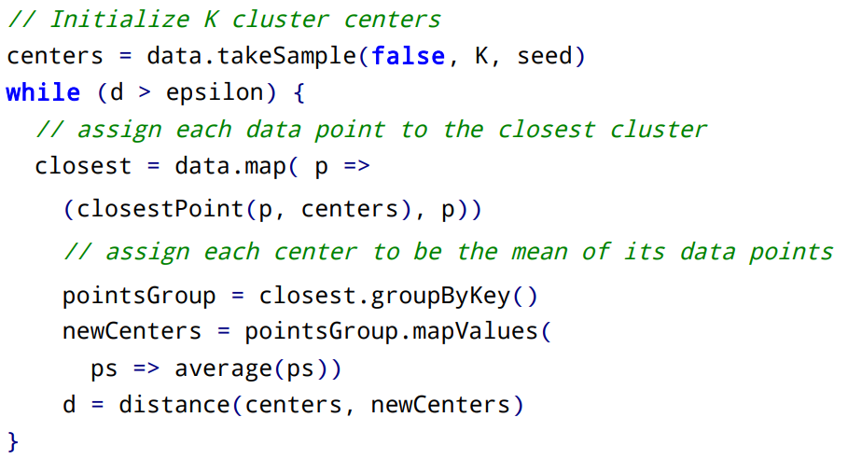
Iteratív algoritmusok
K-Means

Slide 23
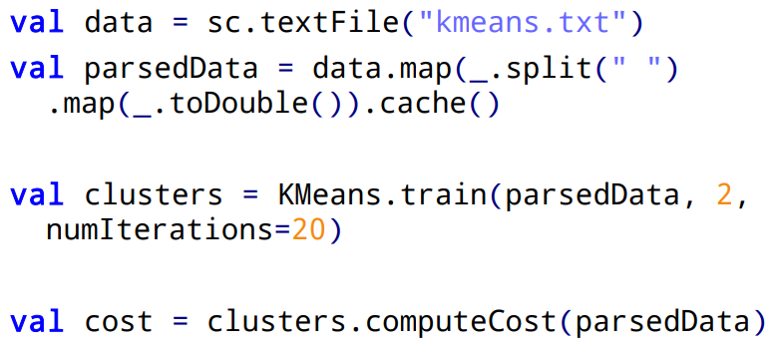
K-Means - SparkML
https://runawayhorse001.github.io/LearningApacheSpark/clustering.html#k-means-model

Slide 24





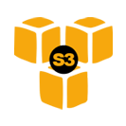







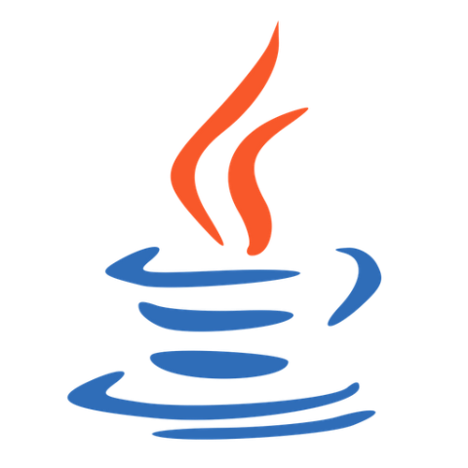
















RDBMS
SQL
Distributions:
CDH
HDP
MapR
DSE
Tachyon
Streaming
Hadoop Input Format
DataFrames API
GraphX
MLlib
Apps
Notes:
SparkR was introduced just a few days ago with Spark 1.4. This is Spark’s first new language API since PySpark was added in 2012. SparkR is based on Spark’s parallel DataFrame abstraction. Users can create SparkR DataFrames from “local” R data frames, or from any Spark data source such as Hive, HDFS, Parquet or JSON. SparkR DataFrames support all Spark DataFrame operations including aggregation, filtering, grouping, summary statistics, and other analytical functions. They also supports mixing-in SQL queries, and converting query results to and from DataFrames. Because SparkR uses the Spark’s parallel engine underneath, operations take advantage of multiple cores or multiple machines, and can scale to data sizes much larger than standalone R programs.
The new DataFrames API was inspired by data frames in R and Pandas in Python. DataFrames integrate with Python, Java, Scala and R and give you state of the art optimization through the Spark SQL Catalyst optimizer. DataFrames are just a distributed collection of data organized into named columns and can be made from tables in Hive, external databases or existing RDDs.
SQL: Spark’s module for working with structured data made of rows and columns. Spark SQL used to work against a special type of RDD called a SchemaRDD, but that is now being replaced with DataFrames. Spark SQL reuses the Hive frontend and metastore, which gives you full compatibility with existing Hive data, queries and UDFs. This allows you to run unmodified Hive queries on existing data warehouses. There is also standard connectivity through JDBC or ODBC via a Simba driver. Tableau uses this Simba driver to send queries down to Spark SQL to run at scale.
Streaming: makes it easy to build scalable fault-tolerant streaming applications with stateful exactly-once symantics out of the box. Streaming allows you to reuse the same code for batch processing and stream processing. In 2012, Spark Streaming was able to process over 60 million records per second on 100 nodes at sub-second processing latency, which makes it 2 – 4x faster than comparable systems like Apache Storm on Yahoo’s S4. Netflix is one of the big users of Spark Streaming. (60 million / 100 = 600k)
Spark Streaming is able to process 100,000-500,000 records/node/sec. This is much faster than Storm and comparable to other Stream processing systems. Sigmoid was able to consume 480,000 records per second per node machines using Kafka as a source.
Kafka: Kafka basically acts as a buffer for incoming data. It is a high-throughput distributed messaging system. So Kafka maintains feeds of messages in categories called topics that get pushed or published into Kafka by producers. Then consumers like Spark Streaming can subscribe to topics and consume the feed of published messages. Each node in a Kafka cluster is called a broker. More than 75% of the time we see Kafka being used instead of Flume.
Flume: Distributed log collection and aggregation service for moving large amounts of log data from many different sources to a centralized data store. So with Flume, data from external sources like web servers is consumed by a Flume source. When a Flume source receives an event, it stores it into one or more channels. The channels will keep the event until its consumed by a Flume sink. So, when Flume pushes the data into the sink, that’s where the data is buffered until Spark Streaming pulls the data from the sink.
MLlib + GraphX: Mllib is Spark’s scalable machine learning library consisting of common algorithms and utilities including classification, regression, clustering, collaborative filtering, dimensionality reduction. MLlib’s datatypes are vectors and matrices and some of the underlying linear algebra operations on them are provided by Breeze and jblas. The major algorithmic components in Mllib are statistics (like max, min, mean, variance, # of non-zeroes, correlations (Pearson’s and Spearman’s correlations), Stratified Sampling, Hypothesis testing, Random Data Generation, Classification & Regression (like linear models, SVMs, logistic regression, linear regression, naïve Bayes, decision trees, random forests, gradient-boosted trees), Collaborative filtering (ALS), Clustering (K-means), Dimensionality reduction (Singular value decomposition/SVD and Principal Component Analysis/PCA), Feature extraction and transformation, optimization (like stochastic gradient descent and limited memory BFGS).
Tachyon: memory based distributed storage system that allows data sharing across cluster frameworks like Spark or Hadoop MapReduce. Project has 60 contributors from 20 institutions. Has a Java-like API similar to that of java.io.File class providing InputStream and OutputStream interfaces. Tachyon also implements the Hadoop FileSystem interface, to allow frameworks that can read from Hadoop Input Formats like MapReduce or Spark to read the data. Tachyon has some interesting features for data in tables… like native support for multi-columned data with the option to put only hot columns in memory to save space.
BlinkDB: is an approximate query engine for running interactive SQL queries on large volumes of data. It allows users to trade off query accuracy for response time by running queries on data samples and presenting results annotated with error bars. BlinkDB was demoed in 2012 on a 100 node Amazon EC2 cluster answering a range of queries on 17 TBs of data in less than 2 seconds (which is over 200x faster than Hive) with an error of 2 – 10%. To do this, BlinkDB uses an offline sampling module that creates uniform and stratified samples from underlying data. Two of the big users of BlinkDB are Conviva and Facebook.

Slide 25







vs
YARN
Mesos
Tachyon
SQL
MLlib
Streaming
Notes:
YARN: is a resource manager
The cool thing about Spark is that it has a unified API for SQL, ML, and Streaming.

Slide 26



10x – 100x

Slide 27

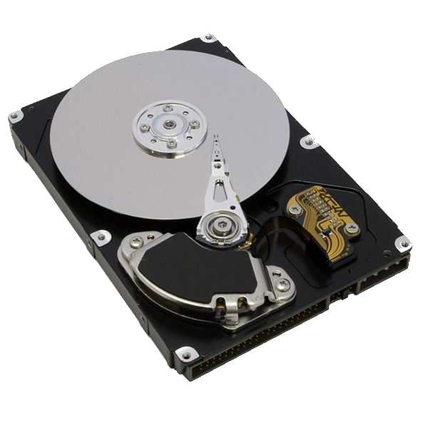

0.1 Gb/s
1 Gb/s or 125 MB/s
Nodes in another rack
CPUs:
Network
10 GB/s
1 Gb/s or 125 MB/s
Nodes in same rack
100 MB/s
600 MB/s
3-12 ms random access
$0.05 per GB
0.1 ms random access
$0.45 per GB

Slide 28
Parallelize
# Parallelize in Python
wordsRDD = sc.parallelize([“fish", “cats“, “dogs”])
Take an existing in-memory collection and pass it to SparkContext’s parallelize method
Not generally used outside of prototyping and testing since it requires entire dataset in memory on one machine
// Parallelize in Scala
val wordsRDD= sc.parallelize(List("fish", "cats", "dogs"))
// Parallelize in Java
JavaRDD<String> wordsRDD = sc.parallelize(Arrays.asList(“fish", “cats“, “dogs”));

Slide 29
Read from text file
# Read a local txt file in Python
linesRDD = sc.textFile("/path/to/README.md")
There are other methods to read data from HDFS, C*, S3, HBase, etc.
// Read a local txt file in Scala
val linesRDD = sc.textFile("/path/to/README.md")
// Read a local txt file in Java
JavaRDD<String> lines = sc.textFile("/path/to/README.md");

Slide 30

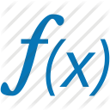

Error, ts, msg1
Warn, ts, msg2
Error, ts, msg1
Info, ts, msg8
Warn, ts, msg2
Info, ts, msg8
Error, ts, msg3
Info, ts, msg5
Info, ts, msg5
Error, ts, msg4
Warn, ts, msg9
Error, ts, msg1
logLinesRDD
(input/base RDD)
.filter( )
Error, ts, msg1
Error, ts, msg1
Error, ts, msg3
Error, ts, msg4
Error, ts, msg1
errorsRDD
Notes:
Introduce that Spark has Operations which can be transformations or actions.
Those are 4 green unique blocks in a single HDFS file
Here we are filtering out the warnings and info messages so we are left with just errors in the RDD.
This doesn’t actually read the file from HDFS just yet… we’re just building out a lineage graph

Slide 31

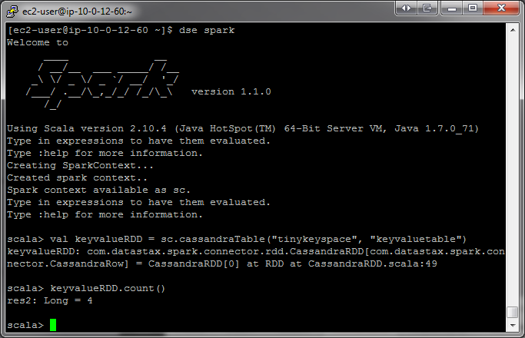
Error, ts, msg1
Error, ts, msg1
Error, ts, msg3
Error, ts, msg4
Error, ts, msg1
errorsRDD
.coalesce( 2 )
Error, ts, msg1
Error, ts, msg3
Error, ts, msg1
Error, ts, msg4
Error, ts, msg1
cleanedRDD
.collect( )
Driver

Slide 32
Execute DAG!
.collect( )
Driver
Notes:
directed acyclic graph.
That is, it is formed by a collection of vertices and directed edges, each edge connecting one vertex to another, such that there is no way to start at some vertex v and follow a sequence of edges that eventually loops back to v again.
A collection of tasks that must be ordered into a sequence, subject to constraints that certain tasks must be performed earlier than others, may be represented as a DAG with a vertex for each task and an edge for each constraint
https://en.wikipedia.org/wiki/Directed_acyclic_graph

Slide 33
Lifecycle of a Spark program
Create some input RDDs from external data or parallelize a collection in your driver program.
Lazily transform them to define new RDDs using transformations like filter() or map()
Ask Spark to cache() any intermediate RDDs that will need to be reused.
Launch actions such as count() and collect() to kick off a parallel computation, which is then optimized and executed by Spark.
Notes:
----- Meeting Notes (6/15/15 16:08) -----
Also note that an application can have many such 1 through 4 procedures.

Slide 34

Dataframes
What is a Dataframe?
a distributed collection of data organized into named columns
Like a table in a relational database
Announced Feb 2015
Inspired by data frames in R and Pandas in Python
Works in:
Features
Scales from KBs to PBs
Supports wide array of data formats and storage systems (Hive, existing RDDs, etc)
State-of-the-art optimization and code generation via Spark SQL Catalyst optimizer
APIs in Python, Java
Notes:
Although inspired by data frames in R and Python (Pandas), Spark Dataframes was designed from the ground-up to support modern big data and data science applications.

Slide 35
Dataframes
Step 1: Construct a DataFrame
from pyspark.sql import SQLContext
sqlContext = SQLContext(sc)
df = sqlContext.jsonFile("examples/src/main/resources/people.json")
# Displays the content of the DataFrame to stdout
df.show()
## age name
## null Michael
## 30 Andy
## 19 Justin
Notes:
With a SQLContext, applications can create DataFrames from an existing RDD, from a Hive table, or from data sources.
As an example, the following creates a DataFrame based on the content of a JSON file:

Slide 36
Dataframes
Step 2: Use the DataFrame
# Print the schema in a tree format
df.printSchema()
## root
## |-- age: long (nullable = true)
## |-- name: string (nullable = true)
# Select only the "name" column
df.select("name").show()
## name
## Michael
## Andy
## Justin
# Select everybody, but increment the age by 1
df.select("name", df.age + 1).show()
## name (age + 1)
## Michael null
## Andy 31
## Justin 20
Notes:
Once built, DataFrames provide a domain-specific language for distributed data manipulation.
Here we include some basic examples of structured data processing using DataFrames:

Slide 37
Dataframes
SQL Integration
from pyspark.sql import SQLContext
sqlContext = SQLContext(sc)
df = sqlContext.sql("SELECT * FROM table")
Notes:
The sql function on a SQLContext enables applications to run SQL queries programmatically and returns the result as a DataFrame.

Slide 38
Dataframes
SQL + RDD Integration
2 methods for converting existing RDDs into DataFrames:
Use reflection to infer the schema of an RDD that contains different types of objects
Use a programmatic interface that allows you to construct a schema and then apply it to an existing RDD.
(more concise)
(more verbose)
Notes:
The 1st method works well when you already know the schema while writing your Spark application.
While the 2nd method is more verbose, it allows you to construct DataFrames when the columns and their types are not known until runtime.

Slide 39
Dataframes
SQL + RDD Integration: via reflection
# sc is an existing SparkContext.
from pyspark.sql import SQLContext, Row
sqlContext = SQLContext(sc)
# Load a text file and convert each line to a Row.
lines = sc.textFile("examples/src/main/resources/people.txt")
parts = lines.map(lambda l: l.split(","))
people = parts.map(lambda p: Row(name=p[0], age=int(p[1])))
# Infer the schema, and register the DataFrame as a table.
schemaPeople = sqlContext.inferSchema(people)
schemaPeople.registerTempTable("people")
Notes:
Spark SQL can convert an RDD of Row objects to a DataFrame, inferring the datatypes.
Rows are constructed by passing a list of key/value pairs as kwargs to the Row class.
The keys of this list define the column names of the table, and the types are inferred by looking at the first row. Since we currently only look at the first row, it is important that there is no missing data in the first row of the RDD.
In future versions we plan to more completely infer the schema by looking at more data, similar to the inference that is performed on JSON files.

Slide 40
Dataframes
SQL + RDD Integration: via reflection
# SQL can be run over DataFrames that have been registered as a table.
teenagers = sqlContext.sql("SELECT name FROM people WHERE age >= 13 AND age <= 19")
# The results of SQL queries are RDDs and support all the normal RDD operations.
teenNames = teenagers.map(lambda p: "Name: " + p.name)
for teenName in teenNames.collect():
print teenName
Notes:
Spark SQL can convert an RDD of Row objects to a DataFrame, inferring the datatypes.
Rows are constructed by passing a list of key/value pairs as kwargs to the Row class.
The keys of this list define the column names of the table, and the types are inferred by looking at the first row. Since we currently only look at the first row, it is important that there is no missing data in the first row of the RDD.
In future versions we plan to more completely infer the schema by looking at more data, similar to the inference that is performed on JSON files.

Slide 41
Dataframes
SQL + RDD Integration: via programmatic schema
DataFrame can be created programmatically with 3 steps:
Create an RDD of tuples or lists from the original RDD
Create the schema represented by a StructType matching the structure of tuples or lists in the RDD created in the step 1
Apply the schema to the RDD via createDataFrame method provided by SQLContext
Notes:
When a dictionary of kwargs cannot be defined ahead of time (for example, the structure of records is encoded in a string, or a text dataset will be parsed and fields will be projected differently for different users), a DataFrame can be created programmatically with three steps.
1) Create an RDD of tuples or lists from the original RDD;
2) Create the schema represented by a StructType matching the structure of tuples or lists in the RDD created in the step 1.
3) Apply the schema to the RDD via createDataFrame method provided by SQLContext.

Slide 42
Dataframes
Step 1: Construct a DataFrame
# Constructs a DataFrame from the users table in Hive.
users = context.table("users")
# from JSON files in S3
logs = context.load("s3n://path/to/data.json", "json")
Notes:
The following example shows how to construct DataFrames in Python. A similar API is available in Scala and Java.

Slide 43
Dataframes
Step 2: Use the DataFrame
# Create a new DataFrame that contains “young users” only
young = users.filter(users.age < 21)
# Alternatively, using Pandas-like syntax
young = users[users.age < 21]
# Increment everybody’s age by 1
young.select(young.name, young.age + 1)
# Count the number of young users by gender
young.groupBy("gender").count()
# Join young users with another DataFrame called logs
young.join(logs, logs.userId == users.userId, "left_outer")
Notes:
Once built, DataFrames provide a domain-specific language for distributed data manipulation. Here is an example of using DataFrames to manipulate the demographic data of a large population of users:

Slide 44


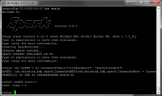

Broadcast variables
&
Accumulators
+
+
+
Notes:
One way to avoid shuffles when joining two datasets is to take advantage of broadcast variables. When one of the datasets is small enough to fit in memory in a single executor, it can be loaded into a hash table on the driver and then broadcast to every executor. A map transformation can then reference the hash table to do lookups.

Slide 45
Ex
T
T
x = 5
x = 5
Ex
T
T
x = 5
x = 5
x = 5
Ex
Notes:
When we pass functions to Spark, like map or filter, they can use variables defined outside them in the driver program, but each task running on the cluster gets a new copy of each variable, and updates from these copies are not propagated back to the driver.
Recall that Spark automatically sends all variables referenced in your closures to the
worker nodes. While this is convenient, it can also be inefficient because (1) the default
task launching mechanism is optimized for small task sizes, and (2) you might, in fact,
use the same variable in multiple parallel operations, but Spark will send it separately
for each operation.

Slide 46
Use Cases:
Broadcast variables – Send a large read-only lookup table to all the nodes, or send a large feature vector in a ML algorithm to all nodes
Accumulators – count events that occur during job execution for debugging purposes. Example: How many lines of the input file were blank? Or how many corrupt records were in the input dataset?
+
+
+

Slide 47
Spark supports 2 types of shared variables:
Broadcast variables – allows your program to efficiently send a large, read-only value to all the worker nodes for use in one or more Spark operations. Like sending a large, read-only lookup table to all the nodes.
Accumulators – allows you to aggregate values from worker nodes back to the driver program. Can be used to count the # of errors seen in an RDD of lines spread across 100s of nodes. Only the driver can access the value of an accumulator, tasks cannot. For tasks, accumulators are write-only.
+
+
+
Notes:
One way to avoid shuffles when joining two datasets is to take advantage of broadcast variables. When one of the datasets is small enough to fit in memory in a single executor, it can be loaded into a hash table on the driver and then broadcast to every executor. A map transformation can then reference the hash table to do lookups.

Slide 48
Broadcast Variables
Broadcast variables let programmer keep a read-only variable cached on each machine rather than shipping a copy of it with tasks
For example, to give every node a copy of a large input dataset efficiently
Spark also attempts to distribute broadcast variables using efficient broadcast algorithms to reduce communication cost

Slide 49
Broadcast Variables
Scala:
val broadcastVar = sc.broadcast(Array(1, 2, 3))
broadcastVar.value
Python:
broadcastVar = sc.broadcast(list(range(1, 4)))
broadcastVar.value

Slide 50
Accumulators
+
+
+
Accumulators are variables that can only be “added” to through an associative operation
Used to implement counters and sums, efficiently in parallel
Spark natively supports accumulators of numeric value types and standard mutable collections, and programmers can extend for new types
Only the driver program can read an accumulator’s value, not the tasks

Slide 51
Accumulators
+
+
+
Scala:
val accum = sc.accumulator(0)
sc.parallelize(Array(1, 2, 3, 4)).foreach(x => accum += x)
accum.value
Python:
accum = sc.accumulator(0)
rdd = sc.parallelize([1, 2, 3, 4])
def f(x):
global accum
accum += x
rdd.foreach(f)
accum.value

Slide 52
Gyakorlathoz
Regisztráció (Apache Spark for education, elte.hu végű emaillel): https://community.cloud.databricks.com
PySpark CheatSheet: https://github.com/runawayhorse001/CheatSheet/blob/master/cheatSheet_pyspark.pdf
Spark with Python – a mai anyag: https://github.com/slaki/Spark-with-Python
A fekete hátterű diák (Spark Summit West 2015): http://training.databricks.com/intro.pdf

