Slide 1
Haladó BigData
5.előadás

Slide 2
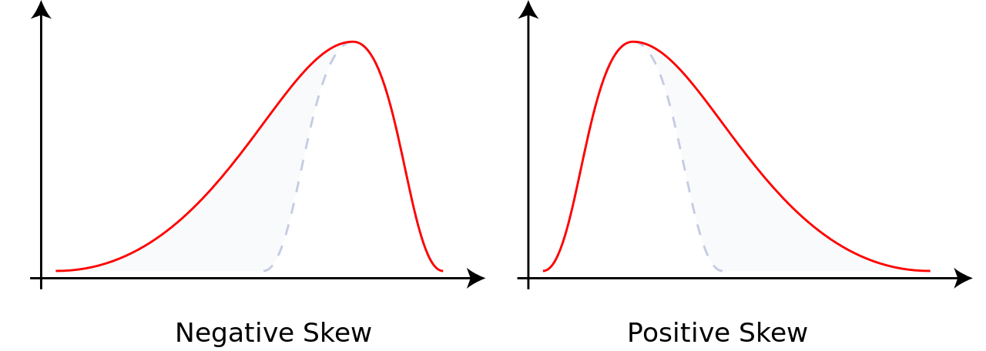
Data exploration https://github.com/slaki/Spark-with-Python/blob/master/data_exploration.html
Basic statistics of variables (columns)
Min, max, mean, stddev, median, quartiles
Spark Dataframe’s describe()
Skewness
Measure of asymmetry
Kurtosis
Measure of tailedness
from pyspark.sql.functions import skewness, kurtosis

Slide 3
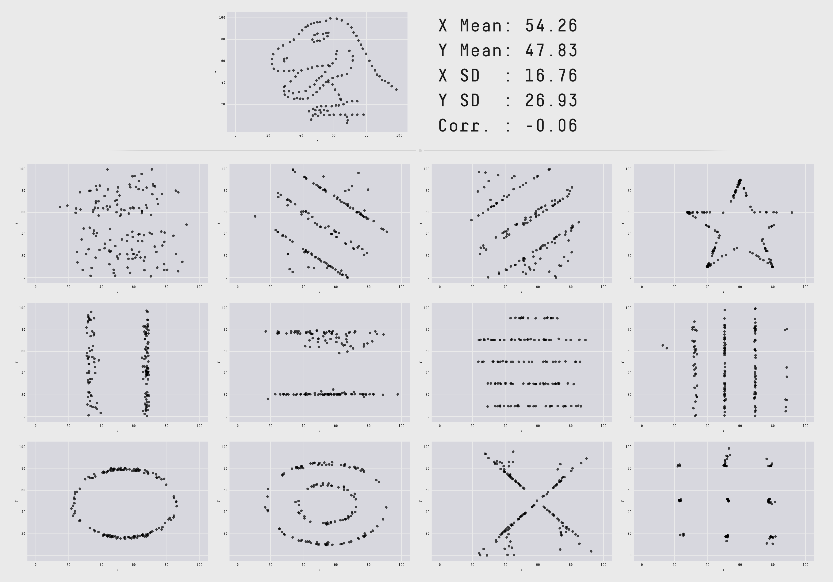
Sometime the statistics can be misleading

Slide 4
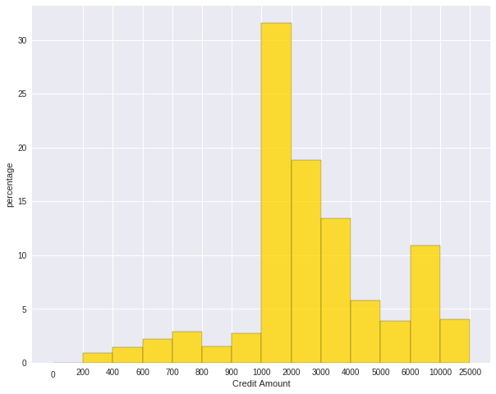
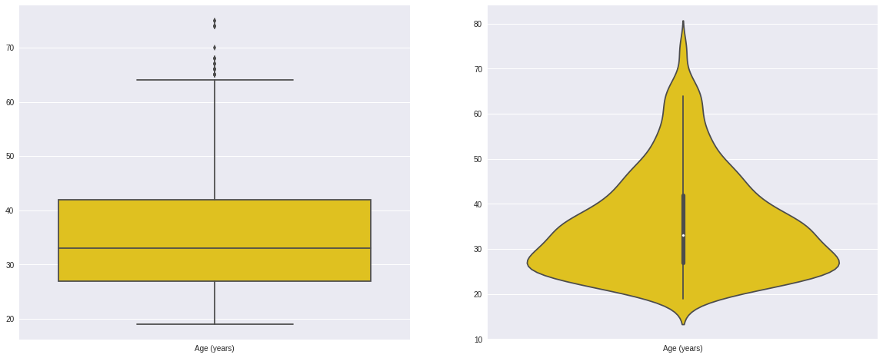
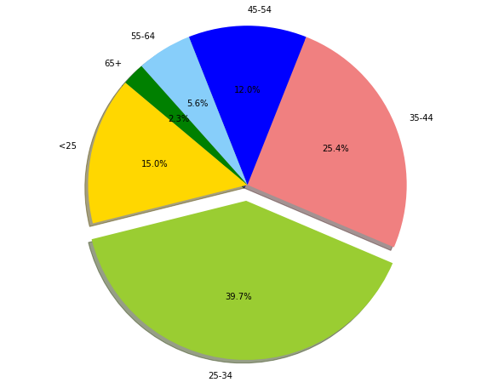
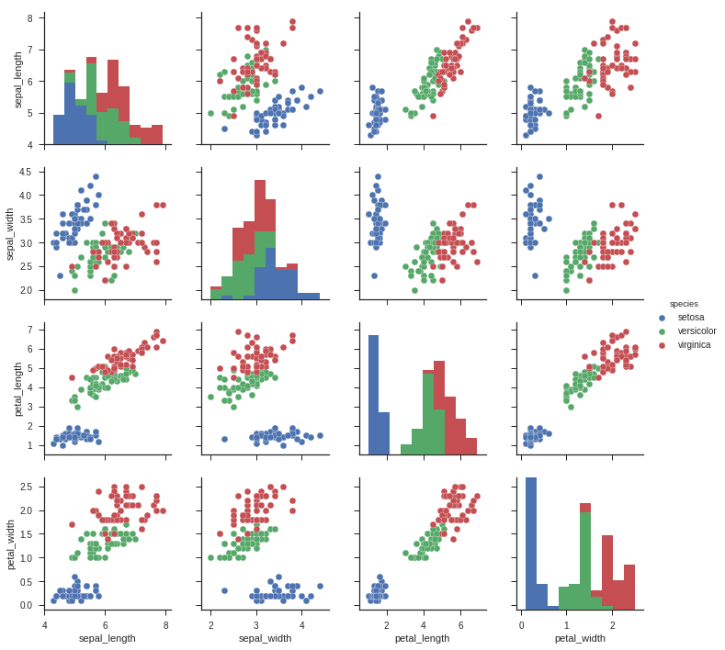
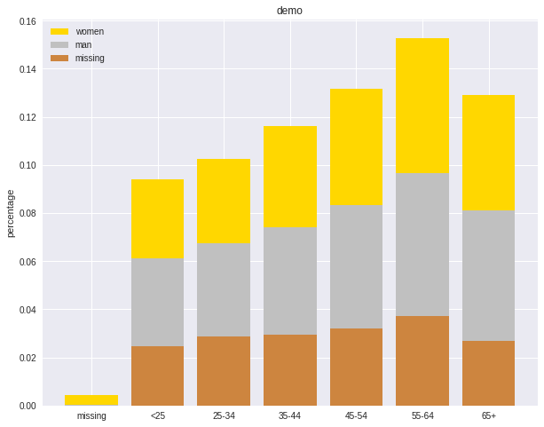
Further tools
Histograms
Box and violin plots
Frequency table
Pie plot
Bar plot
Scatter plots

Slide 5
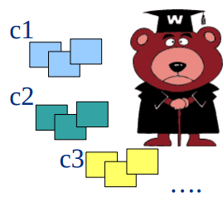
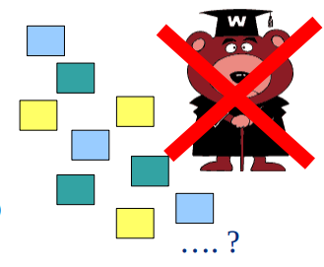
Supervised VS Unsupervised learning
Supervised learning: classification is seen as supervised learning from examples.
Supervision: The data (observations, measurements, etc.) are labeled with pre-defined classes. It is like that a “teacher” gives the classes (supervision).
Test data are classified into these classes too.
Predic class or value label
E.g. naive bayes, Decision Trees, SVM, neural networks
Unsupervised learning (clustering)
Class labels of the data are unknown
Given a set of data, the task is to establish the existence of classes or clusters in the data
Determine data patterns
Self-guided learning
E.g. k-means, genetic algs., clustering…

Slide 6
Supervised learning
Like human learning from past experiences.
A computer does not have “experiences”.
A computer system learns from data, which represent some “past experiences” of an application domain.
Our focus: learn a target function that can be used to predict the values of a discrete class attribute, e.g., approve or not-approved, and high-risk or low risk.
The task is commonly called:
Supervised learning, classification, or inductive learning.

Slide 7
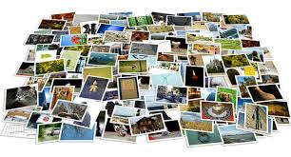
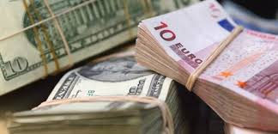


Quiz: Supervised learning
From an album of tagged photos, recognize someone in a picture
Analyze bank data for weird transactions, and flag those for fraud
Given someone’s music choices, and a bunch of features of that music (tempo, genre, etc.) recommend a new song
Cluster students into types based on learning styles

Slide 8

Further examples - 1
An emergency room in a hospital measures 17 variables of newly admitted patients.
blood pressure
age
etc.
A decision is needed: whether to put a new patient in an intensive-care unit.
Due to the high cost of ICU, those patients who may survive less than a month are given higher priority.
Problem: to predict high-risk patients and discriminate them from low-risk patients.

Slide 9
Further examples - 2
A credit card company receives thousands of applications for new cards. Each application contains information about an applicant,
age
Marital status
annual salary
outstanding debts
Credit rating
etc.
Problem: to decide whether an application should approved, or to classify applications into two categories, approved and not approved.

Slide 10
Data & Classification task
Data: A set of data records (also called examples, instances or cases) described by
k features (aka attributes): A₁, A₂, … A_{k}.
a class: Each example is labelled with a pre-defined class.
Goal: To learn a classification model from the data that can be used to predict the classes of new (future, or test) cases/instances.

Slide 11

Features & labels
FEATURES
LABELS
LIKE
DON’T LIKE
Tempo
Intensity
Genre
Gender
Etc.

Slide 12
Scatter plot
soaring
LIKE
?
Intensity
DON’T LIKE
light
Tempo
relaxed
fast

Slide 13
Scatter plot
soaring
?
Intensity
light
Tempo
relaxed
fast

Slide 14
Classification From scatter plot to decision surface
soaring
Intensity
light
Tempo
relaxed
fast

Slide 15
Classification From scatter plot to decision surface
The two classes are linearly separable according to dimensions Tempo and Intensity
soaring
?
Intensity
light
Tempo
relaxed
fast

Slide 16
Classification Non-linearly separable data
What if I only like fast and intense music???
soaring
Intensity
light
Tempo
relaxed
fast

Slide 17
Classification Decision Trees
Idea: We can ask multiple linear questions.
soaring
Fast?
Yes
No
Intensity
Where do we know the final class?
light
Tempo
relaxed
fast

Slide 18
Classification Decision Trees
Idea: We can ask multiple linear questions.
soaring
Fast?
Yes
No
Intensity
Soaring?
Yes
No
light
Tempo
relaxed
fast

Slide 19
Classification Decision Trees
Idea: We can ask multiple linear questions.
soaring
Fast?
Yes
No
Intensity
Soaring?
Yes
No
light
Tempo
relaxed
fast

Slide 20
Classification Decision Trees
Idea: We can ask multiple linear questions.
Y
X<?
5
???
1
2
3
4
5
4
3
2
1
1 2 3 4 5 X

Slide 21
Classification Decision Trees
Idea: We can ask multiple linear questions.
Y
X<3
5
4
Yes
No
3
Y<?
2
1
1 2 3 4 5 X

Slide 22
Classification Decision Trees
Idea: We can ask multiple linear questions.
Y
X<3
5
4
Yes
No
3
Y<4
Y<2
2
1
Yes
No
Yes
No
1 2 3 4 5 X

Slide 23
Decision tree building
How to measure impurity in a bunch of examples?
Entropy
It controls how a DT decides where to split the data
What is the next split?
Choose the one with higher purity
A
A
B
C

Slide 24
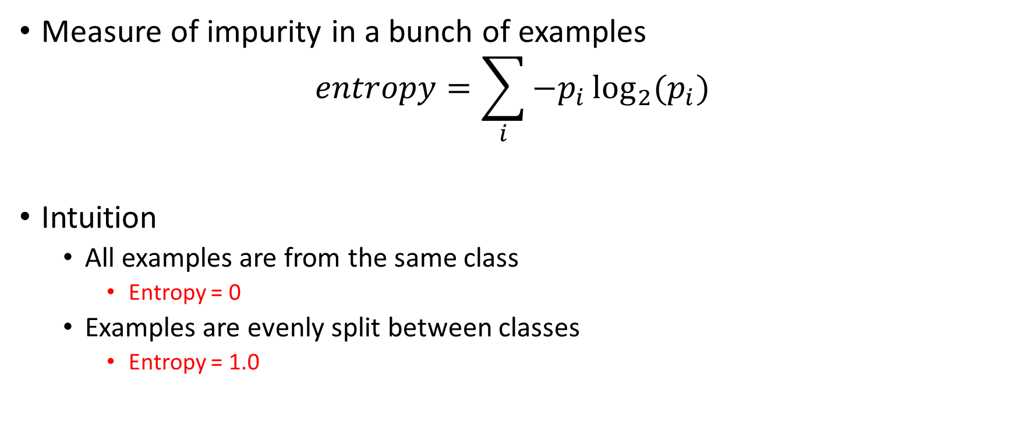
Entropy in nutshell
Measure of impurity in a bunch of examples
$$entropy=\sum_{i}{{−p}_{i}\log_{2}{(p_{i})}}$$
Intuition
All examples are from the same class
Entropy = 0
Examples are evenly split between classes
Entropy = 1.0
Sum over all classes
Fraction of examples in class i

Slide 25
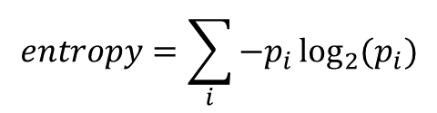
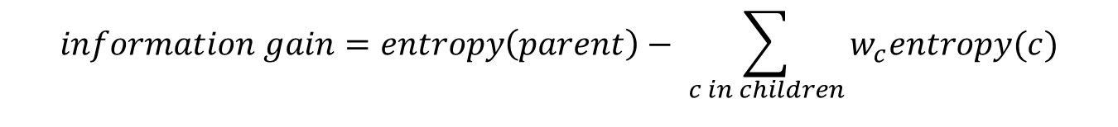
Information gain
$$information gain=entropy\left(parent\right)− \sum_{c in children}{w_{c}entropy(c)}$$
In the beginning:
Entropy of parent = 1.0
$$entropy=\sum_{i}{{−p}_{i}\log_{2}{(p_{i})}}$$
Tempo | Intensity | Gender | Class
Fast | Soaring | Female | Like (l)
Fast | Light | Female | Like (l)
Relaxed | Soaring | Male | Not like (n)
Fast | Light | Male | Not like (n)

Slide 26

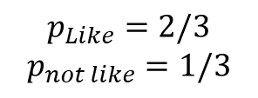
Information gain
$$information gain=entropy\left(parent\right)− \sum_{c in children}{w_{c}entropy(c)}$$
In the beginning:
Entropy of parent = 1.0
llnn
$$entropy=\sum_{i}{{−p}_{i}\log_{2}{(p_{i})}}$$
Fast
Relaxed
3
1
Tempo | Intensity | Gender | Class
Fast | Soaring | Female | Like (l)
Fast | Light | Female | Like (l)
Relaxed | Soaring | Male | Not like (n)
Fast | Light | Male | Not like (n)
lln
n
Entropy = ?
Entropy = 0.0
$$p_{Like}=2/3$$
$$p_{not like}=1/3$$
$entropy= \left[−\frac{2}{3}\log_{2}\left(\frac{2}{3}\right)−\frac{1}{3}\log_{2}\left(\frac{1}{3}\right)\right]$= ?
Notes:
0.92

Slide 27
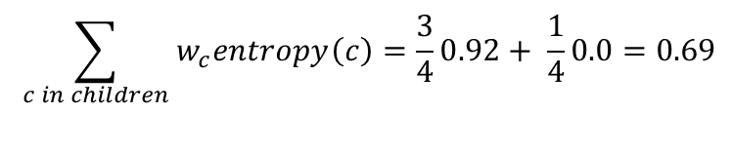

Information gain
$$information gain=entropy\left(parent\right)− \sum_{c in children}{w_{c}entropy(c)}$$
In the beginning:
Entropy of parent = 1.0
llnn
$$entropy=\sum_{i}{{−p}_{i}\log_{2}{(p_{i})}}$$
Fast
Relaxed
3
1
Tempo | Intensity | Gender | Class
Fast | Soaring | Female | Like (l)
Fast | Light | Female | Like (l)
Relaxed | Soaring | Male | Not like (n)
Fast | Light | Male | Not like (n)
lln
n
Entropy = ?
Entropy = 0.0
$$p_{Like}=2/3$$
$$p_{not like}=1/3$$
$entropy= \left[−\frac{2}{3}\log_{2}\left(\frac{2}{3}\right)−\frac{1}{3}\log_{2}\left(\frac{1}{3}\right)\right]$= 0.92
$$\sum_{c in children}{w_{c}entropy\left(c\right)}=\frac{3}{4}0.92+ \frac{1}{4}0.0=0.69$$
Notes:
0.92

Slide 28
Information gain
$$information gain=entropy\left(parent\right)− \sum_{c in children}{w_{c}entropy(c)}$$
0.31
In the beginning:
Entropy of parent = 1.0
llnn
$$entropy=\sum_{i}{{−p}_{i}\log_{2}{(p_{i})}}$$
Fast
Relaxed
3
1
Tempo | Intensity | Gender | Class
Fast | Soaring | Female | Like (l)
Fast | Light | Female | Like (l)
Relaxed | Soaring | Male | Not like (n)
Fast | Light | Male | Not like (n)
lln
n
Entropy = ?
Entropy = 0.0
$$p_{Like}=2/3$$
$$p_{not like}=1/3$$
$entropy= \left[−\frac{2}{3}\log_{2}\left(\frac{2}{3}\right)−\frac{1}{3}\log_{2}\left(\frac{1}{3}\right)\right]$= 0.92
$$\sum_{c in children}{w_{c}entropy\left(c\right)}=\frac{3}{4}0.92+ \frac{1}{4}0.0=0.69$$
Notes:
0.92

Slide 29
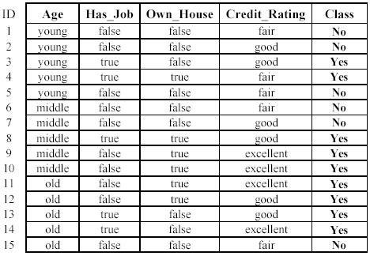
Data
Approved or not

Slide 30
Learning from data
Learn a classification model from the data
Use the model to classify future loan applications into
Yes (approved) and
No (not approved)
What is the class for following case/instance?

Slide 31
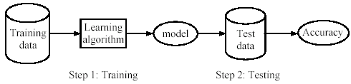
Two phases
Learning (training): Learn a model using the training data
Testing: Test the model using unseen test data to assess the model accuracy

Slide 32

Evaluation of classification methods
Predictive accuracy
Efficiency
time to construct the model
time to use the model
Robustness
handling noise and missing values
Scalability
efficiency in disk-resident databases
Interpretability
understandable and insight provided by the model
Compactness of the model
size of the tree, or the number of rules.

Slide 33
Further metrics
Precision
$${precision}_{i}= \frac{|\left\{elements with real label i\right\}∩\{elements with predicted label i\}|}{\{elements with predicted label i\}}$$
Recall
$${recall}_{i}= \frac{|\left\{elements with real label i\right\}∩\{elements with predicted label i\}|}{\{elements with real label i\}}$$

Slide 34
The ensemble concept
Build multiple models based on
Different training data
Different learning algorithms
Combine decisions of multiple models
E.g. using weighted voting
Training Data
⋅ ⋅ ⋅ ⋅ ⋅ ⋅ ⋅ ⋅
Data1
Data2
Data m
Learner1
Learner2
⋅ ⋅ ⋅ ⋅ ⋅ ⋅ ⋅ ⋅
Learner m
⋅ ⋅ ⋅ ⋅ ⋅ ⋅ ⋅ ⋅
Model1
Model2
Model m
Model Combiner
Final Model

Slide 35

Idea
Combining multiple independent and diverse decisions
Each of them is at least more accurace than random guessing
Random errors cancel each other out
Correct decisions are reinforced
Real life examples
How many jelly beans in the jar?
Individual guess vs group average
Who Wants to be a Millionaire
Expert friend vs audience vote

Slide 36
Homogenous case
Single learning algorithm trained on multiple training data
Data1 ≠ Data2 ≠ … ≠ Data m
Learner1 = Learner2 = … = Learner_m
Different methods for changind training data
Bagging: Resample training data - replicates
Boosting: Reweight training data
Decorate: Add artificial training data

Slide 37
Bagging
Ensembles by randomly resampling the training data (Brieman, 1996)
Given a training set of size n
Create m samples of size n by taking n examples from the original data with replacement
Combine the m resulting models
by majority vote
Decreases error by decresing the variance in the results of unstable learners like DTs

Slide 38
Bagging
Sampling with replacement
Build a classifier on each bootstrap sample
Each example has probability 1/N being selected
For an example not being selected after N times, the probability is (1 – 1/N)^{N} (when N is large, it is close to 1/e)
For an example being selected after N times, the probability is 1 – 1/e = 0.632
A bootstrap sample contains 63% of the original data

Slide 39
Boosting
An iterative procedure to adaptively change distribution of training data by focusing more on previously misclassified records
Initially, all N records are assigned equal weights
Unlike bagging, weights may change at the end of boosting round
The weigth of wrongly classified samples is increased
While for the correctly classified samples it is decreased

Slide 40
Boosting
Records that are wrongly classified will have their weights increased
Records that are classified correctly will have their weights decreased
Example 4 is hard to classify
Its weight is increased, therefore it is more likely to be chosen again in subsequent rounds

Slide 41
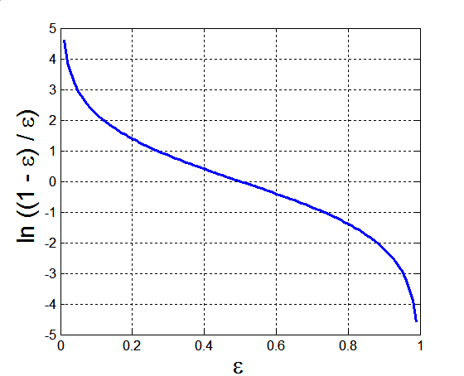
Example: AdaBoost
Base classifiers: C₁, C₂, …, C_{T}
Error rate:
Importance of a classifier:

Slide 42
Example: AdaBoost
Weight update:
Classification:

Slide 43
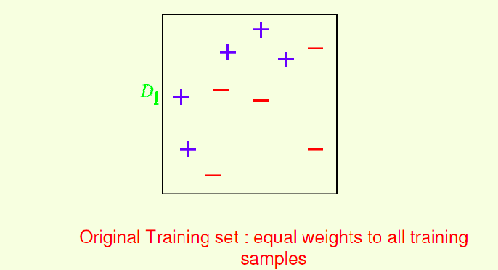
AdaBoost example

Slide 44
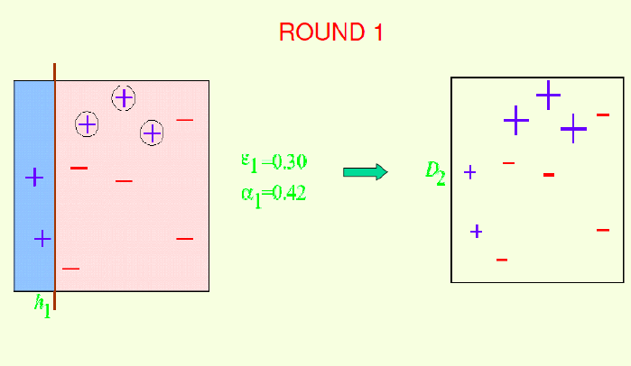
AdaBoost example

Slide 45
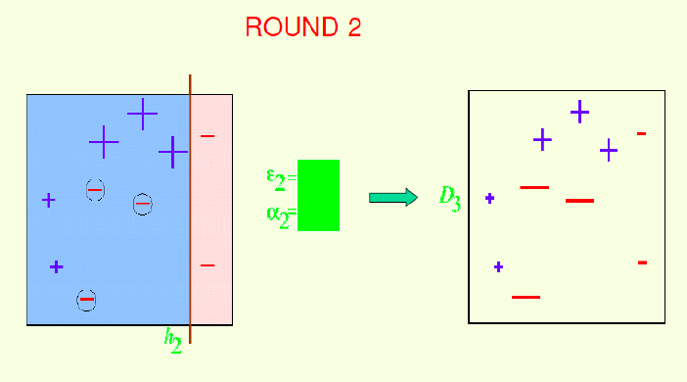
AdaBoost example
Compute the two values and the weight of the instances in Round 2
Notes:
E2=0.214
A2=0.65

Slide 46
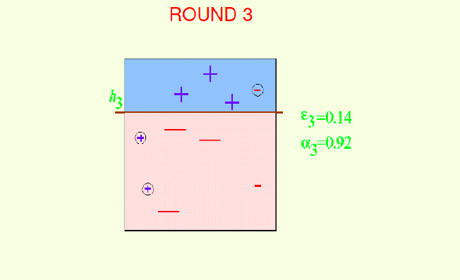
AdaBoost example

Slide 47
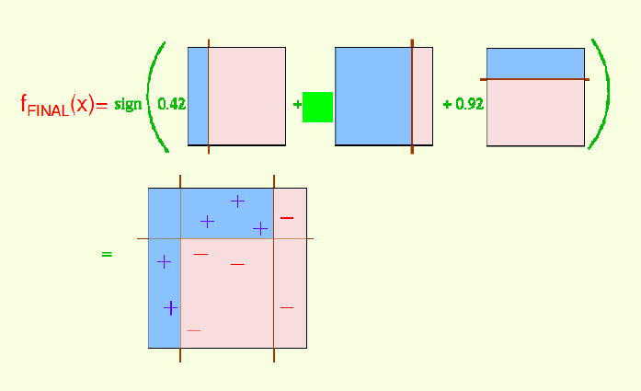
AdaBoost example
Notes:
A2=0.65

Slide 48
Illustrating AdaBoost
Initial weights for each data point
Data points for training

Slide 49
Illustrating AdaBoost

Slide 50
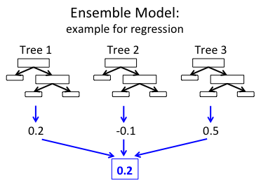
GradientBoostingTree
The idea is similar to AdaBoost…

Slide 51
Category variables
Binary features
Convert to 0/1 or -1/1
For missing values you can use 0.5 or 0 resp.
Nominal features have multiple values
like INNER_CITY/RURAL/SUBURBAN/TOWN
Convert them to multiple binary feature
New column for each value
For missing values introduce a new binary column for this special value
Ordinal features also have multiple values
Like small, medium, large
There are ordering, so they can be converted to integers
Small=0, medium=1, large=2
For missing values introduce an extremal value or introduce a new column similarly to the nominal case

Slide 52
Scaling
Sometimes we have to rescale a feature
or normalize it
Some algs. require variables with values between 0 and 1

Slide 53
Regression
estimating the relationships between a dependent variable (often called the 'outcome variable') and one or more independent variables often called 'predictors', 'covariates', or 'features’)
Linear regression
General linear model
Non-linear regression
More at https://runawayhorse001.github.io/LearningApacheSpark/regression.html

Slide 54
Unsupervised learning
No training data
Learning insights and structure from the data itself

Slide 55
Unsupervised learning
No training data
Learning insights and structure from the data itself
Clustering
Dimension reduction

Slide 56
What is Clustering?
Attach label to each observation or data points in a set
You can say this “unsupervised classification”
Clustering is alternatively called as “grouping”
Intuitively, if you would want to assign same label to a data points that are “close” to each other
Thus, clustering algorithms rely on a distance metric between data points
Sometimes, it is said that the for clustering, the distance metric is more important than the clustering algorithm

Slide 57
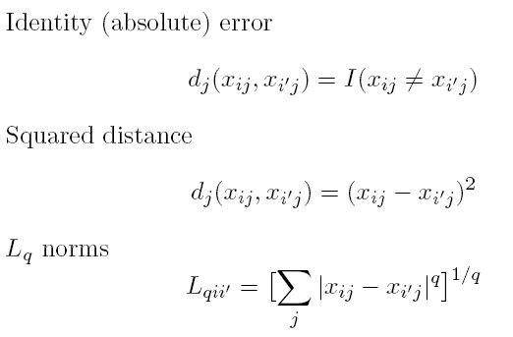
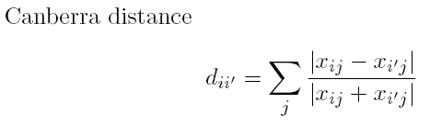
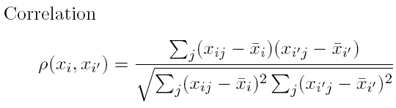
Distances: Quantitative Variables
Data point:
Some examples

Slide 58
Distances: Ordinal and Categorical Variables
Ordinal variables can be forced to lie within (0, 1) and then a quantitative metric can be applied:
For categorical variables, distances must be specified by user between each pair of categories.

Slide 59
Combining Distances
Often weighted sum is used:

Slide 60
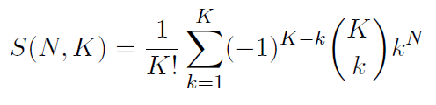
Combinatorial Approach
In how many ways can we assign K labels to N observations?
For each such possibility, we can compute a cost. Pick up the assignment with best cost.
Formidable number of possible assignments:

Slide 61
K-means Overview
An unsupervised clustering algorithm
“K” stands for number of clusters, it is typically a user input to the algorithm; some criteria can be used to automatically estimate K
It is an approximation to an NP-hard combinatorial optimization problem
K-means algorithm is iterative in nature
It converges, however only a local minimum is obtained
Works only for numerical data
Easy to implement
K-Means example:
http://www.naftaliharris.com/blog/visualizing-k-means-clustering/

Slide 62
K-means: Setup
x₁,…, x_{N} are data points or vectors of observations
Each observation (vector x_{i}) will be assigned to one and only one cluster
C(i) denotes cluster number for the i^{th} observation
Dissimilarity measure: Euclidean distance metric
K-means minimizes within-cluster point scatter:
where
m_{k} is the mean vector of the k^{th} cluster
N_{k} is the number of observations in k^{th} cluster

Slide 63
Within and Between Cluster Criteria
Let’s consider total point scatter for a set of N data points:
Distance between two points
T can be re-written as:
If d is square Euclidean distance, then
Where,
Within cluster
scatter
and
Ex.
Between cluster
scatter
Grand mean
Minimizing W(C) is equivalent to maximizing B(C)

Slide 64
K-means Algorithm
For a given cluster assignment C of the data points, compute the cluster means m_{k}:
For a current set of cluster means, assign each observation as:
Iterate above two steps until convergence

Slide 65
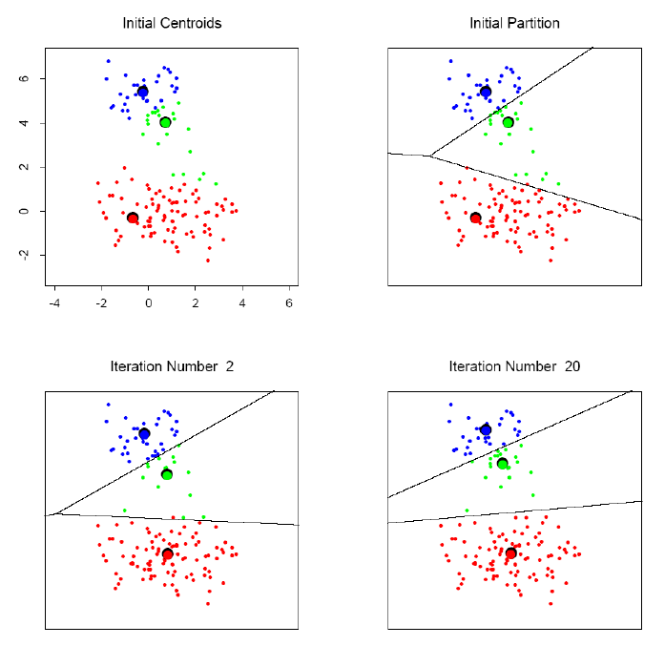
K-means clustering example
Online visualization: http://www.naftaliharris.com/blog/visualizing-k-means-clustering/

Slide 66
K-means Image Segmentation
An image (I)
Three-cluster image (J) on
gray values of I

Slide 67
K-means: summary
Algorithmically, very simple to implement
K-means converges, but it finds a local minimum of the cost function
Works only for numerical observations
K is a user input; alternatively BIC (Bayesian information criterion) or MDL (minimum description length) can be used to estimate K
Outliers can considerable trouble to K-means

Slide 68
References
Udacity Intro to Machine Learning
https://www.udacity.com/courses/ud120
Talk on Supervised learning
by Tonmoy Bhagawati
Book
https://runawayhorse001.github.io/LearningApacheSpark

Slide 69
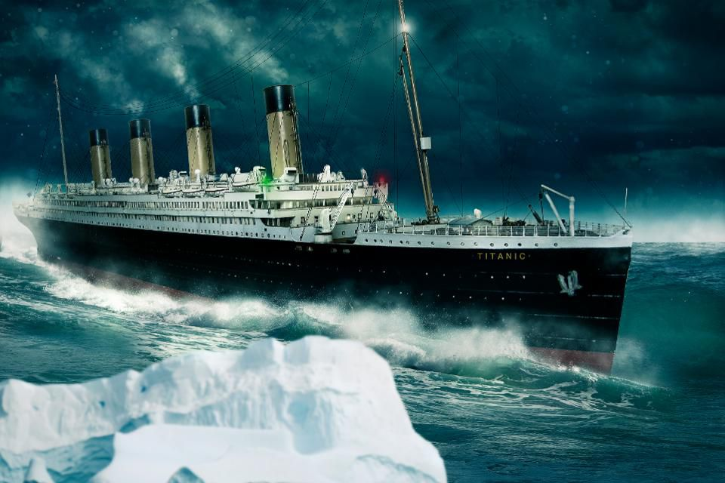
Gyakorlat – Live coding Titanic classification example
Data set:
https://github.com/slaki/Spark-with-Python/blob/master/Data/titanic.csv

Slide 70
Gyakorlat – Live coding Titanic classification example
Reference: https://www.kaggle.com/c/titanic
VARIABLE DESCRIPTIONS:
survival Survival
(0 = No; 1 = Yes)
pclass Passenger Class
(1 = 1st; 2 = 2nd; 3 = 3rd)
name Name
sex Sex
age Age
sibsp Number of Siblings/Spouses Aboard
parch Number of Parents/Children Aboard
ticket Ticket Number
fare Passenger Fare
cabin Cabin
embarked Port of Embarkation
(C = Cherbourg; Q = Queenstown; S = Southampton)

Slide 71
Gyakorlat – Live coding Titanic classification example
SPECIAL NOTES:
Pclass is a proxy for socio-economic status (SES)
1st ~ Upper; 2nd ~ Middle; 3rd ~ Lower
Age is in Years; Fractional if Age less than One (1) *If the Age is Estimated, it is in the form xx.5
With respect to the family relation variables (i.e. sibsp and parch) some relations were ignored. The following are the definitions used for sibsp and parch.
Sibling: Brother, Sister, Stepbrother, or Stepsister of Passenger Aboard Titanic
Spouse: Husband or Wife of Passenger Aboard Titanic (Mistresses and Fiances Ignored)
Parent: Mother or Father of Passenger Aboard Titanic
Child: Son, Daughter, Stepson, or Stepdaughter of Passenger Aboard Titanic
Other family relatives excluded from this study include cousins, nephews/nieces, aunts/uncles, and in-laws. Some children travelled only with a nanny, therefore parch=0 for them. As well, some travelled with very close friends or neighbors in a village, however, the definitions do not support such relations.

Slide 72
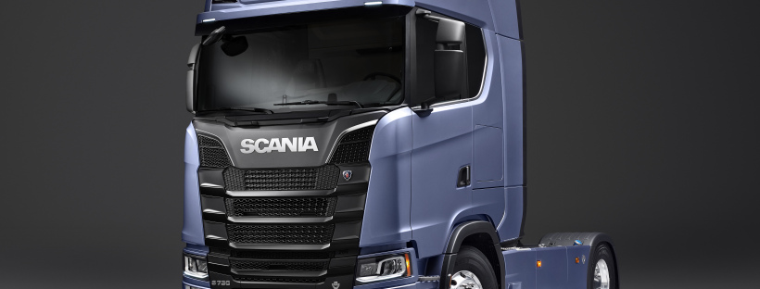
Gyakorlat – Önálló feladat Scania Truck
Failure detection of the Air Pressure System (APS)
„The dataset consists of data collected from heavy Scania trucks in everyday usage. The system in focus is the Air Pressure system (APS) which generates pressurized air that are utilized in various functions in a truck, such as braking and gear changes. The datasets’ positive class corresponds to component failures for a specific component of the APS system. The negative class corresponds to trucks with failures for components not related to the APS system. The data consists of a subset of all available data and has been selected by experts from SCANIA.”
Data set:
http://archive.ics.uci.edu/ml/datasets/APS+Failure+at+Scania+Trucks
Challange and data set:
https://people.dsv.su.se/~isak-kar/IDA2016Challenge.txt

