Slide 1
Haladó BigData
6.előadás

Slide 2
Unsupervised learning
No training data
  Learning insights and structure from the data itself

Slide 3
Unsupervised learning
No training data
  Learning insights and structure from the data itself
Clustering
Dimension reduction

Slide 4
What is Clustering?
Attach label to each observation or data points in a set
You can say this “unsupervised classification”
Clustering is alternatively called as “grouping”
Intuitively, if you would want to assign same label to a data points that are “close” to each other
Thus, clustering algorithms rely on a distance metric between data points
Sometimes, it is said that the for clustering, the distance metric is more important than the clustering algorithm

Slide 5
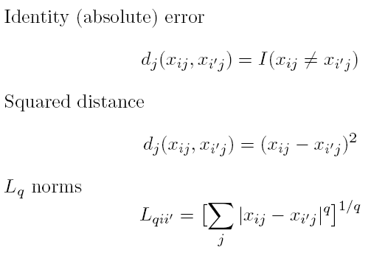
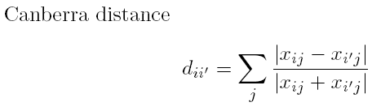
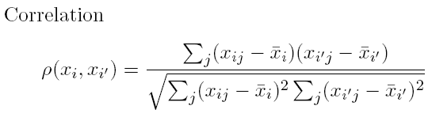
Distances: Quantitative Variables
Data point:
Some examples

Slide 6
Distances: Ordinal and Categorical Variables
Ordinal variables can be forced to lie within (0, 1) and then a quantitative metric can be applied:
For categorical variables, distances must be specified by user between each pair of categories.

Slide 7
Combining Distances
Often weighted sum is used:

Slide 8
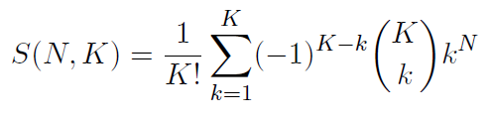
Combinatorial Approach
In how many ways can we assign K labels to N observations?
For each such possibility, we can compute a cost. Pick up the assignment with best cost.
Formidable number of possible assignments:

Slide 9
K-means Overview
An unsupervised clustering algorithm
“K” stands for number of clusters, it is typically a user input to the algorithm; some criteria can be used to automatically estimate K
It is an approximation to an NP-hard combinatorial optimization problem
K-means algorithm is iterative in nature
It converges, however only a local minimum is obtained
Works only for numerical data
Easy to implement
K-Means example:
http://www.naftaliharris.com/blog/visualizing-k-means-clustering/

Slide 10
K-means: Setup
x₁,…, x_{N} are data points or vectors of observations
Each observation (vector x_{i}) will be assigned to one and only one cluster
C(i) denotes cluster number for the i^{th} observation
Dissimilarity measure: Euclidean distance metric
K-means minimizes within-cluster point scatter:
where
m_{k} is the mean vector of the k^{th} cluster
N_{k} is the number of observations in k^{th} cluster

Slide 11
Within and Between Cluster Criteria
Let’s consider total point scatter for a set of N data points:
Distance between two points
T can be re-written as:
If d is square Euclidean distance, then
Where,
Within cluster
scatter
and
Ex.
Between cluster
scatter
Grand mean
Minimizing W(C) is equivalent to maximizing B(C)

Slide 12
K-means Algorithm
For a given cluster assignment C of the data points, compute the cluster means m_{k}:
For a current set of cluster means, assign each observation as:
Iterate above two steps until convergence

Slide 13
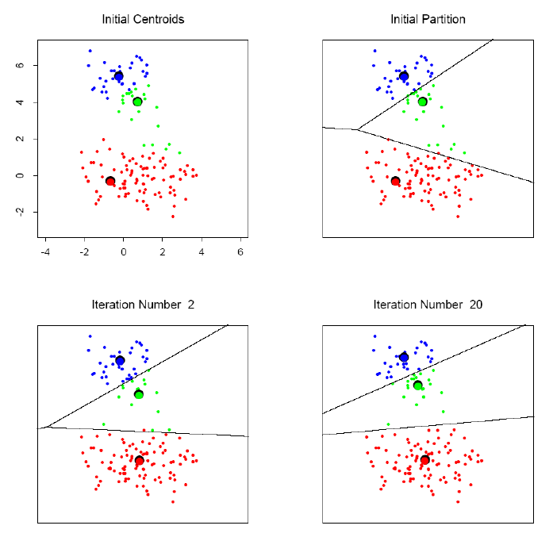
K-means clustering example
Online visualization: http://www.naftaliharris.com/blog/visualizing-k-means-clustering/

Slide 14
K-means Image Segmentation
An image (I)
Three-cluster image (J) on
gray values of I

Slide 15
K-means: summary
Algorithmically, very simple to implement
K-means converges, but it finds a local minimum of the cost function
Works only for numerical observations
K is a user input; alternatively BIC (Bayesian information criterion) or MDL (minimum description length) can be used to estimate K
Outliers can considerable trouble to K-means

Slide 16
Clustering in Spark
https://spark.apache.org/docs/latest/ml-clustering.html
Tutorial:
  https://hub.packtpub.com/building-recommendation-system-with-scala-and-apache-spark-tutorial/

Slide 17
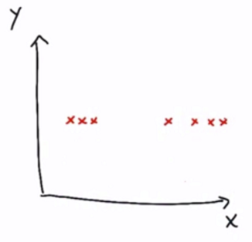
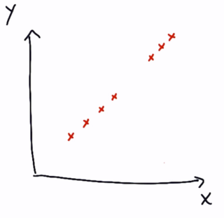
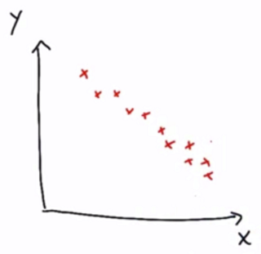
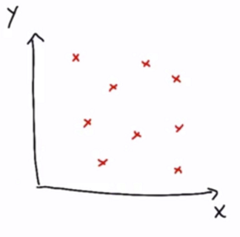
Dimensionality

Slide 18
Dimensionality
1D
1D
1D
2D

Slide 19
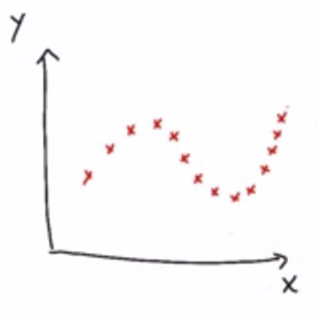
Dimensionality
2D

Slide 20
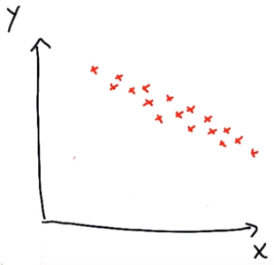
Principal Component Analysis (PCA) in nutshell
New base vectors
  By transitions and rotations only!
Take the centre of the data
a) The principal axis
  the most variations relative to the data points
b) The second principal axis
- less important direction
PCA tells you how important the different axis are.
.

Slide 21
Measurable and latent features
Features of a house are given, what is its price?
Measurable features
Square footage
No. of rooms
School ranking
Neighborhood safety
Latent features
Size
Neighborhood

Slide 22
Measurable and latent features
Features of a house are given, what is its price?
Measurable features
Square footage
No. of rooms
School ranking
Neighborhood safety
Latent features
Size
Neighborhood

Slide 23
Preserving information
Hypothesis: a small number of features actually drives the pattern
Try making a composite feature that more directly probes the undelying phenomenon
  Composite feature – e.g. principle component
Dimension reduction in unsupervised learning

Slide 24
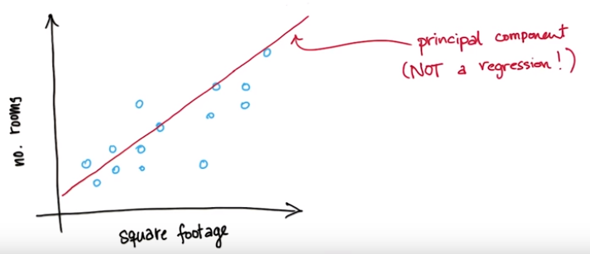
Example: size of a house
Square footage + No. of rooms -> size

Slide 25
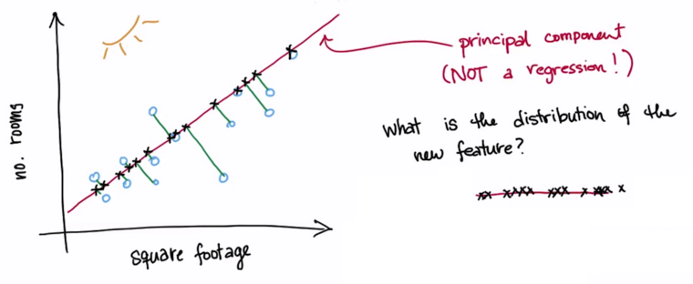
Example: size of a house
Square footage + No. of rooms -> size

Slide 26
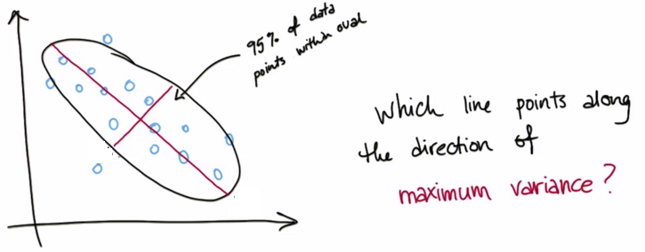
Variance
Roughly the spread of a data distribution
  Similar to std. deviation

Slide 27
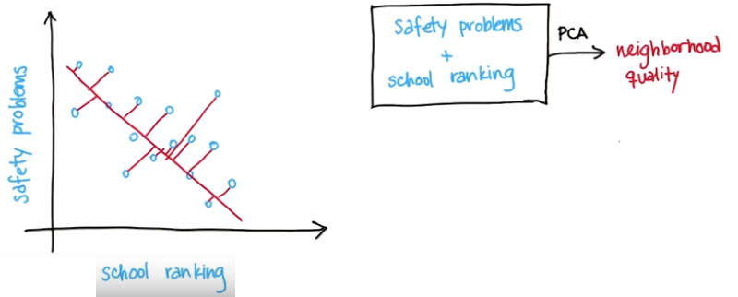
Information loss

Slide 28
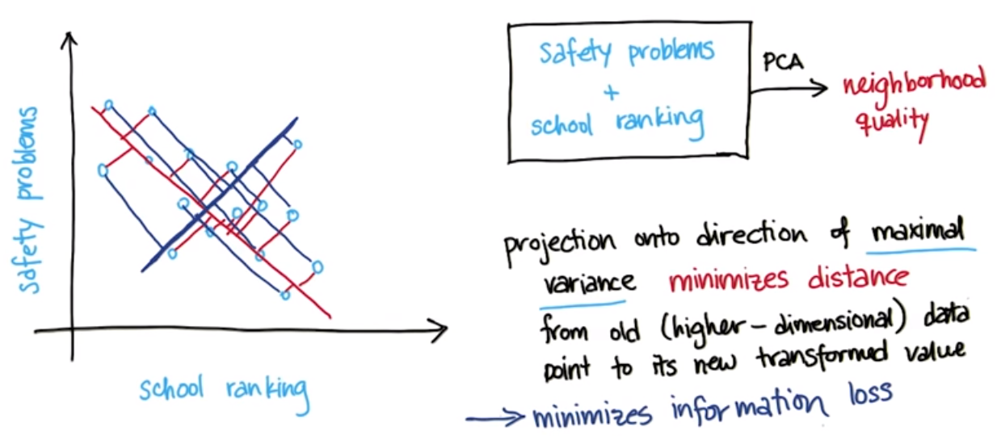
Information loss

Slide 29
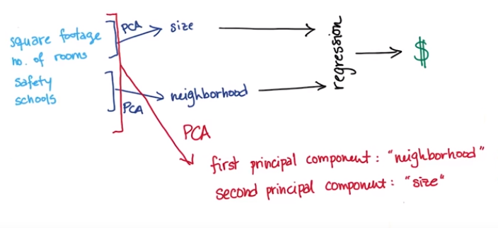
PCA

Slide 30
PCA in sklearn and SparkML
SKLearn:
  http://scikit-learn.org/stable/modules/generated/sklearn.decomposition.PCA.html
Spark ML & MLib:
  https://spark.apache.org/docs/1.5.2/ml-features.html#pca
Check other decomposition algorithms like
  ICA, SVD, etc.

Slide 31
Deep Learning
Slides:
  https://www.slideshare.net/0xdata/introduction-to-deep-learning-keras-and-tensorflow-128124587
This is also a good intro:
  https://www.slideshare.net/databricks/a-tale-of-three-deep-learning-frameworks-tensorflow-keras-pytorch-with-brooke-wenig-and-jules-damji
Another good video tutorial:
  https://www.youtube.com/watch?v=aircAruvnKk

