Slide 1
F-plasmid manuscript interim results

Slide 2
Background
Aim:
Look for gene coincidence/ avoidance relationship among publicly available IncF plasmid sequences
AMR and VF genes of particular interest

Slide 3
Methods
Downloaded plasmid sequences from PLSDB
Filtered for single replicon, circular, >33kbp (Frost et al., 1994), >200 plasmids in family
ggCaller > Coinfinder

Slide 4
Results: Core genomes
 | IncFII_1 | IncFIB(K)_1 | IncFIB(pKPHS1)_1 | IncFIB(pHCM2)_1 | IncFII(pHN7A8)_1
No. plasmids in subfamily | 676 | 334 | 226 | 204 | 201
Core genes (99% <= strains <= 100%) | 0 | 3 | 26 | 10 (8)* | 0
Soft core genes (95% <= strains < 99%) | 1 | 2 | 64 | 31 | 0
Shell genes (15% <= strains < 95%) | 143 | 327 | 129 | 198 | 129
Cloud genes (0% <= strains < 15%) | 2201 | 2081 | 638 | 619 (657)* | 1165
Total genes (0% <= strains <= 100%) | 2345 | 2458 | 857 | 858 (894)* | 1294
5 plasmid families with >200 members (676-201 plasmids)
857 to 2,458 genes per plasmid family
2 families with small (<1000 gene) pangenomes correspond with the 2 families with a ‘workable’ core genome identified.
*with core gene alignment run (core gene alignment run for pHPHS1 were identical)
summary of gene frequencies based on Roary

Slide 5
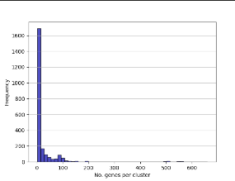
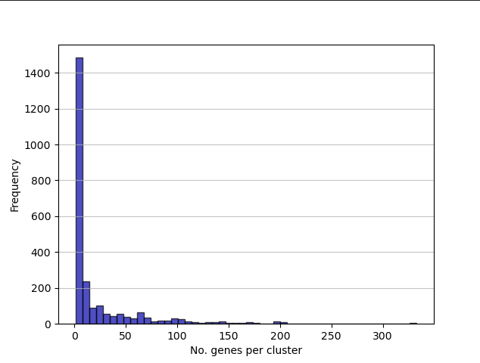
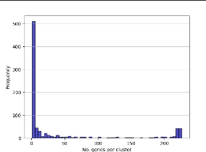
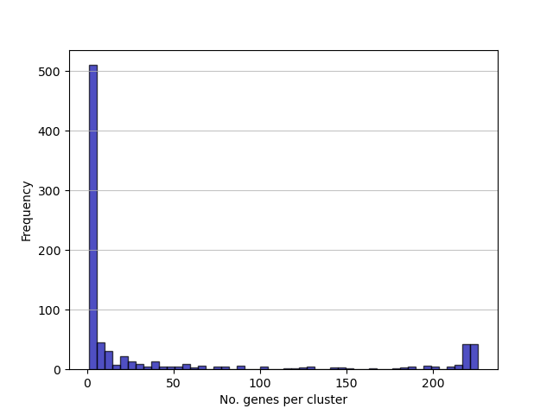
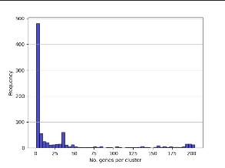
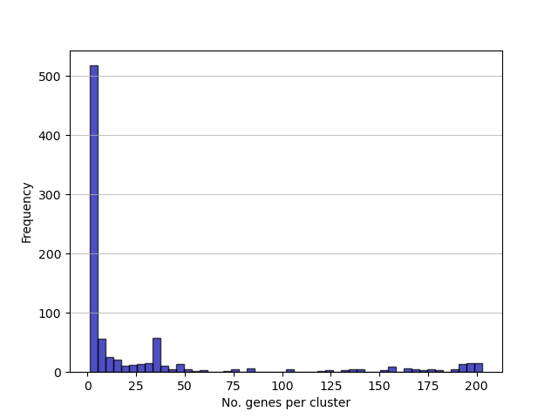
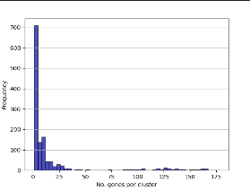
Cluster Sizes
IncFII_1
IncFIB(K)
IncFIB(pKPHS1)_1
IncFIB(pHCM2)_1
IncFII(pHN7A8)_1
All 5 plasmid families show similar distribution of gene cluster size: most clusters have very few genes (<50), very few clusters have many genes.
# of clusters roughly proportional to pangenome size
IncFIB(pKPHS1) and IncFII(pHN7A8) have another small peak of a few large (~200 gene) clusters
Core genes?
Hypothetical genes?

Slide 6
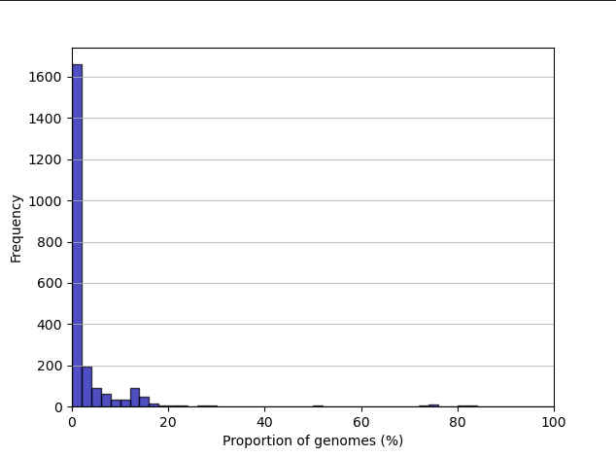
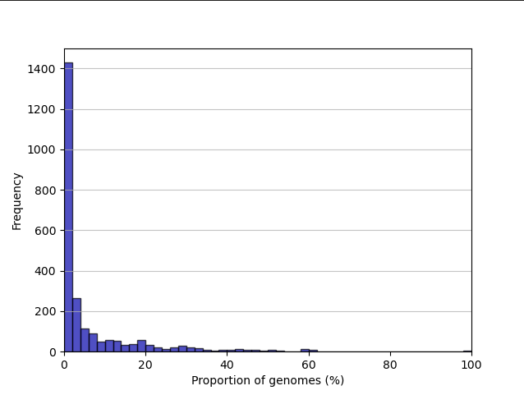
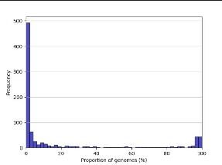
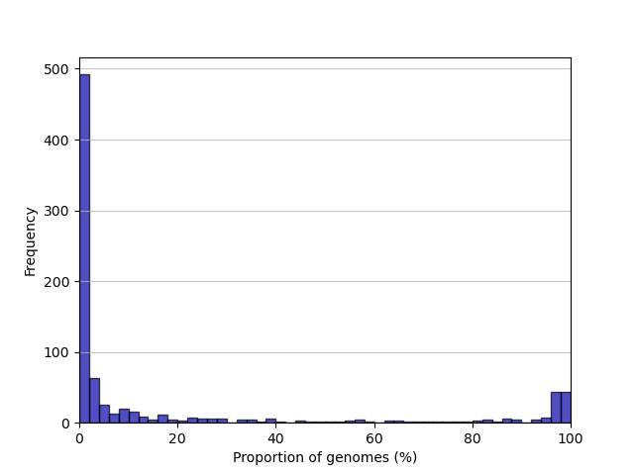
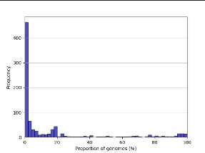
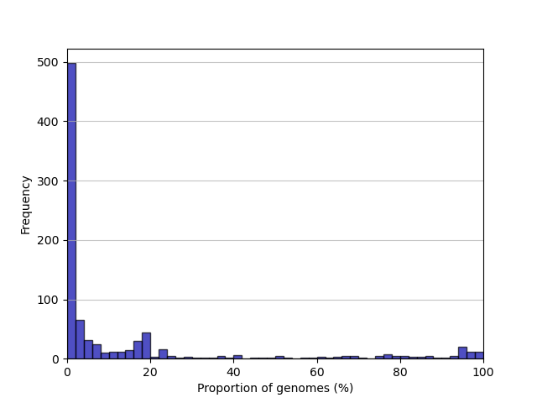
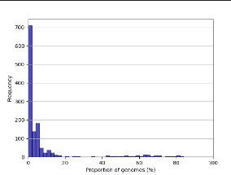
Gene Frequency
IncFII_1
IncFIB(K)
IncFIB(pKPHS1)_1
IncFIB(pHCM2)_1
IncFII(pHN7A8)_1
All 5 plasmid families show similar distribution of gene frequency: most genes present in few (<20%) genomes
IncFIB(pKPHS1) and IncFII(pHN7A8) have a 2nd small peak of a few genes present in almost 100% of genomes
Core genes
ggCaller auto-generated Gene frequency and cluster size plots look suspiciously similar…
- output from core genome alignment looks very similar

Slide 7
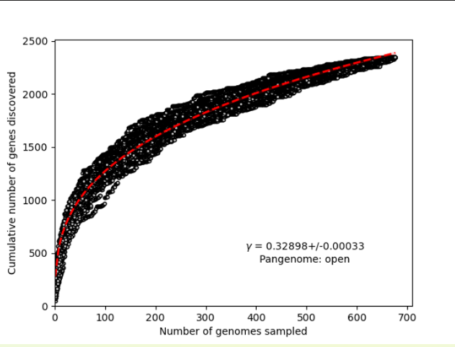
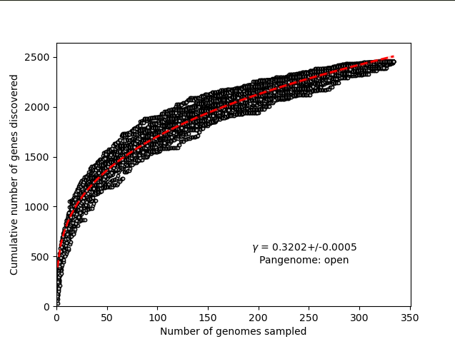
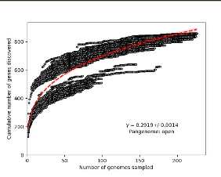
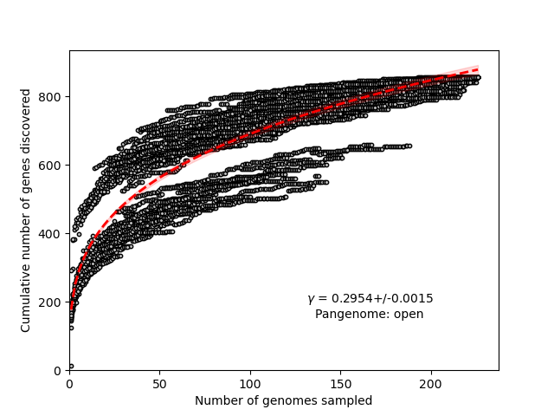
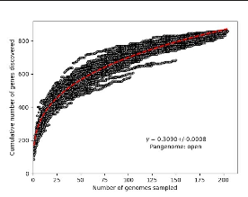
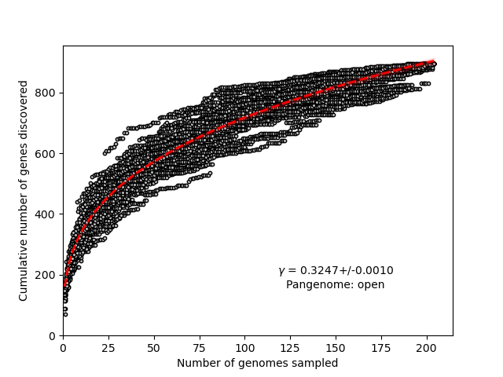
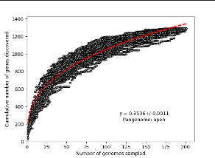
Rarefaction curves
IncFII_1
IncFIB(K)
IncFIB(pKPHS1)_1
IncFIB(pHCM2)_1
IncFII(pHN7A8)_1
Open pangenomes for all 5 families
Parallel lines of IncFIB(pHKPS1) curve?
Same result with coregenome alignment re-run

Slide 8
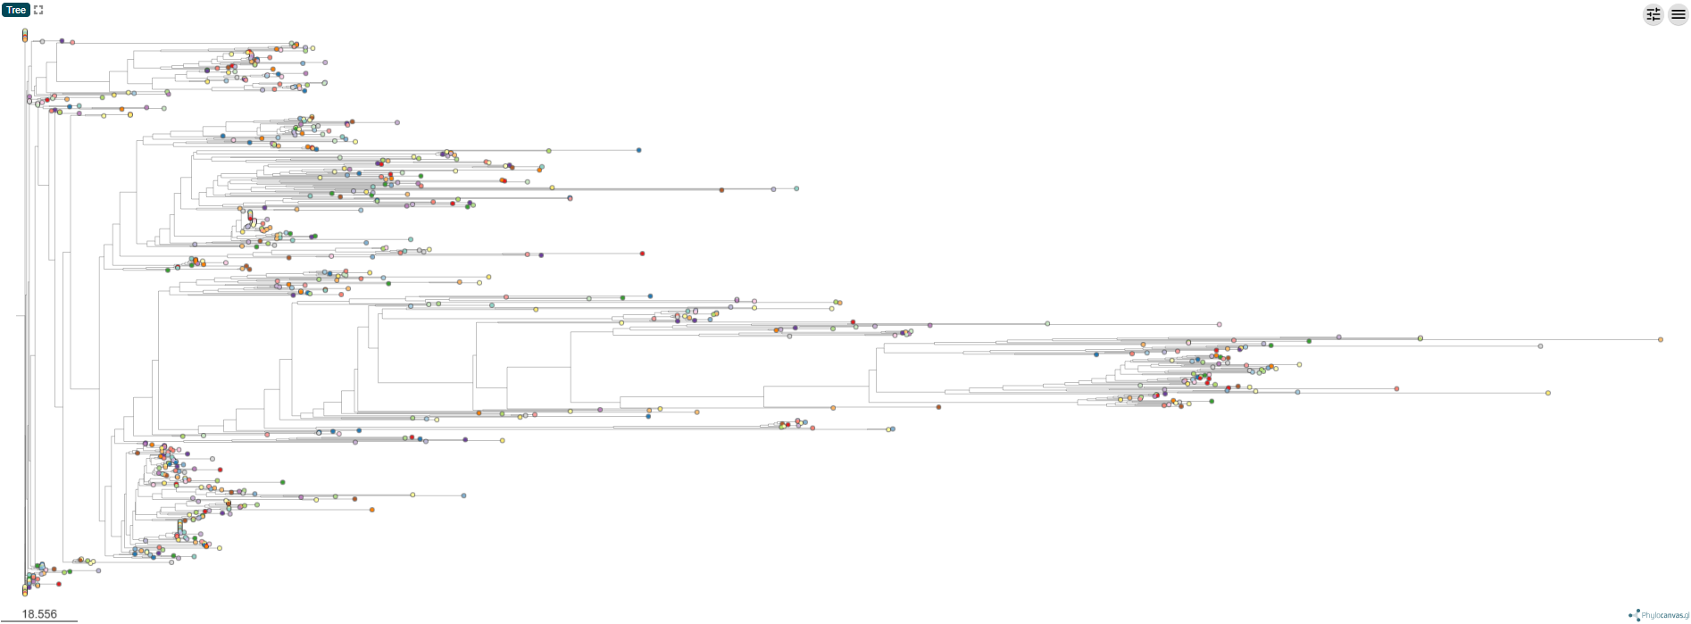
Results: Pangenome Phylogeny
IncFII_1
3-4 subclades?
Generated using Microreact

Slide 9
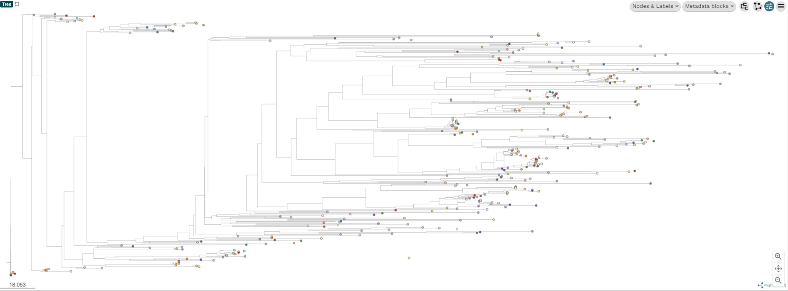
Results: Pangenome Phylogeny
IncFIB(K)
1 main central clade with 2-3 small divergent subclades
Generated using Microreact

Slide 10
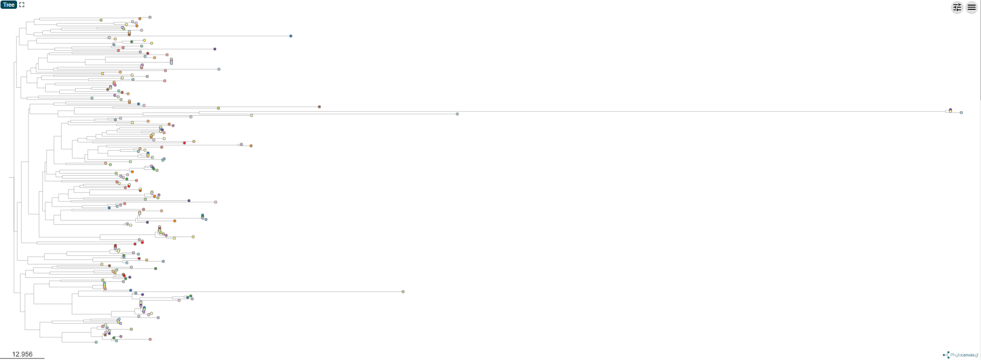
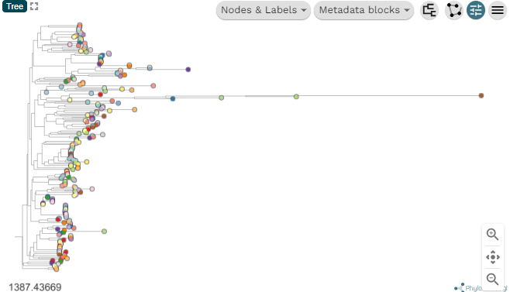
Results: Pangenome Phylogeny
IncFIB(pKPHS1)_1
Mostly well mixed/closely related
except for 2-3 very distant isolated plasmids
Core gene alignment tree on right
Generated using Microreact

Slide 11
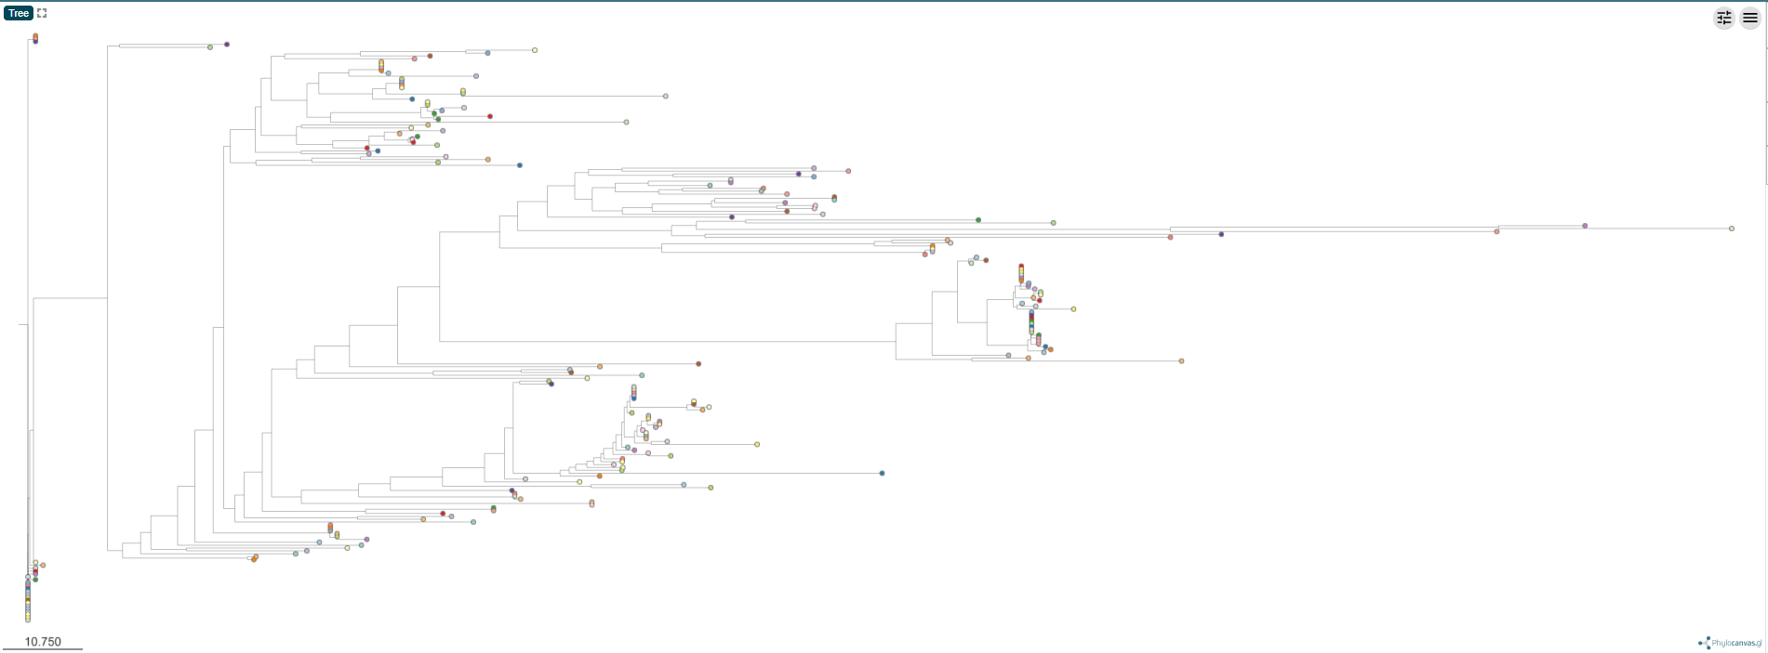
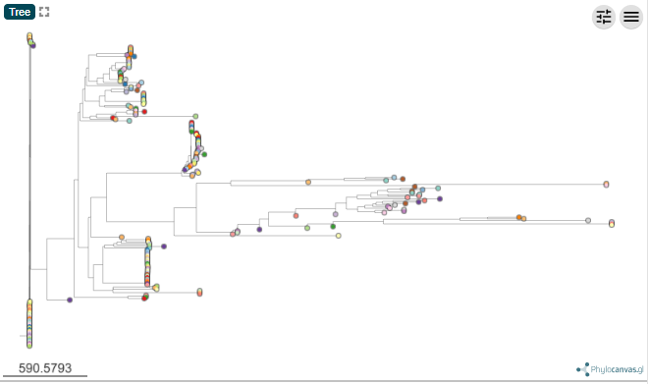
Results: Pangenome Phylogeny
IncFIB(pHCM2)_1
3-4 subclades
Again, 1-2 very distantly related isolated plasmids
Core gene tree on the right
Generated using Microreact

Slide 12
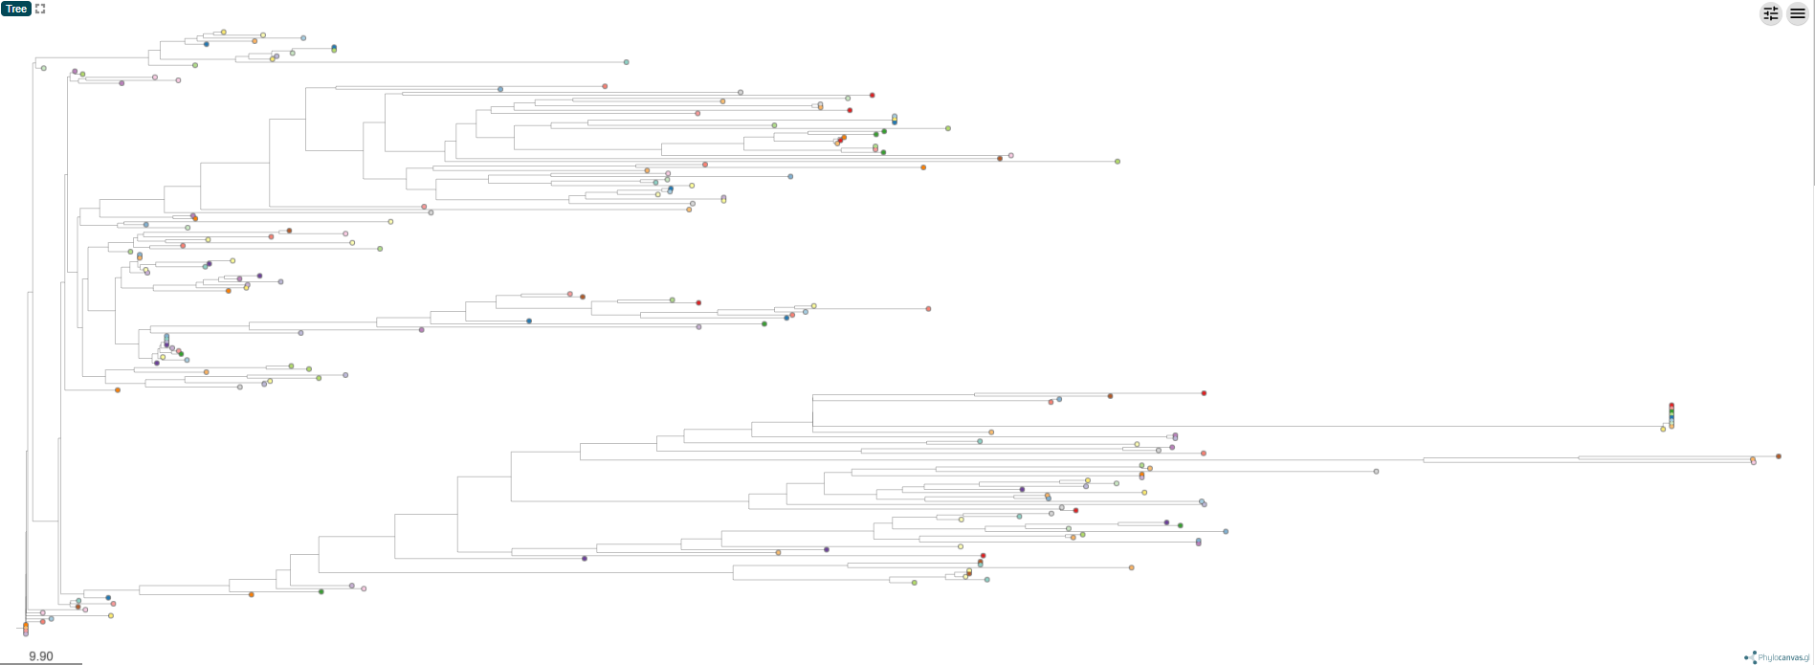
Results: Pangenome Phylogeny
IncFII(pHN7A8)_1
2 quite distinct subclades
Generated using Microreact

Slide 13
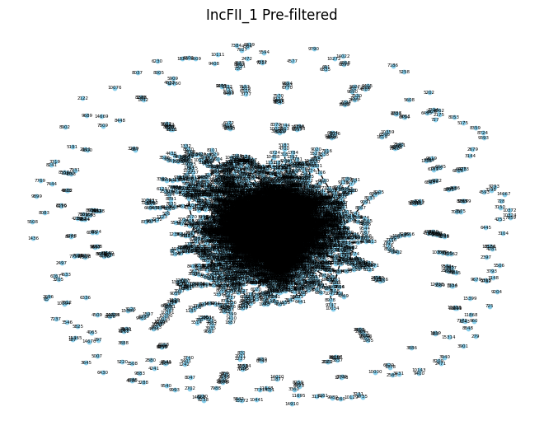
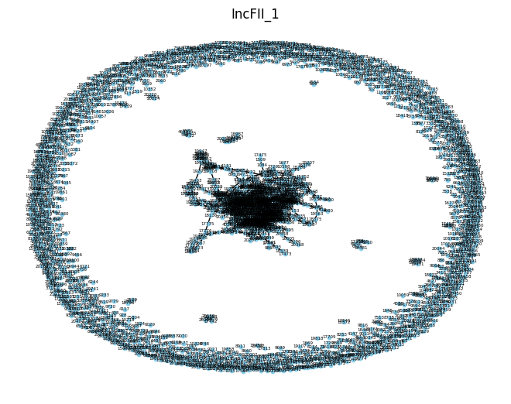
Gene networks
Core genes clusters in the middle?
Filtering removes nodes (gene clusters) with <2 edges by default
Generated using NetworkX (python)

Slide 14
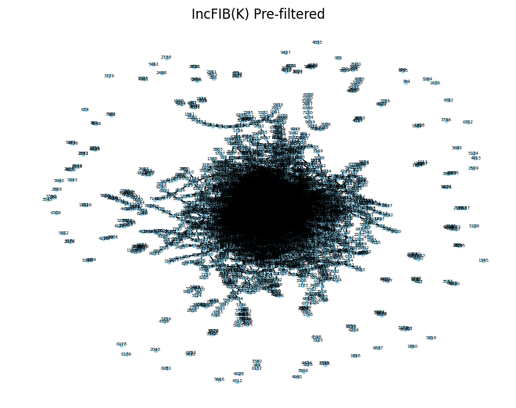
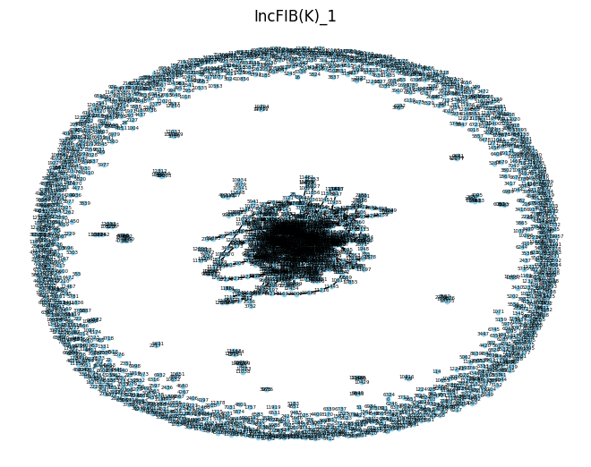
Gene networks
Core genes clusters in the middle?
Filtering removes nodes (gene clusters) with <2 edges by default
Generated using NetworkX (python)

Slide 15
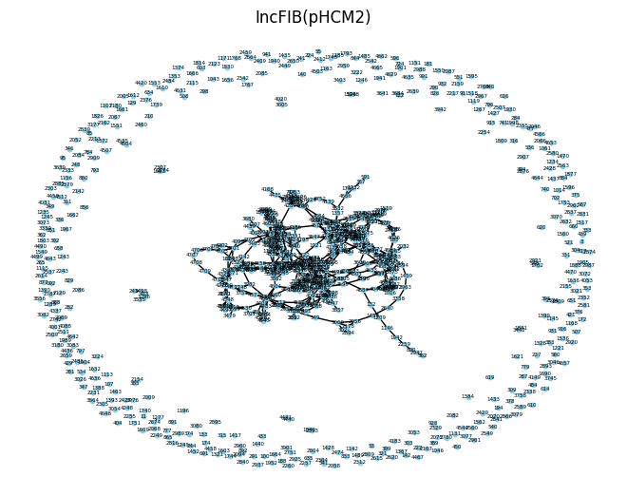
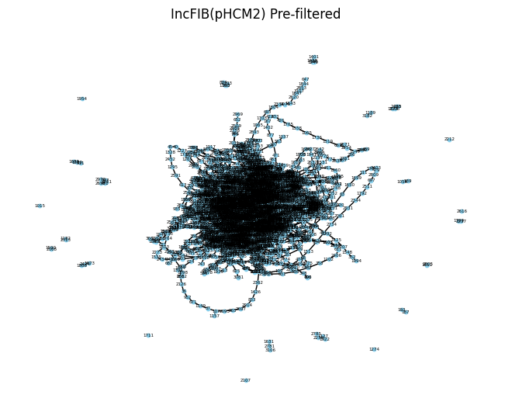
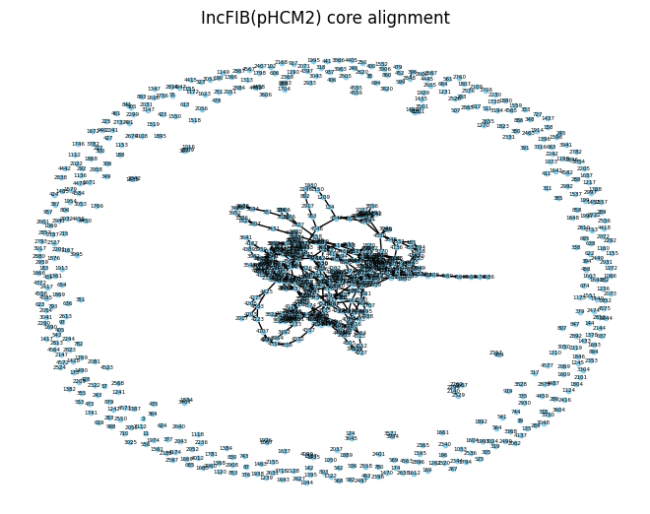
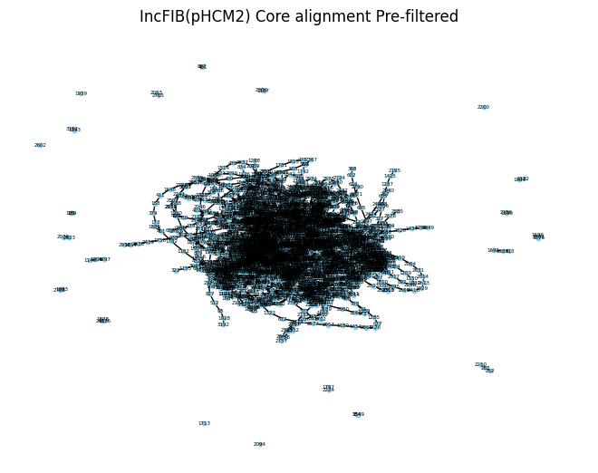
Gene networks
Core genes clusters in the middle?
Filtering removes nodes (gene clusters) with <2 edges by default
Generated using NetworkX (python)

Slide 16
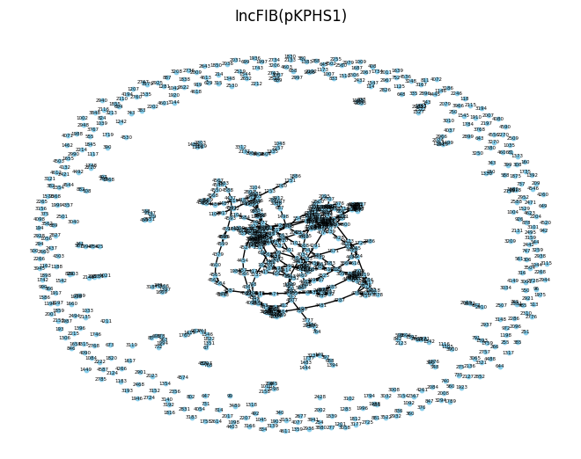
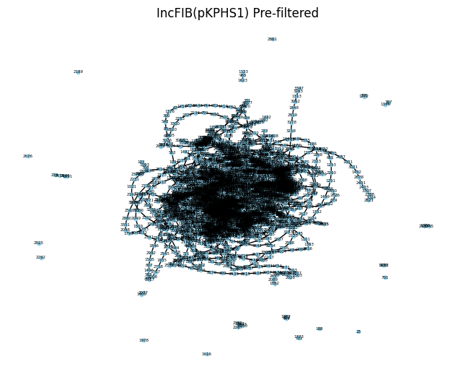
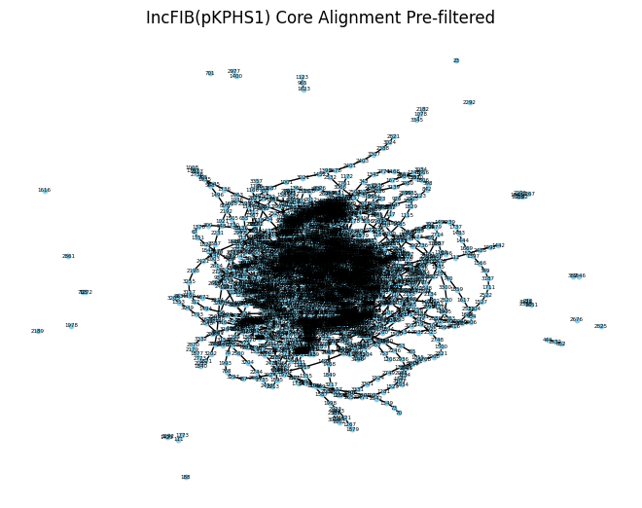
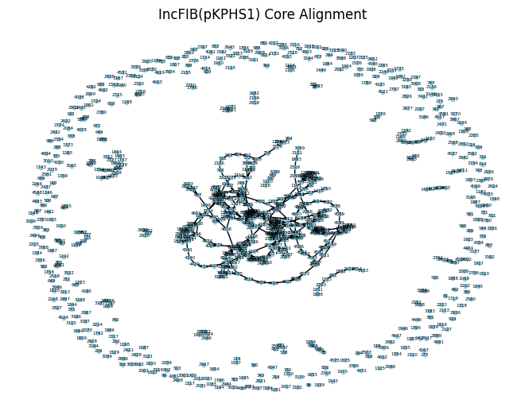
Gene networks
Core genes clusters in the middle?
Filtering removes nodes (gene clusters) with <2 edges by default
Core alignment and pangenome run outputs look very similar
(minus stochasticity? In each run of NetworkX)
Generated using NetworkX (python)

Slide 17
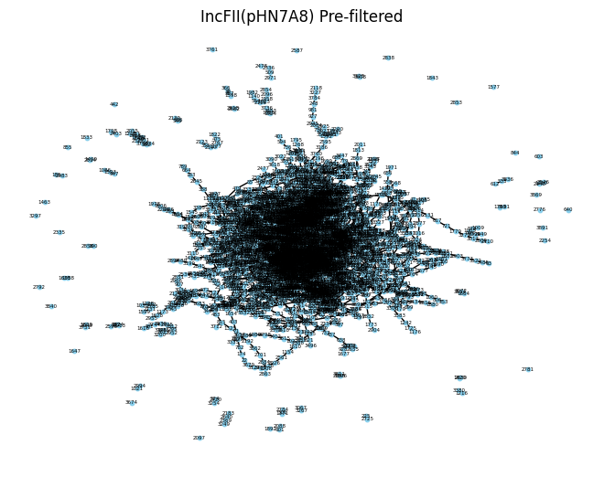
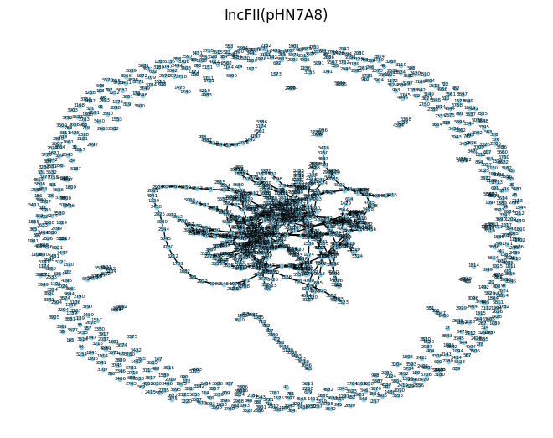
Gene networks
Core genes clusters in the middle?
Filtering removes nodes (gene clusters) with <2 edges by default
Generated using NetworkX (python)

Slide 18
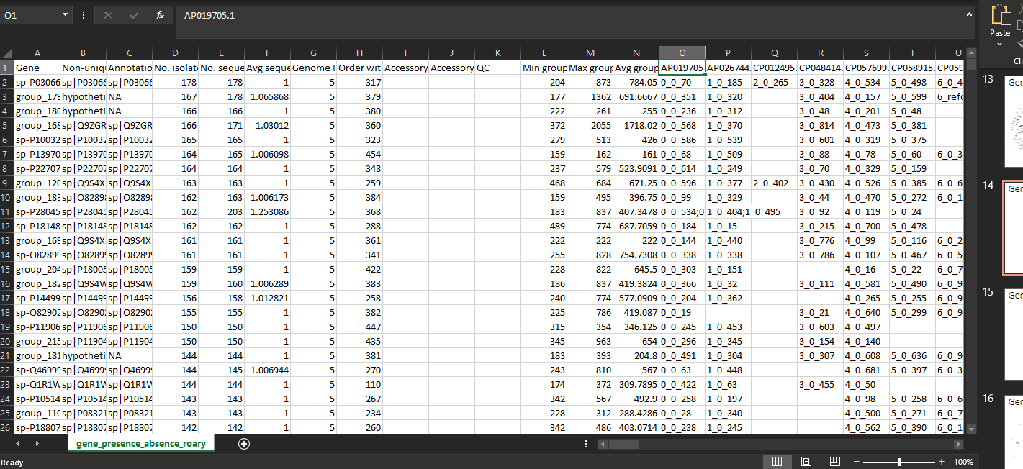
Results:
Gene presence_absence matrices (+ ‘Roary’ format)
GFF files for all sequences

Slide 19
Next Steps:
Core gene alignments for 2 of the plasmid families (IncFIB(pKPHS1)_1 & IncFII(pHN7A8)_1 may be adequate to generate core genome phylogeny as Coinfinder input
ggcaller –refs input.txt –aligner def – alignment core –core-threshold 0.99
Or 95%
Using MAFFT
Generates additional core genome alignment as FASTA, and NJ-tree (.nwk)
+ pre-cluster alignment .fasta and .vcf files
Attempt Will’s method for other 3 clusters
+/- try removing smaller subclade plasmids from IncFIB(K), and splitting IncFII(pHN7A8)_1 in 2???
Notes:
How does similarity matrix > hierarchical clustering prioritise core genome better than pangenome phylogeny?
If all genes are considered when calculating pairwise plasmid similarity score, don’t you have the same problem that you are controlling for coincident accessory genes twice?

Slide 20
Running Coinfinder with 0-length branches set to 1e-20

Slide 21
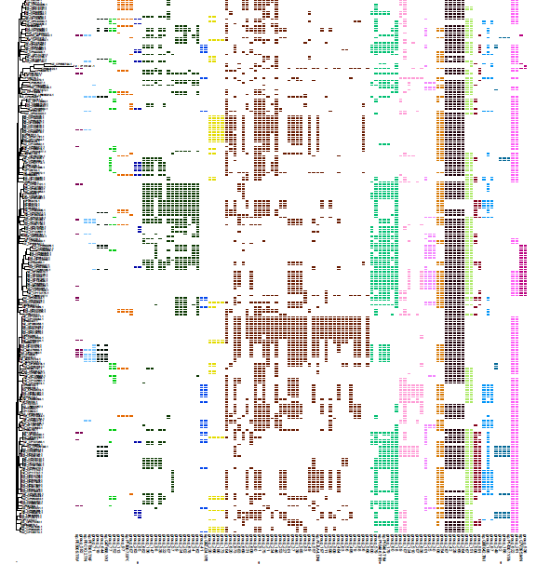
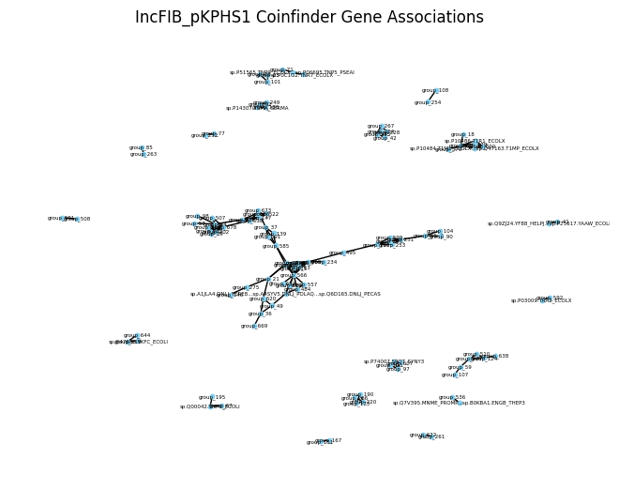
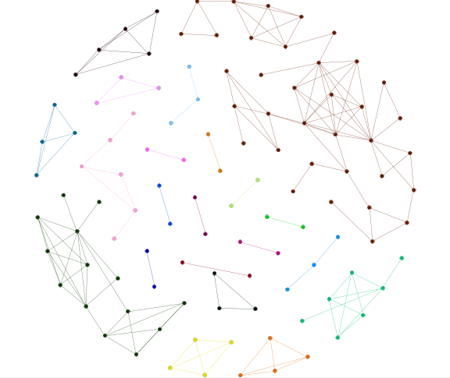
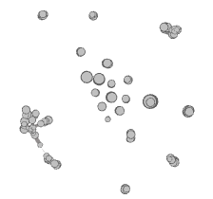
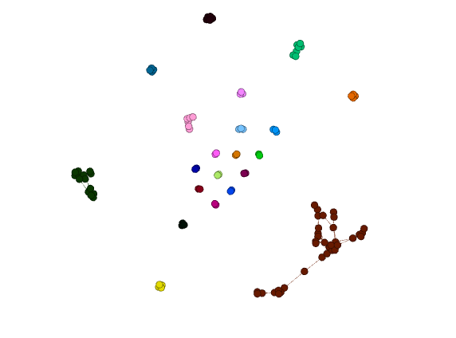
IncFIB(pKPHS1)_1- associations 1e-10
Needed no 0-length branches, so replaced with 1e-10
Outputs: heatmap.pdf
.gexf (no colour)
.gml (coloured in Gephi (Force Atlas; Fruchterman Reingold -globe) below; right Networkx)
Notes:
Heamap- pdf

Slide 22
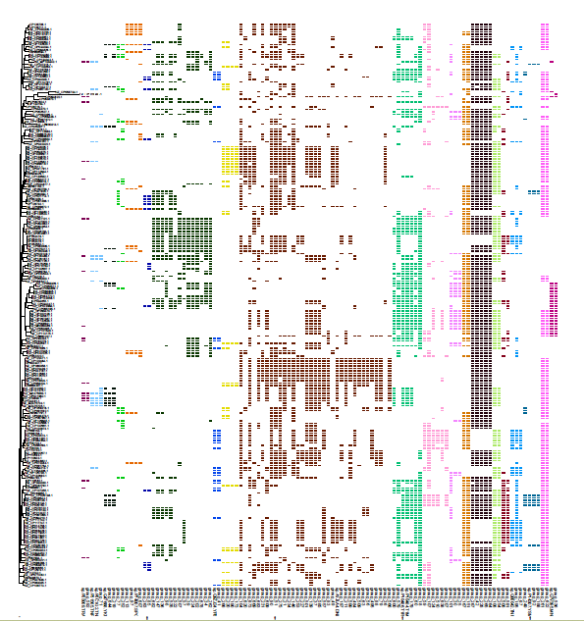
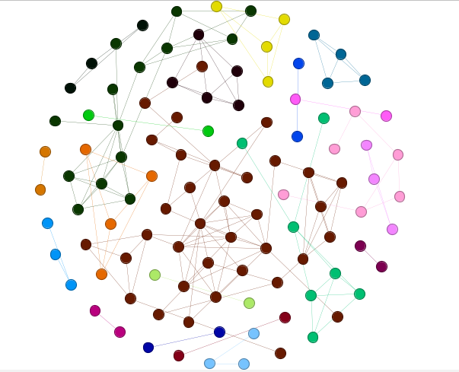
IncFIB(pKPHS1)_1- associations 1e-20
Needed no 0-length branches, so replaced with 1e-10
Outputs: heatmap.pdf
.gexf (coloured in Gephi- Fruchterman Reingold -globe)
.gml (no colour)

Slide 23


IncFIB(pKPHS1)_1- dissociations
Needed no 0-length branches, so replaced with 1e-20
Outputs: heatmap
.gexf (no colour)
.gml (below)

Slide 24



IncFIB(pHCM2)_1- associations
Needed no 0-length branches, so replaced with 1e-20
Outputs: heatmap
.gexf (no colour)
.gml (below)- Gephi (Fruchterman Reingold)

Slide 25


IncFIB(pHCM2)_1- dissociations
Needed no 0-length branches, so replaced with 1e-10
Outputs: heatmap
.gml (below)
.gexf (colour)- Gephi (fruchman Reingold, node size 30)

Slide 26
Now with 0-length branches removed

