Slide 1
Final Project – Text Generation
Advances Topics in Deep Learning
Ohad Ravfogel Yoav Kugler

Slide 2

Mission Statement:
Generating a conversation Similar to the Dialogues in the TV show “The Office”

Slide 3

Specifically:
Generating a conversation between Jim and Dwight

Slide 4

This is our Goal…..

Slide 5
Challenges in Text Generation
Open-ended (no labels…)
susceptible to Phrasing Ambiguities, misspelling, Biases, etc.
Requires “creativity”
Unclear how to measure success

Slide 6
Methods considered
Creating an RNN network (specifically - GRU)
Creating a GAN Network
Using a preprepared network
Tweaking a preprepared network

Slide 7
Database Used
https://raw.githubusercontent.com/tsaruggan/dunder-mifflin-RNNfinity/master/the-office.txt
Continuous dialogue from all episodes of the show

Slide 8
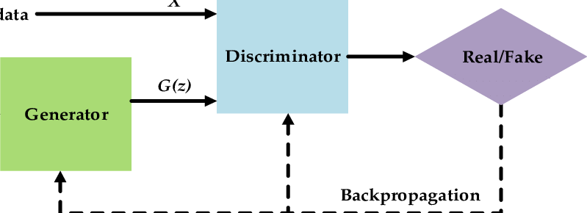
GAN Network
Built from a “generator” creating samples and a “descriptor” trying to distinguish between real samples and generated samples
GANs do not work well with text generation because GANs are initially defined for real-valued continuous data, while texts are naturally discrete

Slide 9
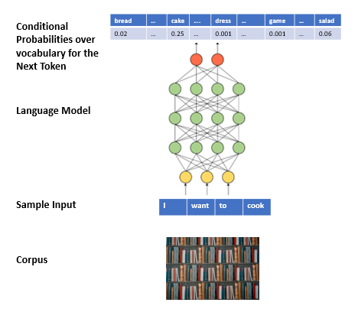
Text Generation using RNN
We tokenize the corpus into chunks of tokens (sequences)considering the maximum size (length) At the end of the tokenization process, we have
Sequences of tokens as samples (inputs or outputs for the LM)
A vocabulary consisting of maximum n number of frequent tokens in the corpus

Slide 10
Text Generation using RNN
In training, we first prepare the train data from the corpus. Then, LM learns the conditional probability distribution of the next token for a sequence (prompt) generated from the corpus.
In inference (text generation) mode, an LM works in a loop:
We provide initial text (prompt) to the LM.
The LM calculates the conditional probability of each vocabulary token to be the next token.

Slide 11
Text Generation using RNN
We sample the next token using this conditional probability distribution.
We concatenate this token to the seed and provide this sequence as the new seed to LM

Slide 12
Creating an RNN Network – Utilizing Three different Networks
Building a “Dialogue Network” which will learn all conversations between Jim and Dwight
Building a “Jim Network” and a “Dwight network” and trying to create a dialogue between them

Slide 13
Results from the Two Networks Model

Slide 14
Results from the Dialogue Model

Slide 15
Utilizing a Preprepared Network
GPT-2 is a transformers model pretrained on a very large corpus of English data in a self-supervised fashion (no human labels)
Trained on Internet content, contains biases

Slide 16
Results Received from the GPT-2 Network

Slide 17
Finetuning a Preprepared Network
We can use the Preprepared network while retraining it on our specific database
Training does not start from scratch – initial weights are those originally learned by the network

Slide 18
Finetuning a Preprepared Network

Slide 19
Results received from a finetuned network

Slide 20
Conclusions
It is difficult to obtain good results by building a model from scratch…
Utilizing a preprepared model provides better results
By utilizing a preprepared model while performing finetuning, it is possible to obtain quite reasonable results, even without resulting to state of the art models

Slide 21
Questions?

