Slide 1
Polymorphism
Obvious is not always obvious

Slide 2
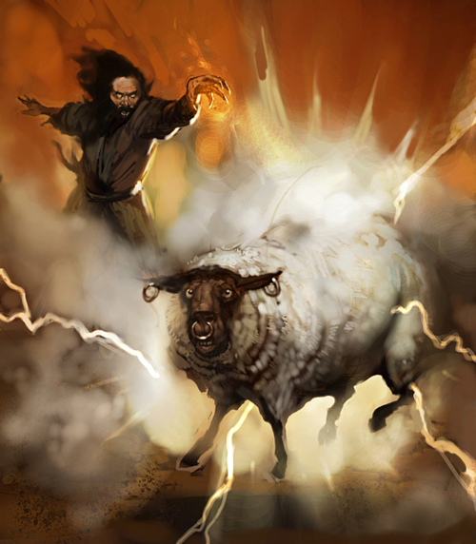
Polymorhism

Slide 3
But... Why?
Treating multiple objects of different types as objects of base class (ex. collections, arrays)
Virtual methods (!)
Dependency Injection (!)
Etc...

Slide 4
Virtual members
var mammals = new List<Mammal>
{
new Human {Age = 28, Legs = 2},
new Monkey {Age = 4, Legs = 2},
new Mammal {Age = 23, Legs = 3}
};
foreach (var mammal in mammals)
{
mammal.Say();
}

Slide 5
Overriding
var derived = new Derived(); derived.DoSomething();
var @base = (Base)derived;
@base.DoSomething();

Slide 6
Preventing from overriding
Sealed
New
// Example 3

Slide 7
Obvious is not always obvious
// Example 4

Slide 8
Inheriting interfaces
IHero hero = new PoorHero();
hero.Fly();
hero = new RegularHero();
hero.Fly();

Slide 9
Inheriting interfaces
var superHero = new SuperHero();
superHero.Fly();
superHero.GodMode();
superHero.Stab();
IHero hero = superHero;
hero.Fly();
IAssassin assassin = superHero;
assassin.Stab();
IMarvelFeatures marvelFeatures = superHero;
marvelFeatures.GodMode();

Slide 10
Abstracts
public abstract class Base
{
public abstract void DoSth();
public virtual void DoSthElse()
{
Console.WriteLine("I'm doin' it!");
}
public void DoEvenMore()
{
Console.WriteLine("Pass");
}
}

Slide 11
Access Modifiers
Private – access within struct/class
Public – „get me anywhere I am” (solution scope)
Internal – „get me if I’m yours” (project scope)
Protected – access within struct/class or „get me if I gave birth to you!” (inheritance scope)

