Slide 1
ANALYSTLAB AFRICA | DATA SCIENCE INTERNSHIP
HealthConnect Rwanda:
Healthcare Analytics
and Decision Support
5,000
4,443
Appointments
Patients
One-year source extract
Distinct patient IDs
Integrated data quality review, exploratory analysis, statistical testing, forecasting, and clustering.
30
41
Source tables
Visuals
Relational source files
Numbered notebook charts
Dorian NJAMI, Certified Data Scientist
Week 6 project | October 2026

Slide 2
HEALTHCONNECT RWANDA | WEEK 6
Executive overview
This analysis combines 30 source tables into an appointment-level dataset and evaluates where the records can support decisions today.
94.9%
25.5%
2.93 / 5
0.916
Location mismatch
Chronic history unknown
Mean satisfaction
Receipts vs. volume
4,744 of 5,000 appointments
1,131 of 4,443 patients
1,756 rated records
Monthly Spearman correlation
The dataset is structurally clean, but key mappings and financial status fields still need reconciliation.
Models were exploratory. Admission and satisfaction classifiers did not reach useful holdout performance, and the annual forecasts rely on only twelve monthly observations.
Dorian NJAMI | AnalystLab Africa Data Science Internship
2

Slide 3
HEALTHCONNECT RWANDA | WEEK 6
Data integration and quality controls
30 SOURCE TABLES
APPOINTMENT MASTER
VALIDATION
Patient, appointment, clinical, financial, operational, and feedback data.
→
5,000 unique appointments linked with patient and service attributes.
→
Key uniqueness, completeness, domain checks, and referential review.
Zero null cells after cleaning means missing values were handled explicitly. It does not mean all source facts are verified.
Highest-priority data issues
• 94.9% department/facility identifier disagreement
• Billing statuses conflict with linked payment activity
• Currency, active coverage, staffing assignments, and bed occupancy are not verified
Dorian NJAMI | AnalystLab Africa Data Science Internship
3

Slide 4
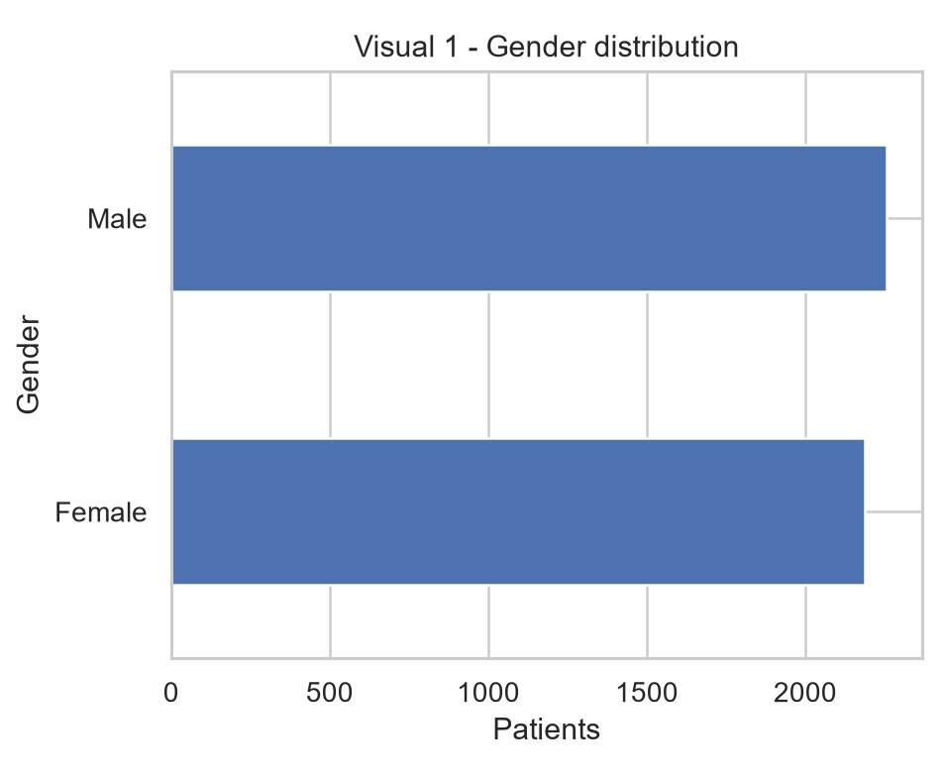
HEALTHCONNECT RWANDA | WEEK 6
Patient profile
The cohort spans all ages and is almost evenly split by recorded gender. Clinical history is incomplete for roughly one in four patients.
45.5 years
50.8%
Mean age
Male patients
Median: 46 years
2,256 male / 2,187 female
Chronic conditions are recorded for 3,312 patients. Another 1,131 have no history recorded, so the data cannot confirm whether they have no chronic condition.
Do not use “not recorded” as a negative diagnosis or interpret the appointment cohort as population prevalence.
Dorian NJAMI | AnalystLab Africa Data Science Internship
4

Slide 5
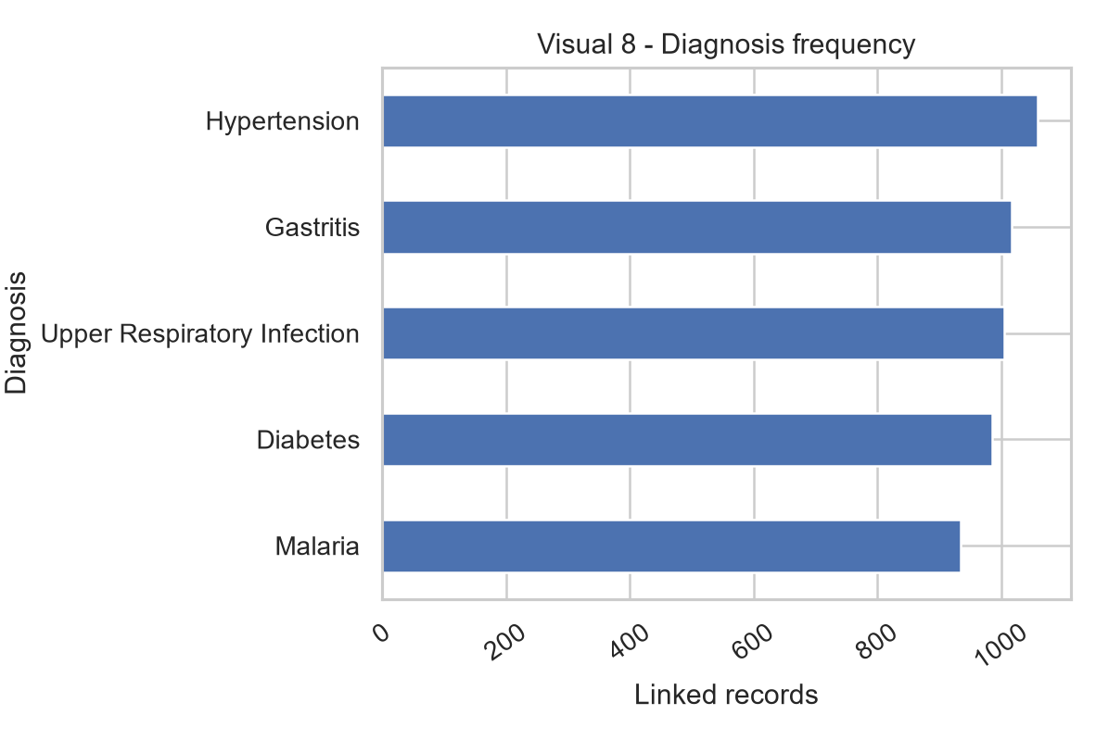
HEALTHCONNECT RWANDA | WEEK 6
Clinical activity
Diagnosis categories are relatively balanced. Laboratory records link to 45.4% of cohort visits, while diagnosis records are present across the appointment cohort.
1,059
45.4%
Most common diagnosis
Visits with lab record
Hypertension
2,272 appointments
The charts count linked records, not disease incidence, abnormal test results, treatment adherence, or clinical necessity. Severity labels were not independently validated.
These patterns describe documentation in the supplied files, not the health profile of Rwanda.
Dorian NJAMI | AnalystLab Africa Data Science Internship
5

Slide 6
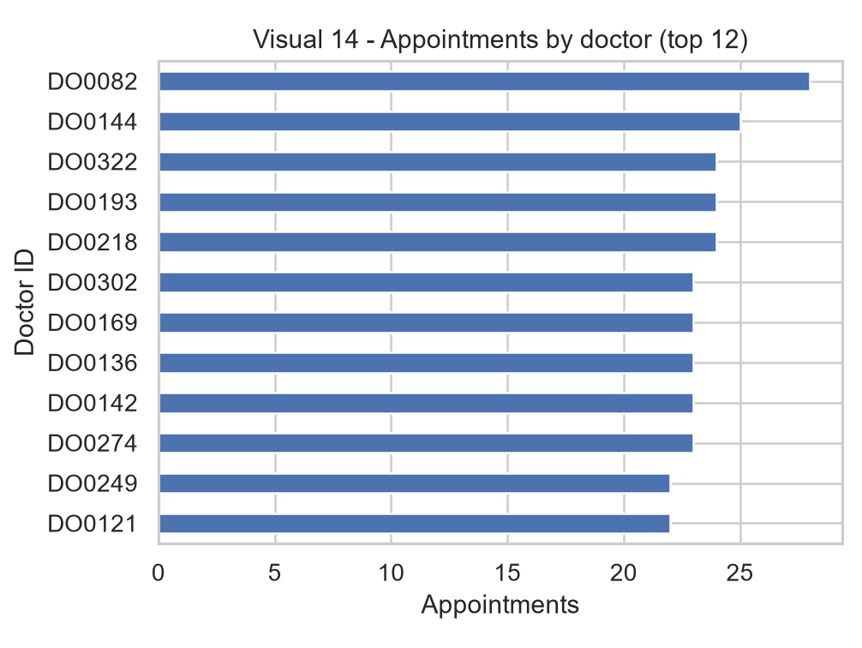
HEALTHCONNECT RWANDA | WEEK 6
Operational patterns and measurement gaps
The available rosters provide context on listed staff and equipment, but they do not record assignments, shifts, availability over time, or patient-to-resource events.
5–28
2,000
Visits per doctor
Listed beds
Observed appointments in cohort
All status labels: Available
A roster count is not a measure of actual workload or utilization. Facility volume also lacks a capacity denominator, so it should not be called occupancy or utilization.
Collect time-stamped shifts, assignments, occupancy, and equipment events before ranking capacity.
Dorian NJAMI | AnalystLab Africa Data Science Internship
6

Slide 7
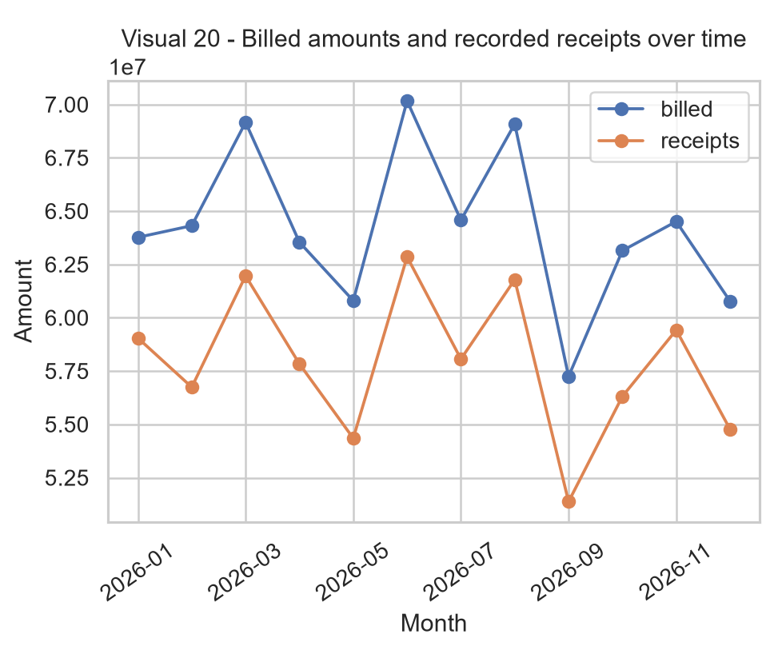
HEALTHCONNECT RWANDA | WEEK 6
Financial activity and reconciliation
Linked invoices and payment transactions show monthly co-movement, but their statuses and calculated balances are inconsistent.
70.2m
57.2m
Highest monthly billed
Lowest monthly billed
June, source units
September, source units
Receipts remain below billed totals. Paid bills still have calculated balances, and Pending bills can have payments. Currency is unspecified. The unlinked Revenue_Summary is not assigned to departments.
Reconcile each bill against transactions before reporting collected or outstanding revenue.
Dorian NJAMI | AnalystLab Africa Data Science Internship
7

Slide 8
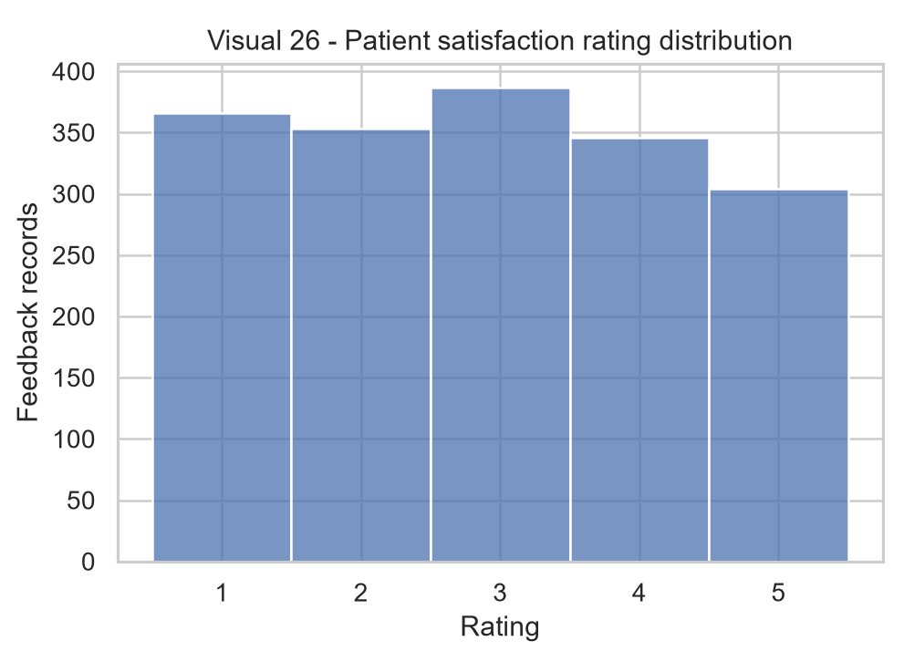
HEALTHCONNECT RWANDA | WEEK 6
Patient experience
Feedback is mixed and covers 35.1% of appointments. The response gap means reported ratings may not represent every patient.
2.93 / 5
40.9%
Average score
Ratings 1–2
Median and mode: 3
719 of 1,756 rated records
Department averages range from 2.76 to 3.02. The visible facility gap is descriptive and may reflect different patient mix or response patterns.
Review low-score feedback themes together with response rates before setting service targets.
Dorian NJAMI | AnalystLab Africa Data Science Internship
8

Slide 9
HEALTHCONNECT RWANDA | WEEK 6
Statistical findings
Holm adjustment controls the chance of false positives across the five related tests. H2 is not significant after this adjustment.
Test
Raw p
Holm p
Result
Satisfaction by facility
0.727
1.000
No evidence of difference
Admission rate by age group
0.0448
0.1793
Not significant after adjustment
Severity and length of stay
0.684
1.000
No observed association
Workload proxy and satisfaction
0.731
1.000
No observed association
Receipts and patient volume
0.00003
0.00014
Strong monthly association
The H2 effect is small (Cramer’s V = 0.047). H5 is based on 12 monthly observations and does not establish causality.
Dorian NJAMI | AnalystLab Africa Data Science Internship
9

Slide 10
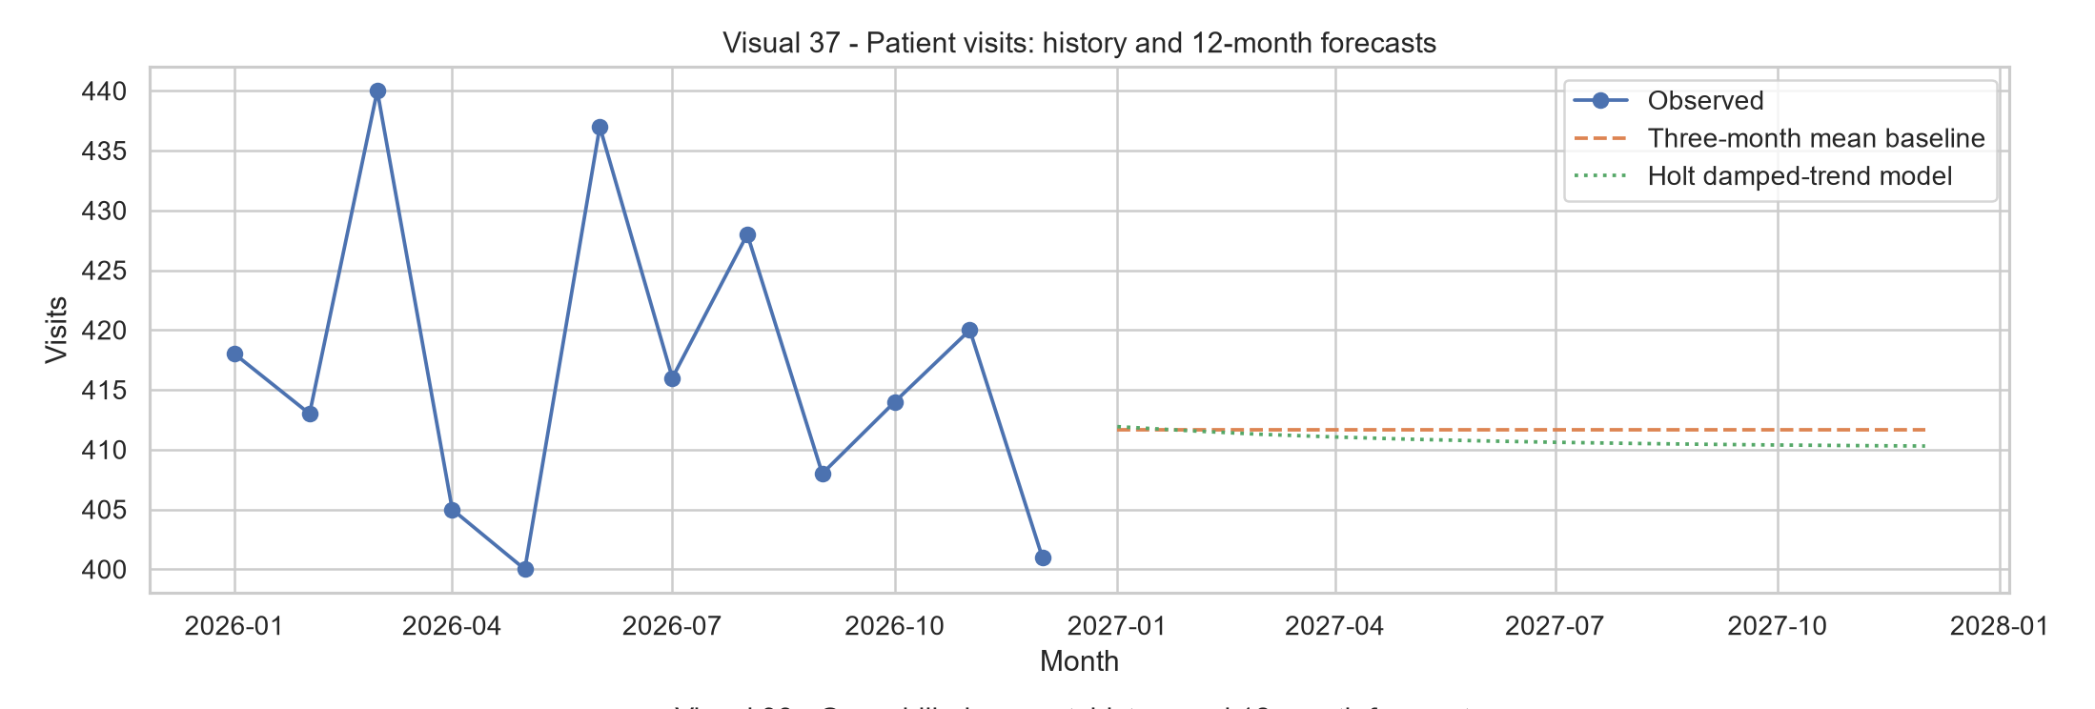
HEALTHCONNECT RWANDA | WEEK 6
Demand and financial forecasts
A three-month moving-average baseline outperformed Holt’s damped trend in the final-three-month rolling backtest for each series.
~412
62.81m
Visits / month
Billed / month
Three-month average baseline
Source amount units
56.84m
Receipts / month
Source amount units
Only 12 observed months are available. Forecasts are short-data planning baselines without reliable annual seasonality.
Dorian NJAMI | AnalystLab Africa Data Science Internship
10

Slide 11
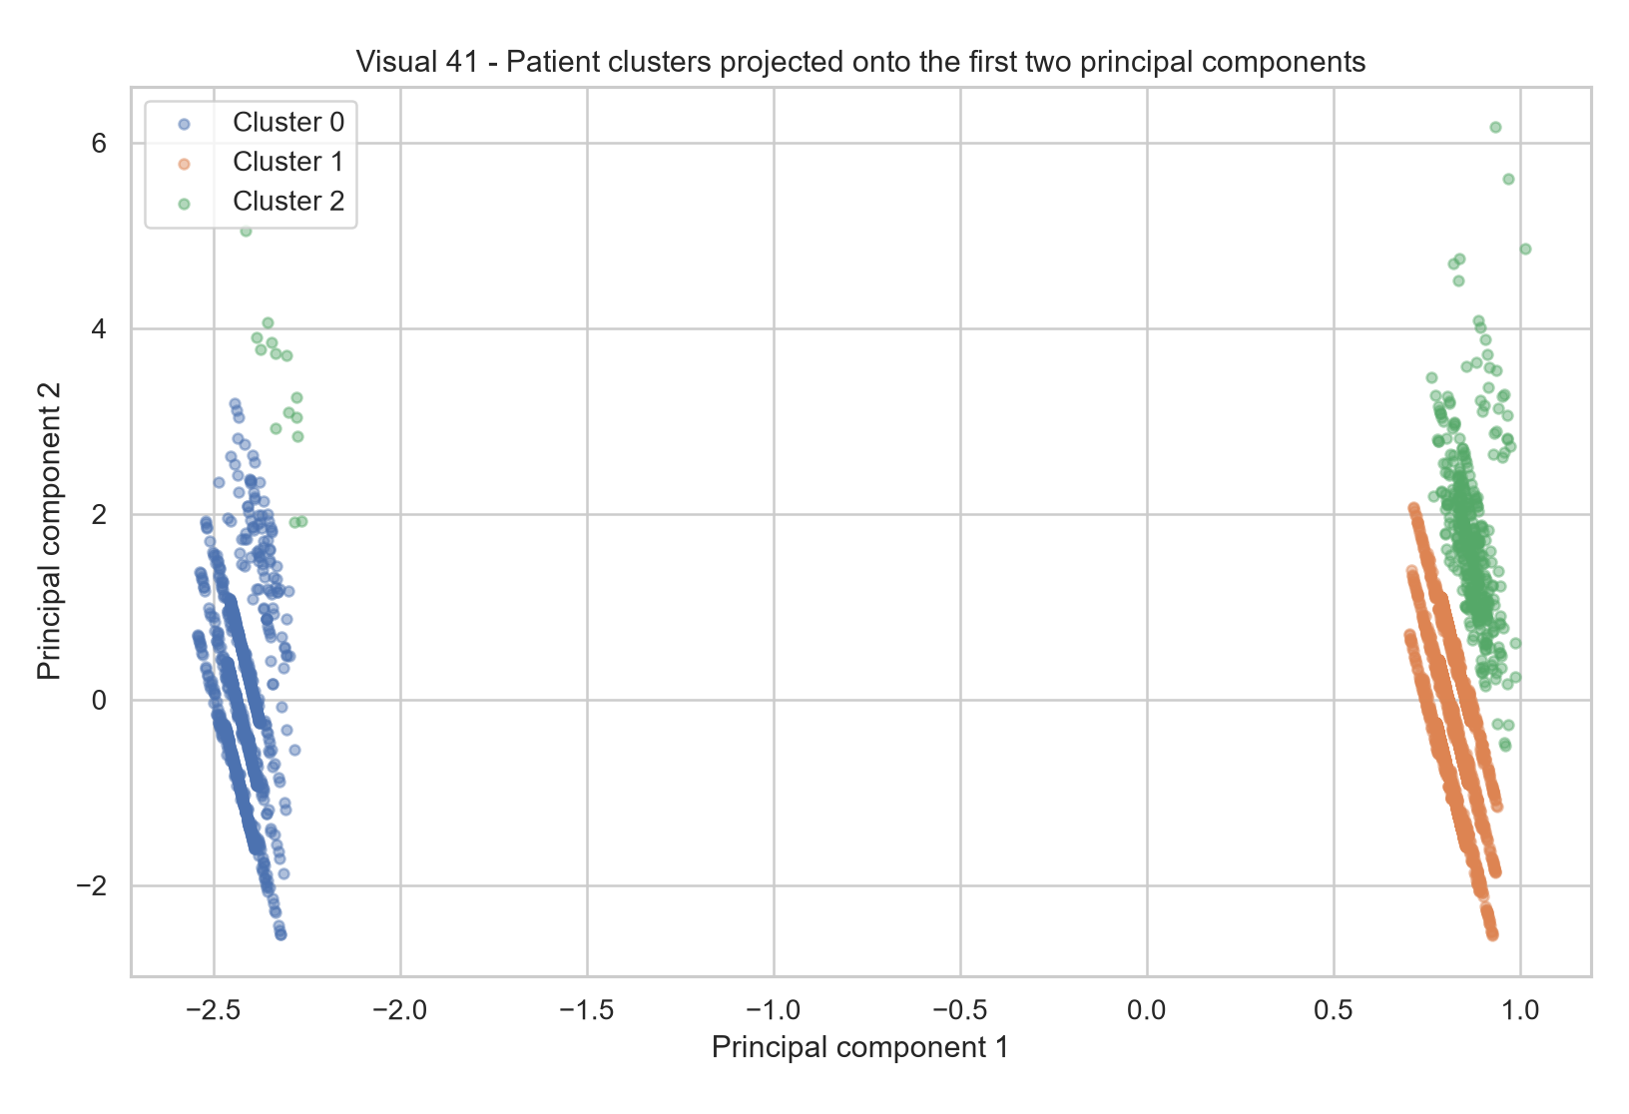
HEALTHCONNECT RWANDA | WEEK 6
Prediction and exploratory segments
0.466
Admission ROC AUC
Balanced accuracy: 0.468
0.201
Satisfaction balanced accuracy
Five rating classes
0.411
Patient clustering silhouette
Three clusters selected
Both classifiers performed poorly on held-out data and are not ready for operational decisions. Admission precision was 0.101.
Clusters support descriptive follow-up only. Do not use them to triage or label individual patients.
Dorian NJAMI | AnalystLab Africa Data Science Internship
11

Slide 12
HEALTHCONNECT RWANDA | WEEK 6
Management priorities and next steps
01
Reconcile location identifiers
02
Align invoices and payments
Assign mapping owners and publish an approved DepartmentID-to-FacilityID reference.
Define bill status rules and reconcile amount, payments, claims, and balance.
03
Improve source capture
04
Measure real capacity
Record currency, event dates, unknown clinical history, and source lineage.
Add time-stamped staff assignments, bed occupancy, and equipment availability.
05
Strengthen patient feedback
06
Build modeling evidence
Review rating themes with response coverage by department and facility.
Extend the history and validate against temporal holdouts before deployment.
First milestone: a governed, reconciled dataset with clear owners for each operational and financial metric.
Dorian NJAMI | AnalystLab Africa Data Science Internship
12

