Slide 1
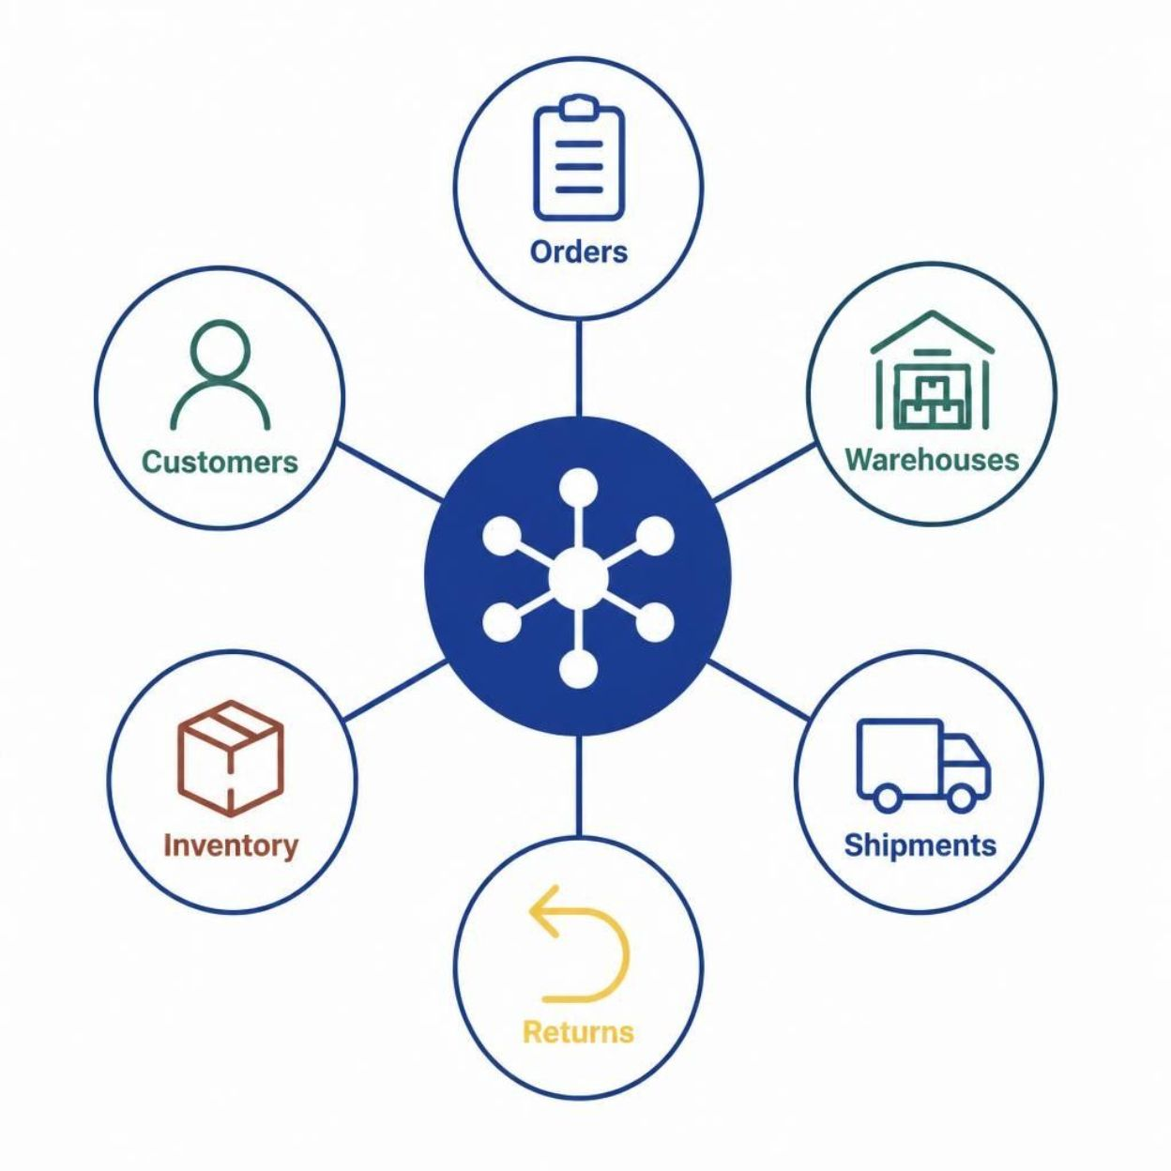
SwiftLog Logistics Limited
SwiftLog Logistics:
Supply Chain Intelligence & AI Transformation
End-to-End Analytics, Feature Engineering, and Operational Optimization
Dorian NJAMI, Certified Data Scientist
AnalystLab Africa Lab Internship · Week 5 Data Science Project
10 Integrated Relational CSV Datasets | 5,000 Orders | 1,000 Customers | 15 Warehouses

Slide 2

Executive Overview & Operational Challenges
SwiftLog manages nationwide fulfillment, inventory tracking, and customer deliveries across Nigeria. Rapid scaling caused fulfillment friction, rising order cancellations, and delivery delays.
32.5%
3.55
p = 0.0014
Order Cancellation Rate
Days Average Transit Delay
Delay-Return Correlation
1,626 / 5,000 orders
Across all hubs
Statistically significant
Integrated 10 relational tables into a Master Analytical Dataset of 287,320 merged records. Suppliers remained standalone to preserve relational integrity without synthetic data contamination.
34.3% Pending Orders
1,716 / 5,000
2

Slide 3
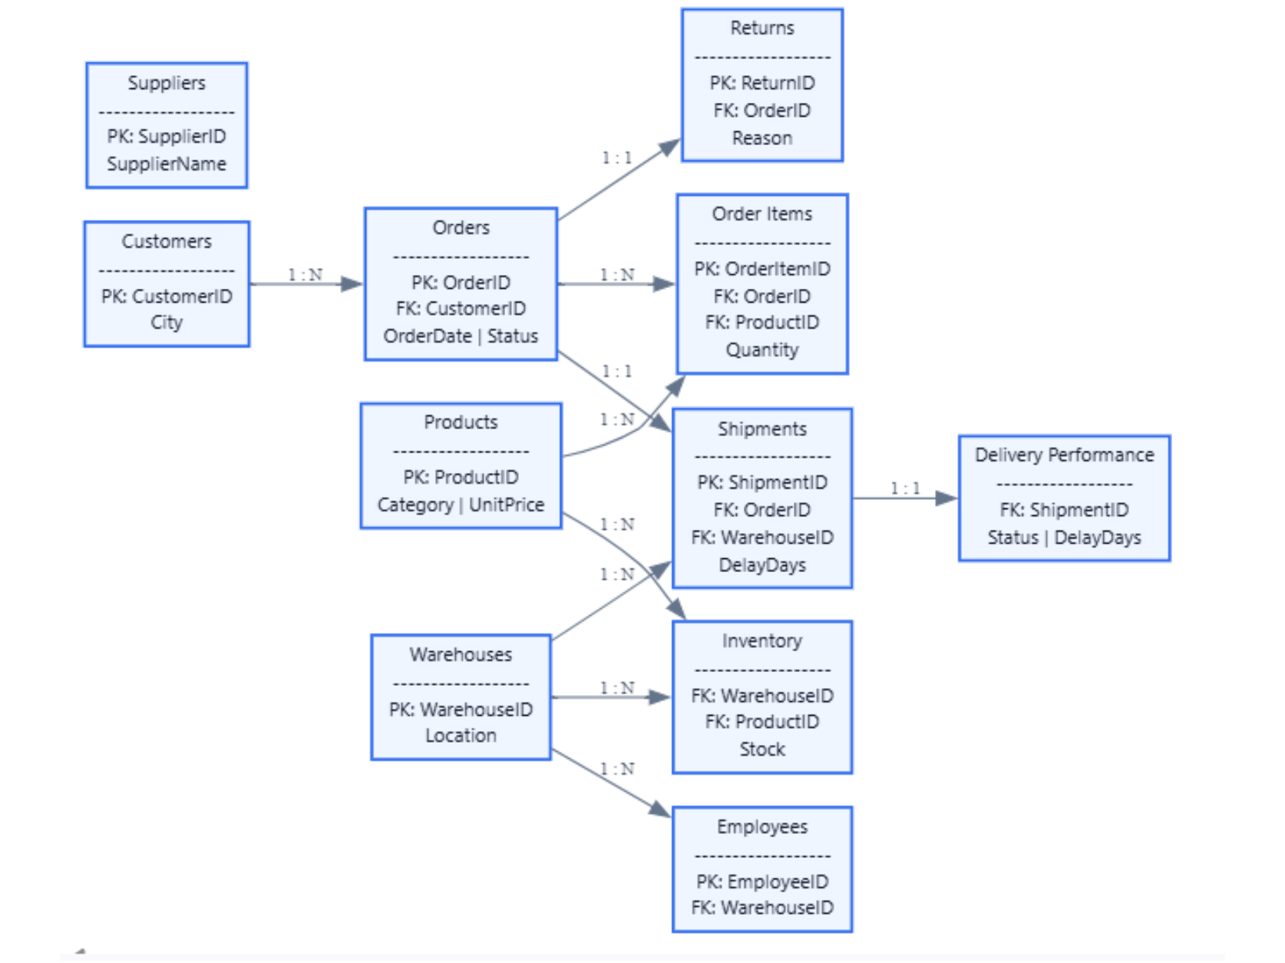
Multi-Dataset Integration & Data Cleaning Pipeline
Joined 10 operational CSVs into one unified schema: Orders, Customers, Order_Items, Products, Shipments, Delivery_Perf, Warehouses, Inventory, Employees, Returns.
Audit & sanitize
11 raw tables; 0% missingness at ingestion. 3 duplicate rows found in Inventory (sanitized).
Standardize & cap
title() and strip() across City, Category, Location, Return Reason. IQR capping on Quantity, UnitPrice, Stock, DelayDays.
Resolve left joins
Missing left-join return records imputed as “No Return”.
ERD · Orders linked to Shipments, Inventory, and Returns. Original image, unaltered.
3

Slide 4
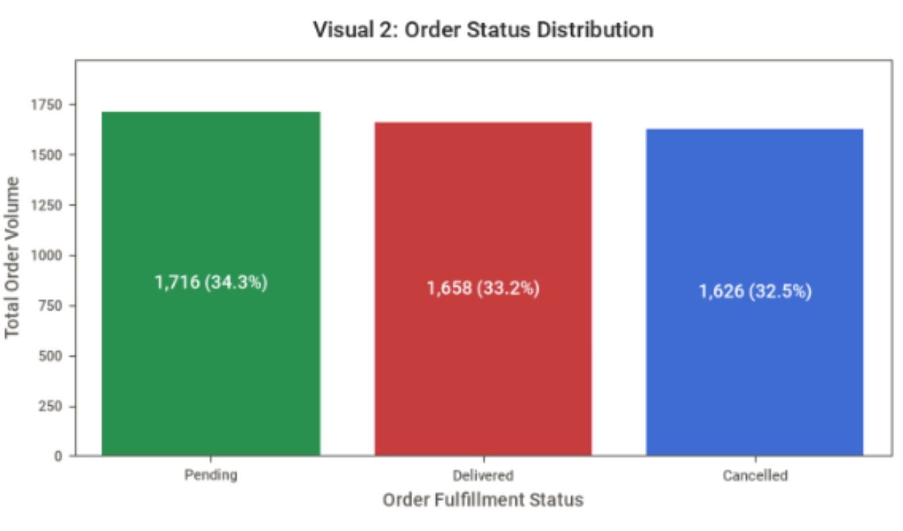
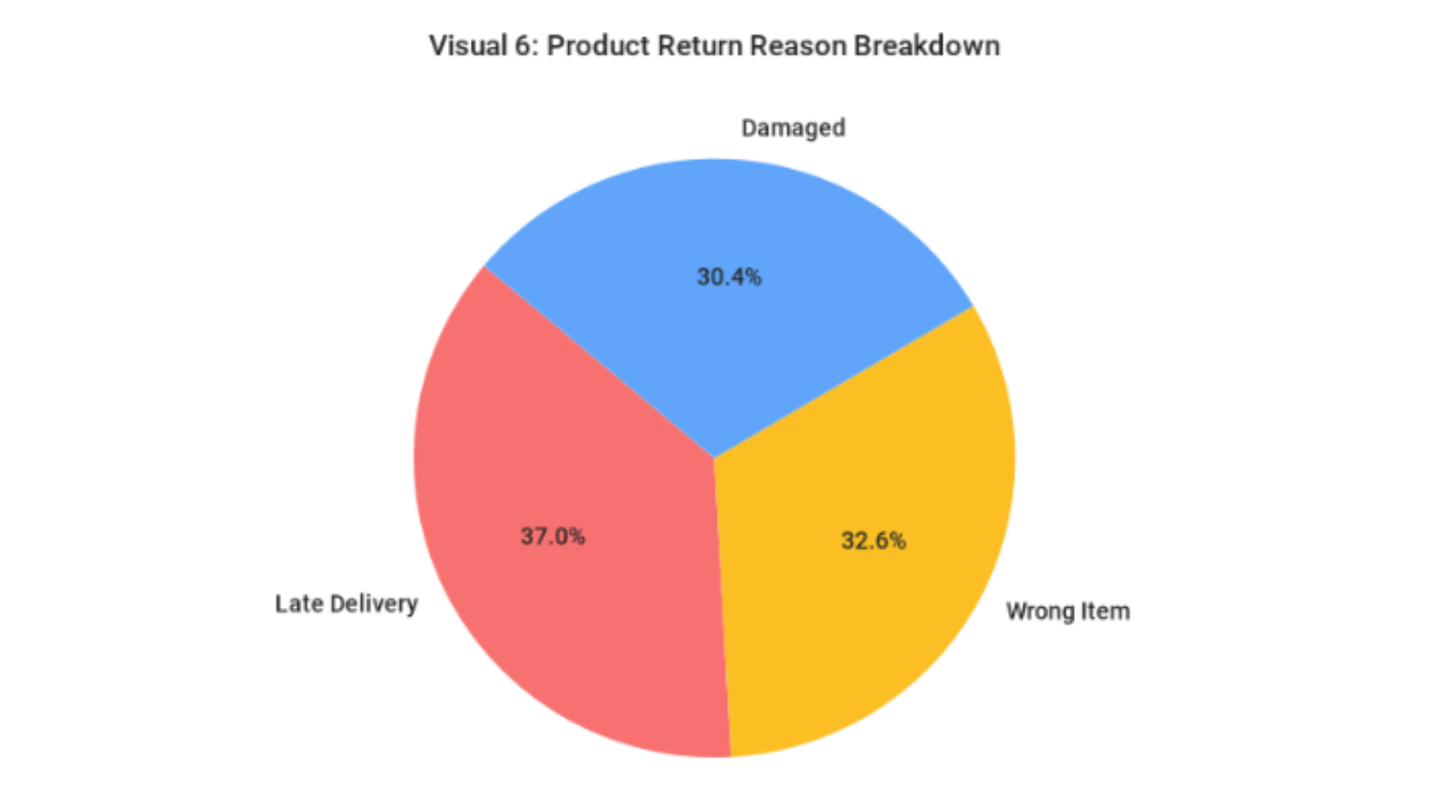
Baseline Logistics & Fulfillment Profiling
Geographic demand is evenly balanced: Ibadan (26.2%), Kano (25.3%), Lagos (24.6%), Abuja (23.9%).
Returns · Late Delivery 37.0% | Wrong Item Shipped 32.6% | Damaged Goods 30.4%
Order status · Pending 34.3% | Delivered 33.2% | Cancelled 32.5%
Over 90% of returns stem from internal operational errors: packaging, picking, and transit speed, not customer preference.
4

Slide 5
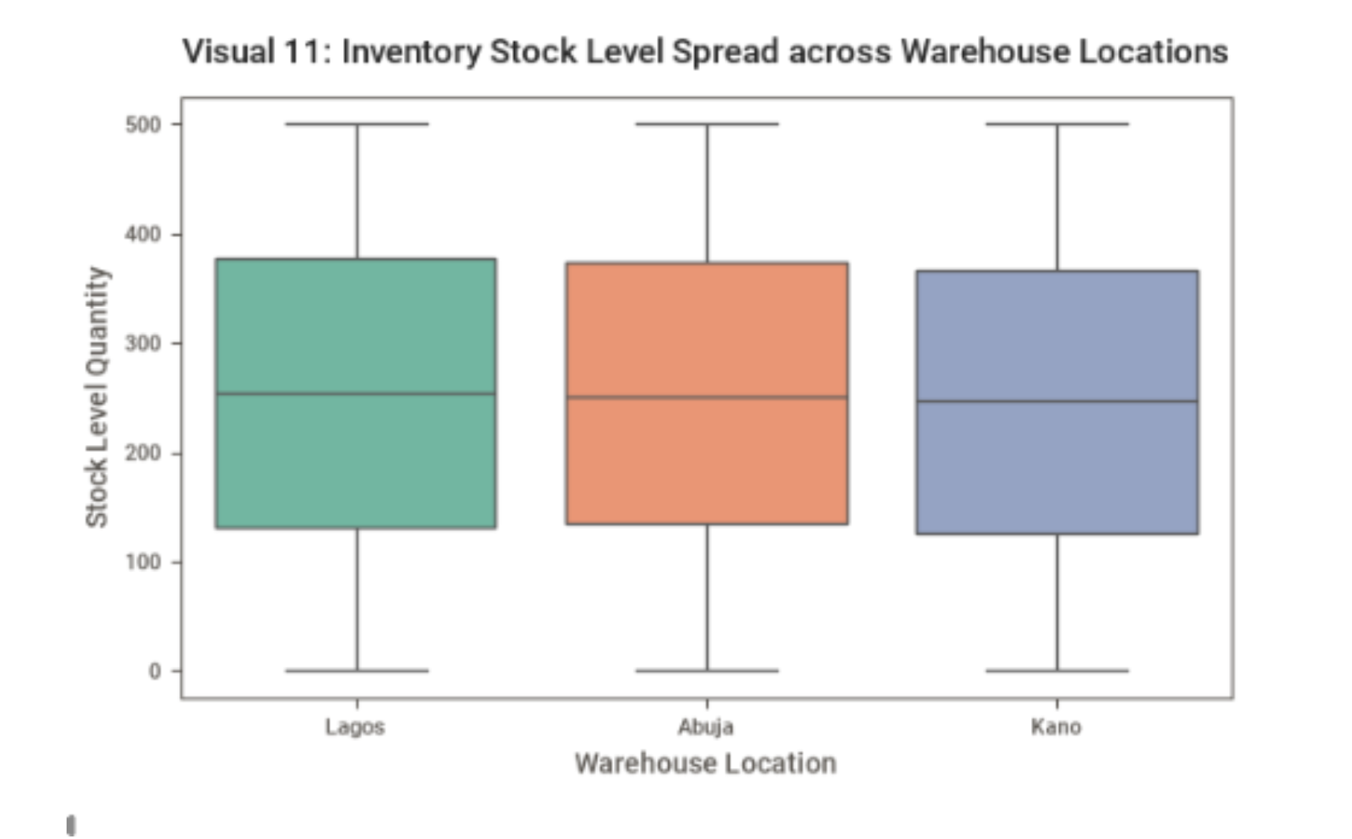
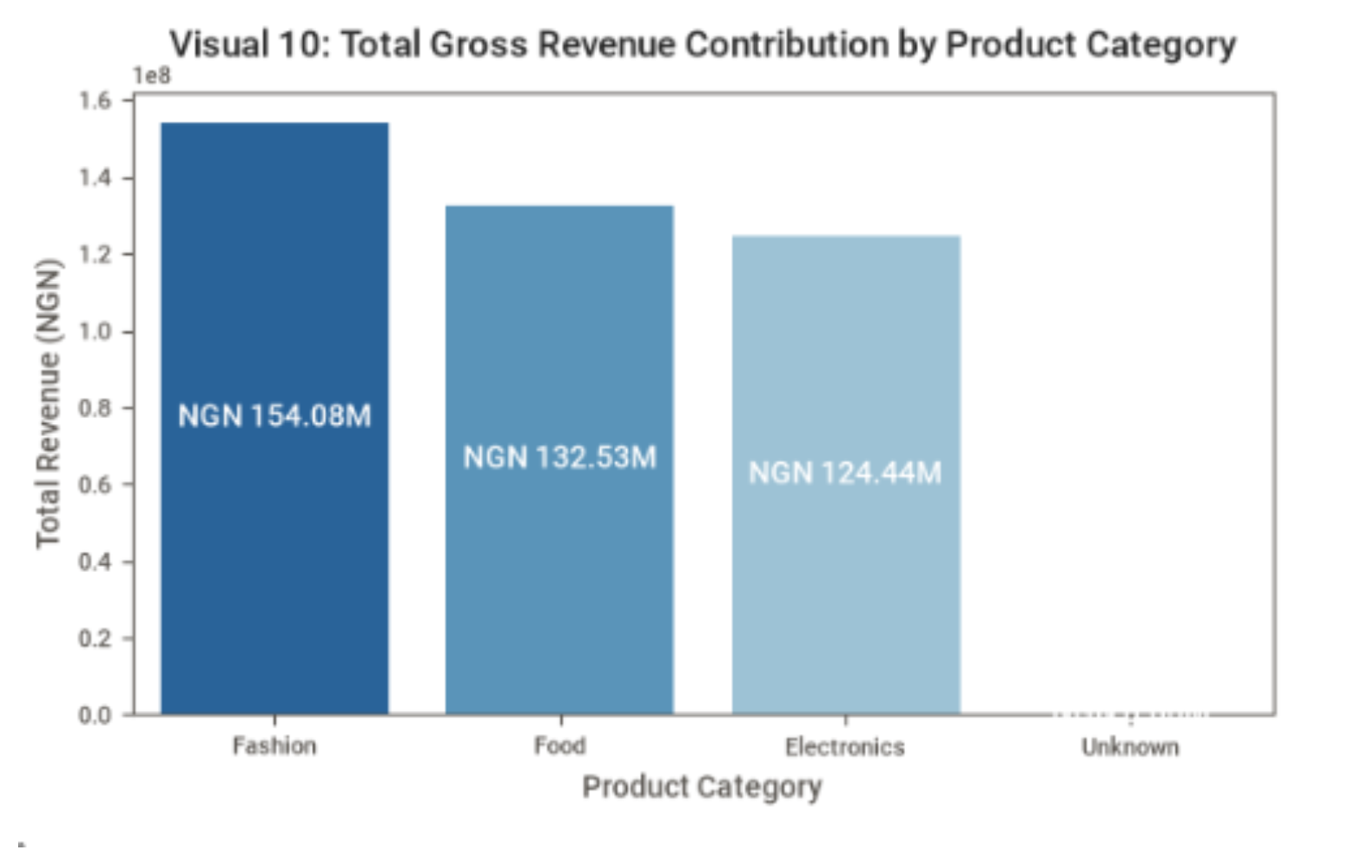
Category Revenue Contribution & Inventory Distribution
Revenue led by Fashion (NGN 154.08M), then Food (NGN 132.53M) and Electronics (NGN 124.44M).
Visual 10 · Revenue by category, unaltered
Visual 11 · Inventory across warehouses, unaltered
Product prices range from NGN 11.78 to NGN 496.61; mean NGN 260.62, median NGN 258.78.
Median inventory: 253 units per SKU-warehouse pair, from 0 (stockouts) to 500 units.
5

Slide 6
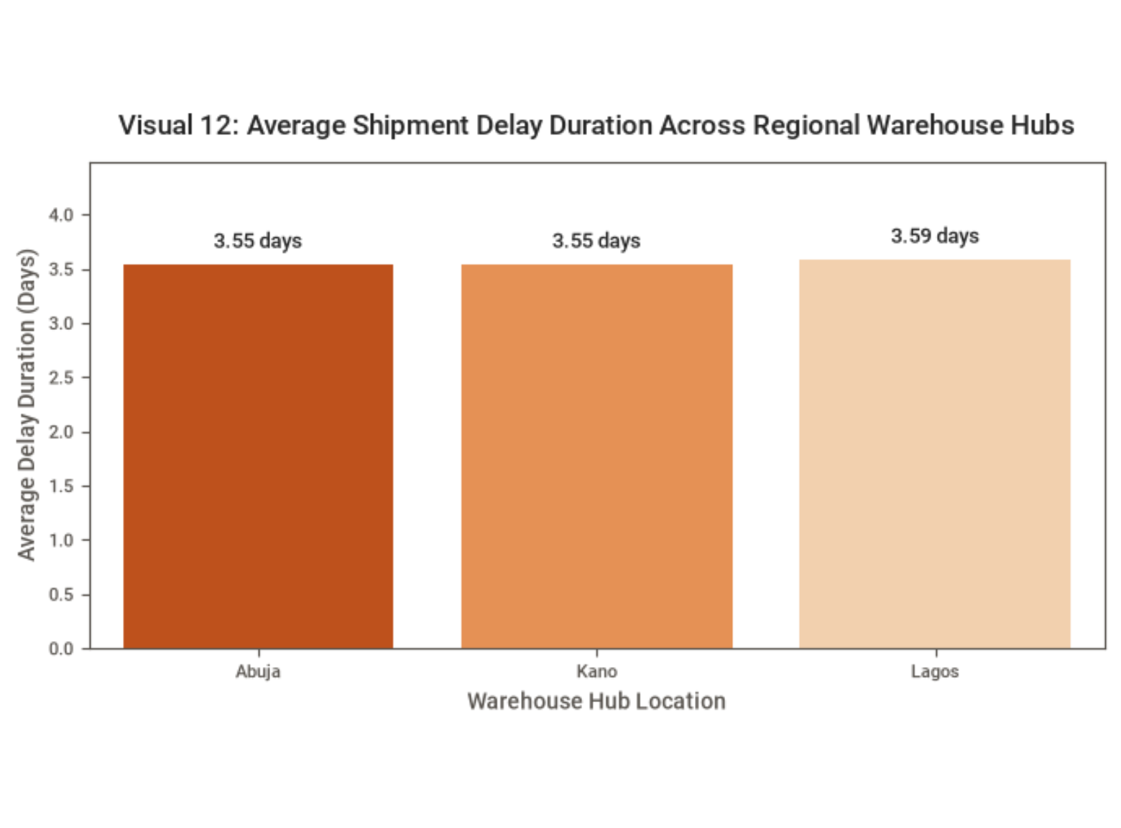
Hypothesis Testing: Facility & Regional Uniformity
H1 · Delivery across warehouses
One-Way ANOVA: F = 0.7181, p = 0.7581. Fail to reject H0: delays do not vary significantly between warehouses.
H2 · Returns across categories
Chi-Square: chi2 = 0.5452, p = 0.9089. Fail to reject H0: return frequency is independent of category.
H3 · Delays across regions
One-Way ANOVA: F = 0.2420, p = 0.7851. Fail to reject H0: Lagos 3.59 days, Abuja 3.55, Kano 3.55.
Visual 12 · Average shipment delay by regional hub, unaltered
Systemic nationwide operational friction, not isolated facility mismanagement.
6

Slide 7
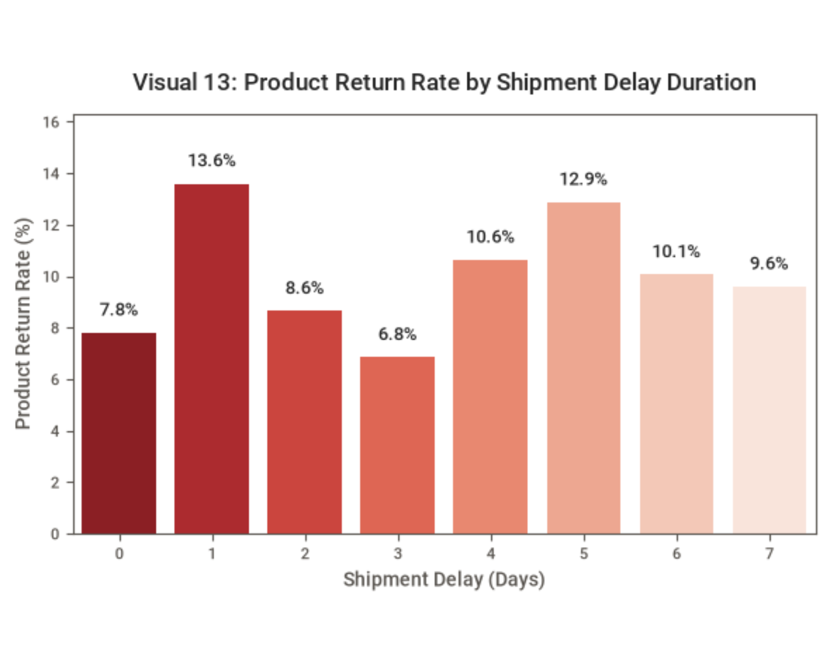
Empirical Proof: Delay-Return Causality
Key finding · H4
p = 0.001398
Delays vs returns · REJECT H0
Chi-Square: chi2 = 10.2084, df = 1; p < 0.05.
Shipment delays (DelayDays > 0) have a statistically significant positive effect on product returns.
H5 · Order status across cities
Chi-Square: chi2 = 7.1980, df = 6, p = 0.3029. Fail to reject H0: cancellations (~32.5%) are uniform across cities.
Visual 13 · Return rate by shipment delay duration, unaltered
7

Slide 8
Predictive Analytics & Feature Engineering
16 domain-specific predictive features across 4 operational domains to power Machine Learning models.
Logistics & Delivery Performance
Customer Behavioral Value
Delivery_Delay_Flag (binary delay indicator)
Delivery_Duration (3 + DelayDays)
Delivery_Efficiency_Score (100 / (1 + DelayDays))
Customer_Lifetime_Value_Est (cumulative CLV sum)
Average_Customer_Spend & Customer_Order_Frequency
Customer_Return_Frequency (normalized return rate per buyer)
Warehouse Operations & Velocity
Seasonality & Demand
Warehouse_Total_Dispatches & Warehouse_Utilisation_Rate
Inventory_Turnover_Est (Quantity / Stock)
Order_Month, Order_DayOfWeek, Is_Weekend_Order, Monthly_Demand_Trend, Seasonal_Demand_Indicator
8

Slide 9
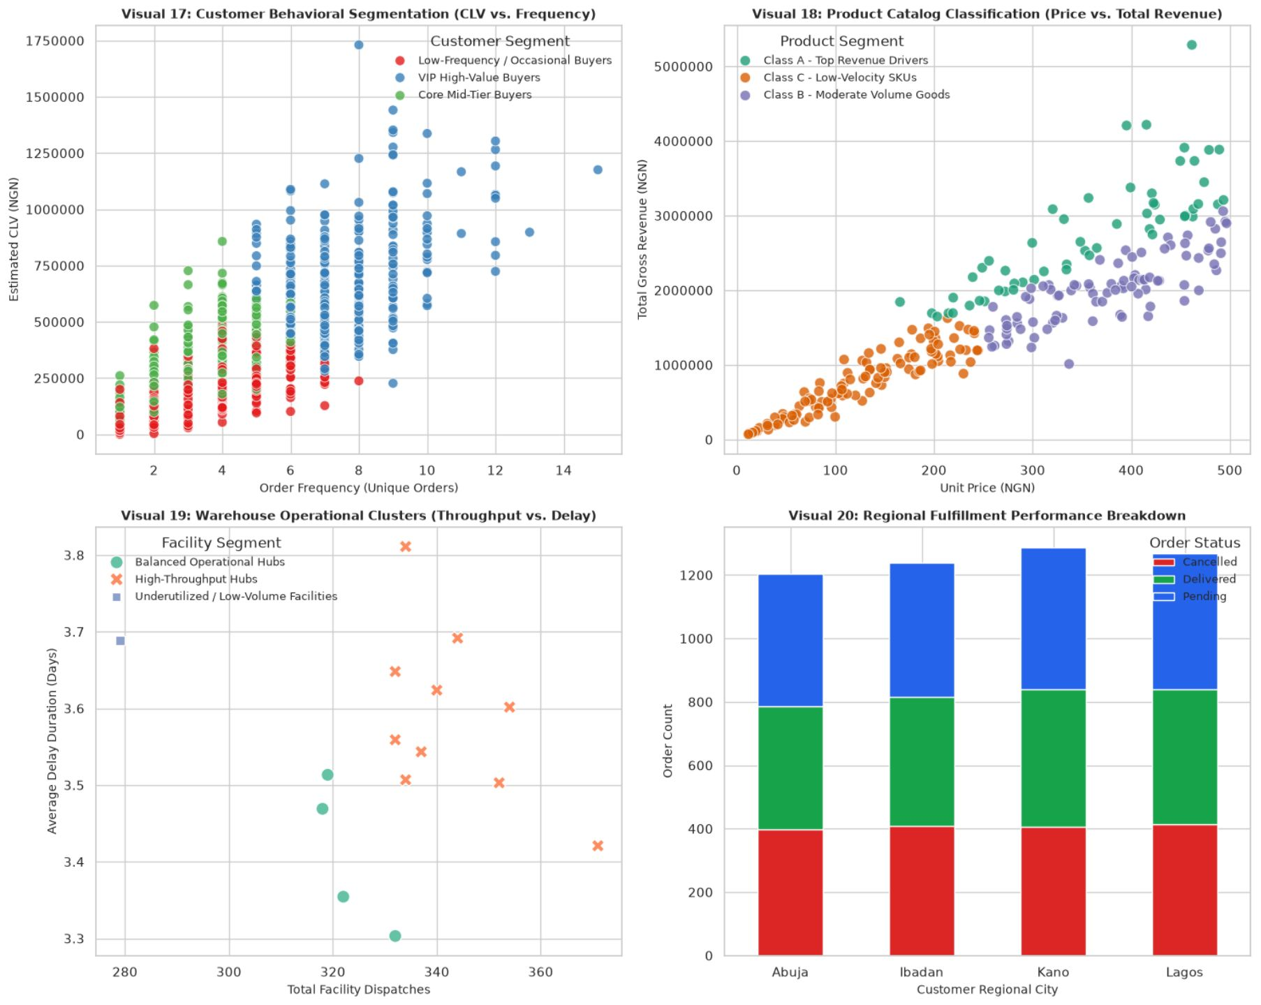
Customer, Product, & Warehouse Segmentation
Customers (1,000)
VIP High-Value Buyers (331): CLV NGN 750k–1.75M, 6–15 orders, drives >55% of revenue.
Core Mid-Tier (294): CLV NGN 400k–750k.
Low-Frequency (366): CLV < NGN 400k, 1–6 orders.
Products ABC (250 SKUs)
Class A (55): price > NGN 200, revenue up to NGN 5.3M per SKU.
Class B (87): NGN 1M–3M.
Class C (108): < NGN 1.5M.
Warehouses (15) · High-Throughput Hubs (10): 330–370 dispatches; Balanced Hubs (4); Underutilized Facility (1).
Visuals 17–18 · Customer segmentation and product classification, unaltered
9

Slide 10




Core Operational Bottlenecks Identified
Cancellation Friction
Reverse Logistics Cost Driver
32.5% cancellation rate driven by pre-dispatch delays and out-of-stock events.
Confirmed link between shipment delays and return rates (p = 0.0014).
Fulfillment Process Errors
Network-Wide Capacity Imbalance
63% of returns caused by wrong items shipped (32.6%) and damaged packaging (30.4%).
10 overloaded High-Throughput hubs with peak delays up to 3.8 days, alongside 1 underutilized facility.
10

Slide 11
Actionable Executive Recommendations
01
Automated SLA Delay Alerts
Flag dispatches exceeding 2 days in transit to reduce returns (p = 0.0014)
02
VIP Loyalty & Priority Dispatch
Expedited shipping for the 331 VIP buyers
03
Order Cancellation Mitigation
Pre-dispatch tracking surveys to reduce the 32.5% cancellation rate
04
Safety Stock Controls for Class A Items
Automated reorder triggers for the 55 top revenue SKUs
05
Standardized Protective Packaging
Eliminate the 30.4% damage return rate
06
Barcode Verification Scanning
Packing station scanners to eradicate picking errors (32.6% wrong items)
07
Workforce Rebalancing
Reallocate staff from low-volume facilities to the 10 High-Throughput hubs
08
National Logistics Infrastructure Standardization
Uniform SLAs across Lagos, Abuja, Kano, and Ibadan
09
Supplier ERP Key Integration
Map SupplierID to inventory batches for SLA enforcement
10
Predictive ML Integration
Deploy delay prediction models using Delivery_Efficiency_Score and Customer_Return_Frequency
11

Slide 12
Machine Learning Roadmap & Predictive Capabilities
01
02
03
Delay Prediction
Return Propensity Scoring
Automated Stock Forecasting
Predictive Delay Classification
Customer Return Propensity Scoring
Gradient Boosting (XGBoost/LightGBM) on Delivery_Efficiency_Score and Warehouse_Utilisation_Rate to forecast delayed dispatches before carrier handover.
Demand Forecasting & Replenishment
Logistic Regression/Random Forest to score return probability per transaction using Customer_Return_Frequency and DelayDays.
Time-Series XGBoost with Monthly_Demand_Trend and Seasonal_Demand_Indicator to adjust safety stock.
SwiftLog is fully equipped with clean, engineered master datasets ready for production Machine Learning deployment.
12

