Slide 1
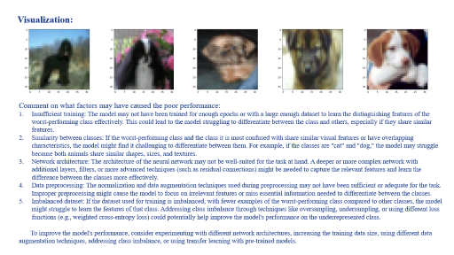

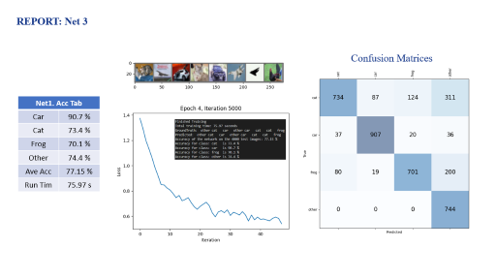
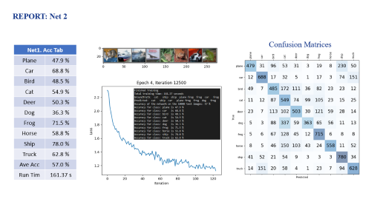
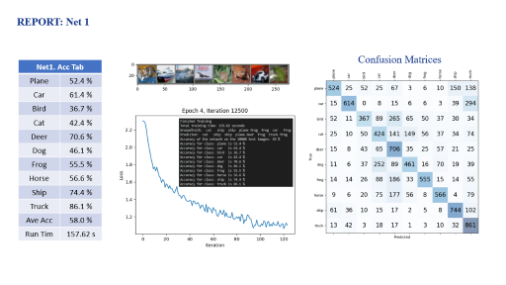
HOMEWORK 3B
ECE/CS 8690 2302 Computer Vision
$$Image Classification$$
Xuanbo Miao
14422044
xmiao@mail.missouri.edu
Abstract
This assignment addresses the enhancement of a convolutional neural network (CNN) for multi-class image classification. Challenges like poor classification performance on specific classes are analyzed using a confusion matrix. Factors affecting performance include insufficient training, similarity between classes, suboptimal network architecture, inadequate data preprocessing, and imbalanced dataset. Various techniques are suggested to improve performance, such as experimenting with network architectures, increasing training data size, applying data augmentation, addressing class imbalance, and using transfer learning. The assignment underscores the importance of understanding and optimizing factors that affect CNN performance in computer vision tasks.

Slide 2
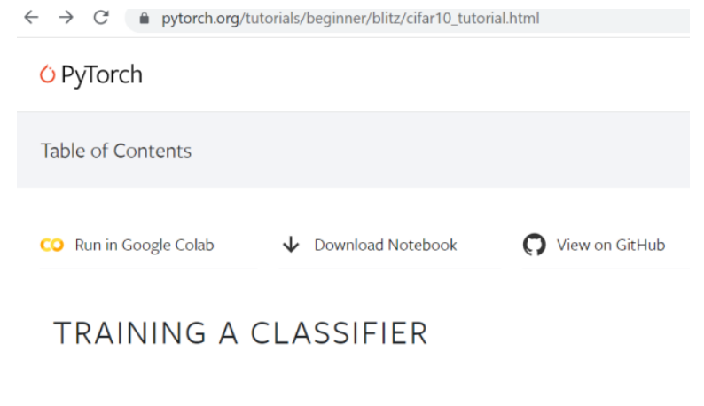
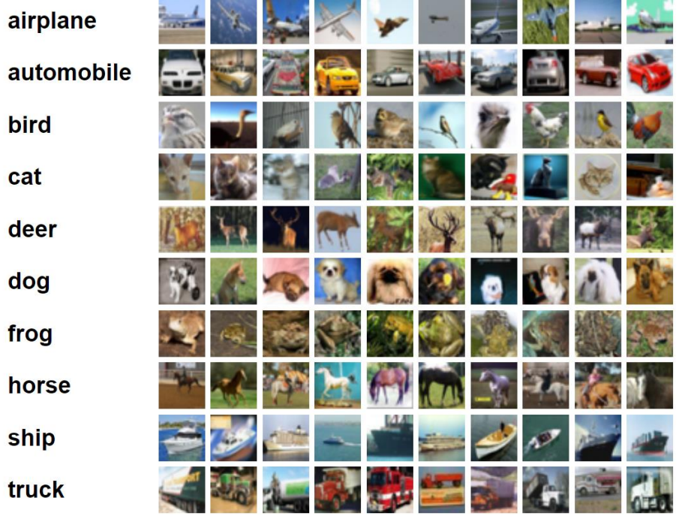
Introduction
Overview
Create, train, and test a convolutional neural network for image classification
Modify existing image classification code from PyTorch tutorial
Evaluate and compare different network architectures
Use CIFAR10 dataset for training and testing
Dataset: CIFAR10
60,000 images of 10 common classes
Image size: 32 x 32 x 3
50,000 training images and 10,000 test images
Built-in dataset in Torchvision

Slide 3
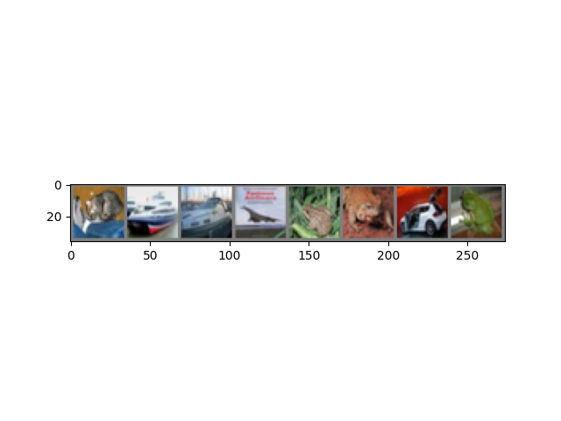
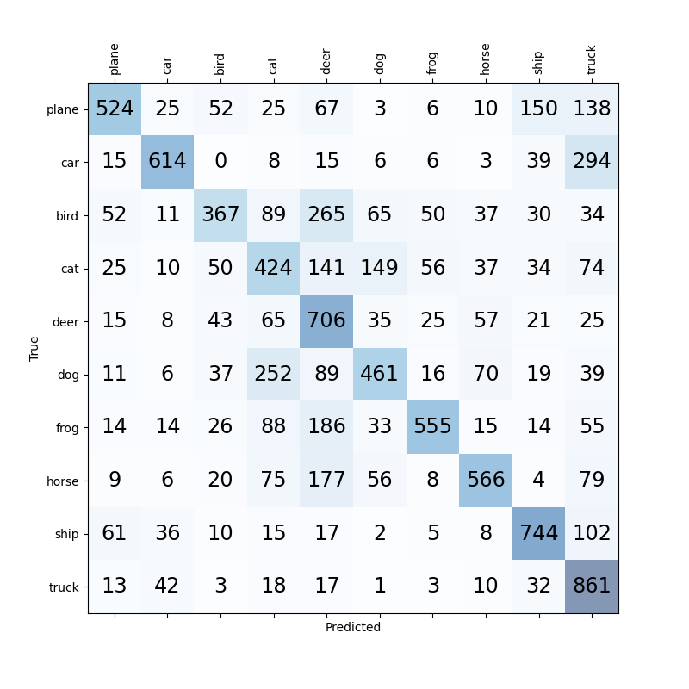
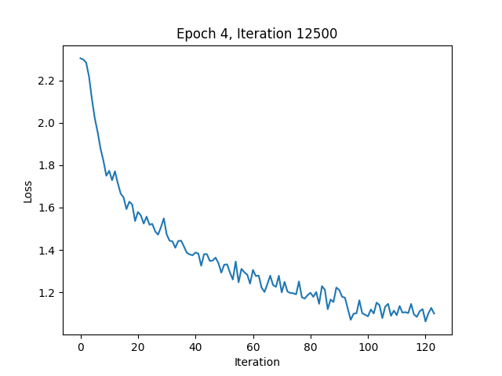
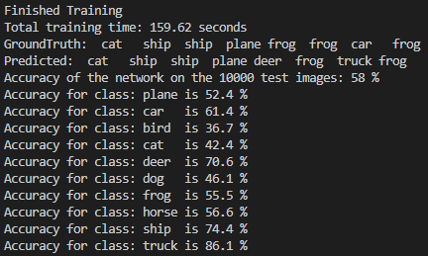
REPORT: Net 1
Confusion Matrices
Net1. Acc Tab
Plane | 52.4 %
Car | 61.4 %
Bird | 36.7 %
Cat | 42.4 %
Deer | 70.6 %
Dog | 46.1 %
Frog | 55.5 %
Horse | 56.6 %
Ship | 74.4 %
Truck | 86.1 %
Ave Acc | 58.0 %
Run Tim | 157.62 s

Slide 4
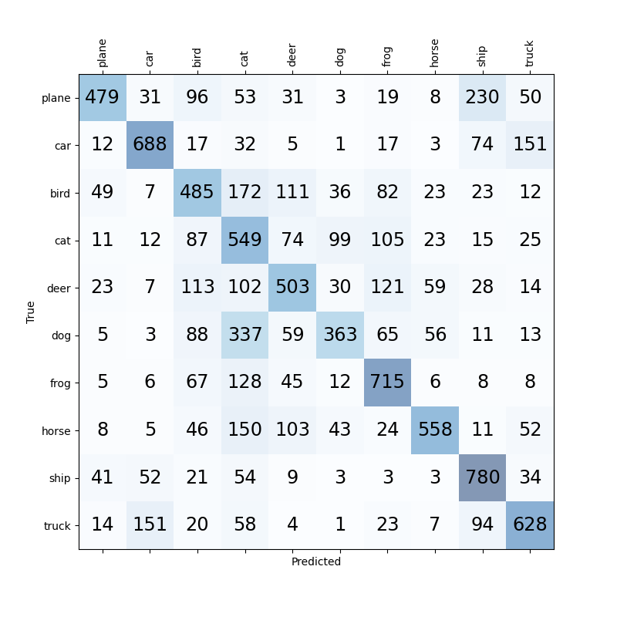
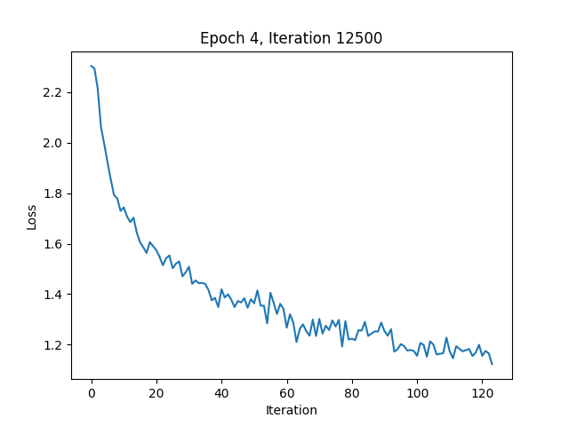
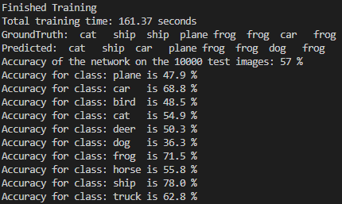
REPORT: Net 2
Confusion Matrices
Net1. Acc Tab
Plane | 47.9 %
Car | 68.8 %
Bird | 48.5 %
Cat | 54.9 %
Deer | 50.3 %
Dog | 36.3 %
Frog | 71.5 %
Horse | 58.8 %
Ship | 78.0 %
Truck | 62.8 %
Ave Acc | 57.0 %
Run Tim | 161.37 s

Slide 5
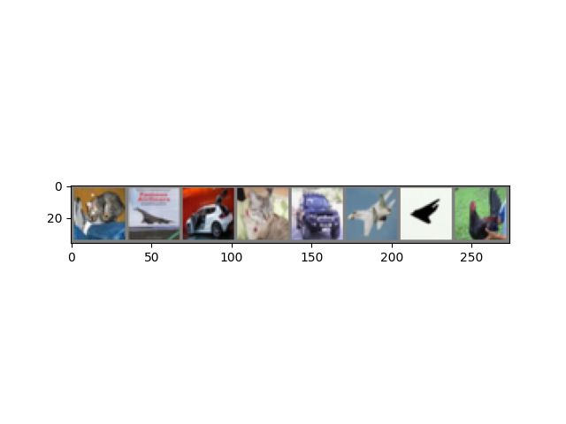
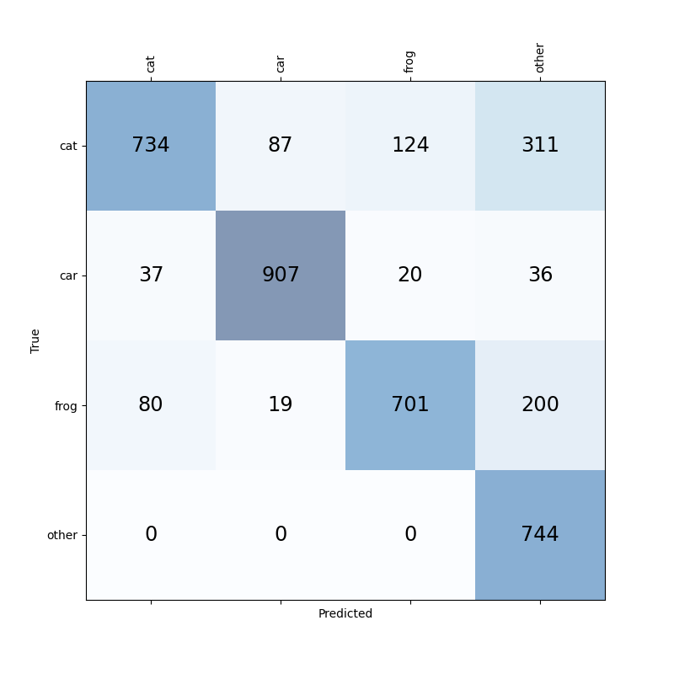
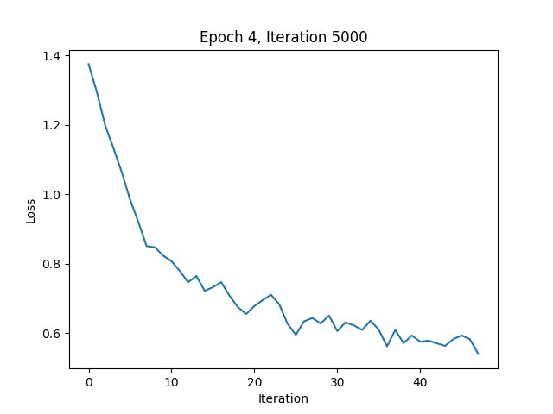
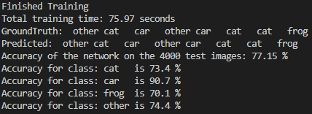
REPORT: Net 3
Confusion Matrices
Net1. Acc Tab
Car | 90.7 %
Cat | 73.4 %
Frog | 70.1 %
Other | 74.4 %
Ave Acc | 77.15 %
Run Tim | 75.97 s

Slide 6
Q & A:
Confusion Matrices
Net1. Acc Tab
Plane | 47.9 %
Car | 68.8 %
Bird | 48.5 %
Cat | 54.9 %
Deer | 50.3 %
Dog | 36.3 %
Frog | 71.5 %
Horse | 58.8 %
Ship | 78.0 %
Truck | 62.8 %
Ave Acc | 57.0 %
Run Tim | 161.37 s
1. 10-class classification: for the class on which your model (Network 2) has the worst accuracy?
Dog
2. what is the other class it is most confused with?
Cat

Slide 7
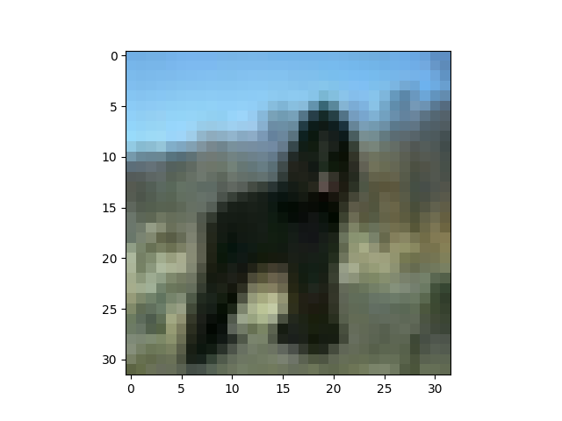
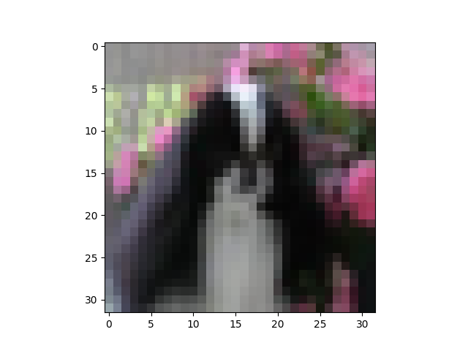
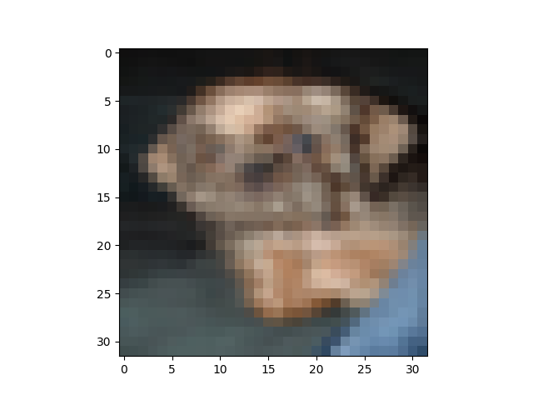
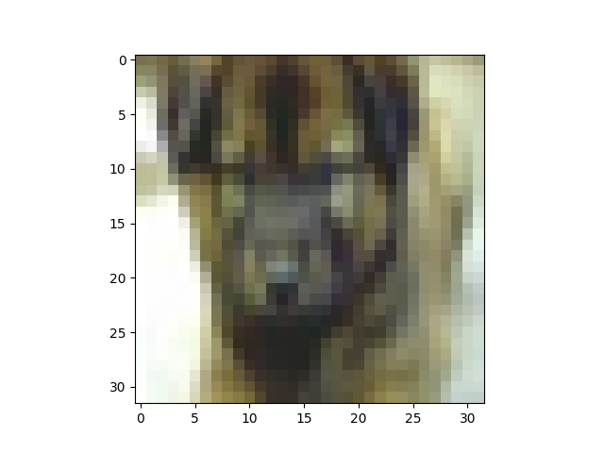
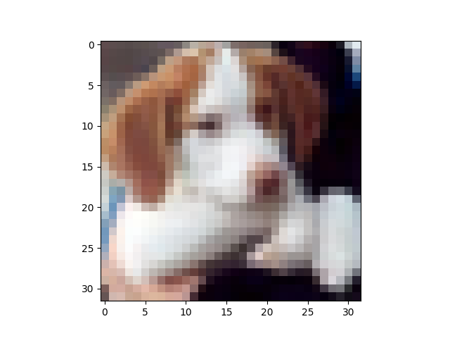
Visualization:
Comment on what factors may have caused the poor performance:
Insufficient training: The model may not have been trained for enough epochs or with a large enough dataset to learn the distinguishing features of the worst-performing class effectively. This could lead to the model struggling to differentiate between the class and others, especially if they share similar features.
Similarity between classes: If the worst-performing class and the class it is most confused with share similar visual features or have overlapping characteristics, the model might find it challenging to differentiate between them. For example, if the classes are "cat" and "dog," the model may struggle because both animals share similar shapes, sizes, and textures.
Network architecture: The architecture of the neural network may not be well-suited for the task at hand. A deeper or more complex network with additional layers, filters, or more advanced techniques (such as residual connections) might be needed to capture the relevant features and learn the difference between the classes more effectively.
Data preprocessing: The normalization and data augmentation techniques used during preprocessing may not have been sufficient or adequate for the task. Improper preprocessing might cause the model to focus on irrelevant features or miss essential information needed to differentiate between the classes.
Imbalanced dataset: If the dataset used for training is imbalanced, with fewer examples of the worst-performing class compared to other classes, the model might struggle to learn the features of that class. Addressing class imbalance through techniques like oversampling, undersampling, or using different loss functions (e.g., weighted cross-entropy loss) could potentially help improve the model's performance on the underrepresented class.
To improve the model's performance, consider experimenting with different network architectures, increasing the training data size, using different data augmentation techniques, addressing class imbalance, or using transfer learning with pre-trained models.

Slide 8
Interpretation & Discussion
This assignment aimed to implement a computer vision model, likely a convolutional neural network (CNN), to perform image classification on a given dataset. The goal was to train the model to learn the features of the images and correctly classify them into their respective classes.
Objectives: 1. Understand the dataset: It is crucial to explore and analyze the dataset to get an idea of the distribution of classes, the variety of images, and any potential class imbalance. This step helps determine the appropriate preprocessing techniques, data augmentation strategies, and network architectures; 2. Preprocess the data: The dataset needs to be preprocessed, including resizing, normalization, and data augmentation, to improve the model's ability to learn the features and generalize better; 3. Implement the model: Design and implement a suitable CNN architecture for image classification. The model should be able to learn the distinguishing features of the different classes and classify images with reasonable accuracy; 4. Train and evaluate the model: Train the model using an appropriate loss function and optimization algorithm. Evaluate the model's performance using relevant metrics, such as accuracy, precision, recall, and F1-score. A confusion matrix can also be used to identify the classes that the model struggles with the most.
Challenges: 1. Choosing the right network architecture: Designing an optimal CNN architecture for the task can be challenging. It requires experimenting with different layer types, depth, and activation functions; 2. Dealing with class imbalance: If the dataset is imbalanced, the model might struggle to learn the features of underrepresented classes. Techniques like oversampling, undersampling, or using different loss functions can help address this issue; 3. Handling similar classes: If certain classes share similar visual features, the model might have difficulties differentiating between them.
Potential Improvements: 2. Experiment with different network architectures: Try deeper or more complex networks, or use pre-trained models via transfer learning to improve the model's performance; 2.Use advanced techniques: Implement advanced techniques like residual connections, batch normalization, or dropout to enhance the model's ability to generalize; 3. Address class imbalance: Experiment with techniques like oversampling, undersampling, or using different loss functions to improve the model's performance on underrepresented classes; 4. Optimize hyperparameters: Perform hyperparameter tuning, such as adjusting the learning rate, batch size, and number of epochs, to find the best combination that maximizes the model's performance.
In conclusion, this assignment provided valuable experience in implementing and evaluating a computer vision model for image classification. By addressing the challenges and implementing potential improvements, the model's performance can be further enhanced, paving the way for more accurate and robust image classification solutions.

