Slide 1
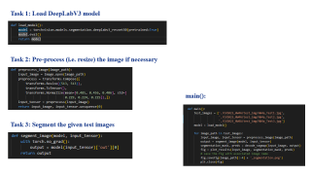
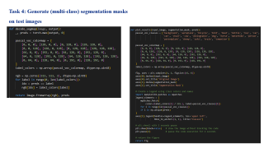
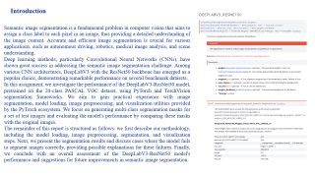
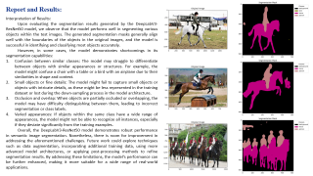

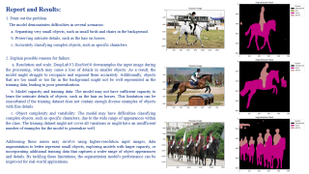


HOMEWORK 4A
ECE/CS 8690 2302 Computer Vision
$$Semantic Segmentation using$$
$$Pre−trained Deep Learning Networks$$
Xuanbo Miao
14422044
xmiao@mail.missouri.edu
Abstract
This assignment evaluates the performance of the DeepLabV3-ResNet50 model, a state-of-the-art semantic image segmentation network, on a set of test images. Using PyTorch and TorchVision segmentation frameworks, we preprocess input images, segment them, and visualize the results. We assess the model's performance by comparing generated masks with original images, and discuss potential reasons for incorrect segmentation, such as insufficient training data, class imbalance, occlusion, object variability, and image quality. Our findings provide insights into the strengths and weaknesses of the DeepLabV3 model for semantic image segmentation and suggest directions for future improvements.

Slide 2
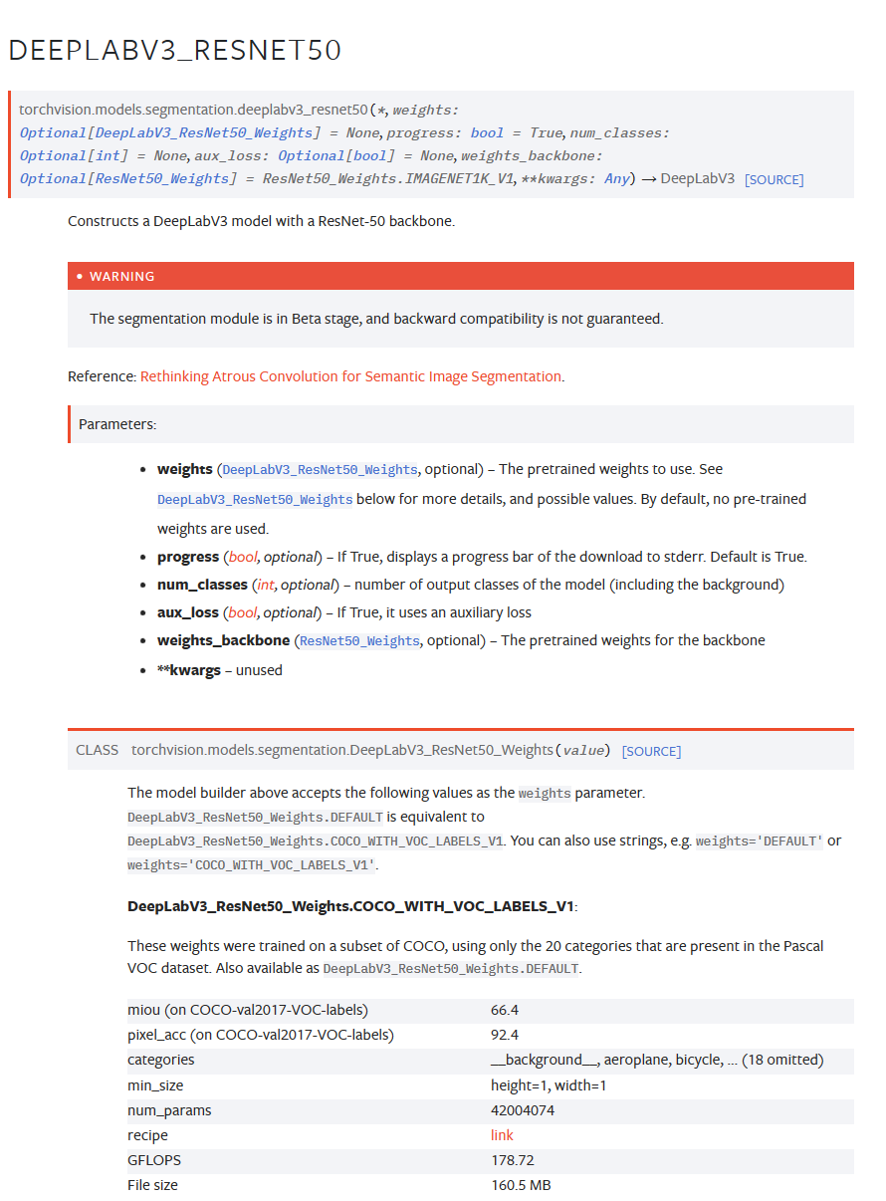
Introduction
Semantic image segmentation is a fundamental problem in computer vision that aims to assign a class label to each pixel in an image, thus providing a detailed understanding of the image content. Accurate and efficient image segmentation is crucial for various applications, such as autonomous driving, robotics, medical image analysis, and scene understanding.
Deep learning methods, particularly Convolutional Neural Networks (CNNs), have shown great success in addressing the semantic image segmentation challenge. Among various CNN architectures, DeepLabV3 with the ResNet50 backbone has emerged as a popular choice, demonstrating remarkable performance on several benchmark datasets.
In this assignment, we investigate the performance of the DeepLabV3-ResNet50 model, pretrained on the 20-class PASCAL VOC dataset, using PyTorch and TorchVision segmentation frameworks. We aim to gain practical experience with image segmentation, model loading, image preprocessing, and visualization utilities provided by the PyTorch ecosystem. We focus on generating multi-class segmentation masks for a set of test images and evaluating the model's performance by comparing these masks with the original images.
The remainder of this report is structured as follows: we first describe our methodology, including the model loading, image preprocessing, segmentation, and visualization steps. Next, we present the segmentation results and discuss cases where the model fails to segment images correctly, providing possible explanations for these failures. Finally, we conclude with an overall assessment of the DeepLabV3-ResNet50 model's performance and suggestions for future improvements in semantic image segmentation.

Slide 3

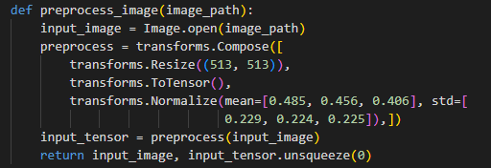
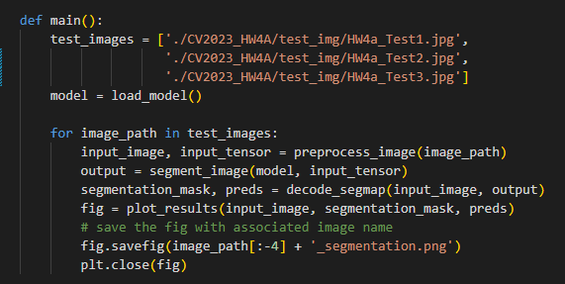

Task 1: Load DeepLabV3 model
Task 2: Pre-process (i.e. resize) the image if necessary
main():
Task 3: Segment the given test images

Slide 4
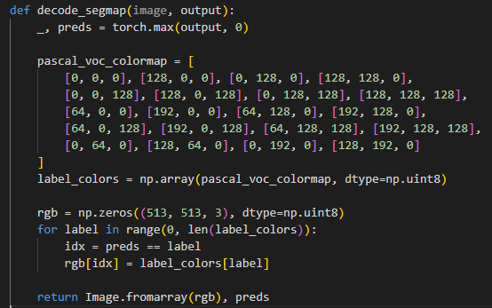
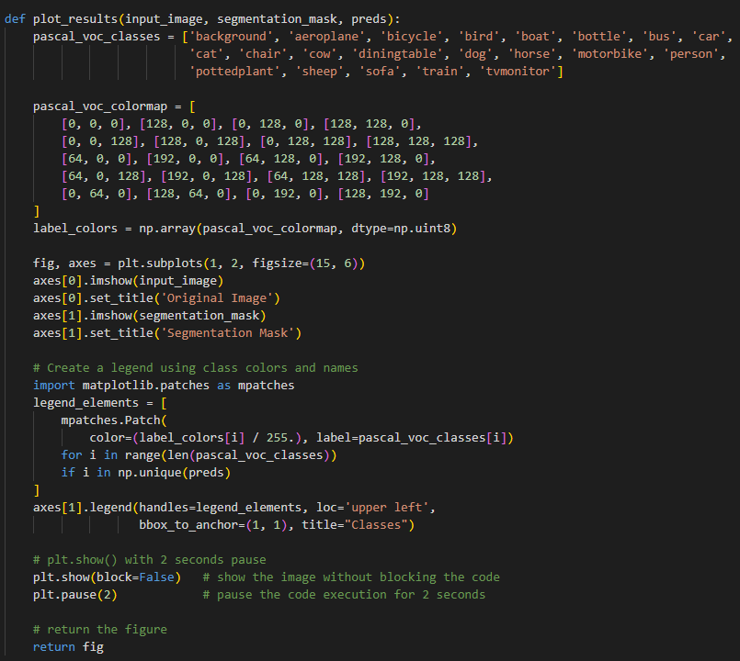
Task 4: Generate (multi-class) segmentation masks on test images

Slide 5
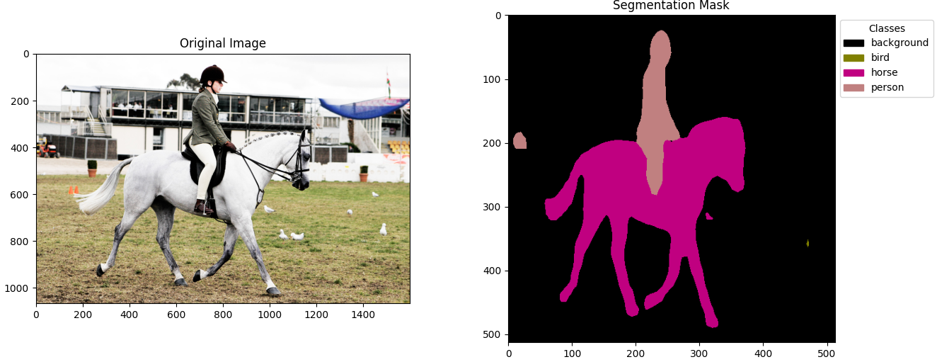
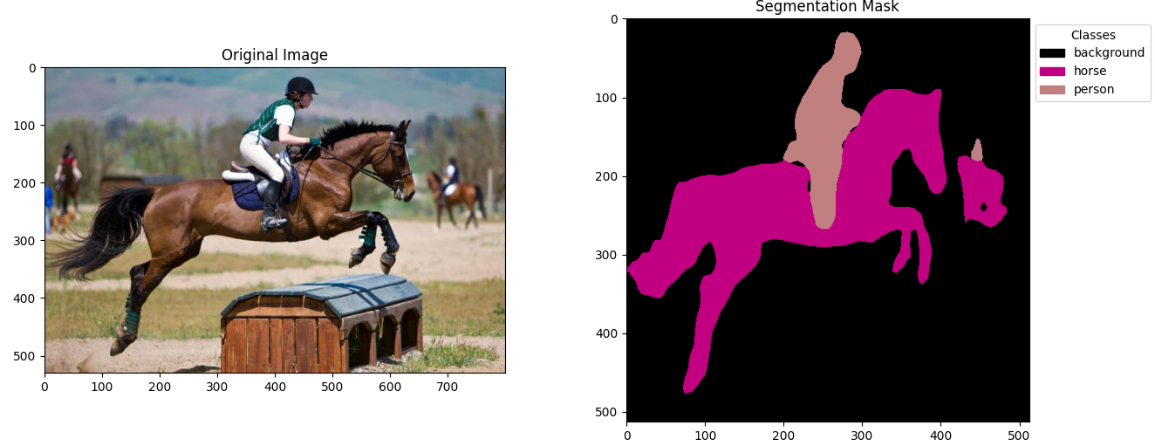
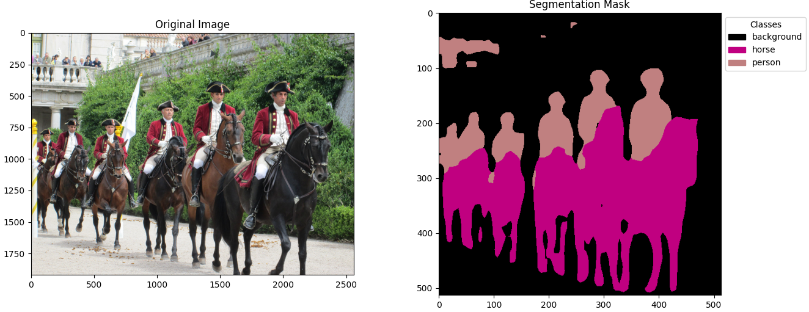
Report and Results:
1. Point out the problem:
The model demonstrates difficulties in several scenarios:
a. Separating very small objects, such as small birds and chairs in the background.
b. Preserving intricate details, such as the hair on horses.
c. Accurately classifying complex objects, such as specific characters.
2. Explain possible reasons for failure:
a. Resolution and scale: DeepLabV3-ResNet50 downsamples the input image during the processing, which may cause a loss of details in smaller objects. As a result, the model might struggle to recognize and segment them accurately. Additionally, objects that are too small or too far in the background might not be well represented in the training data, leading to poor generalization.
b. Model capacity and training data: The model may not have sufficient capacity to learn the intricate details of objects, such as the hair on horses. This limitation can be exacerbated if the training dataset does not contain enough diverse examples of objects with fine details.
c. Object complexity and variability: The model may have difficulties classifying complex objects, such as specific characters, due to the wide range of appearances within the class. The training dataset might not cover all variations or might have an insufficient number of examples for the model to generalize well.
Addressing these issues may involve using higher-resolution input images, data augmentation to better represent small objects, exploring models with larger capacity, or incorporating additional training data that captures a wider range of object appearances and details. By tackling these limitations, the segmentation model's performance can be improved for real-world applications.

Slide 6
Report and Results:
Interpretation of Results:
Upon evaluating the segmentation results generated by the DeepLabV3-ResNet50 model, we observe that the model performs well in segmenting various objects within the test images. The generated segmentation masks generally align well with the boundaries of the objects in the original images, and the model is successful in identifying and classifying most objects accurately.
However, in some cases, the model demonstrates shortcomings in its segmentation capabilities:
Confusion between similar classes: The model may struggle to differentiate between objects with similar appearances or structures. For example, the model might confuse a chair with a table or a bird with an airplane due to their similarities in shape and context.
Small objects or fine details: The model might fail to capture small objects or objects with intricate details, as these might be less represented in the training dataset or lost during the down-sampling process in the model architecture.
Occlusion and overlap: When objects are partially occluded or overlapping, the model may have difficulty distinguishing between them, leading to incorrect segmentation or class labels.
Varied appearances: If objects within the same class have a wide range of appearances, the model might not be able to recognize all instances, especially if they deviate significantly from the training examples.
Overall, the DeepLabV3-ResNet50 model demonstrates robust performance in semantic image segmentation. Nonetheless, there is room for improvement in addressing the aforementioned challenges. Future work could explore techniques such as data augmentation, incorporating additional training data, using more advanced model architectures, or applying post-processing methods to refine segmentation results. By addressing these limitations, the model's performance can be further enhanced, making it more suitable for a wide range of real-world applications.

