Slide 1
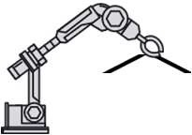

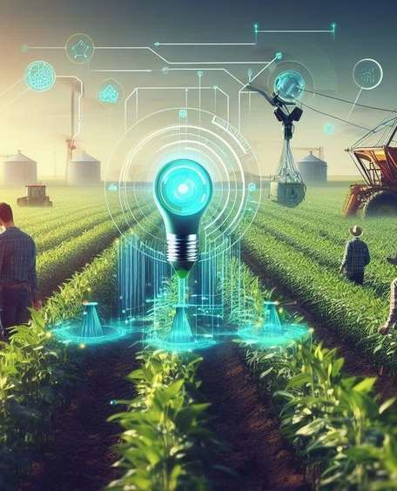
DJSCE
IETE-iSF
Revolutionizing Agriculture with IoT
Presented By: Team LOLLogic
Harsh Doshi (EXTC TE)
Shubham Bhimavat (EXTC TE)
Shreya Pathak (EXTC TE)
Khushi Dalal (CSE-IOT TE)

Slide 2
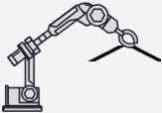

Introduction
DJSCE
IETE-iSF
Problem Statement:
Traditionally, farmers rely on experience and limited information to make crucial decisions, leading to uncertain harvests and potential losses. This lack of data-driven insights hinders optimal resource allocation and risk management, creating a significant challenge for sustainable and profitable agriculture.

Slide 3
Addressing Agricultural Challenges
DJSCE
IETE-iSF
Erratic weather: Climate volatility cripples farmers' ability to choose the right crops, leading to unpredictable harvests and financial instability.
Blind decision-making: Lack of regular data-driven insights forces farmers and companies to gamble decisions, jeopardizing their livelihoods.
Financial hardship: Affordability & access gaps leave small companies & farmers behind, hampering progress despite available solutions
Lack of user-friendly tools: Many tools present a significant technical barrier, discouraging use by farmers and companies

Slide 4
Our IoT-Based Agriculture Solution
DJSCE
IETE-iSF
Solution:
This solution deploys a sensor network to capture real-time, multi-parameter data. This data stream feeds a machine learning model, predicting crop health and yield accurately. No need for technical expertise - you get clear, actionable insights to optimize decisions and maximize yield, while minimizing risk.

Slide 5
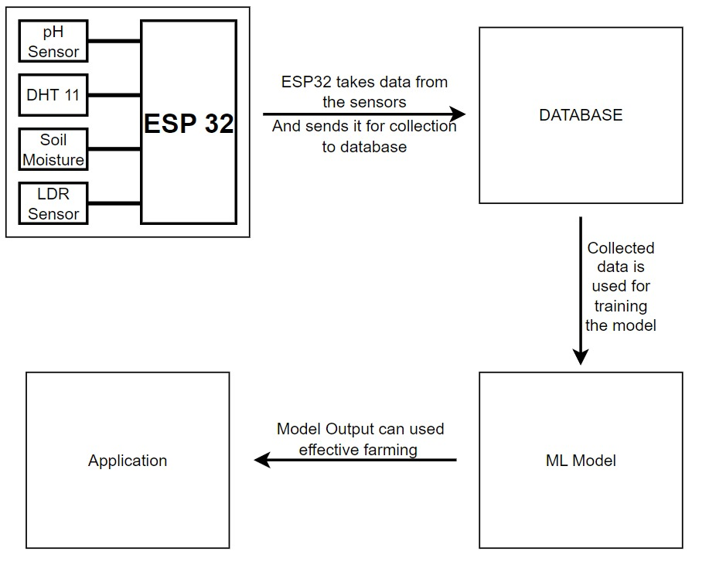
System Architecture:
DJSCE
IETE-iSF
Array of Sensors gather data,
Feeding a secure database.
A trained ML model analyzes it and predicts future yeilds.
Data visualizations to the User Device.
Array of Sensors gather data,
Feeding a secure database.
A trained ML model analyzes it and predicts future yeilds.
Data visualizations to the User Device.

Slide 6
Key Components:
DJSCE
IETE-iSF
Sensors: Temperature sensor, pH sensor, soil moisture sensor, light sensor,
Other Resources used:
Datasets: Kaggle/Roboflow
Machine Learning & Modeling: TensorFlow,PyTorch on Google Colab
User interface: Blynk or Arduino IOT Cloud

Slide 7
Data Analytics:
DJSCE
IETE-iSF
A network of sensors collects real-time data on various parameters.
This information then flows into a centralized database, carefully organized and readily accessible.
A powerful machine learning model, honed on historical data, analyzes the fresh input, generating accurate predictions for crop yield and lifespan.
These valuable insights are translated into intuitive data visualizations, empowering farmers to make informed decisions.

Slide 8
Transforming Farming Practices:
DJSCE
IETE-iSF
Our innovative solution unlocks the power of actionable data, empowering the next generation to navigate challenges and cultivate sustainable harvests for generations to come. A future where farmers utilize powerful insights to optimize decision-making, minimize risk, and ensure long-term agricultural resilience.

