Slide 1
Untitled
wilfried Dossou-Yovo

Slide 2
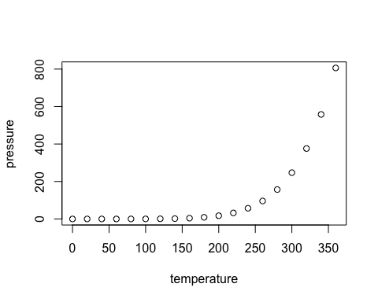
R Markdown
This is an R Markdown presentation. Markdown is a simple formatting syntax for authoring HTML, PDF, and MS Word documents. For more details on using R Markdown see http://rmarkdown.rstudio.com.
When you click the Knit button a document will be generated that includes both content as well as the output of any embedded R code chunks within the document.
Slide with Bullets
Bullet 1
Bullet 2
Bullet 3
Slide with R Output
summary(cars)
## speed dist ## Min. : 4.0 Min. : 2.00 ## 1st Qu.:12.0 1st Qu.: 26.00 ## Median :15.0 Median : 36.00 ## Mean :15.4 Mean : 42.98 ## 3rd Qu.:19.0 3rd Qu.: 56.00 ## Max. :25.0 Max. :120.00
Slide with Plot

Slide 3
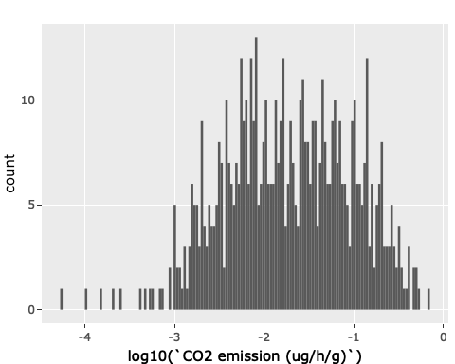
Sensitivity of CO2 emission rate to temperature in cranberry soils
Wilfried Dossou-Yovo, Serge Étienne Parent,Noura Ziadi, Bertrand Normand, and Léon Étienne parent
## [1] "2022-10-10"
1. Objective
This notebook generate the result of CO2 data analysis. Data set contains a collection of soil caracteristics, measured co2 emission collected from incubation study. Soil samples was collected from two cranberry fied stand of eastern canada. Incubation study was carried out at Agriculture and Agri-food Canada(sainte-foy, quebec,qc) from February to Mai 2019. The aim of this study was to measure CO2 emission rates in cranberry soils of Eastern Canada as related to soil temperature and depth
2. Statistical questions
In addition to data exploration, this notebook will answer the following statistical questions.
What is the influence of soil depth and temperature on CO2 emission?
Can Arrhenius equation and Q10 be useful to describe temperature sensitivity of carbon decomposition across layers?
3. Packages
We need package tidyverse which loads a set of packages for easy data manipulation(Ex: dplyr) and visualization (ex: ggplot2). We also use ggpubr to customise publication ready plot, ggpmisc and grid are useful packages as extensions to ggplot2.
## ── Attaching packages ─────────────────────────────────────── tidyverse 1.3.1 ──
## ✔ ggplot2 3.3.6 ✔ purrr 0.3.4 ## ✔ tibble 3.1.7 ✔ dplyr 1.0.9 ## ✔ tidyr 1.2.0 ✔ stringr 1.4.0 ## ✔ readr 2.1.2 ✔ forcats 0.5.2
## ── Conflicts ────────────────────────────────────────── tidyverse_conflicts() ── ## ✖ dplyr::filter() masks stats::filter() ## ✖ dplyr::lag() masks stats::lag()
## ── Attaching packages ────────────────────────────────────── tidymodels 0.2.0 ──
## ✔ broom 0.8.0 ✔ rsample 0.1.1 ## ✔ dials 0.1.1 ✔ tune 0.2.0 ## ✔ infer 1.0.0 ✔ workflows 0.2.6 ## ✔ modeldata 0.1.1 ✔ workflowsets 0.2.1 ## ✔ parsnip 0.2.1 ✔ yardstick 0.0.9 ## ✔ recipes 0.2.0
## ── Conflicts ───────────────────────────────────────── tidymodels_conflicts() ── ## ✖ scales::discard() masks purrr::discard() ## ✖ dplyr::filter() masks stats::filter() ## ✖ recipes::fixed() masks stringr::fixed() ## ✖ dplyr::lag() masks stats::lag() ## ✖ yardstick::spec() masks readr::spec() ## ✖ recipes::step() masks stats::step() ## • Search for functions across packages at https://www.tidymodels.org/find/
## ## Attaching package: 'plotly'
## The following object is masked from 'package:ggplot2': ## ## last_plot
## The following object is masked from 'package:stats': ## ## filter
## The following object is masked from 'package:graphics': ## ## layout
4. Import data
We load two data data_pot and data_co2 involved in our anylisis. data_pot contained details about sites sampling, soil sampling(soil depth, weight, water content and bulk density), laboratory incubation temperature while data_co2 contained details about laboratory incubation time, co2 emission and jar masson details. data_co2 was combined with data_pot with left_join function
## ℹ Using "','" as decimal and "'.'" as grouping mark. Use `read_delim()` for more control.
## Rows: 72 Columns: 12 ## ── Column specification ──────────────────────────────────────────────────────── ## Delimiter: ";" ## chr (1): Sites ## dbl (11): ID pot, Depth (cm), Repetition, Temperature (°C), Pot weight (g), ... ## ## ℹ Use `spec()` to retrieve the full column specification for this data. ## ℹ Specify the column types or set `show_col_types = FALSE` to quiet this message. ## Rows: 648 Columns: 5 ## ── Column specification ──────────────────────────────────────────────────────── ## Delimiter: "," ## dbl (5): ID pot, Time (days), Initial CO2 (ppm), Final CO2 (ppm), Time final... ## ## ℹ Use `spec()` to retrieve the full column specification for this data. ## ℹ Specify the column types or set `show_col_types = FALSE` to quiet this message.
## # A tibble: 72 × 12 ## `ID pot` Sites `Depth (cm)` Repetition `Temperature (°C)` `Pot weight (g)` ## <dbl> <chr> <dbl> <dbl> <dbl> <dbl> ## 1 6 A9 10 1 10 245. ## 2 21 A9 10 1 20 251. ## 3 54 A9 10 1 30 250. ## 4 18 A9 10 2 10 246. ## 5 59 A9 10 2 20 248. ## 6 60 A9 10 2 30 255. ## 7 41 A9 10 3 20 248. ## 8 55 A9 10 3 10 249. ## 9 61 A9 10 3 30 249. ## 10 20 A9 10 4 10 245. ## # … with 62 more rows, and 6 more variables: `Soil weight (g)` <dbl>, ## # `Water volume (ml)` <dbl>, `Water content (%)` <dbl>, ## # `Bulk density (g/cm3)` <dbl>, `Carbone(%)` <dbl>, pHCaCl2 <dbl>
5. Some calculations
Several variables have been added to our data in order to proceed for analysis. The added variables are the following: Temperature (Kelvin), Molar Volume (L/mol), Headspace Volume (mL), Dry soil weight (g), CO2 emission (ug/h/g), CO2 emission (mg/kg), decomposition rate K, lnKand 1/T(T = Temperature(Kelvin)
## Warning in log(K): NaNs produced
6. Exploratory data analysis
6.1 Histogram
## Warning in FUN(X[[i]], ...): NaNs produced ## Warning in FUN(X[[i]], ...): NaNs produced
## Warning: Removed 37 rows containing non-finite values (stat_bin).

Slide 4
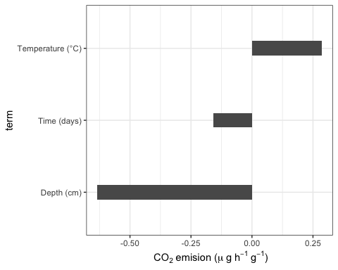
Data contains some outliers, let remove them
## Warning in mask$eval_all_mutate(quo): NaNs produced
Now data look well distributed
6.2 Correlations
## ## Correlation method: 'pearson' ## Missing treated using: 'pairwise.complete.obs'

Slide 5
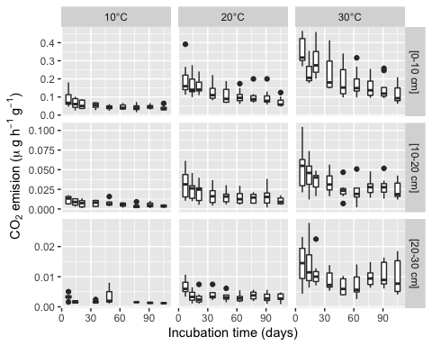
6.3 Boxplot

Slide 6
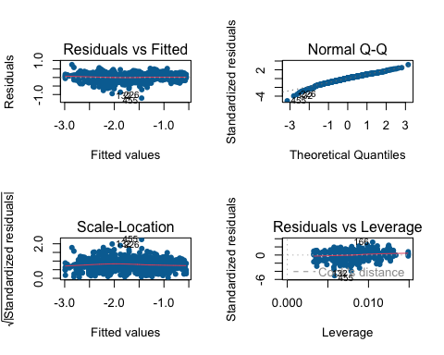
7.What is the influence of soil depth and temperature on CO2 emission?
7.1 Build model: linear regression
Fit model
Exploring model results
## # A tibble: 5 × 5 ## term estimate std.error statistic p.value ## <chr> <dbl> <dbl> <dbl> <dbl> ## 1 (Intercept) -1.70 0.00983 -173. 0 ## 2 `Time (days)` -0.103 0.00985 -10.5 1.22e- 23 ## 3 `Depth (cm)` -0.579 0.00993 -58.3 3.08e-247 ## 4 `Temperature (°C)` 0.273 0.00992 27.6 3.81e-108 ## 5 Sites_PF45 -0.0202 0.00984 -2.05 4.11e- 2
## # A tibble: 1 × 12 ## r.squared adj.r.squared sigma statistic p.value df logLik AIC BIC ## <dbl> <dbl> <dbl> <dbl> <dbl> <dbl> <dbl> <dbl> <dbl> ## 1 0.868 0.867 0.240 969. 6.71e-258 4 7.36 -2.71 23.6 ## # … with 3 more variables: deviance <dbl>, df.residual <int>, nobs <int>
Inspect the model

Slide 7
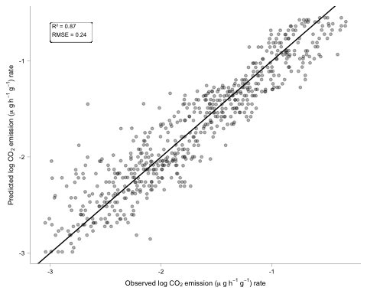
Prediction
collect Metrics
## # A tibble: 1 × 3 ## .metric .estimator .estimate ## <chr> <chr> <dbl> ## 1 rmse standard 0.239
## # A tibble: 1 × 3 ## .metric .estimator .estimate ## <chr> <chr> <dbl> ## 1 rsq standard 0.868

Slide 8
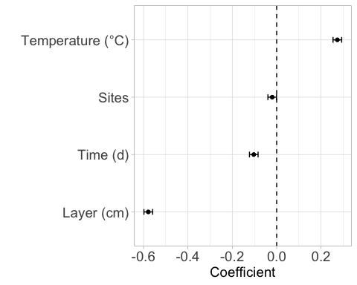
7.3 Variable coefficient and confidence intervals

Slide 9
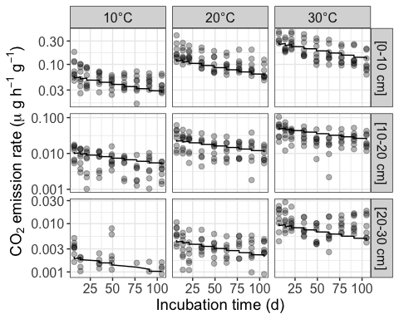
7.3 Prediction model of CO2 emission in cranberry soils in three-layer positions (0-10 cm, 10-20 cm, 20-30 cm) and at three temperatures (10, 20 and 30oC).

Slide 10
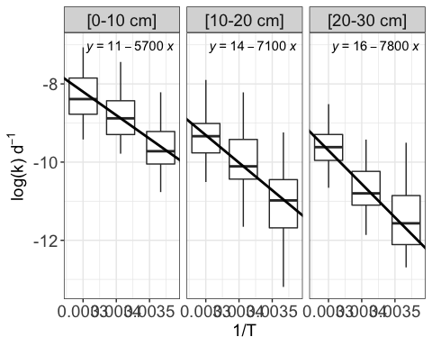
8. What is the temperature sensitivity across cranberry soil layers?
8.1 Fit of Arrhenius equation
The Arrhenius equation has been used to describe temperature sensitivity to CO2 emission. The Arrhenius equation was computed as follows:
$$k=Ae^{\frac{−Ea}{RT}}$$
$$log\left(k\right)=log\left(Ae^{\frac{−Ea}{RT}}\right)$$
$$log\left(k\right)=log\left(A\right)+log\left(e^{\frac{−Ea}{RT}}\right)$$
$$log\left(k\right)=log\left(A\right)−\frac{1}{T}×\left(\frac{Ea}{R}\right)$$
Where $A$ is the pre-exponential factor and $Ea$ is activation energy assumed to be independent of temperature, $R$ is the universal gas constant and $T$ is absolute temperature (Kelvin)
## # A tibble: 3 × 2 ## `Depth (cm)` linmod ## <dbl> <list> ## 1 10 <lm> ## 2 20 <lm> ## 3 30 <lm>
## # A tibble: 3 × 3 ## `Depth (cm)` Intercept Slope ## <dbl> <dbl> <dbl> ## 1 10 11.6 -6002. ## 2 20 14.0 -7052. ## 3 30 18.5 -8558.

Slide 11
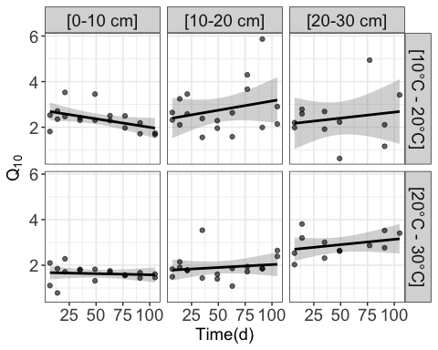
8.2 Activation Energy computation
## # A tibble: 3 × 3 ## Soil_layers adj_r_sq Ea ## <chr> <dbl> <dbl> ## 1 10 0.477 47.5 ## 2 20 0.402 58.6 ## 3 30 0.507 64.9
8.3 Computing K median in order to compute Q10 value accross soil depth
## # A tibble: 3 × 14 ## `Depth (cm)` variable n min max median q1 q3 iqr mad mean ## <dbl> <chr> <dbl> <dbl> <dbl> <dbl> <dbl> <dbl> <dbl> <dbl> <dbl> ## 1 10 Q10 36 0.785 3.53 1.82 1.67 2.32 0.647 0.542 1.99 ## 2 20 Q10 36 1.08 5.87 2.05 1.79 2.63 0.845 0.579 2.33 ## 3 30 Q10 24 0.627 4.94 2.63 2.17 3.05 0.879 0.709 2.64 ## # … with 3 more variables: sd <dbl>, se <dbl>, ci <dbl>
## `geom_smooth()` using formula 'y ~ x'

Slide 12
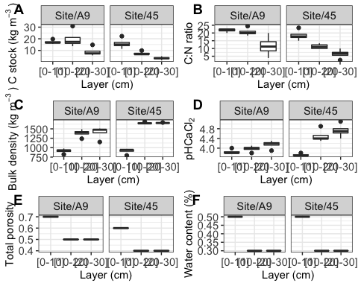
## `geom_smooth()` using formula 'y ~ x'
9. Soil description
9.1 Soil layers properties
Import data
## ℹ Using "','" as decimal and "'.'" as grouping mark. Use `read_delim()` for more control.
## Rows: 24 Columns: 15 ## ── Column specification ──────────────────────────────────────────────────────── ## Delimiter: ";" ## chr (3): Location, Layer (cm), 0_30_ID ## dbl (12): Sample, Site age, Repetition, Bulk density (kg m-3), pHCaCl2, Sand... ## ## ℹ Use `spec()` to retrieve the full column specification for this data. ## ℹ Specify the column types or set `show_col_types = FALSE` to quiet this message.
Some calculations
## # A tibble: 3 × 3 ## `Layer (cm)` mean_C_over_N se_C_over_N ## <chr> <dbl> <dbl> ## 1 [0-10] 20.1 1.05 ## 2 [10-20] 16.0 1.91 ## 3 [20-30] 9.02 1.96
## # A tibble: 1 × 13 ## variable n min max median q1 q3 iqr mad mean sd se ## <chr> <dbl> <dbl> <dbl> <dbl> <dbl> <dbl> <dbl> <dbl> <dbl> <dbl> <dbl> ## 1 C stock (k… 24 1.67 30.9 12.5 6.57 16.7 10.1 7.78 12.1 7.05 1.44 ## # … with 1 more variable: ci <dbl>
## # A tibble: 3 × 14 ## `Layer (cm)` variable n min max median q1 q3 iqr mad mean ## <chr> <chr> <dbl> <dbl> <dbl> <dbl> <dbl> <dbl> <dbl> <dbl> <dbl> ## 1 [0-10] C stock (… 8 11.4 22.2 16.2 15.1 17.4 2.35 1.60 16.6 ## 2 [10-20] C stock (… 8 6.52 30.9 11.8 6.74 17.1 10.4 7.62 13.6 ## 3 [20-30] C stock (… 8 1.67 14.8 5.36 3.31 7.42 4.11 3.04 6.09 ## # … with 3 more variables: sd <dbl>, se <dbl>, ci <dbl>
## # A tibble: 3 × 14 ## `Layer (cm)` variable n min max median q1 q3 iqr mad mean ## <chr> <chr> <dbl> <dbl> <dbl> <dbl> <dbl> <dbl> <dbl> <dbl> <dbl> ## 1 [0-10] C:N ratio 8 15 23.3 20.9 17.8 22.5 4.72 2.98 20.1 ## 2 [10-20] C:N ratio 8 10 24.4 15.8 11.5 20 8.5 6.18 16.0 ## 3 [20-30] C:N ratio 8 2.5 20 8.33 5.96 10.6 4.66 4.32 9.02 ## # … with 3 more variables: sd <dbl>, se <dbl>, ci <dbl>

Slide 13
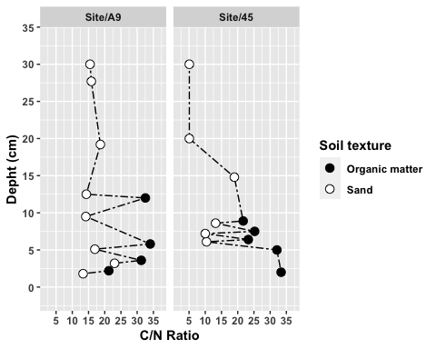
9.2 C:N ratio in alternate sublayers of sand and organic matter
Data loading
## ℹ Using "','" as decimal and "'.'" as grouping mark. Use `read_delim()` for more control.
## Rows: 23 Columns: 20 ## ── Column specification ──────────────────────────────────────────────────────── ## Delimiter: ";" ## chr (6): Projet, Site, Horizon, Layers, Soil texture, Munsell_color ## dbl (14): Depht (cm), Thickness(cm), Bulk density(kg m-3), Site_age, Weigh_s... ## ## ℹ Use `spec()` to retrieve the full column specification for this data. ## ℹ Specify the column types or set `show_col_types = FALSE` to quiet this message.
## # A tibble: 23 × 20 ## Projet Site Horizon `Depht (cm)` `Thickness(cm)` Layers `Bulk density(…` ## <chr> <chr> <chr> <dbl> <dbl> <chr> <dbl> ## 1 Pedology Belang… H1 1.8 1.8 [0-1.… 913. ## 2 Pedology Belang… H2 2.2 0.4 [1.8-… 913. ## 3 Pedology Belang… H3 3.2 1 [2.2-… 913. ## 4 Pedology Belang… H4 3.6 0.4 [3.2-… 913. ## 5 Pedology Belang… H5 5.1 1.5 [3.6-… 913. ## 6 Pedology Belang… H6 5.8 0.7 [5.1-… 913. ## 7 Pedology Belang… H7 9.5 3.7 [5.8-… 913. ## 8 Pedology Belang… H8 12 2 [9.5-… 1384. ## 9 Pedology Belang… H9 12.5 0.5 [12-1… 1384. ## 10 Pedology Belang… H10 19.2 6.7 [12.5… 1384. ## # … with 13 more rows, and 13 more variables: `Soil texture` <chr>, ## # Site_age <dbl>, Munsell_color <chr>, Weigh_superior_2MM <dbl>, ## # `Weigh _0_2MM` <dbl>, Repetition <dbl>, pHCaCl2 <dbl>, CTRL_C_pourc <dbl>, ## # CTRL_S_pourc <dbl>, CTRL_N_pourc <dbl>, C_pourc <dbl>, S_pourc <dbl>, ## # N_pourc <dbl>
C:N ratio computation
Generating the plots
## Warning: `expand_scale()` is deprecated; use `expansion()` instead. ## Warning: `expand_scale()` is deprecated; use `expansion()` instead.

