Slide 1
No API? No problem!
API mocking with WireMock
An open source workshop by …
Originally created by Bas Dijkstra – bas@ontestautomation.com – https://www.ontestautomation.com
Notes:
Please replace the … with your own name. I would really like it if you left the bottom line intact though, as a way of thanking me. That’s really all I’m asking for, the rest of the workshop is yours to butcher (erm, improve).
1

Slide 2
What are we going to do?
Stubbing, mocking and service virtualization
WireMock
Exercises, examples, …
Notes:
The workshop starts with a background on how stubbing, mocking and service virtualization can help you remove bottlenecks in your test environment. Then, we’re going to take a look at how WireMock enables you to write mocks in Java using a powerful and intuitive API. And of course, most importantly, the participants are going to do the hard work..
2

Slide 3
Preparation
Install JDK (Java 8 preferred)
Install IntelliJ IDEA (or any other IDE)
Download or clone project
Import Maven project in IDE
Notes:
Depending on the way you deliver this workshop, this sheet can be altered or even removed. When I delivered it, I had participants bring in their own laptop and asked them to follow installation instructions. I only provided them for Eclipse and mentioned that whenever they wanted to use a different IDE, they were allowed to do so. I wanted to keep things simple and therefore did not provide installation instructions for other IDEs.
3

Slide 4
Problems in test environments
Systems are constructed out of of many different components
Not all of these components are always available for testing
Parallel development
No control over testdata
Fees required for using third party component
…

Slide 5
Problems in test environments
Mobile app
SaaS dependency
Under development
Access fees
System under test
No suitable test data
Limited access
Backend system
Mainframe

Slide 6
Simulation during test execution
Simulate dependency behaviour
Regain full control over test environment
Available on demand
Full control over test data (edge cases!)
No third party component usage fees
…

Slide 7
Stubbing
Predefined responses
No flexibility
Status verification

Slide 8
Mocking
Define mock behavior during test initialization
(Somewhat) more flexible
Behaviour verification

Slide 9
Service virtualization
Simulate complex dependency behaviour
‘Enterprise level’ stubbing / mocking
Support for many different protocols and message formats
Data driven

Slide 10
Problems in test environments
Mobile app
SaaS dependency
Under development
Access fees
System under test
No suitable test data
Limited access
Backend system
Mainframe

Slide 11
Simulation in test environments
Virtualized mobile app
Virtualized SaaS dependency
Unrestricted access
Unrestricted access
System under test
Unrestricted access
Unrestricted access
Virtualized backend system
Virtualized mainframe

Slide 12

Our API under test
Zippopotam.us
Returns location data based
on country and zip code
http://api.zippopotam.us/
RESTful API
Notes:
Explain why this API was chosen (simple, very ‘real’ data, something lots of people can relate to)
Mocks are included in the project to avoid the risk of the API being unavailable during the workshop (this actually happened to me once), feel free to remove it and test against the actual API
Alternatively, you can always use your own API of course!
12

Slide 13
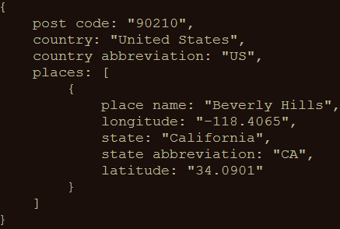

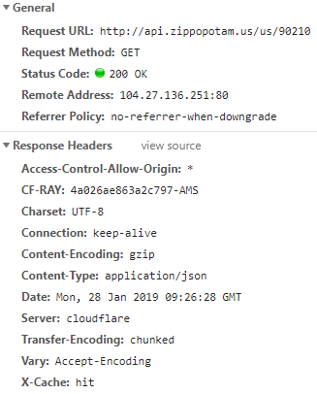
An example
GET http://api.zippopotam.us/us/90210
Notes:
Explain why this API was chosen (simple, lots of features, very ‘real’ data, something lots of people can relate to)
Mocks are included in the project to avoid the risk of the API being unavailable during the workshop (this actually happened to me once), feel free to remove it and test against the actual API
Alternatively, you can always use your own API of course!
13

Slide 14
API consumer
request
API provider
response
System
System
Notes:
In the first 8 years of my career I wrote an awful lot of horrible automation

Slide 15
What might we want to simulate?
Supporting operations other than GET
Creating specific responses for edge cases
Delays, fault status codes, malformatted responses, …
…

Slide 16
WireMock
http://wiremock.org
Java
HTTP mock server
only supports HTTP(S)
open source
developed and maintained by Tom Akehurst

Slide 17
Install WireMock
Maven
<dependency> <groupId>com.github.tomakehurst</groupId>
<artifactId>wiremock-jre8</artifactId>
<version>2.26.3</version>
<scope>test</test>
</dependency>

Slide 18
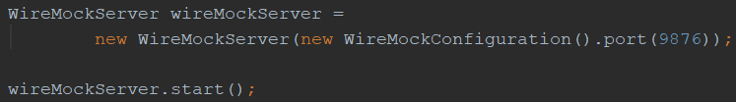
Starting WireMock
In Java (via JUnit @Rule)
In Java (without using JUnit)
Standalone
java -jar wiremock-standalone-2.26.3.jar --port 9876

Slide 19
Configure responses
In (Java) code
Using JSON mapping files

Slide 20
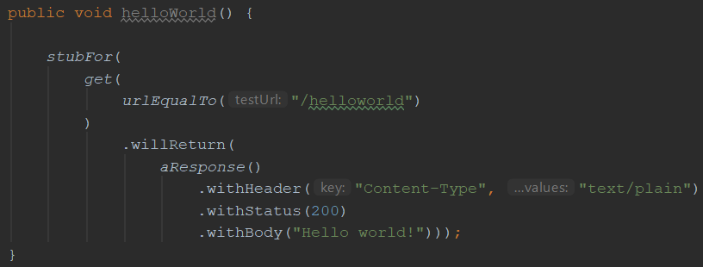
An example mock defined in Java

Slide 21
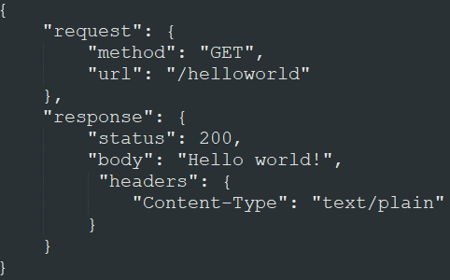
The same mock, but now in JSON

Slide 22
Useful WireMock features
Verification
Verify that certain requests are sent by application under test
Record and playback
Generate mocks based on request-response pairs (traffic)
Fault simulation
…
Full documentation at http://wiremock.org/docs/

Slide 23
Now it’s your turn!
src/test/java/exercises/
WireMockExercises1.java
Create a couple of basic mocks
You can choose between Java, JSON or do both
JSON mappings should be placed in
src/test/resources/mappings
Verify your solution by running the tests in the same file
Notes:
The answers to the JSON exercises can be found in src/test/resources/answers. Move the corresponding JSON files to the mappings folder for WireMock to pick them up

Slide 24
Request matching
Send a response only when certain properties in the request are matched
Options for request matching:
URL
HTTP method
Query parameters
Headers
Request body elements
…

Slide 25
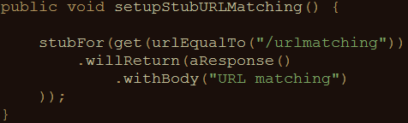
Example: URL matching (Java)
Other URL options:
urlPathEqualTo (using exact values)
urlMatching (using regular expressions)
urlPathMatching (using regular expressions)

Slide 26
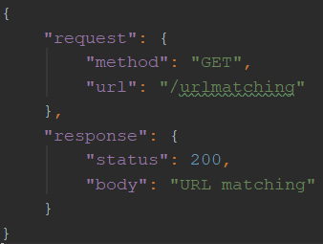
Example: URL matching (JSON)

Slide 27
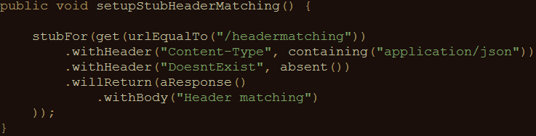
Example: header matching (Java)
absent(): check that parameter is not in request

Slide 28
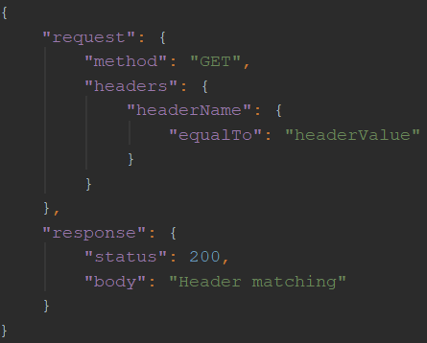
Example: header matching (JSON)

Slide 29
Other matching strategies
Authentication (Basic, OAuth(2))
Query parameters
Request body
Multipart/form-data
You can write your own matching logic too

Slide 30
Fault simulation
Extend test coverage by simulating faults
Often hard to do in real systems
Easy to do using stubs or mocks
Used to test the exception handling of your application under test

Slide 31
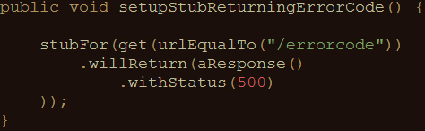
Example: HTTP status code (Java)
Often used HTTP status codes:
Client error Server error
403 (Forbidden) 500 (Internal server error)
404 (Not found) 503 (Service unavailable)

Slide 32
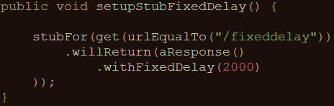
Example: timeout (Java)
Random delay can also be used
Uniform, lognormal, chunked dribble distribution options
Can be configured on a per-stub basis as well as globally

Slide 33
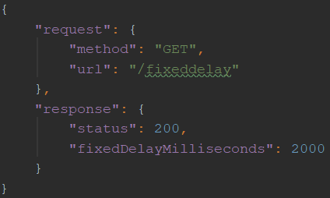
Example: timeout (JSON)

Slide 34
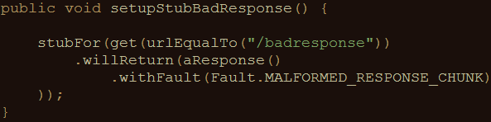
Example: bad responses (Java)
HTTP status code 200, but garbage in response body
Other options:
RANDOM_DATA_THEN_CLOSE (as above, without HTTP 200)
EMPTY_RESPONSE (does what it says on the tin)
CONNECTION_RESET_BY_PEER (close connection, no response)

Slide 35
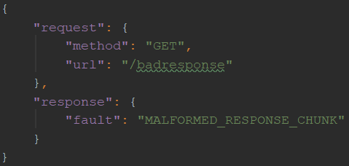
Example: bad responses (JSON)

Slide 36
Now it’s your turn!
src/test/java/wiremockexercises/
WireMockExercises2.java
Create mocks that simulate edge / error cases
You can choose between Java, JSON or do both
Use the appropriate request matcher strategy
Verify your solution by running the tests

Slide 37
Statefulness
Sometimes, you want to simulate stateful behaviour
Shopping cart (empty / full)
Database (data present / not present)
Order in which requests arrive is significant

Slide 38
Stateful mocks in WireMock
Supported through the concept of a Scenario
Essentially a finite state machine (FSM)
States and state transitions
Combination of current state and incoming request determines the response being sent
Before now, it was only the incoming request

Slide 39
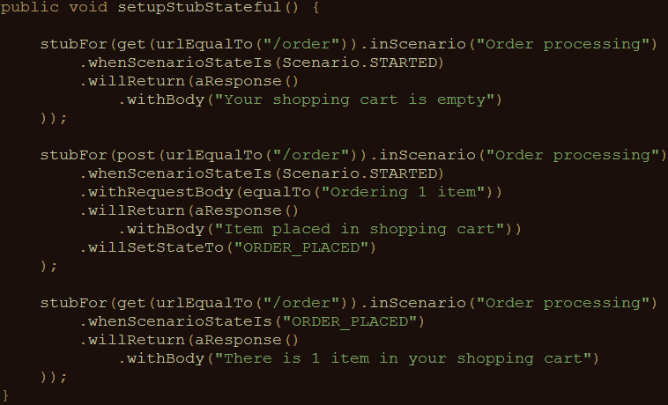
Stateful mocks: an example (Java)

Slide 40
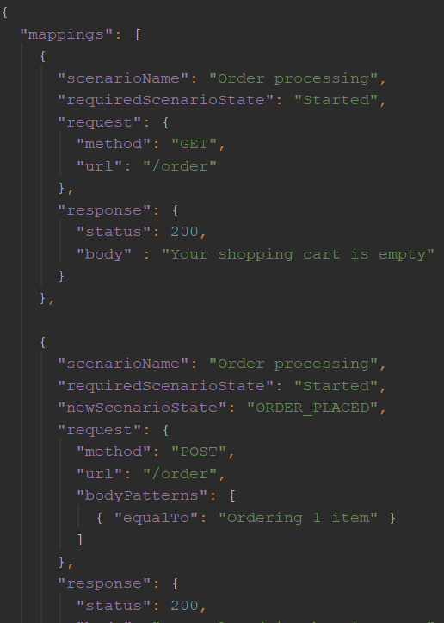
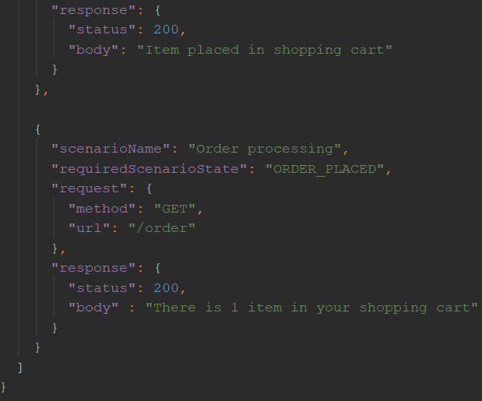
Stateful mocks: an example (JSON)

Slide 41
Now it’s your turn!
src/test/java/wiremockexercises/
WireMockExercises3.java
Create a stateful mock that exerts the described behaviour
You can choose between Java, JSON or do both
Verify your solution by running the tests

Slide 42
Response templating
Often, you want to reuse elements from the request in the response
Request ID header
Unique body elements (client ID, etc.)
Cookie values
WireMock supports this through response templating

Slide 43
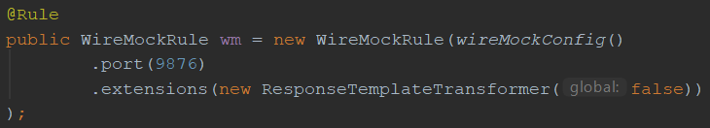
Setup response templating
In code: through the JUnit rule
Global == false: response templating transformer has to be enabled for individual stubs

Slide 44
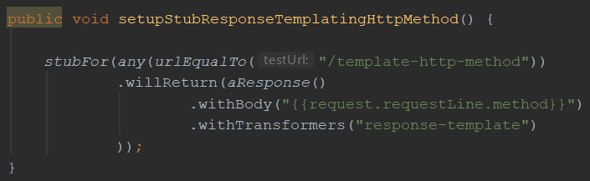
Enable/apply response templating
This template reads the HTTP request method (GET/POST/PUT/…) and returns it as the response body

Slide 45
Request attributes
Many different request attributes available for use
request.requestLine.method : HTTP method (example)
request.requestLine.path.[<n>] : n^{th} path segment
request.requestLine.scheme : protocol (e.g. HTTPS)
…
All available attributes listed at
http://wiremock.org/docs/response-templating/

Slide 46
Request attributes (cont’d)
Extracting and reusing body elements
In case of a JSON request body:
{{jsonPath request.body ‘$.path.to.element’}}
In case of an XML request body:
{{xPath request.body ‘/path/to/element/text()’}}

Slide 47
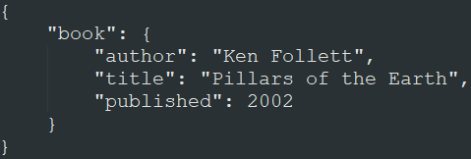
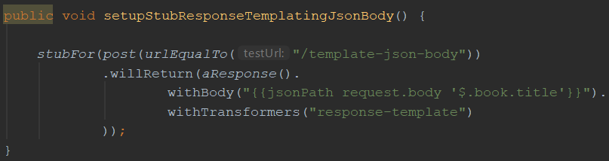
JSON extraction example
When sent this JSON
request body:
This stub returns a response with body “Pillars of the Earth”:

Slide 48
Exercise time!
WireMockExercises5
Use request templating
Exercises are defined in the comments
Verify your solution by running the tests

Slide 49
Mock specification via JSON
So far, we’ve only specified mock behaviour in Java code
Mocks live for the duration of the test run
Want longer living mocks? Use JSON mapping files
WireMock can be run as a standalone process

Slide 50
Running WireMock standalone
java –jar wiremock-standalone-2.18.0.jar --port 9876
‘mappings’ subfolder should contain JSON mapping definitions
‘__files’ subfolder contains additional files

Slide 51
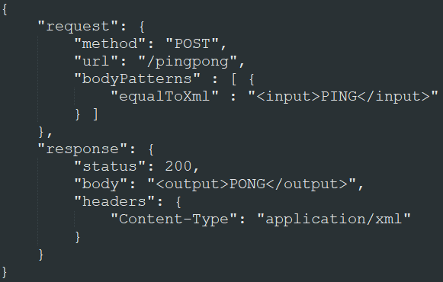
JSON mapping files
All features available in Java also available through JSON mappings
Example:

Slide 52
JSON mapping files
Documentation of all features, along with examples on how to implement them through JSON mapping files can be found at
http://wiremock.org/docs/

Slide 53
Demo
Using JSON mapping files to configure stubs

Slide 54
Record and playback options
Use WireMock as a proxy
Record request-response pairs (traffic)
Genererate mock from recorded traffic

Slide 55
Demo
Using record and playback in WireMock

Slide 56
Pros and cons of record and playback
Pros:
Easy creation of mocks
Analyse traffic of which there are no specifications
Cons:
Rerecording necessary when interface changes
Mocks are not flexible
Mocks are hard to extend
Similar to record and playback in test automation

Slide 57
Other useful features
Verification (was a given message sent ?)
Response transformations (via extensions)
Integration into a CI / CD pipeline
Documentation: http://wiremock.org/docs/

Slide 58
?

Slide 59
Contact
Email:
Blog:
LinkedIn:
Twitter:

