Slide 1
No API? No problem!
API mocking with WireMock
An open source workshop by …
Originally created by Bas Dijkstra – bas@ontestautomation.com – http://www.testautomation.com - @_basdijkstra
Notes:
Please replace the … with your own name. I would really like it if you left the bottom line intact though, as a way of thanking me. That’s really all I’m asking for, the rest of the workshop is yours to butcher (erm, improve).
1

Slide 2
What are we going to do?
Stubbing, mocking and service virtualization
WireMock
Get your hands dirty
Notes:
The workshop starts with a background on how stubbing, mocking and service virtualization can help you remove bottlenecks in your test environment. Then, we’re going to take a look at how WireMock enables you to write mocks in Java using a powerful and intuitive API. And of course, most importantly, the participants are going to do the hard work..
2

Slide 3
Preparation
Install IntelliJ IDEA (or any other IDE)
Download or clone project
Import Maven project in IDE
Notes:
Depending on the way you deliver this workshop, this sheet can be altered or even removed. When I delivered it, I had participants bring in their own laptop and asked them to follow installation instructions. I only provided them for Eclipse and mentioned that whenever they wanted to use a different IDE, they were allowed to do so. I wanted to keep things simple and therefore did not provide installation instructions for other IDEs.
3

Slide 4
Problems in test environments
Systems are constructed out of of many different components
Not all of these components are always available for testing
Parallel development
No control over testdata
Fees required for using third party component
…

Slide 5
Problems in test environments
Mobile app
SaaS dependency
Under development
Access fees
System under test
No suitable test data
Limited access
Backend system
Mainframe

Slide 6
Simulation during test execution
Simulate dependency behavior
Regain full control over test environment
Available on demand
Full control over test data (edge cases!)
No third party component usage fees
…

Slide 7
Stubbing
Predefined responses
No flexibility
Status verification

Slide 8
Mocking
Define mock behavior during test initialization
(Somewhat) more flexible
Behavior verification

Slide 9
Service virtualization
Simulate complex dependency behavior
‘Enterprise level’ stubbing / mocking
Support for many different protocols and message formats
Data driven

Slide 10
Problems in test environments
Mobile app
SaaS dependency
Under development
Access fees
System under test
No suitable test data
Limited access
Backend system
Mainframe

Slide 11
Simulation in test environments
Virtualized mobile app
Virtualized SaaS dependency
Unrestricted access
Unrestricted access
System under test
Unrestricted access
Unrestricted access
Virtualized backend system
Virtualized mainframe

Slide 12
WireMock
http://wiremock.org
Java
HTTP mock server
only supports HTTP(S)
open source
developed and maintained by Tom Akehurst

Slide 13
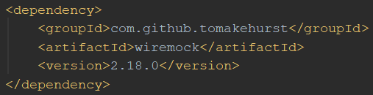
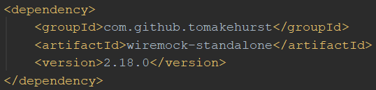

Install WireMock
Maven
Gradle

Slide 14
Run WireMock
In Java (via JUnit @Rule)
In Java (without using JUnit)
Standalone
java -jar wiremock-standalone-2.18.0.jar --port 9876

Slide 15
Configure responses
In (Java) code
Using JSON mapping files

Slide 16
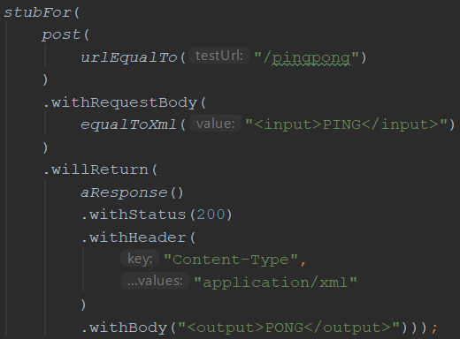
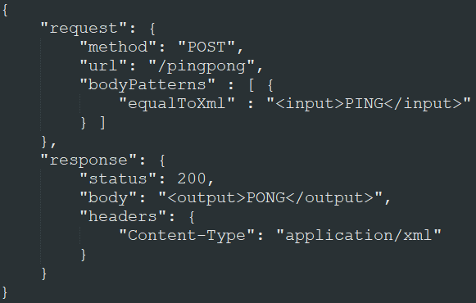
An example mock
In Java
In JSON

Slide 17
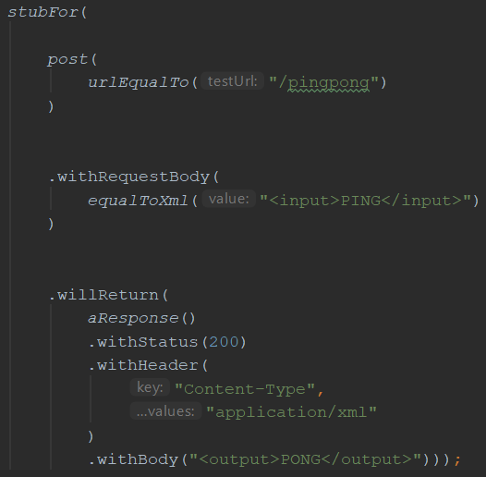
Syntax
This stub responds to:
A HTTP POST to /pingpong
With body <input>PING</input>
With an answer having:
HTTP status code 200
content type application/xml
body <output>PONG</output>

Slide 18
Useful WireMock features
Verification
Verify that certain requests are sent by application under test
Record and playback
Generate mocks based on request-response pairs (traffic)
Fault simulation
…
Full documentation at http://wiremock.org/docs/

Slide 19
Running WireMock standalone
Start WireMock server
Options: port, keystore, ...
Make mocks permanently available
For example for multiple teams
Reconfigure mocks via JSON
java -jar wiremock-standalone-2.18.0.jar --port 9876

Slide 20
Starting and stopping WireMock during test execution
Integration in test execution
Mocks in version control (Git, etc.)
JUnit integration using @Rule annotation
Can be used without having to use JUnit as well

Slide 21
Demo
Running and using WireMock in standalone mode
Use of WireMock in the exercises
Writing your very first mock

Slide 22
Exercise time!
WireMockExercises1.java
Create a number of simple mocks
Exercises are defined in the comments
Verify your solution by running the tests

Slide 23
Request matching
Send a response only when certain properties in the request are matched
Options for request matching:
URL
HTTP method
Query parameters
Headers
Request body elements
…

Slide 24
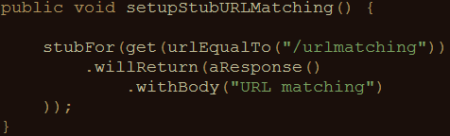
Example: URL matching
Other URL options:
urlPathEqualTo (using exact values)
urlMatching (using regular expressions)
urlPathMatching (using regular expressions)

Slide 25
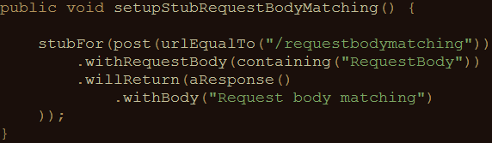
Example: body element matching
Other request body matching options:
equalTo (using exact values)
matching, notMatching (using regular expressions)

Slide 26
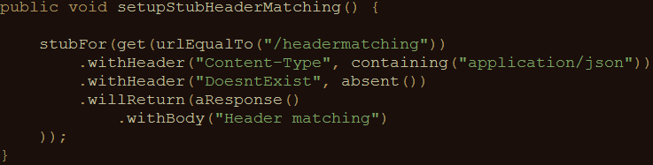
Example: header matching
absent(): check that parameter is not in request

Slide 27
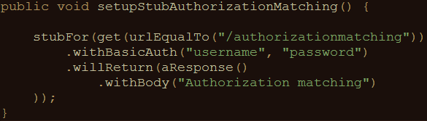
Example: basic authentication matching
HTTPS is supported
Oauth(2) can be simulated using header matching

Slide 28
Exercise time!
WireMockExercises2
Use request matching
Exercises are defined in the comments
Verify your solution by running the tests

Slide 29
Fault simulation
Extend test coverage by simulating faults
Often hard to do in real systems
Easy to do using stubs or mocks
Used to test the exception handling of your application under test

Slide 30
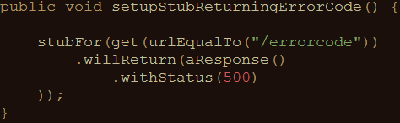
Example: HTTP status code
Often used HTTP status codes:
Client error Server error
403 (Forbidden) 500 (Internal server error)
404 (Not found) 503 (Service unavailable)

Slide 31
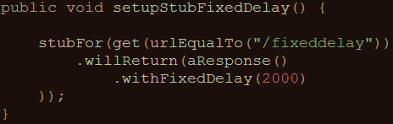
Example: timeout
Random delay can also be used
Uniform, lognormal, chunked dribble distribution options
Can be configured on a per-stub basis as well as globally

Slide 32
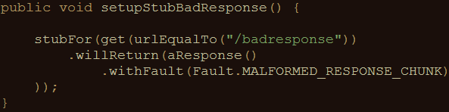
Example: bad responses
HTTP status code 200, but garbage in response body
Other options:
RANDOM_DATA_THEN_CLOSE (as above, without HTTP 200)
EMPTY_RESPONSE (does what it says on the tin)
CONNECTION_RESET_BY_PEER (close connection, no response)

Slide 33
Exercise time!
WireMockExercises3
Use fault simulation
Exercises are defined in the comments
Verify your solution by running the tests

Slide 34
Stateful mocks
The mocks we created until now have been stateless
Order of calling mocks does not influence behavior
Not always true in the real world
Request A > request B might differ from request B > request A

Slide 35
Stateful mocks in WireMock
Supported through the concept of a Scenario
Essentially a finite state machine (FSM)
States and state transitions
Combination of current state and incoming request determines the response being sent
Before now, it was only the incoming request

Slide 36
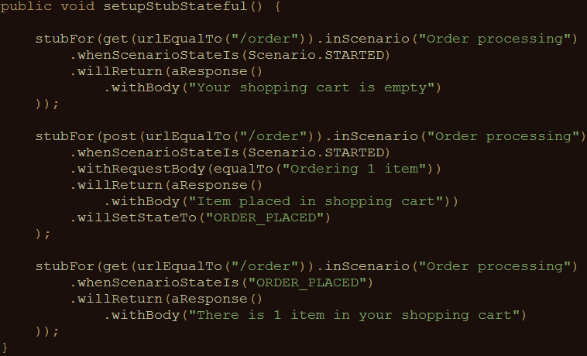
Stateful mocks: an example

Slide 37
Exercise time!
WireMockExercises4
Use stateful mocks
Exercises are defined in the comments
Verify your solution by running the tests

Slide 38
Response templating
Often, you want to reuse elements from the request in the response
Request ID header
Unique body elements (client ID, etc.)
Cookie values
WireMock supports this through response templating

Slide 39
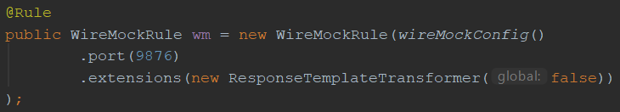
Setup response templating
In code: through the JUnit rule
Global == false: response templating transformer has to be enabled for individual stubs

Slide 40
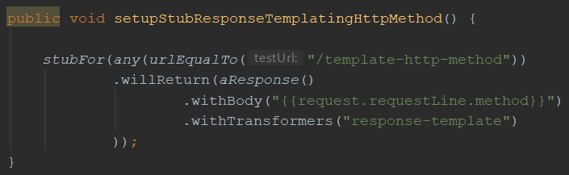
Enable/apply response templating
This template reads the HTTP request method (GET/POST/PUT/…) and returns it as the response body

Slide 41
Request attributes
Many different request attributes available for use
request.requestLine.method : HTTP method (example)
request.requestLine.path.[<n>] : n^{th} path segment
request.requestLine.scheme : protocol (e.g. HTTPS)
…
All available attributes listed at
http://wiremock.org/docs/response-templating/

Slide 42
Request attributes (cont’d)
Extracting and reusing body elements
In case of a JSON request body:
{{jsonPath request.body ‘$.path.to.element’}}
In case of an XML request body:
{{xPath request.body ‘/path/to/element/text()’}}

Slide 43
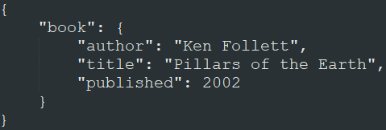
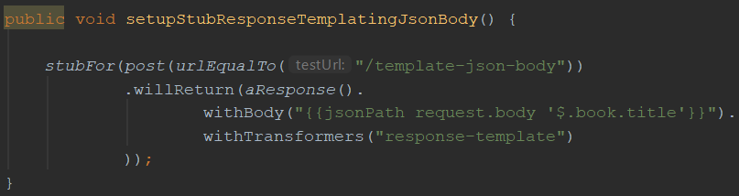
JSON extraction example
When sent this JSON
request body:
This stub returns a response with body “Pillars of the Earth”:

Slide 44
Exercise time!
WireMockExercises5
Use request templating
Exercises are defined in the comments
Verify your solution by running the tests

Slide 45
Mock specification via JSON
So far, we’ve only specified mock behaviour in Java code
Mocks live for the duration of the test run
Want longer living mocks? Use JSON mapping files
WireMock can be run as a standalone process

Slide 46
Running WireMock standalone
java –jar wiremock-standalone-2.18.0.jar --port 9876
‘mappings’ subfolder should contain JSON mapping definitions
‘__files’ subfolder contains additional files

Slide 47
JSON mapping files
All features available in Java also available through JSON mappings
Example:

Slide 48
JSON mapping files
Documentation of all features, along with examples on how to implement them through JSON mapping files can be found at
http://wiremock.org/docs/

Slide 49
Demo
Using JSON mapping files to configure stubs

Slide 50
Record and playback options
Use WireMock as a proxy
Record request-response pairs (traffic)
Genererate mock from recorded traffic

Slide 51
Demo
Using record and playback in WireMock

Slide 52
Pros and cons of record and playback
Pros:
Easy creation of mocks
Analyse traffic of which there are no specifications
Cons:
Rerecording necessary when interface changes
Mocks are not flexible
Mocks are hard to extend
Similar to record and playback in test automation

Slide 53
Other useful features
Verification (was a given message sent ?)
Response transformations (via extensions)
Integration into a CI / CD pipeline
Documentation: http://wiremock.org/docs/

Slide 54
?

Slide 55
Contact
Email:
Blog:
LinkedIn:
Twitter:

