Slide 1
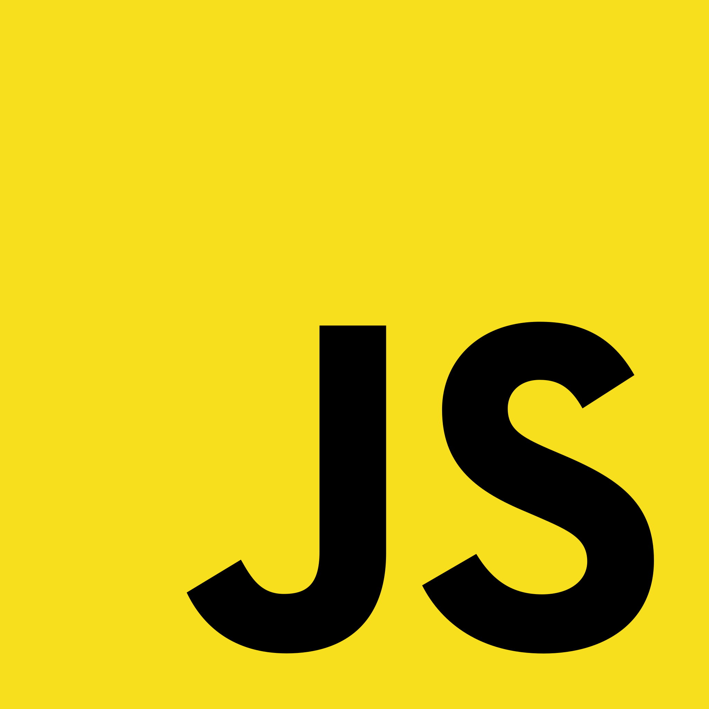
JAVASCRIPT

Slide 2
What is Javascript
High Level, just in time compiled programming language
Runs on browser and server
Dynamic typed language
One of the most popular programming language

Slide 3





Companies that uses javascript

Slide 4
What can you do with javascript
Frontend Development
Backend Development
Full Stack Development

Slide 5
Content
Syntax
Js Statement
variables
Operators
Data Type
Functions
Objects
Events
Js strings
Js Numbers
Array
If Else
Switch
Loop
Advanced javascript
Git & GitHub
DOM
Objects
Functions
Classes(OOP)
Asynchronous & Synchronous Programming code execution
Web API
AJAX
JSON
REST API

