Slide 1
FullStack WEB DEVELOPMENT WITHOUT JAVASCRIPT
S Ravi Kumar
Solution Architect
KP Astrologer
@techierathore

Slide 2
Agenda
Full Stack Development Decisions Confusion
What is WebAssembly?
What is Blazor?
Project Creation Demo
How does Blazor work?
Blazor.Server Vs Blazor.WASM
Future Possibilities of Blazor
Questions

Slide 3










Current State of FullStack Development
https://...
JS

Slide 4





















Current State of the SPA Front End
Pick a Language:
Pick a Framework:
Pick your tools:
Common

Slide 5
Problems
Whole lot of people don’t like JS
Dynamically typed
Less integration, more stitching
Browser support
Moves too fast, lots of choice, intimidating
node_modules
SPA’s are more expensive to maintain
Front-end + Back-end team
Training up full stack to be great at both (very difficult)
When using a different language than JS on the backend…
Duplicate Business Logic (like validation) or just have server
No IDE/compiler help between backend models + front end making AJAX calls
Unless bringing in yet another tool (GraphQL, TypeScript/C# syncer, etc.)

Slide 6



Slide 7
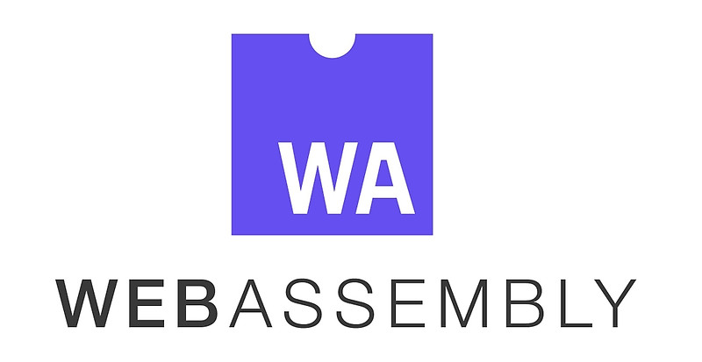
What is Web Assembly (WASM)?
WebAssembly (WASM) is a low-level binary format language that can be run in modern web browsers that runs at near-native speeds.
Compilation Target for other languages
Browser standard
No more JS monopoly

Slide 8
What is Blazor?
Blazor is a .NET SPA framework maintained by Microsoft & Community using C# and HTML that runs in the browser via WebAssembly….
Uses Razor syntax
Browser + Razor = Blazor
Uses component-based architecture
Client Side Runs on top of Mono
Blazor == UI Framework == MVC or Web Forms
Mono == Runtime == .NET Framework or .NET Core
Server Side Runs with help of Signal-R
Development led by Steve Sanderson, of KnockoutJS fame

Slide 9
https://...

Slide 10
Why would you be interested in this?
C# is a fantastic language
…not that JavaScript isn’t…but statically typed languages are winning (see: TS, Flow, Reason, etc.)
46% of respondents to npm survey are using TypeScript
ASP.NET Core performance
#7 on TechEmpower
8x faster than Node, 1.5x faster than Netty (Java), 47x faster than Django (Python), 7x faster than Kotlin, etc.
Share logic with existing .NET backend
Validation logic
Models from Server when retrieve from the Client
Consolidate frontend and backend teams under one language
Backed by a Trillion Dollar Company (Microsoft)

Slide 11

Demo
Hello World on Blazor
Component Architecture
Dependency Injection
Sharing logic
Techierathore

Slide 12
Rapid Fire Questions
How big client version is?
2.4MB
Very little work done thus far to optimize
Do WASM files cache like JS and CSS files?
Yes
How does it work under the hood?

Slide 13


https://...
https://...
DOM
DOM
Client-side
(Blazor WebAssembly)
Server-side
(Blazor Server)

Slide 14
DEPENDENCY INJECTION
SERVER-SIDE RENDERING
COMPONENT MODEL
FORMS & VALIDATION
DEBUGGING
PUBLISHING
ROUTING
LAYOUTS
UNIT TESTING
AUTO REBUILD
ASSEMBLY TRIMMING
JAVASCRIPT INTEROP
INTELLISENSE & TOOLING
COMPONENT PACKAGES

Slide 15
Pros & Cons of Blazor Server
Pros
> Thin client
> Full runtime
> Simpler arch.
https://...
DOM
Cons
> No offline
> Latency
> Server resources

Slide 16
Client-side
(Blazor WebAssembly)
Server-side
(Blazor Server)
Preview now
Release target: May 2020
Shipped
Part of .NET Core 3.0
Great for:
- Offline support / PWA
- Zero latency UI
- Static-files hosting
Great for:
- Thin client
- Full runtime
- All code on server

Slide 17
Vision FOR Blazor
Client-side
(Blazor WebAssembly)
Server-side
(Blazor Server)
Preview now
Release target: May 2020
Shipped
Part of .NET Core 3.0
Blazor + Electron
(Desktop app with web rendering)
Blazor + Native UI
(Mobile/desktop with native OS UI)
Uncommitted
Sample available now
Very experimental!
Super-early, no sample yet

Slide 18













Future State of the Front End? (besides JS)
Pick a Language:
Pick a Framework:
???
Pick your tools:

Slide 19
How do I get started & Where to go Next ?
How to Get started :
Visual Studio 2019 with the ASP.NET and web development workload selected.
Visit Official Docs site : http://Blazor.net.
Community Docs:
https://github.com/AdrienTorris/awesome-blazor
https://github.com/StevenTCramer/awesome-blazor

Slide 20


Thank You & Questions
Azure Solution Architect
Community Speaker , KP Astrologer
Founder : DotCoreTechies (https://www.meetup.com/DotCoreTechies/)
Tweets : @techierathore
GitHub : https://github.com/techierathore
Blog : https://www.techierathore.com
S Ravi Kumar
Solution Architect / KP Astrologer

