Slide 1
Predicting Political Ideology Using Machine Learning
MACS 30100
Charlotte Li, Eddie Tian, Peter Zhang, Jiahang Luo

Slide 2
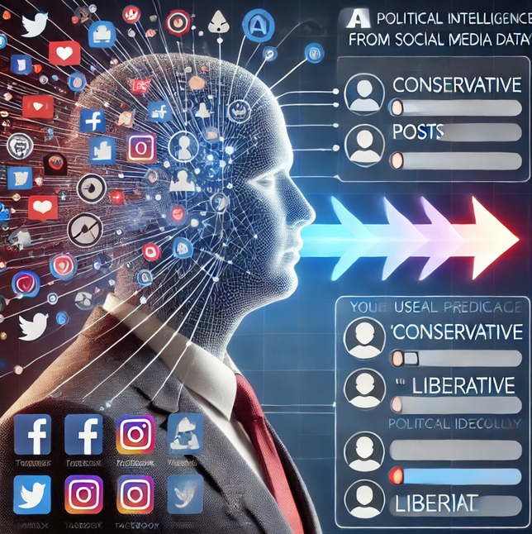
Predicting Political Ideology Using Machine Learning
Research Question
How do social media usage patterns and demographic information reveal individuals’ political ideology?
Literature
Beyond Binary Labels: Political Ideology Prediction of Twitter Users (Preotiuc-Pietro et al., 2017)
Quantifying Social Media’s Political Space: Estimating Ideology from Publicly Revealed Preferences on Facebook (Bond & Messing, 2015)
Demographics and Personality Discovery on Social Media: A Machine Learning Approach ((Tuomchomtam & Soonthornphisaj, 2021))
Machine Learning Task
Multi-Class Classification
(5 Classes: Very Conservative → Very Liberal)
Models Used:
Logistic Regression, Random Forest, XGBoost, Deep Learning (PyTorch)

Slide 3
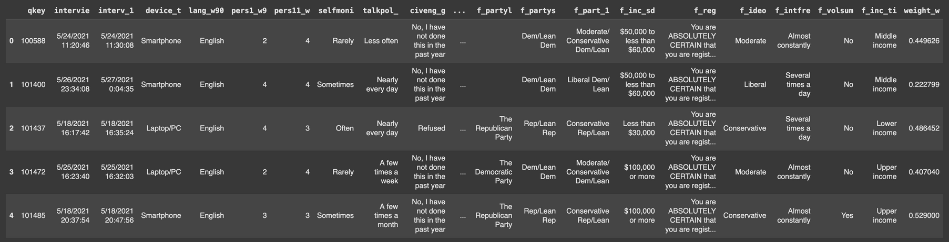
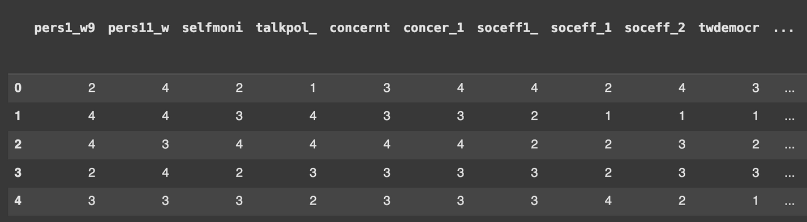

df.head( )
PEW ATP WAVE 90
Outcome
political ideology
5 levels
ordinal encoded
------------------
cleaned_encoded_df.head( )
Features
116 features
social media use
demographics
54 nominal : one-hot encoded
62 ordinal: ordinal encoded
cleaned_encoded_df.shape( )
(2529, 229)

Slide 4
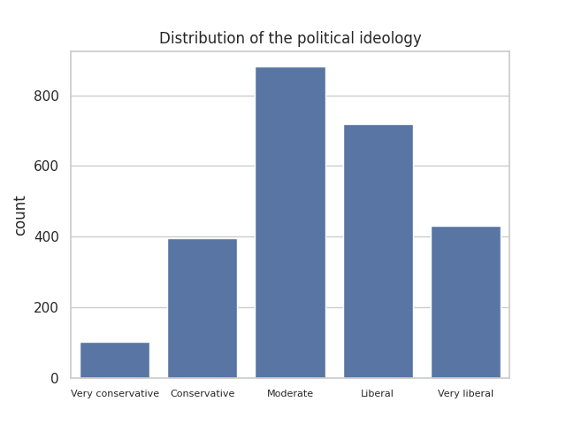
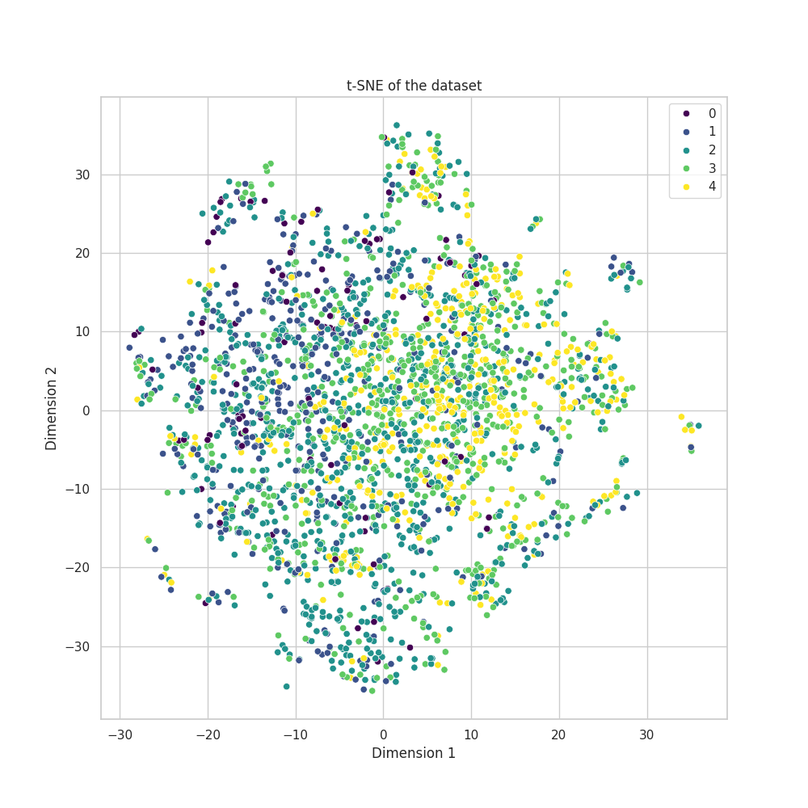
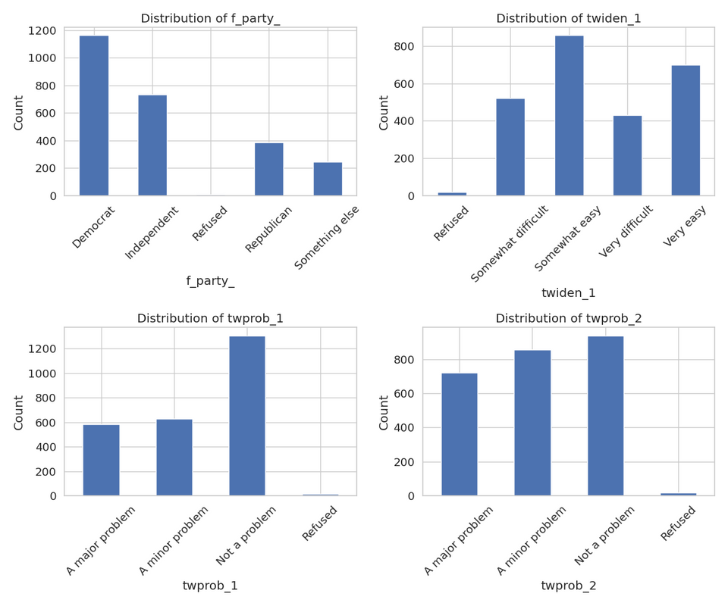
EXPLORATORY DATA ANALYSIS

Slide 5
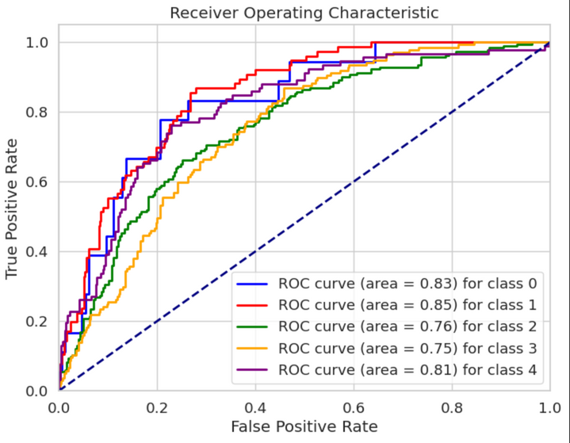
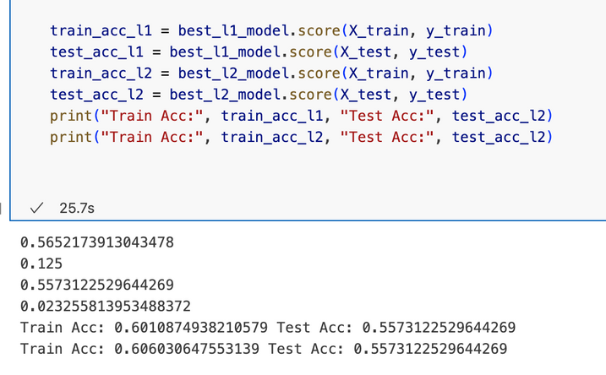
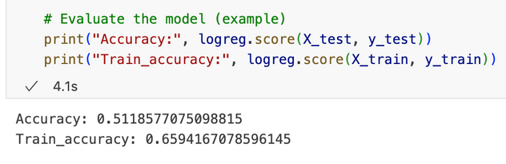
Logistic Regression
Baseline Logistic Regression Model
Trained without regularization with accuracy of 0.51
L1 Regularization (Lasso)
Resolve Overfit
L2 Regularization (Ridge)
Best-Performing AUC = 0.85

Slide 6
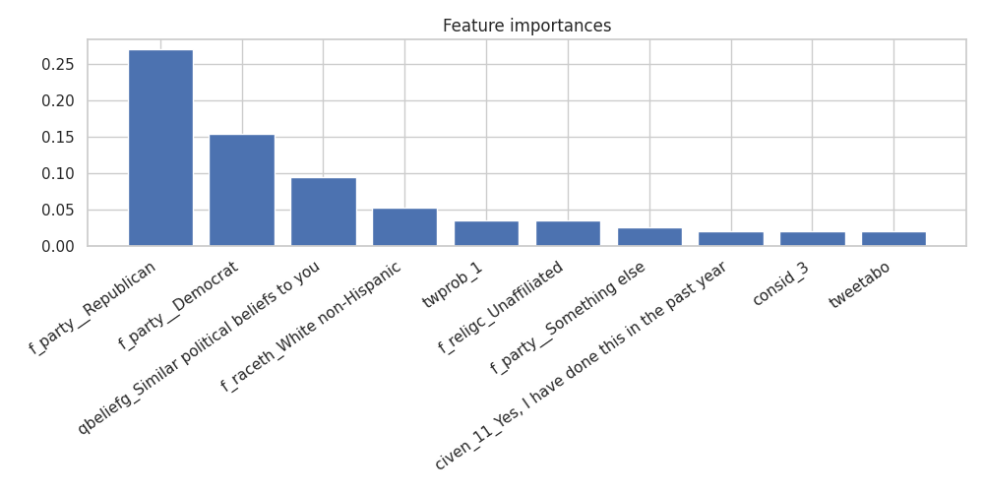
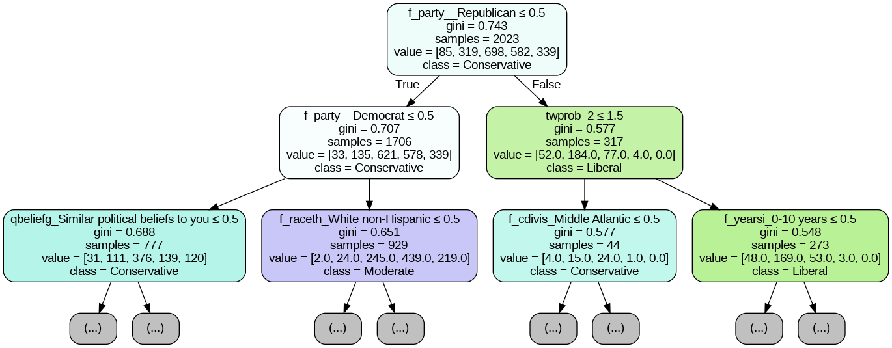
Decision Tree Classifier
# hyper-parameter tunning
param_dist = {
'max_depth': randint(1, 10),
'min_samples_leaf': randint(1, 10),
'criterion': ['gini', 'entropy']}
rs = RandomizedSearchCV(dt_clf, param_dist, n_iter=100, cv=5, random_state=SEED)
rs.fit(X_train, y_train)
# best hyperparameters
{'criterion': 'gini', 'max_depth': 6, 'min_samples_leaf': 4}

Slide 7
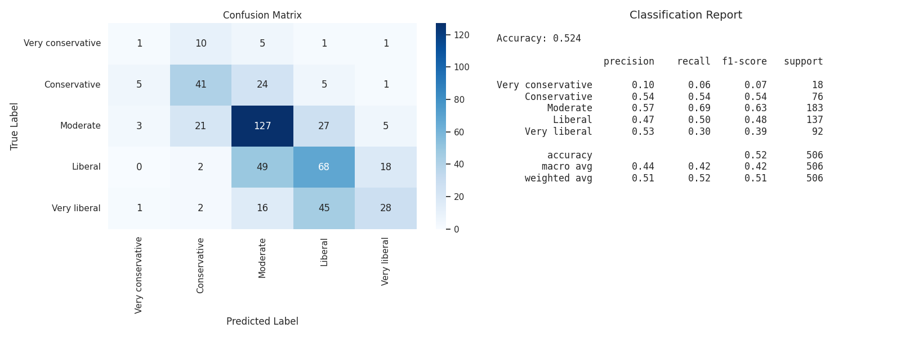
Decision Tree Classifier

Slide 8
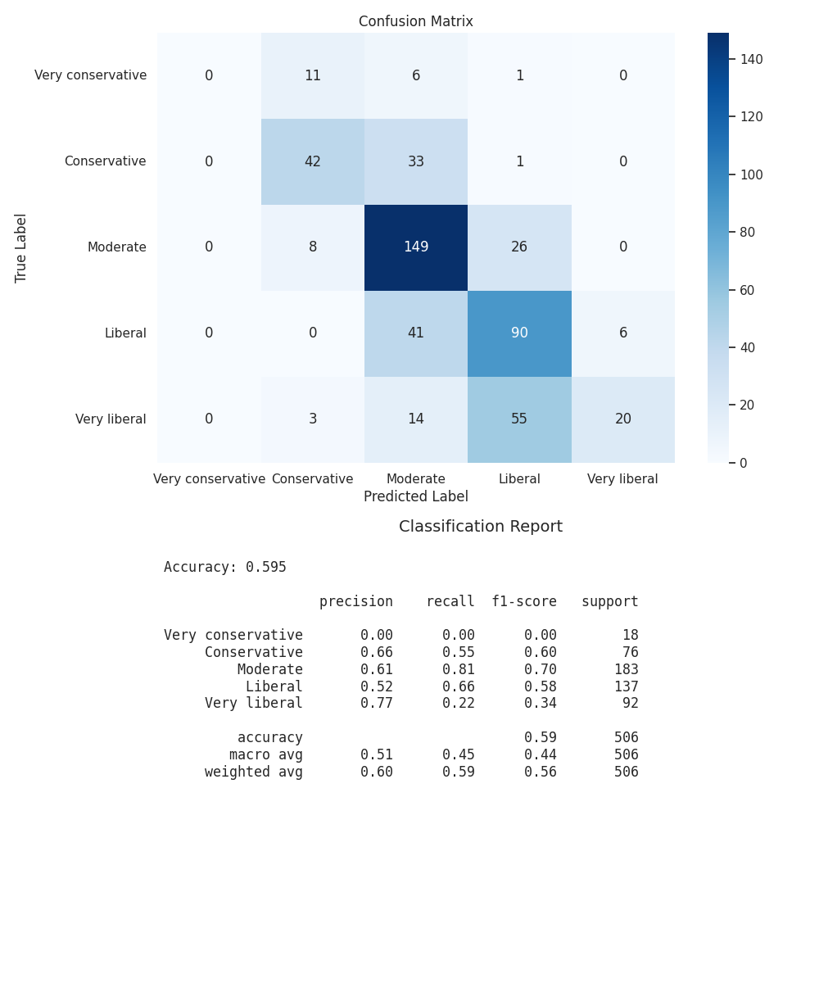
Random Forest
# hyper-parameter tuning w/ randomized search
param_dist = {
'n_estimators': randint(128, 2048),
'max_depth': randint(1, 20),
'min_samples_leaf': randint(1, 20),
'criterion': ['gini', 'entropy']}
rs = RandomizedSearchCV(rf_clf, param_dist,
n_iter=8, cv=5, random_state=SEED, n_jobs=3)
rs.fit(X_train, y_train)
# best hyperparameters
{'criterion': 'entropy', 'max_depth': 14,
'min_samples_leaf': 13, 'n_estimators': 1473}
# accuracy
best_rf.score(X_test, y_test)
0.595

Slide 9
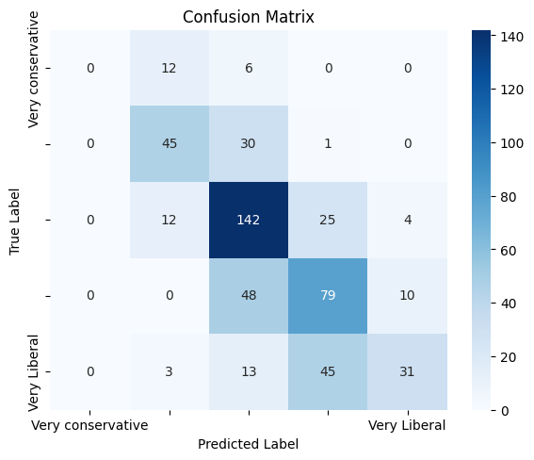
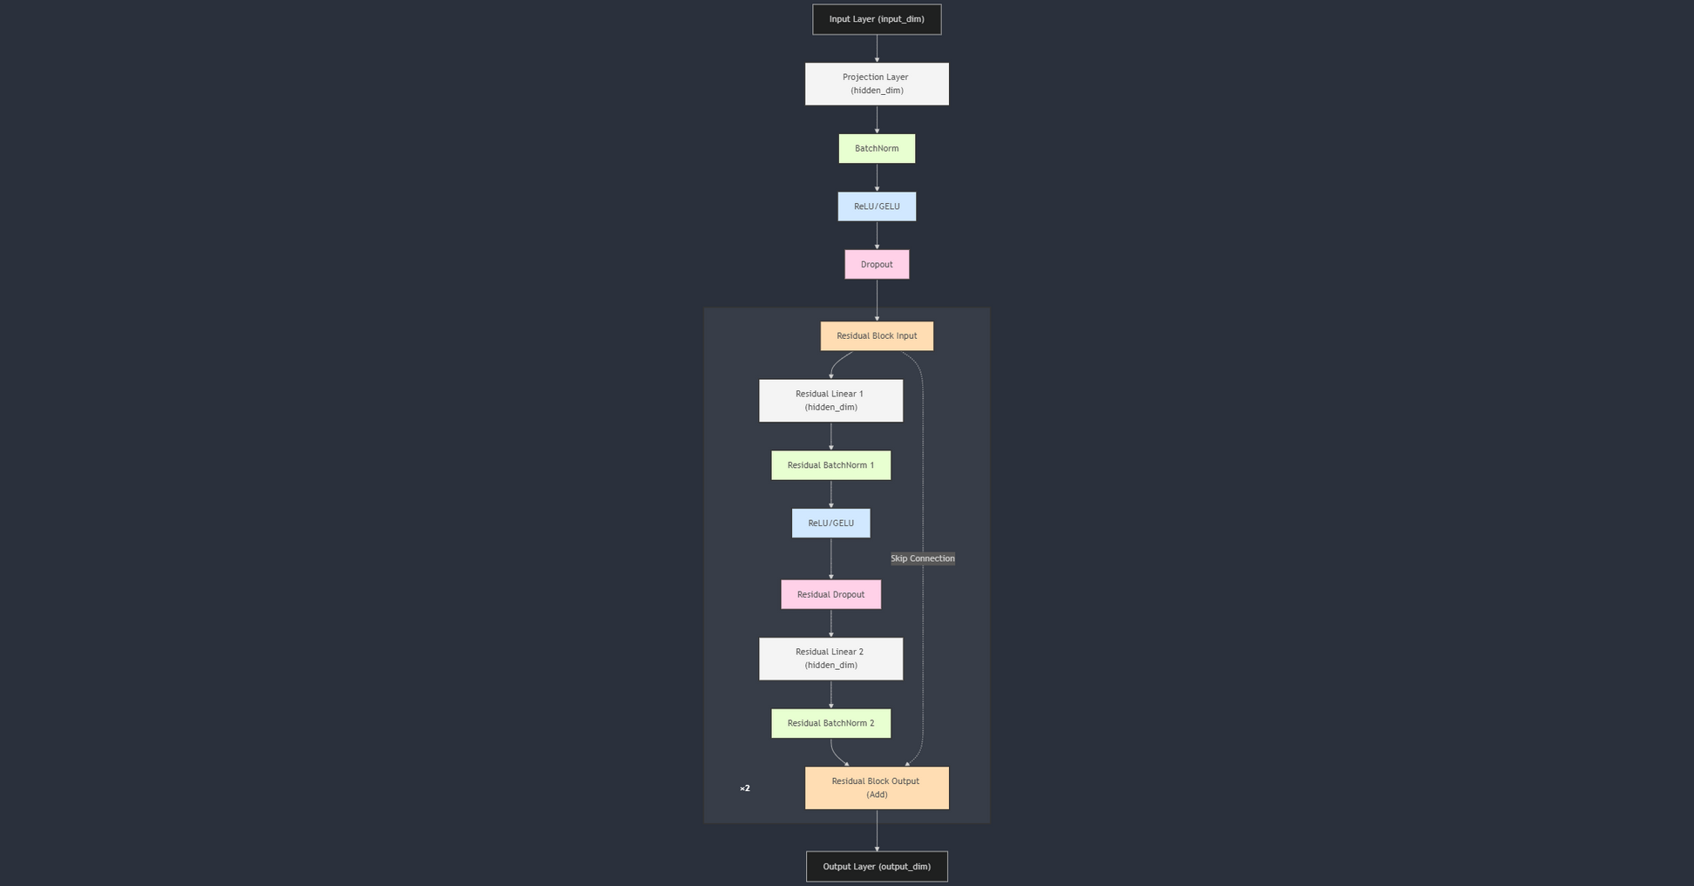
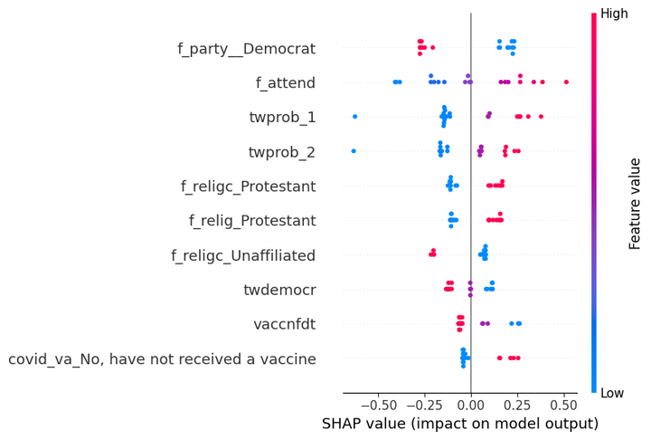
Neural Network
Model Architecture
Linear Projection
Residual Block x2
Linear Layer x2
Skip Connection (Add)
Output Layer
Hyperparameter Search
Hidden Dimension: 64, 128, 256
Dropout: 0.0, 0.5, 0.6
Activation: ReLU, GELU
Learning Rate: 0.001, 0.0005, 0.0001
Batch Size: 32, 64, 128
Height: 2, 3, 4
Use BatchNorm: True, False
Weight Decay: 0.0, 0.0001, 0.0005, 0.001
Results
Accuracy: 58.70%
Weighted F1: 56.61%
SHAP Values

Slide 10
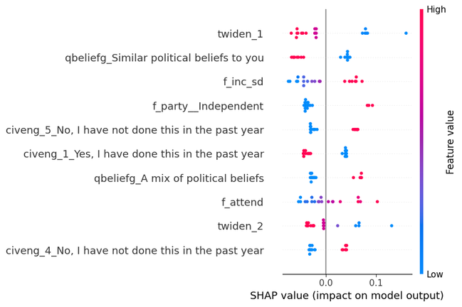
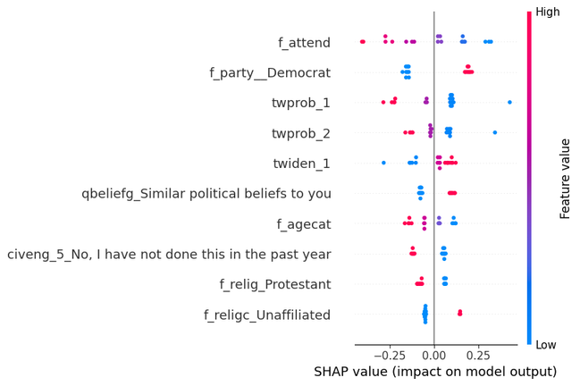
Neural Network
Very Conservative
Moderate
Very Liberal
No vaccination for conservatives!
Moderates can often be identified through their public profiles
Party affiliation and religious services are strong predictors
Free speech concerns indicate conservative beliefs (twprob_1 & 2)

Slide 11
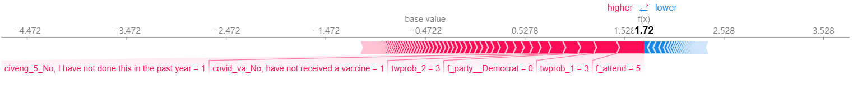
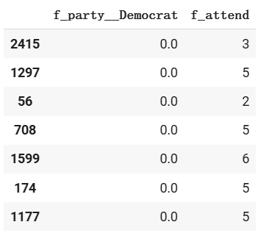
Neural Network: Error Analysis
SHAP Force Graph of a Very Conservative classified as Conservative
Model overfitted on the training set,
classifying all Democrats as Conservative.
Thus the model cannnot distinguish Very Conservative from Conservative, and Very Liberal from Liberal.
More data, or up/down-sampling might help.
. . .

Slide 12
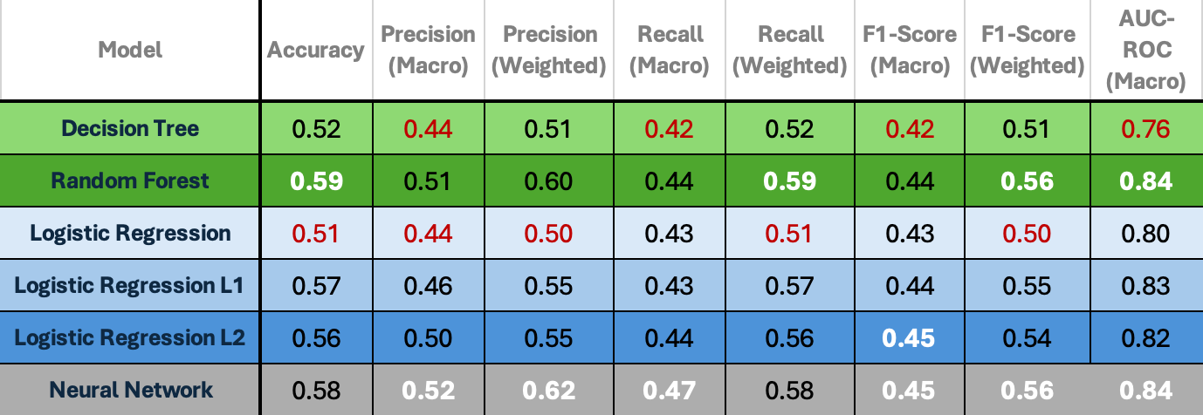
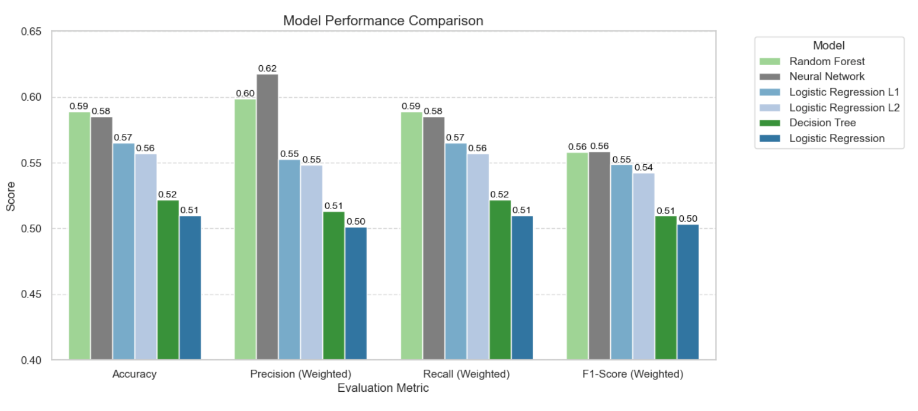
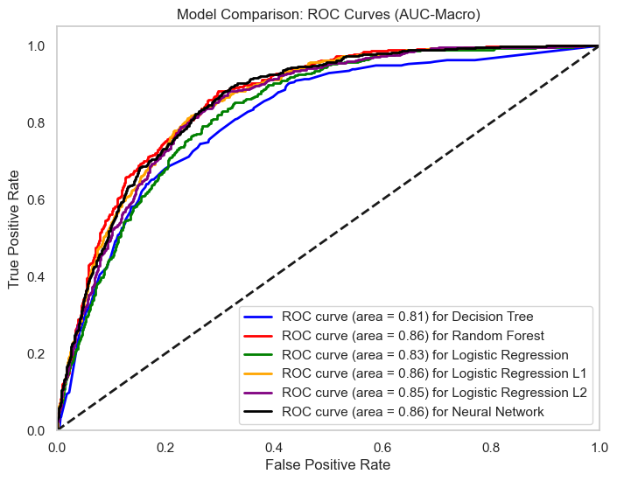
Comparison
&
Evaluation

Slide 13
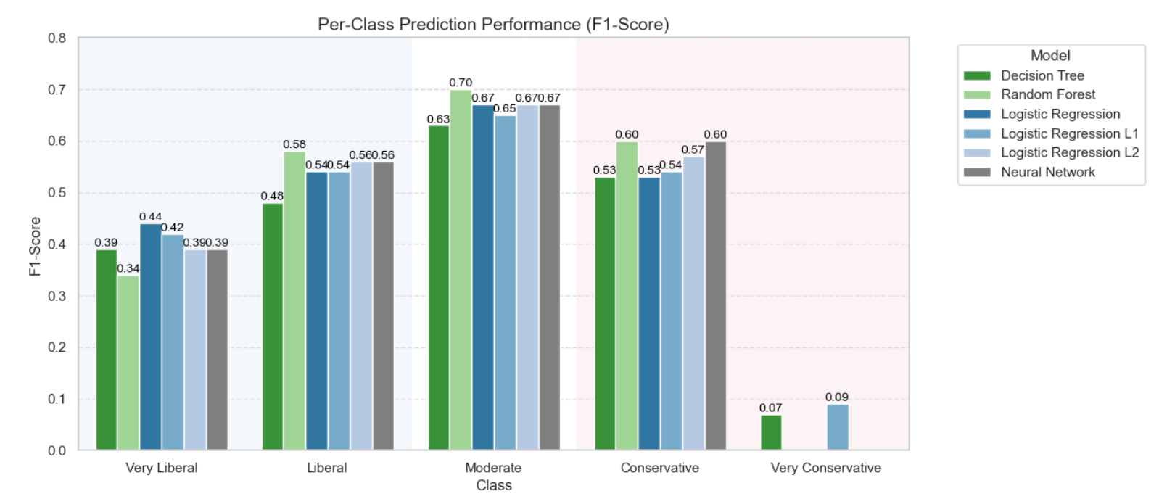
Comparison & Evaluation (Per-class)

Slide 14
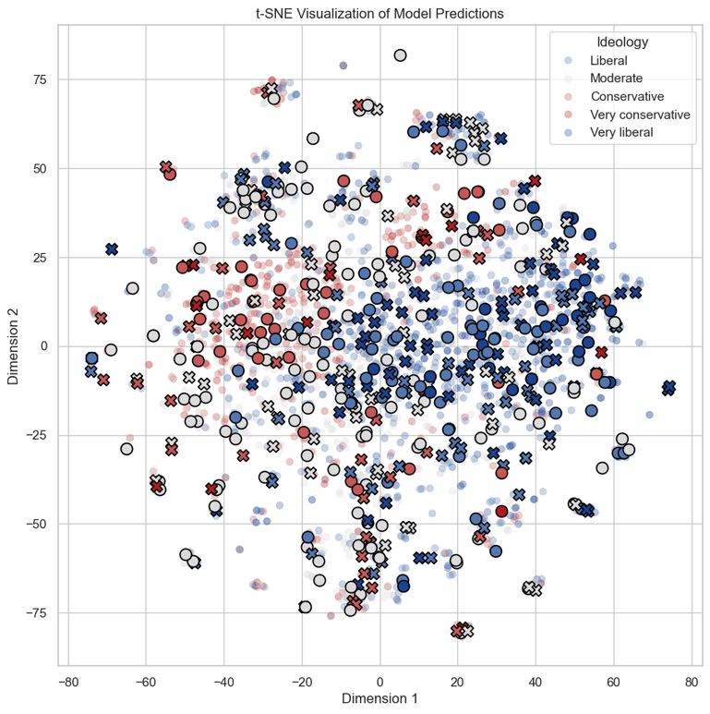
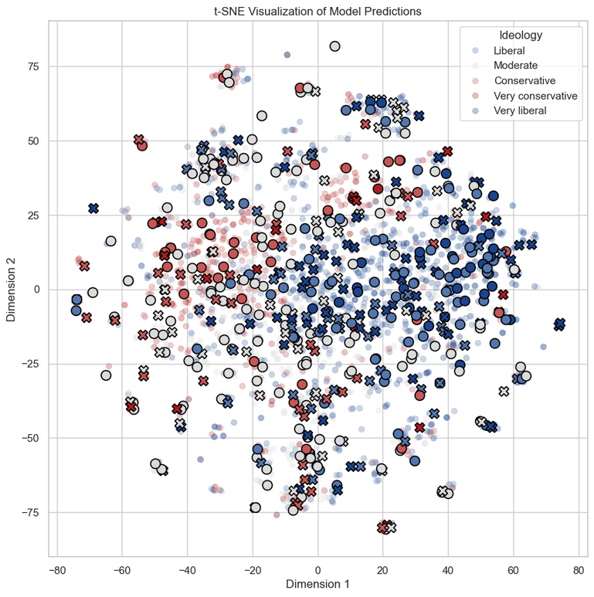
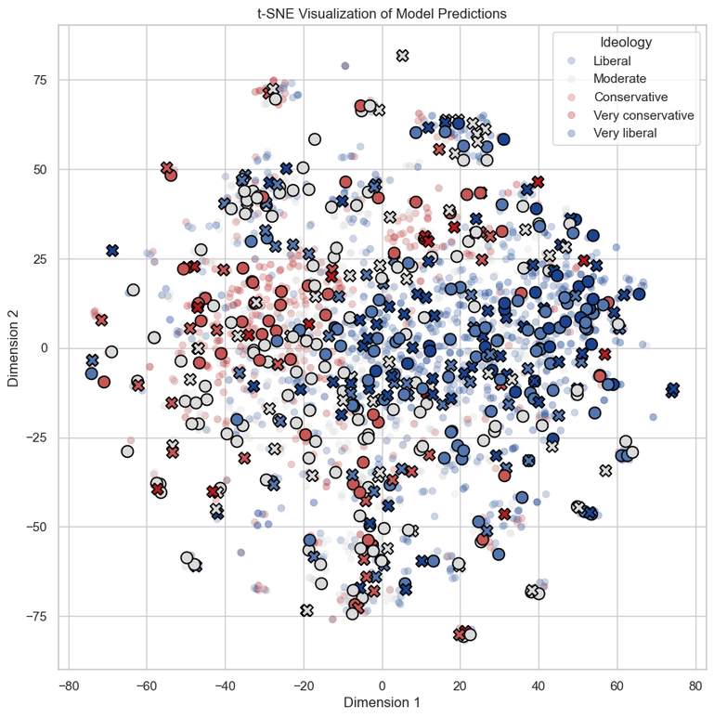
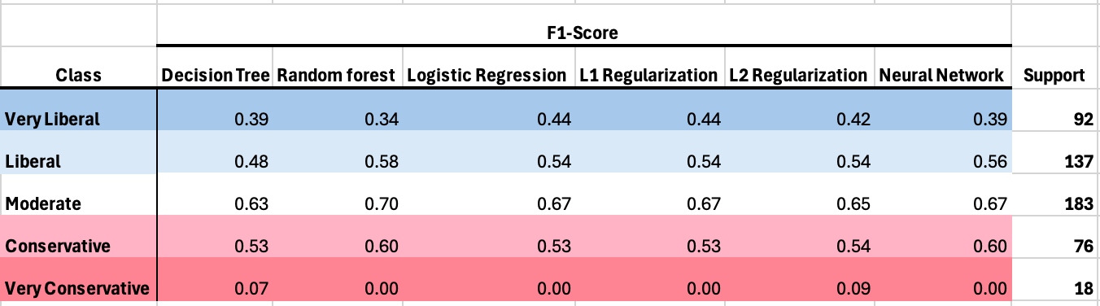
Decision Tree
Logistic Regression L2
Neural Network Model
Error Analysis
(Per-class)

Slide 15
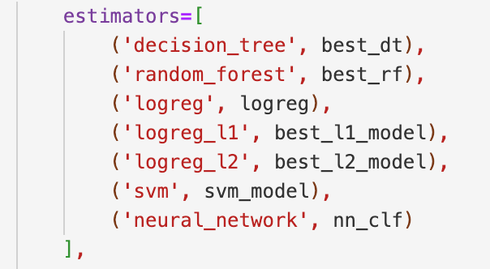
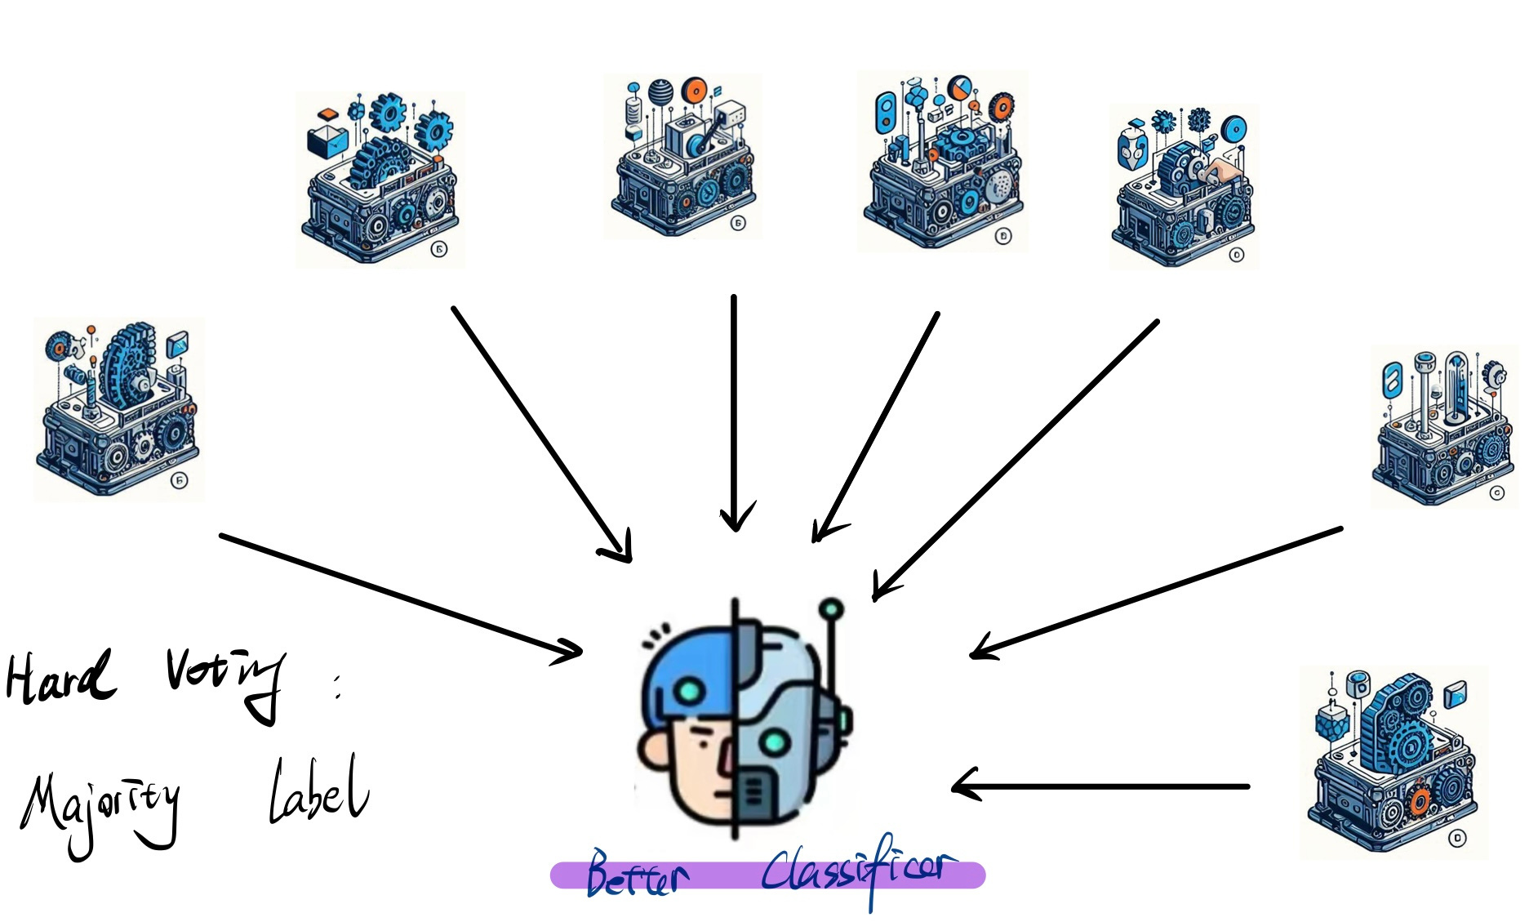
Ensemble -- Voting

Slide 16
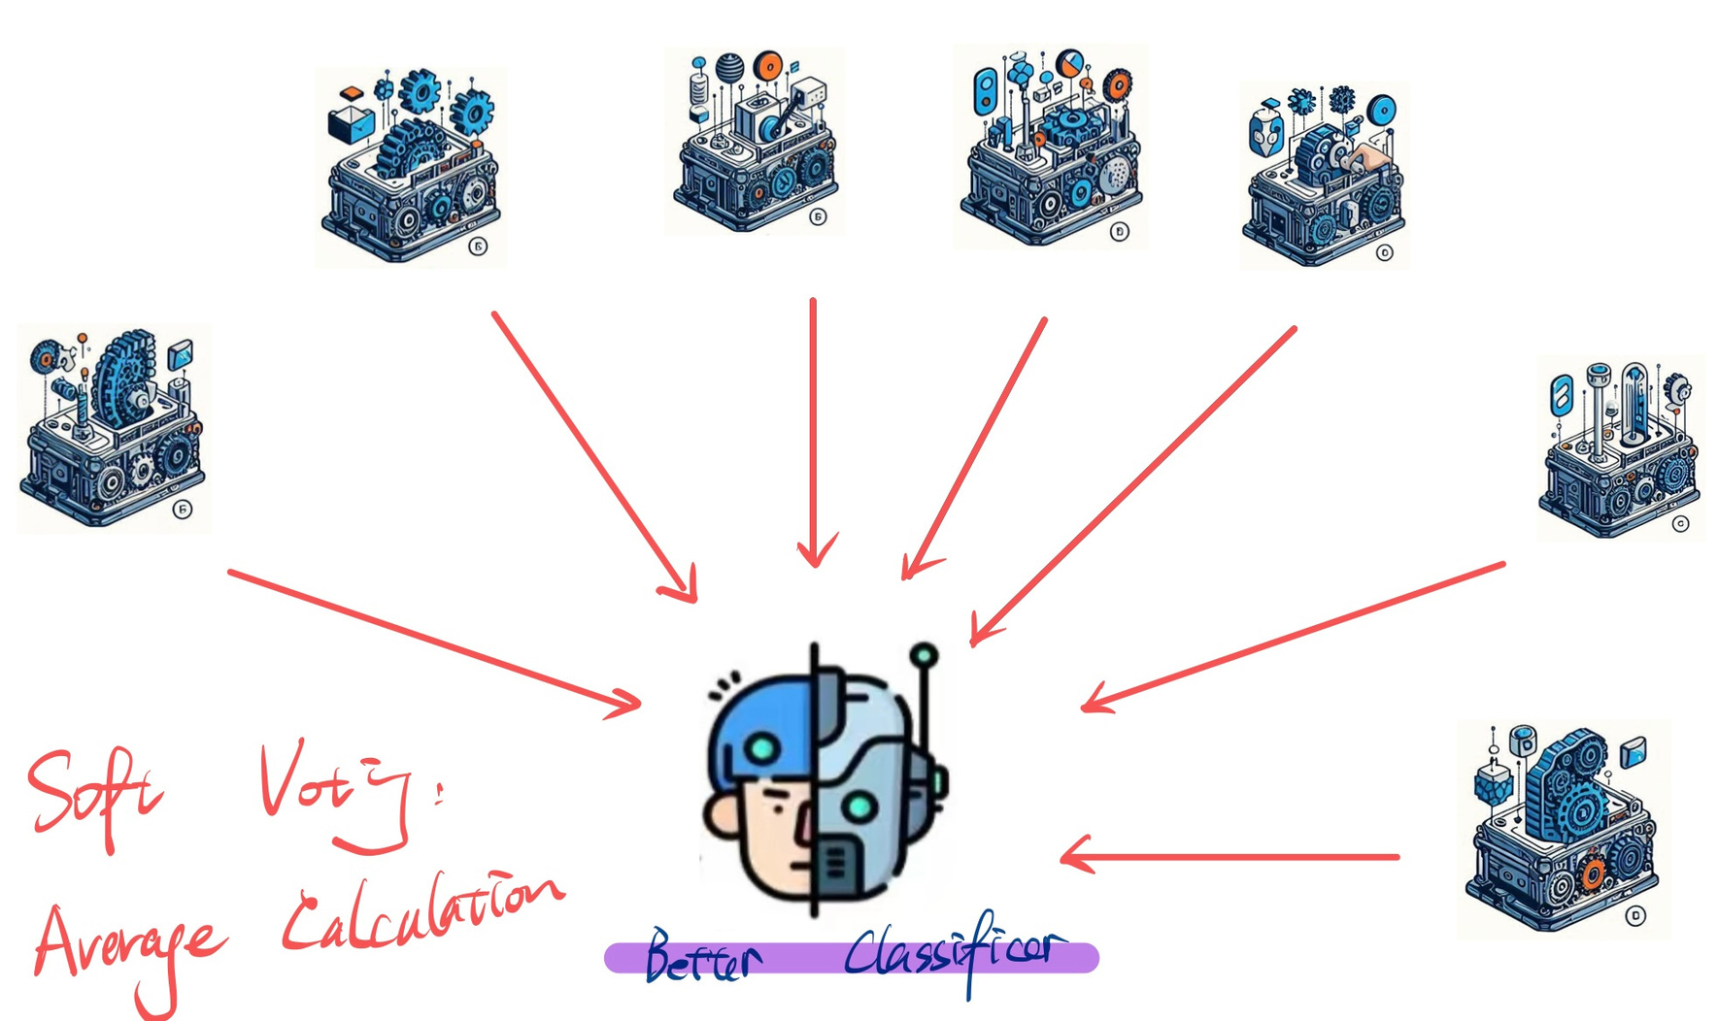
Ensemble -- Voting

Slide 17
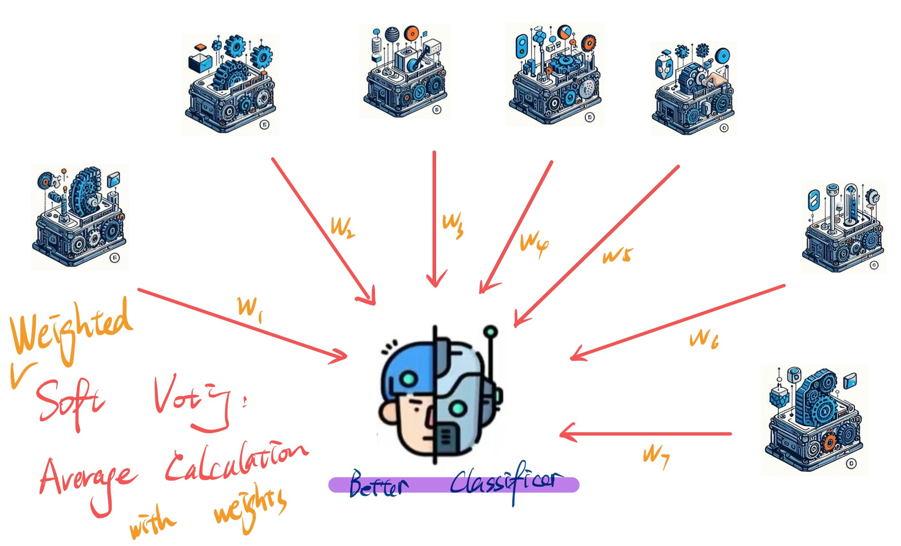
Ensemble -- Voting

Slide 18
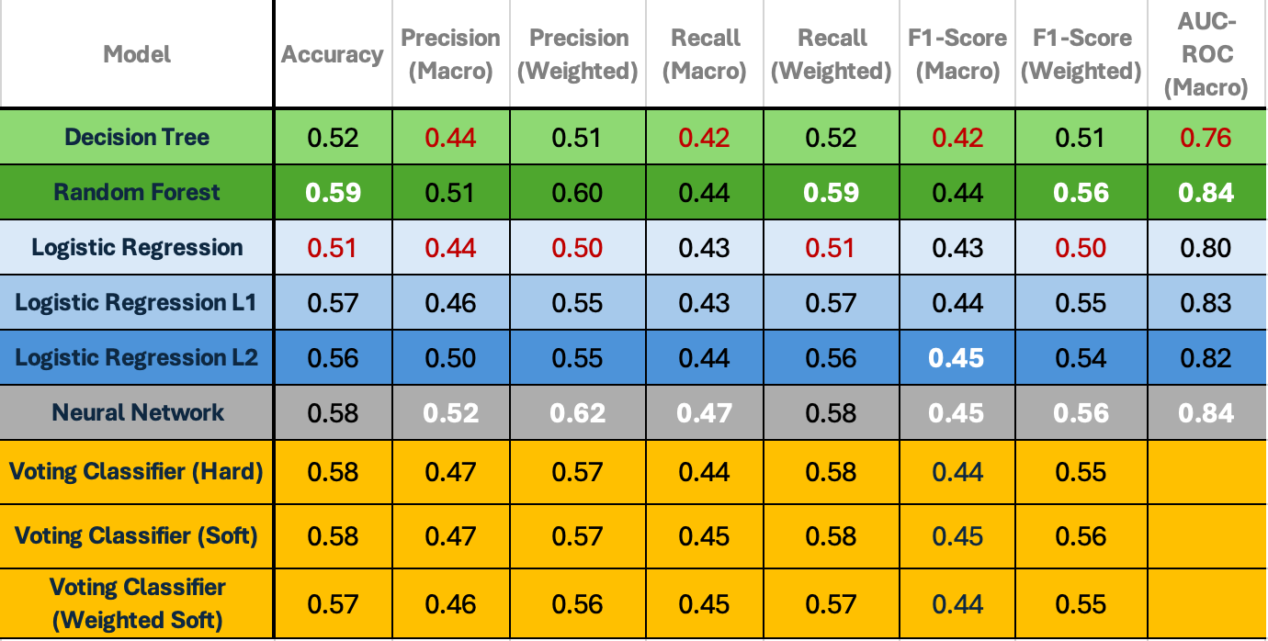
Final Model Performance Report:

Slide 19
Answering the research question
Research Question
How do social media usage patterns and demographic information reveal individuals’ political ideology?
Machine Learning can predict political ideology to a great extent.
Party affiliation, freedom of speech, and religious service attendence are powerful predictors.
Extreme ideologies are harder to detect.
Future Work
More data; up/down sampling
Data augmentation with LLM
Predictions based on actual twitter posts
More advanced stance detection to study ideology as dynamic social construct

Slide 20
Lab Feedback
Omit party affiliation, compare model performance and identify other important features.
The definition of ideology changes over time: applying a fundamental definition of conservative and liberal leanings, and evaluate individual opinions might provide a more objective understanding of the bipartisan system.
From Anita’s Group

Slide 21
Contributions
Eddie Tian: Research Question, Data Preprocessing, Tree-based models
Jiahang Luo: Research Question, EDA, Logistic Regression Models
Peter Zhang: Research Question, EDA, Neural Network
Charlotte Li: Research Question, EDA, Error Analysis, Ensemble Methods

